Slide 1
Isaiah 9:1-7
^{[a]}But there will be no gloom for her who was in anguish. In the former time he brought into contempt the land of Zebulun and the land of Naphtali, but in the latter time he has made glorious the way of the sea, the land beyond the Jordan, Galilee of the nations.^{[b] 2 [c]} The people who walked in darkness have seen a great light; those who dwelt in a land of deep darkness, on them has light shone.³ You have multiplied the nation; you have increased its joy; they rejoice before you as with joy at the harvest, as they are glad when they divide the spoil.⁴ For the yoke of his burden, and the staff for his shoulder, the rod of his oppressor, you have broken as on the day of Midian.

Slide 2
⁵ For every boot of the tramping warrior in battle tumult and every garment rolled in blood will be burned as fuel for the fire.⁶ For to us a child is born, to us a son is given; and the government shall be upon^{[d]} his shoulder, and his name shall be called^{[e]} Wonderful Counselor, Mighty God, Everlasting Father, Prince of Peace. ⁷ Of the increase of his government and of peace there will be no end, on the throne of David and over his kingdom, to establish it and to uphold it with justice and with righteousness from this time forth and forevermore. The zeal of the Lord of hosts will do this.

Slide 3
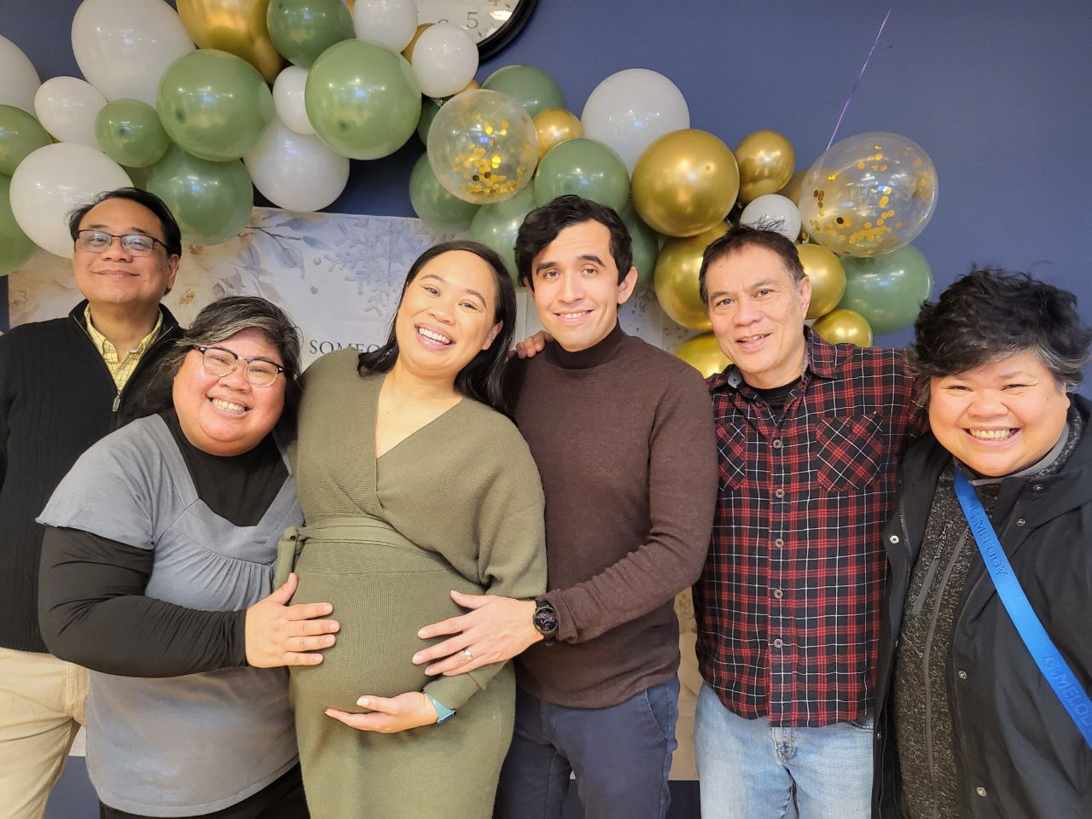

Slide 4
FOR TO US A CHILD IS BORN Isaiah 9:1-7 Key Verse: 6: “For to us a child is born, to us a son is given; and the government shall be upon^{[d]} his shoulder, and his name shall be called^{[e]} Wonderful Counselor, Mighty God, Everlasting Father, Prince of Peace.

Slide 5
Look at verses 1-2. “But there will be no gloom for her who was in anguish. In the former time he brought into contempt the land of Zebulun and the land of Naphtali, but in the latter time he has made glorious the way of the sea, the land beyond the Jordan, Galilee of the nations.^{[b]2 [c]} The people who walked in darkness have seen a great light; those who dwelt in a land of deep darkness, on them has light shone.”

Slide 6
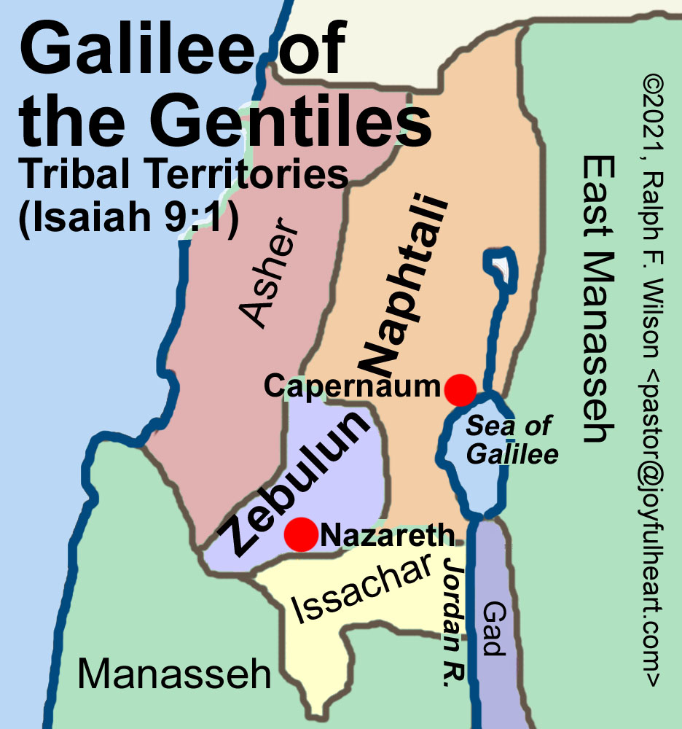

Slide 7
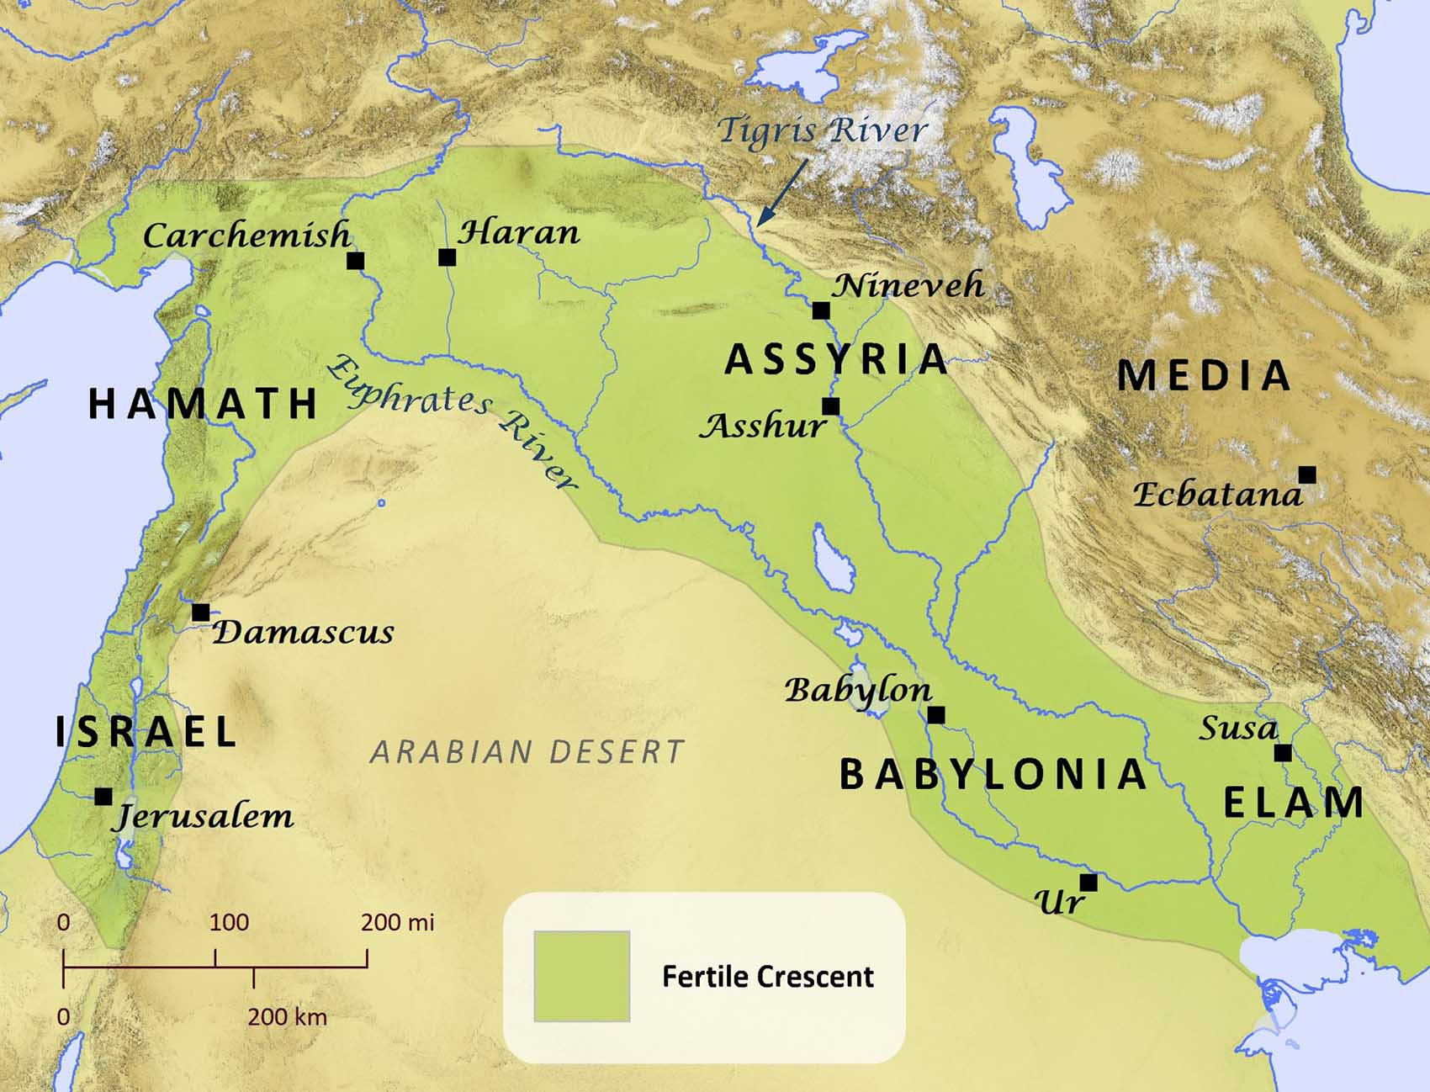

Slide 9
Matthew 4:13-16, “¹³ And leaving Nazareth he went and lived in Capernaum by the sea, in the territory of Zebulun and Naphtali, ¹⁴so that what was spoken by the prophet Isaiah might be fulfilled:¹⁵ ‘The land of Zebulun and the land of Naphtali, the way of the sea, beyond the Jordan, Galilee of the Gentiles—¹⁶ the people dwelling in darkness have seen a great light, and for those dwelling in the region and shadow of death, on them a light has dawned.’”

Slide 10
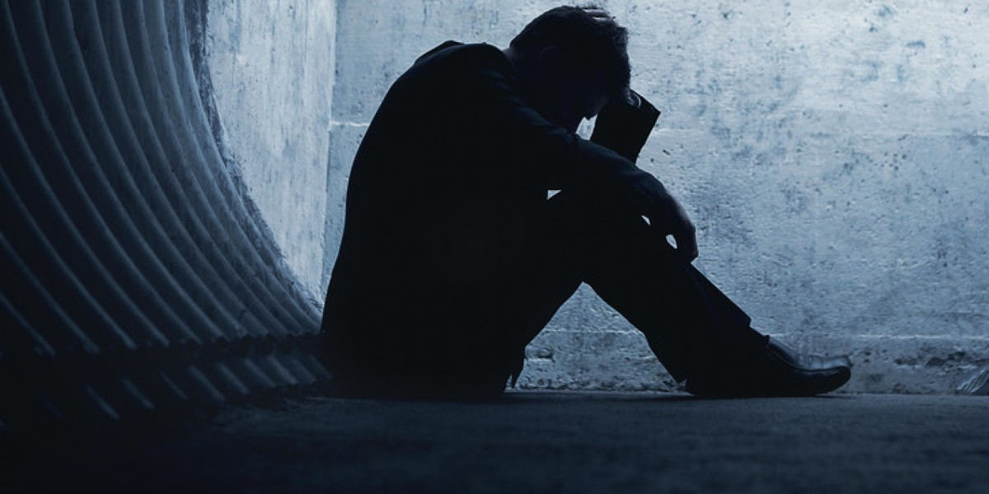

Slide 11
John 8:12b: “I am the light of the world. Whoever follows me will not walk in darkness, but will have the light of life.”

Slide 12
Look at verses 3-4. “³ You have multiplied the nation; you have increased its joy; they rejoice before you as with joy at the harvest, as they are glad when they divide the spoil.⁴ For the yoke of his burden, and the staff for his shoulder, the rod of his oppressor, you have broken as on the day of Midian.”

Slide 13
Revelation 7:9a reads, “After this I looked and there before me was a great multitude that no one could count, from every nation, tribe, people and language, standing before the throne and in front of the Lamb.”

Slide 14
Look at verse 5. “⁵ For every boot of the tramping warrior in battle tumult and every garment rolled in blood will be burned as fuel for the fire.”

Slide 15
Look at verse 6. “⁶ For to us a child is born, to us a son is given; and the government shall be upon^{[d]} his shoulder, and his name shall be called^{[e]} Wonderful Counselor, Mighty God, Everlasting Father, Prince of Peace.”

Slide 16
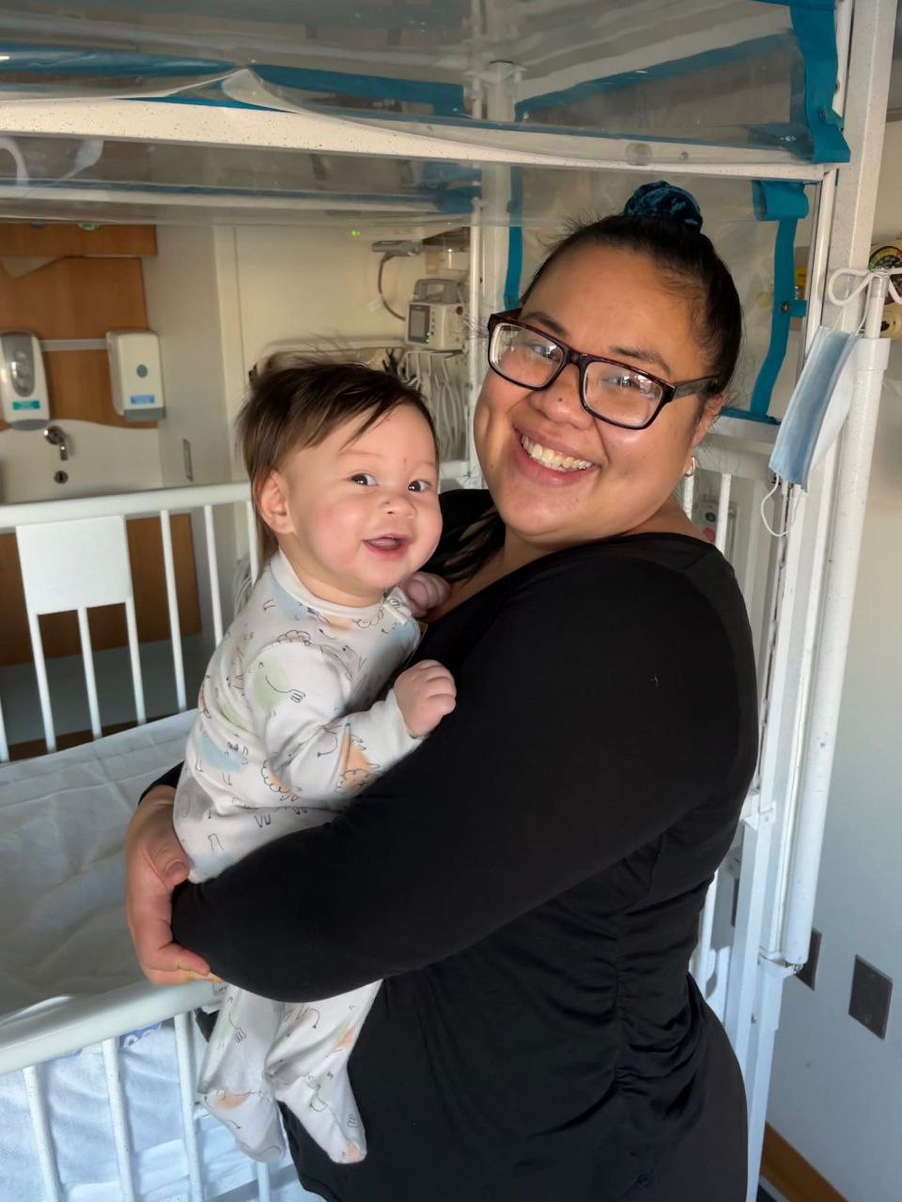

Slide 17
Luke 2:10, “And the angel said to them, ‘Fear not, for behold, I bring you good news of great joy that will be for all the people. For unto you is born this day in the city of David a Savior, who is Christ the Lord.’”

Slide 18
John 3:3, “Jesus answered him, ‘Truly, truly, I say to you, unless one is born again he cannot see the kingdom of God.’”

Slide 19
Philippians 4:13, “¹³ I can do all things through him who strengthens me.”

Slide 20
John 17:3, “³And this is eternal life, that they know you, the only true God, and Jesus Christ whom you have sent.”

Slide 21
Philippians 4:7, “⁷ And the peace of God, which surpasses all understanding, will guard your hearts and your minds in Christ Jesus.”

Slide 22
Look at verse 7. “⁷ Of the increase of his government and of peace there will be no end, on the throne of David and over his kingdom, to establish it and to uphold it with justice and with righteousness from this time forth and forevermore. The zeal of the Lord of hosts will do this.”

