Slide 1
2 Peter 2:10b-22 “10…who follow the corrupt desire of the sinful nature and despise authority. ^{[e]} Bold and willful, they do not tremble as they blaspheme the glorious ones, ¹¹ whereas angels, though greater in might and power, do not pronounce a blasphemous judgment against them before the Lord. ¹² But these, like irrational animals, creatures of instinct, born to be caught and destroyed, blaspheming about matters of which they are ignorant, will also be destroyed in their destruction, ¹³ suffering wrong as the wage for their wrongdoing. They count it pleasure to revel in the daytime. They are blots and blemishes, reveling in their deceptions,^{[f]} while they feast with you. ¹⁴ They have eyes full of adultery,^{[g]} insatiable for sin. They entice unsteady souls. They have hearts trained in greed. Accursed children! ¹⁵ Forsaking the right way, they have gone astray. They have followed the way of Balaam, the son of Beor, who loved gain from wrongdoing, ¹⁶ but was rebuked for his own transgression; a speechless donkey spoke with human voice and restrained the prophet's madness.

Slide 2
¹⁷ These are waterless springs and mists driven by a storm. For them the gloom of utter darkness has been reserved. ¹⁸ For, speaking loud boasts of folly, they entice by sensual passions of the flesh those who are barely escaping from those who live in error. ¹⁹ They promise them freedom, but they themselves are slaves^{[h]} of corruption. For whatever overcomes a person, to that he is enslaved. ²⁰ For if, after they have escaped the defilements of the world through the knowledge of our Lord and Savior Jesus Christ, they are again entangled in them and overcome, the last state has become worse for them than the first. ²¹ For it would have been better for them never to have known the way of righteousness than after knowing it to turn back from the holy commandment delivered to them. ²² What the true proverb says has happened to them: “The dog returns to its own vomit, and the sow, after washing herself, returns to wallow in the mire.”

Slide 4
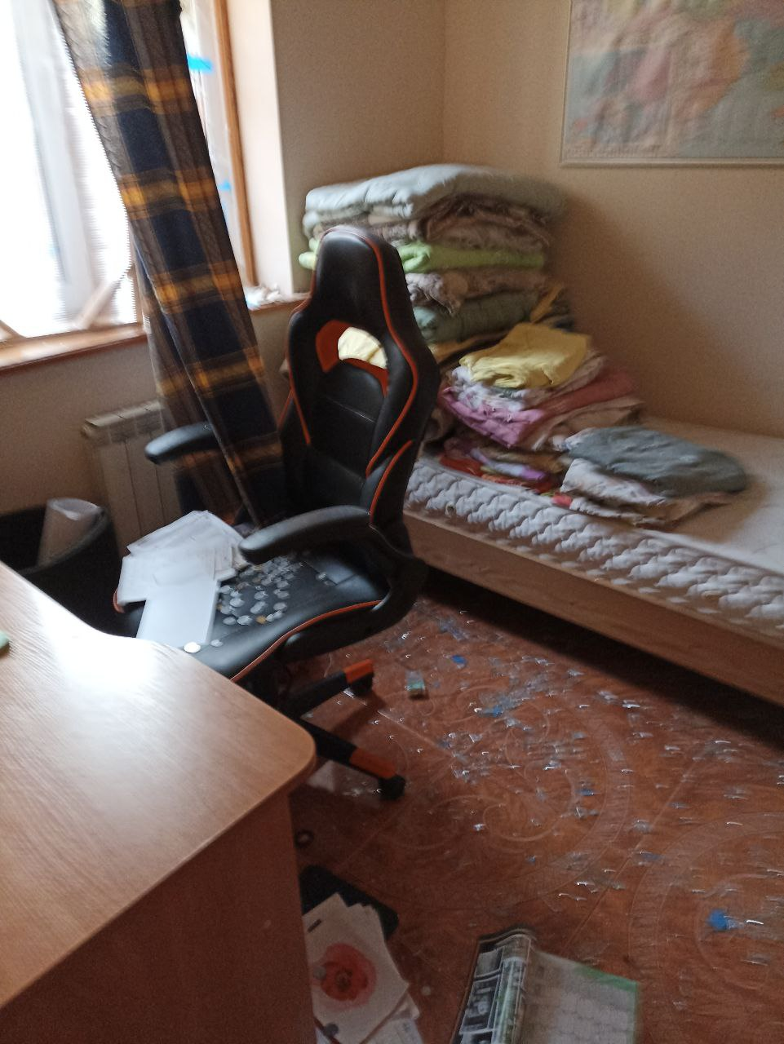
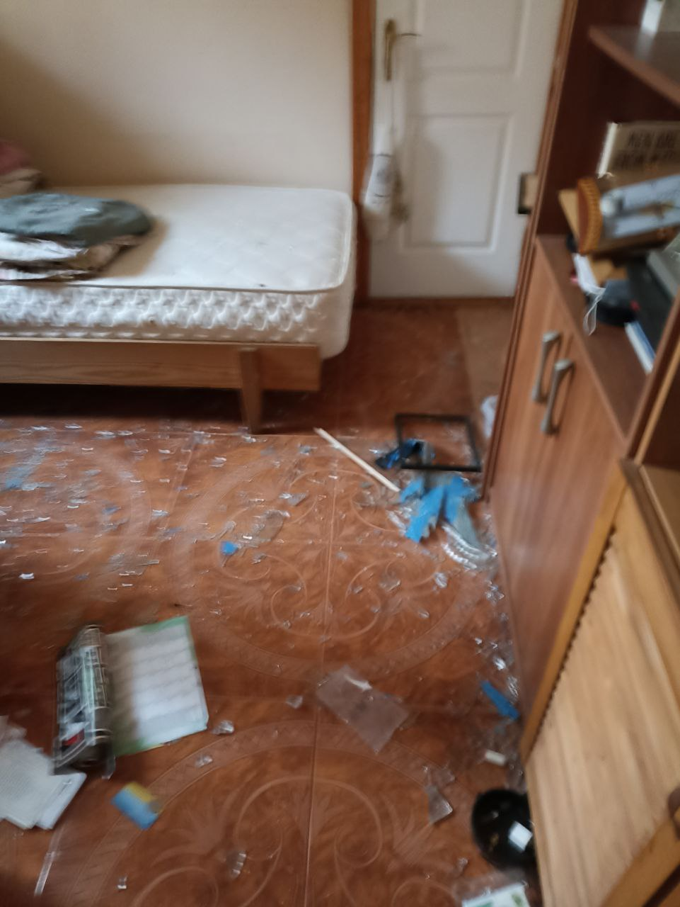

Slide 5
ESCAPE THE DEFILEMENTS OF FALSE TEACHERS 2 Peter 2:10b-22 Key Verse: 20a: “For if, after they have escaped the defilements of the world through the knowledge of our Lord and Savior Jesus Christ.”

Slide 6
Look at verses 10b-11. “…who follow the corrupt sinful nature and despise authority. Bold and willful, they do not tremble as they blaspheme the glorious ones, ¹¹ whereas angels, though greater in might and power, do not pronounce a blasphemous judgment against them before the Lord.”

Slide 8
Jude verses 8-10 reads, “Yet in like manner these people also, relying on their dreams, defile the flesh, reject authority, and blaspheme the glorious ones. ⁹ But when the archangel Michael, contending with the devil, was disputing about the body of Moses, he did not presume to pronounce a blasphemous judgment, but said, ‘The Lord rebuke you.’ ¹⁰ But these people blaspheme all that they do not understand, and they are destroyed by all that they, like unreasoning animals, understand instinctively.”

Slide 9
Acts 19:13-16, “Then some of the itinerant Jewish exorcists undertook to invoke the name of the Lord Jesus over those who had evil spirits, saying, ‘I adjure you by the Jesus whom Paul proclaims.’ ¹⁴ Seven sons of a Jewish high priest named Sceva were doing this. ¹⁵ But the evil spirit answered them, ‘Jesus I know, and Paul I recognize, but who are you?’ ¹⁶ And the man in whom was the evil spirit leaped on them, mastered all of them and overpowered them, so that they fled out of that house naked and wounded.”

Slide 10
Look at verses 12-13a. “But these, like irrational animals, creatures of instinct, born to be caught and destroyed, blaspheming about matters of which they are ignorant, will also be destroyed in their destruction, ¹³ suffering wrong as the wage for their wrongdoing.”

Slide 11
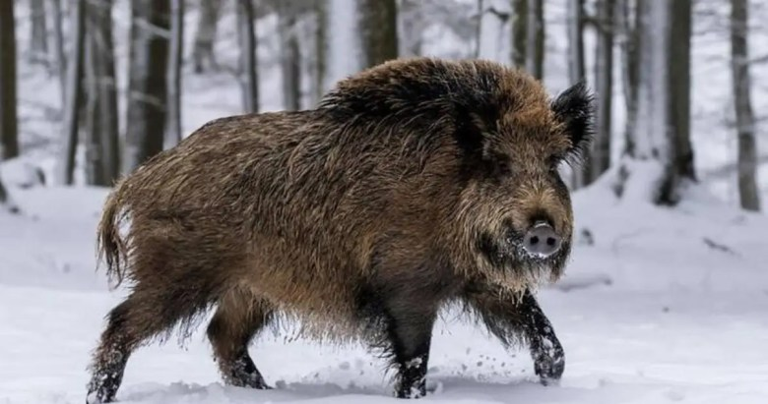

Slide 12
Look at verses 13b-14. “They count it pleasure to revel in the daytime. They are blots and blemishes, reveling in their deceptions,^{[f]} while they feast with you. ¹⁴ They have eyes full of adultery,^{[g]} insatiable for sin. They entice unsteady souls. They have hearts trained in greed. Accursed children!”

Slide 13
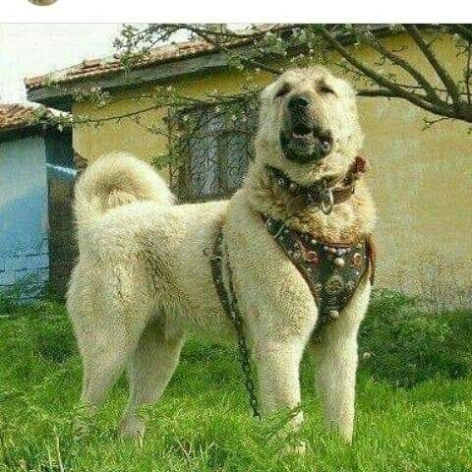

Slide 14
Look at verses 15-16. “Forsaking the right way, they have gone astray. They have followed the way of Balaam, the son of Beor, who loved gain from wrongdoing, ¹⁶ but was rebuked for his own transgression; a speechless donkey spoke with human voice and restrained the prophet's madness.”

Slide 15
Look at verses 15-16. “Forsaking the right way, they have gone astray. They have followed the way of Balaam, the son of Beor, who loved gain from wrongdoing, ¹⁶ but was rebuked for his own transgression; a speechless donkey spoke with human voice and restrained the prophet's madness.”

Slide 16
Numbers 22:30 reads, “And the donkey said to Balaam, ‘Am I not your donkey, on which you have ridden all your life long to this day? Is it my habit to treat you this way?’ And he said, ‘No.’”

Slide 17
Look at verses 17-19. “These are waterless springs and mists driven by a storm. For them the gloom of utter darkness has been reserved. ¹⁸ For, speaking loud boasts of folly, they entice by sensual passions of the flesh those who are barely escaping from those who live in error. ¹⁹ They promise them freedom, but they themselves are slaves^{[h]} of corruption. For whatever overcomes a person, to that he is enslaved.”

Slide 18
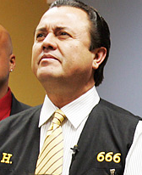

Slide 19
Look at verse 20. “For if, after they have escaped the defilements of the world through the knowledge of our Lord and Savior Jesus Christ, they are again entangled in them and overcome, the last state has become worse for them than the first.”

Slide 20
Look at verse 21. “For it would have been better for them never to have known the way of righteousness than after knowing it to turn back from the holy commandment delivered to them.”

Slide 21
Joshua 13:22, “In addition to those slain in battle, the Israelites had put to the sword Balaam son of Beor, who practiced divination.”

Slide 22
Matthew 12:43-45 reads, “When an impure spirit comes out of a person, it goes through arid places seeking rest and does not find it. ⁴⁴ Then it says, ‘I will return to the house I left.’ When it arrives, it finds the house unoccupied, swept clean and put in order. ⁴⁵ Then it goes and takes with it seven other spirits more wicked than itself, and they go in and live there. And the final condition of that person is worse than the first. That is how it will be with this wicked generation.”

Slide 23
Hebrew 4:4-6 reads, “It is impossible for those who have once been enlightened, who have tasted the heavenly gift, who have shared in the Holy Spirit, ⁵ who have tasted the goodness of the word of God and the powers of the coming age ⁶ and who have fallen away, to be brought back to repentance. To their loss they are crucifying the Son of God all over again and subjecting him to public disgrace.”

Slide 24
Look at verse 22. “What the true proverb says has happened to them: ‘The dog returns to its own vomit, and the sow, after washing herself, returns to wallow in the mire.’”

