Slide 1
2 Peter 2:1-10a But false prophets also arose among the people, just as there will be false teachers among you, who will secretly bring in destructive heresies, even denying the Master who bought them, bringing upon themselves swift destruction. ² And many will follow their sensuality, and because of them the way of truth will be blasphemed. ³ And in their greed they will exploit you with false words. Their condemnation from long ago is not idle, and their destruction is not asleep.

Slide 2
⁴ For if God did not spare angels when they sinned, but cast them into hell^{[a]} and committed them to chains^{[b]} of gloomy darkness to be kept until the judgment; ⁵ if he did not spare the ancient world, but preserved Noah, a herald of righteousness, with seven others, when he brought a flood upon the world of the ungodly; ⁶ if by turning the cities of Sodom and Gomorrah to ashes he condemned them to extinction, making them an example of what is going to happen to the ungodly;^{[c]} ⁷ and if he rescued righteous Lot, greatly distressed by the sensual conduct of the wicked

Slide 3
⁸ (for as that righteous man lived among them day after day, he was tormenting his righteous soul over their lawless deeds that he saw and heard); ⁹ then the Lord knows how to rescue the godly from trials,^{[d]} and to keep the unrighteous under punishment until the day of judgment, ¹⁰ and especially those who indulge^{[e]} in the lust of defiling passion and despise authority.

Slide 4
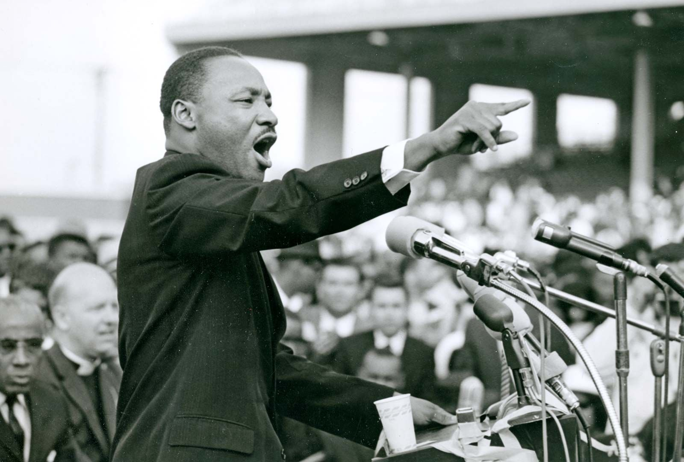

Slide 6
Revelation 21:8, “But as for the cowardly, the faithless, the detestable, as for murderers, the sexually immoral, sorcerers, idolaters, and all liars, their portion will be in the lake that burns with fire and sulfur, which is the second death.”

Slide 7
THE LORD KNOWS HOW TO RESCUE THE GODLY 2 Peter 2:1-10a Key Verse: 9: “…then the Lord knows how to rescue the godly from trials,^{[d]} and to keep the unrighteous under punishment until the day of judgment.”

Slide 8
Chapter 1:19-21, “And we have the prophetic word more fully confirmed, to which you will do well to pay attention as to a lamp shining in a dark place, until the day dawns and the morning star rises in your hearts, ²⁰ knowing this first of all, that no prophecy of Scripture comes from someone's own interpretation. ²¹ For no prophecy was ever produced by the will of man, but men spoke from God as they were carried along by the Holy Spirit.”

Slide 9
Look at verse 1. “But false prophets also arose among the people, just as there will be false teachers among you, who will secretly bring in destructive heresies, even denying the Master who bought them, bringing upon themselves swift destruction.”

Slide 10
Deuteronomy 13:1-5, “If a prophet or a dreamer of dreams arises among you and gives you a sign or a wonder, ² and the sign or wonder that he tells you comes to pass, and if he says, ‘Let us go after other gods,’ which you have not known, ‘and let us serve them,’ ³ you shall not listen to the words of that prophet or that dreamer of dreams. For the Lord your God is testing you, to know whether you love the Lord your God with all your heart and with all your soul. ⁴ You shall walk after the Lord your God and fear him and keep his commandments and obey his voice, and you shall serve him and hold fast to him. ⁵ But that prophet or that dreamer of dreams shall be put to death, because he has taught rebellion against the Lord your God, who brought you out of the land of Egypt and redeemed you out of the house of slavery, to make you leave the way in which the Lord your God commanded you to walk. So you shall purge the evil from your midst.”

Slide 11
Look at verses 1b-3. “…who will secretly bring in destructive heresies, even denying the Master who bought them, bringing upon themselves swift destruction. And many will follow their sensuality, and because of them the way of truth will be blasphemed. And in their greed they will exploit you with false words. Their condemnation from long ago is not idle, and their destruction is not asleep.”

Slide 12
2 Timothy 4:3-4, “For the time is coming when people will not endure sound teaching, but having itching ears they will accumulate for themselves teachers to suit their own passions, and will turn away from listening to the truth and wander off into myths.”

Slide 13
Matthew 10:38-39, “And whoever does not take his cross and follow me is not worthy of me. Whoever finds his life will lose it, and whoever loses his life for my sake will find it.”

Slide 14
1 John 2:15-17 reads, “Do not love the world or the things in the world. If anyone loves the world, the love of the Father is not in him. ¹⁶ For all that is in the world—the desires of the flesh and the desires of the eyes and pride of life—is not from the Father but is from the world. ¹⁷ And the world is passing away along with its desires, but whoever does the will of God abides forever.”

Slide 15
Look at verse 4. “For if God did not spare angels when they sinned, but cast them into hell^{[a]} and committed them to chains^{[b]} of gloomy darkness to be kept until the judgment.”

Slide 16
Psalm 8:5 reads, “Yet you have made him a little lower than the heavenly beings and crowned him with glory and honor.”

Slide 17
Jude verse 6 reads, “And the angels who did not stay within their own position of authority, but left their proper dwelling, he has kept in eternal chains under gloomy darkness until the judgment of the great day.”

Slide 18
Revelation 12:8-9 reads, “…but he was defeated, and there was no longer any place for them in heaven. And the great dragon was thrown down, that ancient serpent, who is called the devil and Satan, the deceiver of the whole world—he was thrown down to the earth, and his angels were thrown down with him.”

Slide 19
Look at verse 5. “If he did not spare the ancient world, but preserved Noah, a herald of righteousness, with seven others, when he brought a flood upon the world of the ungodly.”

Slide 20
Look at verses 6-8. “…if by turning the cities of Sodom and Gomorrah to ashes he condemned them to extinction, making them an example of what is going to happen to the ungodly;^{[c]} ⁷ and if he rescued righteous Lot, greatly distressed by the sensual conduct of the wicked ⁸ (for as that righteous man lived among them day after day, he was tormenting his righteous soul over their lawless deeds that he saw and heard).”

Slide 21
Matthew 5:19-20, “Therefore whoever relaxes one of the least of these commandments and teaches others to do the same will be called least in the kingdom of heaven, but whoever does them and teaches them will be called great in the kingdom of heaven. For I tell you, unless your righteousness exceeds that of the scribes and Pharisees, you will never enter the kingdom of heaven.”

Slide 22
Look at verses 9-10a. “Then the Lord knows how to rescue the godly from trials,^{[d]} and to keep the unrighteous under punishment until the day of judgment, ¹⁰ and especially those who indulge^{[e]} in the lust of defiling passion and despise authority.”

Slide 23
Matthew 24:24-25, “For false christs and false prophets will arise and perform great signs and wonders, so as to lead astray, if possible, even the elect. See, I have told you beforehand.”

