Slide 1
Lament (Ps 42:1-4). ¹ As the deer pants for streams of water, so my soul pants for you, my God.
² My soul thirsts for God, for the living God. When can I go and meet with God?
³ My tears have been my food day and night, while people say to me all day long, “Where is your God?”
⁴ These things I remember as I pour out my soul: how I used to go to the house of God under the protection of the Mighty One with shouts of joy and praise among the festive throng.
Hope(Ps 42:5). ⁵Why, my soul, are you downcast? Why so disturbed within me? Put your hope in God, for I will yet praise him, my Savior and my God.

Slide 2
Lament (Psalm 42:6-7). ⁶ My soul is downcast within me; therefore I will remember you from the land of the Jordan, the heights of Hermon—from Mount Mizar.
⁷ Deep calls to deep in the roar of your waterfalls; all your waves and breakers have swept over me.
Hope (Psalm 42:8).
⁸ By day the Lord directs his love, at night his song is with me— a prayer to the God of my life.

Slide 3
Lament (Psalm 42:9-10). ⁹ I say to God my Rock, “Why have you forgotten me? Why must I go about mourning, oppressed by the enemy?”
¹⁰ My bones suffer mortal agony as my foes taunt me, saying to me all day long, “Where is your God?”
Hope (Psalm 42:11)
¹¹ Why, my soul, are you downcast? Why so disturbed within me? Put your hope in God, for I will yet praise him, my Savior and my God.

Slide 4
Lament (Psalm 43:1-4). ¹ Vindicate me, my God, and plead my cause against an unfaithful nation. Rescue me from those who are deceitful and wicked.
² You are God my stronghold. Why have you rejected me? Why must I go about mourning, oppressed by the enemy?
³ Send me your light and your faithful care, let them lead me; let them bring me to your holy mountain, to the place where you dwell.
⁴ Then I will go to the altar of God, to God, my joy and my delight. I will praise you with the lyre, O God, my God.
Hope (Psalm 43:5)
⁵ Why, my soul, are you downcast? Why so disturbed within me? Put your hope in God, for I will yet praise him, my Savior and my God.

Slide 5
Feeling Down, Looking Up (Psalm 42-43).
Anguish of Alienation from God
Hoping in the Lord’s Salvation
“Why, my soul, are you downcast? Why so disturbed within me? Put your hope in God, for I will yet praise him, my Savior and my God” (Ps 42:5, 11; 43:5).

Slide 6
The Transition from Despair to Hope
The drought (Ps 42:1-5)—thirsty. Looking back: God in the past. A remembrance of the past.
The depths (Ps 42:6-11)—drowning. Looking around: God in the present. A reflection of the present.
The release (Ps 43:1-5)—deliverance. Looking ahead: God in the future. An anticipation of God's presence and deliverance.

Slide 7
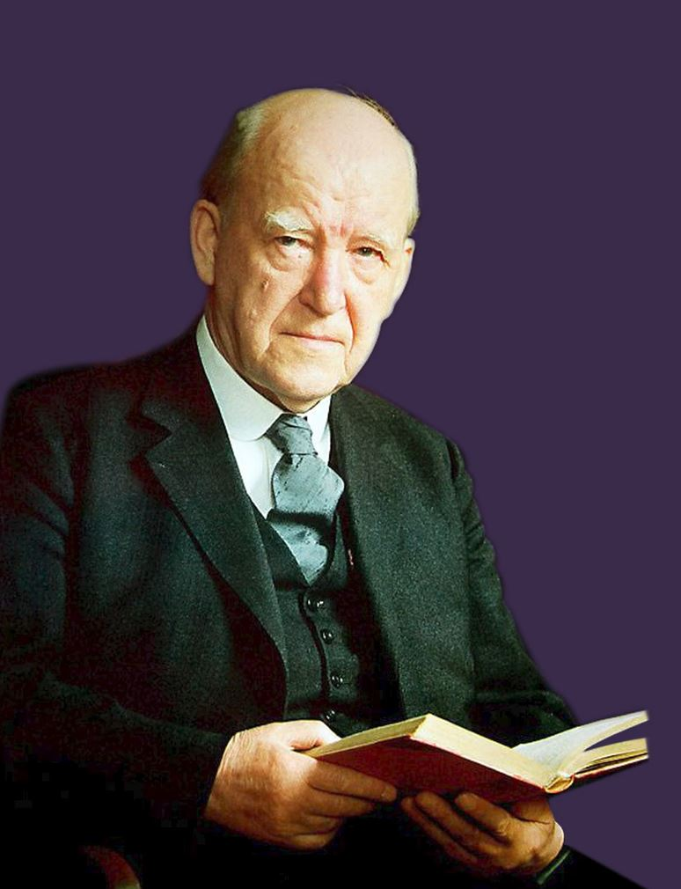

Slide 8
I say that we must talk to ourselves instead of allowing ‘ourselves’ to talk to us! Do you realize what this means? I suggest that the main trouble in this whole matter of spiritual depression in a sense is this, that we allow our self to talk to us instead of talking to our self. Am I just trying to be deliberately paradoxical? Far from it. This is the very essence of wisdom in this matter.

Slide 10
NIV | Robert Alter | Alec Motyer
¹ As the deer pants for streams of water, so my soul pants for you, my God. ² My soul thirsts for God, for the living God. When can I go and meet with God? | ¹ As a deer yearns for streams of water, so I yearn for You, O God. ² My whole being thirsts for God, for the living God. When shall I come and see the presence of God? | ¹ Like a deer craves for channels full of water just so my soul craves for you, O God. ² My soul is thirsty for God, for the living, transcendent God. When will I come and be seen before God?

