Slide 1
Feeling Far From God (Psalm 77)
A. Cry for Help (1-2). ¹ I cried out to God for help; I cried out to God to hear me.
² When I was in distress, I sought the Lord; at night I stretched out untiring hands, and I would not be comforted.
B. Remember God at Night (3-6). ³ I remembered you, God, and I groaned; I meditated, and my spirit grew faint.
⁴ You kept my eyes from closing; I was too troubled to speak.
⁵ I thought about the former days, the years of long ago;
⁶ I remembered my songs in the night. My heart meditated and my spirit asked:

Slide 2
C. Questions (7-9). ⁷ “Will the Lord reject forever? Will he never show his favor again?
⁸ Has his unfailing love [ḥeseḏ] vanished forever? Has his promise failed for all time?
⁹ Has God [El] forgotten to be merciful? Has he in anger withheld his compassion?”
B’. Remember God’s Mighty Deeds (10-12). ¹⁰ Then I thought, “To this I will appeal: the years when the Most High [Elyon] stretched out his right hand.
¹¹ I will remember the deeds of the Lord [Yah]; yes, I will remember your miracles of long ago.
¹² I will consider all your works and meditate on all your mighty deeds.”

Slide 3
A’. Confidence in God’s Help (13-20). ¹³ Your ways, God, are holy. What god is as great as our God?
¹⁴ You are the God who performs miracles; you display your power among the peoples.
¹⁵ With your mighty arm you redeemed your people, the descendants of Jacob and Joseph.
¹⁶ The waters saw you, God, the waters saw you and writhed; the very depths were convulsed. [Baal was the storm god.]
¹⁷ The clouds poured down water, the heavens resounded with thunder; your arrows flashed back and forth.
¹⁸ Your thunder was heard in the whirlwind, your lightning lit up the world; the earth trembled and quaked.
¹⁹ Your path led through the sea, your way through the mighty waters, though your footprints were not seen.
²⁰ You led your people like a flock by the hand of Moses and Aaron.

Slide 4
How does Psalm 77 point to Jesus?
Jesus hears our cry (Ps 77:1).
Jesus performs miracles (Ps 77:14).
Jesus is our Great Shepherd (Ps 77:20).

Slide 5
Feeling Far From God (Psalm 77:1-20; Key Verses: 77:1, 7-9).
When Nothing Helps
When God Seems to Withdraw From You
“I cried out to God for help; I cried out to God to hear me” (Ps 77:1).
⁷ “Will the Lord reject forever? 1
Will he never show his favor again? 2
⁸ Has his unfailing love vanished forever? 3
Has his promise failed for all time? 4
⁹ Has God forgotten to be merciful? 5
Has he in anger withheld his compassion?” 6

Slide 6
Feeling Far From God (Psalm 77:1-20)
A. Cry for help (1-2).
B. Remember God at Night (3-6).
C. Questions (7-9).
B’. Remember God’s Mighty Deeds (10-12).
A’. Confidence in God’s Help (13-20).

Slide 7
The Changing Mood and Flow of Psalm 77
The Irritations of a Depressed Soul (1-9).
The Intention to Refocus the Mind (10-15).
The Illustration of God’s Past Blessings (16-20).
Lamentation (1-9) to
Reflection (10-12) and ultimately to
Celebration (13-20).

Slide 8
Downcast and Discouraged (Psalm 42-43).
Lament (Ps 42:1-4). ¹ As the deer pants for streams of water, so my soul pants for you, my God.
² My soul thirsts for God, for the living God. When can I go and meet with God?
³ My tears have been my food day and night, while people say to me all day long, “Where is your God?”
⁴ These things I remember as I pour out my soul: how I used to go to the house of God under the protection of the Mighty One with shouts of joy and praise among the festive throng.
Hope(Ps 42:5). ⁵Why, my soul, are you downcast? Why so disturbed within me? Put your hope in God, for I will yet praise him, my Savior and my God.

Slide 9
Lament (Psalm 42:6-7). ⁶ My soul is downcast within me; therefore I will remember you from the land of the Jordan, the heights of Hermon—from Mount Mizar.
⁷ Deep calls to deep in the roar of your waterfalls; all your waves and breakers have swept over me.
Hope (Psalm 42:8).
⁸ By day the Lord directs his love, at night his song is with me— a prayer to the God of my life.

Slide 10
Lament (Psalm 42:9-10). ⁹ I say to God my Rock, “Why have you forgotten me? Why must I go about mourning, oppressed by the enemy?”
¹⁰ My bones suffer mortal agony as my foes taunt me, saying to me all day long, “Where is your God?”
Hope (Psalm 42:11)
¹¹ Why, my soul, are you downcast? Why so disturbed within me? Put your hope in God, for I will yet praise him, my Savior and my God.

Slide 11
Downcast and Discouraged (Psalm 42-43).
Anguish of Alienation from God
Hoping in the Lord’s Salvation
Feeling Down, Looking Up
“Why, my soul, are you downcast? Why so disturbed within me? Put your hope in God, for I will yet praise him, my Savior and my God” (Ps 42:5, 11; 43:5).

Slide 12
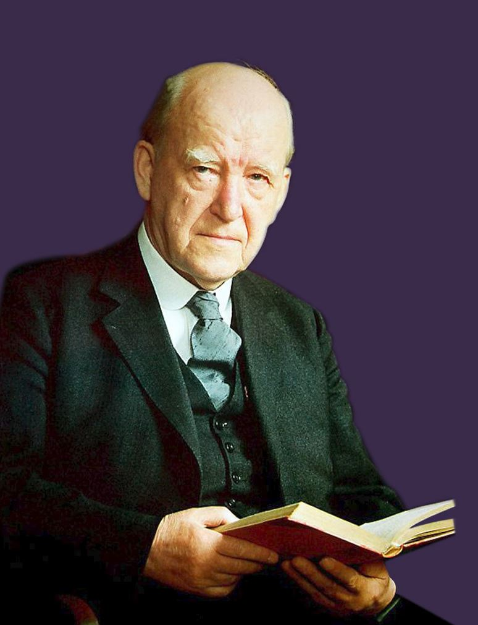
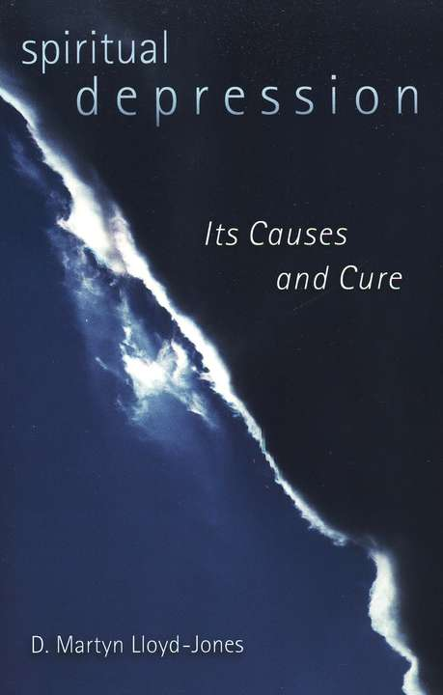

Slide 13
I say that we must talk to ourselves instead of allowing ‘ourselves’ to talk to us! Do you realize what this means? I suggest that the main trouble in this whole matter of spiritual depression in a sense is this, that we allow our self to talk to us instead of talking to our self. Am I just trying to be deliberately paradoxical? Far from it. This is the very essence of wisdom in this matter.

Slide 14
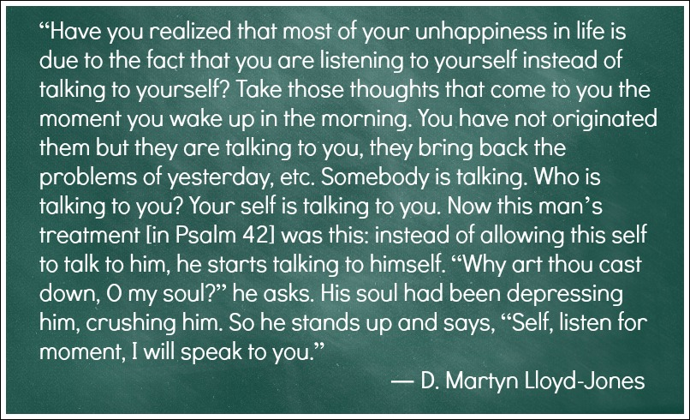

Slide 15
What to do when you feel down and discouraged
Long for God (Ps 42:1-2; 77:1-2).
Talk to God and to yourself (Ps 42:5).
Be honest with yourself and others (Ps 77:3-9).
Face and confront your shadow self.
Know that God will never forsake you (Dt 31:6)…
…yet can you feel forsaken by God?
Comfortable to be vulnerable, happy to be helpless, satisfied with sadness, sorrow and suffering.
It is not unChristian to express desperate negative emotions (Ps 22:1-2; 13:1-2; 73:2; 51:3-4).

Slide 16
What are Lament Psalms?
Also known as psalms of complaint or protest.
A prayer coming out of pain, a cry of desperation to God, an honest rehearsing of grief and agony, of fear, doubt, helplessness, sadness and sorrow.
Is it being a good Christian to express negativity?
Can/should Christians be HOT, express weakness?
Very common (30-70% of the psalms).

Slide 17
Be honest with yourself, and confront your shadow self to be wholly yourself.
Carl Jung stressed the need of self-acceptance as the way to self-realization, meaning the integration of the shadow. It is the growing ability to allow the dark side of our personality to enter into our awareness and thus prevent a one-sided life in which only that which is presentable to the outside world is considered as a real part of ourselves. To come to an inner unity, totality and wholeness, every part of our self should be accepted and integrated. Christ represents the light in us. But Christ was crucified between two murderers and we cannot deny them, and certainly not the murderers who live in us. Nouwen.

