Slide 1
PRAYER (Psalm 84): ⁴ Blessed are those who dwell in your house; they are ever praising you.
⁵ Blessed are those whose strength is in you, whose hearts are set on pilgrimage.
¹⁰ Better is one day in your courts than a thousand elsewhere; I would rather be a doorkeeper in the house of my God than dwell in the tents of the wicked.
¹¹ For the Lord God is a sun and shield; the Lord bestows favor [grace] and honor [glory]; no good thing does he withhold from those whose walk is blameless.
¹² Lord Almighty, blessed is the one who trusts in you.

Slide 2
Pilgrimage (Psalm 84:1-11): A Journey Longing for God. 11/18/24.
“Blessed are those whose strength is in you, whose hearts are set on pilgrimage. As they pass through the Valley of Baka [weeping]…” (Psalm 84:5).
How do you gain strength for your pilgrimage?

Slide 3
“Always remember this: life is a journey. It is a path, a journey to meet Jesus.” - Pope Francis.
“The way to heaven is a heavenly life, an imitation of those who are in heaven in their holy enjoyments, loving, adoring, serving, and praising God and the Lamb.” - Jonathan Edwards.

Slide 7
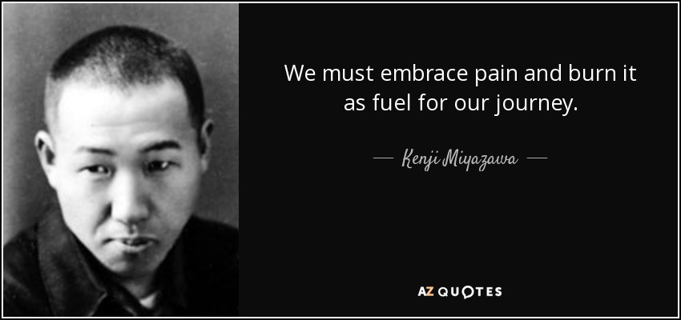
Therefore…

Slide 8
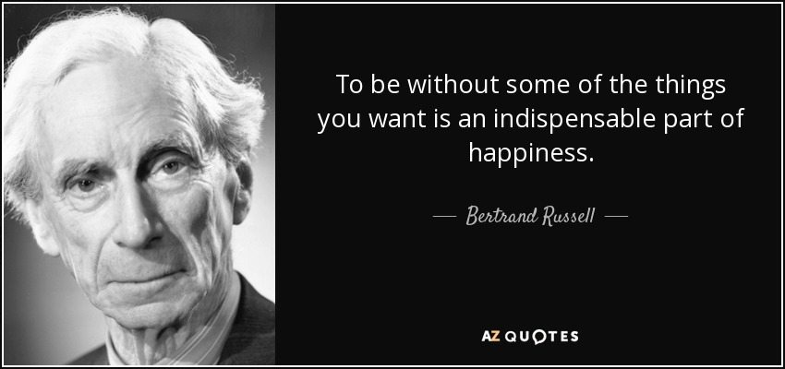

Slide 9
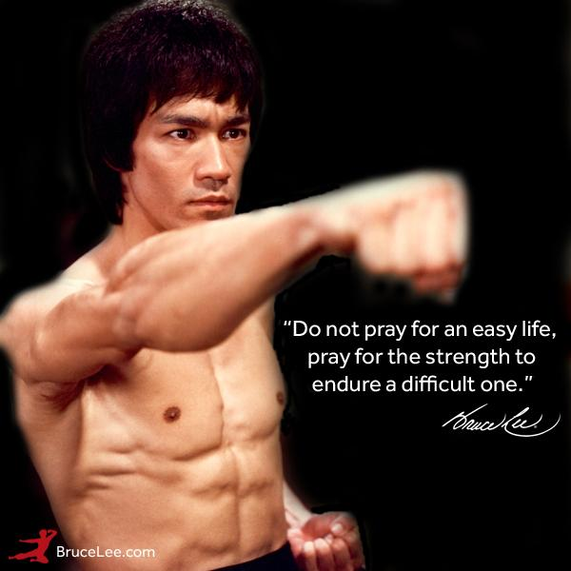

Slide 10
Beauty (Psalm 27): The Beauty of “One Thing.” 2/25/24.
“One thing I ask from the Lord, this only do I seek: that I may dwell in the house of the Lord all the days of my life, to gaze on the beauty of the Lord and to seek him in his temple” (Psalm 27:4).

Slide 11
Confidence (27:1-3): Whom shall I fear (1)?
¹ The Lord is my light and my salvation —whom shall I fear? The Lord is the stronghold of my life—of whom shall I be afraid?
² When the wicked advance against me to devour me, it is my enemies and my foes who will stumble and fall.
³ Though an army besiege me, my heart will not fear; though war break out against me, even then I will be confident
[bāṭaḥ]. “I trust [bāṭaḥ] in you; do not let me be put to shame, nor let my enemies triumph over me” (Ps 25:2).
“Vindicate me, Lord, for I have led a blameless life; I have trusted [bāṭaḥ] in the Lord and have not faltered” (Ps 26:2).

Slide 12
Desire (27:4-6): One thing I ask (4)
⁴ One thing I ask from the Lord, this only do I seek: that I may dwell in the house of the Lord all the days of my life, to gaze on the beauty of the Lord and to seek him in his temple.
⁵ For in the day of trouble he will keep me safe in his dwelling; he will hide me in the shelter of his sacred tent and set me high upon a rock.
⁶ Then my head will be exalted above the enemies who surround me; at his sacred tent I will sacrifice with shouts of joy; I will sing and make music to the Lord.

Slide 13
Plea (27:7-12): Hear my voice (7)
⁷ Hear my voice when I call, Lord; be merciful to me and answer me.
⁸⁻¹⁰ My heart says of you, “Seek his face!” Your face Lord, I will seek. Do not hide your face from me, do not turn your servant away in anger; you have been my helper. Do not reject me or forsake me, God my Savior. Though my father and mother forsake me, the Lord will receive me. [Divine presence.]
¹¹ Teach me your way, Lord; lead me in a straight path because of my oppressors [enemies]. [Divine instruction.]
¹² Do not turn me over to the desire of my foes, for false witnesses rise up against me, spouting malicious accusations. [Divine vindication.]

Slide 14
Confidence (13-14): Wait for the Lord
¹³ I remain confident of this: I will see the goodness of the Lord in the land of the living.
¹⁴ Wait for the Lord; be strong and take heart and wait for the Lord.
*The temple is a symbol of God’s presence, eternal security and an ongoing relationship and experience with God.

Slide 15
Dwelling in God’s house/temple (27:4)
“How lovely is your dwelling place, Lord Almighty! My soul yearns, even faints, for the courts of the Lord; my heart and my flesh cry out for the living God. Even the sparrow … and the swallow… Blessed are those who dwell in your house” (Psalm 84:1-4).
“Surely…I will dwell in the house of the Lord forever” (23:4).
“Who may ascend the mountain of the Lord? Who may stand in his holy place?”
“The one who has clean hands and a pure heart” (Ps 24:3-4).
“Lord, I love the house where you live, the place where your glory dwells” (Ps 26:8).
“Hear my cry for mercy as I call to you for help, as I lift up my hands toward your Most Holy Place” (Ps 28:2).
“Oh, how I love your law! I meditate on it all day long” (Ps 119:97; 1:2).
“I love you, Lord, my strength” (Ps 18:1). “I love the Lord” (Ps 116:1).

Slide 16
How does Psalm 27 point to Christ?
“The Lord is my light and my salvation” (Ps 27:1).
“Hear my voice when I call, Lord” (Ps 27:7).
“…for false witnesses rise up against me, spouting malicious accusations” (Ps 27:11).
Jesus is the light (Jn 1:4-5; 8:12; 1 Jn 4:5); dispels darkness.
Jesus is the One God hears. “During the days of Jesus’ life on earth, he offered up prayers and petitions with fervent cries and tears to the one who could save him from death, and he was heard because of his reverent submission” (Heb 5:7).
Jesus is the One whom false witnesses rose against. “The chief priests and the whole Sanhedrin were looking for false evidence against Jesus so that they could put him to death” (Mt 26:59).

Slide 17
ONE (Psalm 27:4): “One thing I ask”
“The main thing is to keep the main thing the main thing.”
Paul: “my only aim” (Ac 20:24). “One thing I do” (Phil 3:13).
“There is one body and one Spirit, just as you were called to one hope when you were called; ⁵ one Lord, one faith, one baptism; ⁶ one God and Father of all, who is over all and through all and in all” (Eph 4:4-6).
“One thing I know” (Jn 9:25).
Jesus: “One thing you lack” (Mk 10:21). “…only one thing is necessary” (Lk 10:42).
God: “Hear, O Israel: The Lord our God, the Lord is one” (Deut 6:4).

Slide 18
What was Jesus’ “one thing”?
“Didn’t you know I had to be in my Father’s house?” “And Jesus grew in wisdom and stature, and in favor with God and man” (Lk 2:49, 52).
“The time has come,” he said. “The kingdom of God has come near. Repent and believe the good news!” “Come, follow me,” Jesus said, “and I will send you out to fish for people” (Mk 1:15, 17).
“…when Christ came into the world, he said: ‘Here I am—it is written about me in the scroll—I have come to do your will, my God’” (Heb 10:5, 7).
“As the time approached for him to be taken up to heaven, Jesus resolutely set out for Jerusalem” (Lk 9:51). Now Jesus was going up to Jerusalem. On the way, he took the Twelve aside and said to them, “We are going up to Jerusalem, and…” (Mt 20:17-18).
“The hour has come for the Son of Man to be glorified” (Jn 12:23).
“It was just before the Passover Festival. Jesus knew that the hour had come for him to leave this world and go to the Father” (Jn 13:1).
“…yet not my will, but yours be done” (Lk 22:42).
“Father, the hour has come. Glorify your Son, that your Son may glorify you” (Jn 17:1).
“My God, my God…” (Matthew 27:46; Mark 15:34; Psalm 22:1).

