Slide 1
The Pilgrim’s Goal (Ps 84:1-4)
For the director of music. Of the Sons of Korah. A psalm.
¹ How lovely is your dwelling place, Lord Almighty!
² My soul yearns, even faints, for the courts of the Lord; my heart and my flesh cry out for the living God. [“an appetite for God”—CS Lewis]
³ Even the sparrow has found a home, and the swallow a nest for herself, where she may have her young—a place near your altar, Lord Almighty, my King and my God.
⁴ Blessed are those who dwell in your house; they are ever praising you.

Slide 2
The Pilgrim’s Journey (Ps 84:5-7)
⁵ Blessed are those whose strength is in you, whose hearts are set on pilgrimage.
⁶ As they pass through the Valley of Baka [weeping], they make it a place of springs; the autumn rains also cover it with pools.
⁷ They go from strength to strength, till each appears before God in Zion.
Turn your pain into pilgrimage.

Slide 3
The Pilgrim’s God (Ps 84:8-12)
⁸ Hear my prayer, Lord God Almighty; listen to me, God of Jacob.
⁹ Look on our shield, O God; look with favor on your anointed one [māšîaḥ].
¹⁰ Better is one day in your courts than a thousand elsewhere; I would rather be a doorkeeper in the house of my God than dwell in the tents of the wicked.
¹¹ For the Lord God is a sun and shield; the Lord bestows favor [grace] and honor [glory]; no good thing does he withhold from those whose walk is blameless.
¹² Lord Almighty, blessed is the one who trusts in you.

Slide 4
“In the Psalms, we hear the voice of the human heart speaking to God and the voice of God speaking to the human heart.” - Eugene Peterson.
…and with passionate pleas, petitions, penitence and penance.
“The Psalms were prayed by people who understood that God had everything to do with them.” - Eugene Peterson.
In Psalm 84 we want to think about life as a story, as a journey and as a pilgrimage.

Slide 5
Life as a Pilgrimage Longing for God (Psalm 84:1-11) 11/18/24
“Blessed are those whose strength is in you, whose hearts are set on pilgrimage” (Psalm 84:5).
How do you gain strength for your pilgrimage?

Slide 7
How can you tell how strong you truly are?

Slide 8
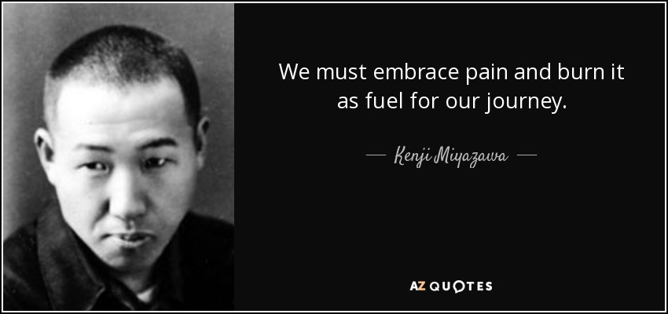
What do you do about pain during your pilgrimage?
Japanese novelist, poet and writer of children’s literature. 1896-1933 (37, pneumonia).
Why is there pain during your life pilgrimage?
“Cursed is the ground because of you…” (Gen 3:17). Lent.
“Blessed are those who mourn, for…” (Mt 5:4).
“Dear friends, do not be surprised at the fiery ordeal that has come on you to test you, as though something strange were happening to you. But…” (1 Pet 4:12-13).
“Consider it pure joy…because…” (James 1:2-4),
“In this world you will have…” (Jn 16:33).

Slide 9
What do you really want in life?

Slide 10
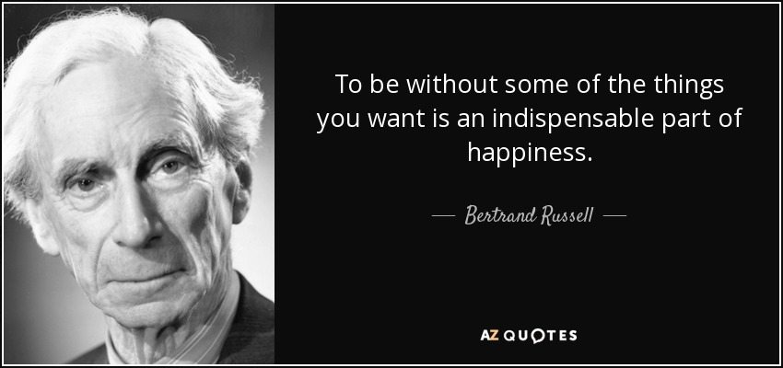
What is a way to be happy during your pilgrimage?
What about the very difficult and tough times during your pilgrimage?

Slide 11
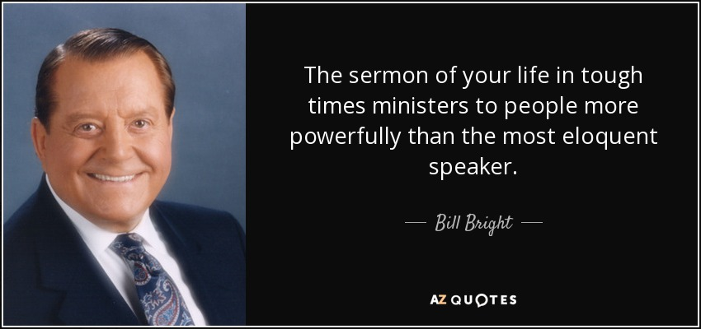
“That is why, for Christ’s sake, I delight in weaknesses,… in hardships,… in difficulties. For when I am weak, then I am strong” (2 Corinthians 12:10).
After David’s sin and repentance, he said, “Then I will teach transgressors your ways, so that sinners will turn back to you” (Psalm 51:13).

Slide 12
What about hiccups and tragedies occurring during your pilgrimage?

Slide 13
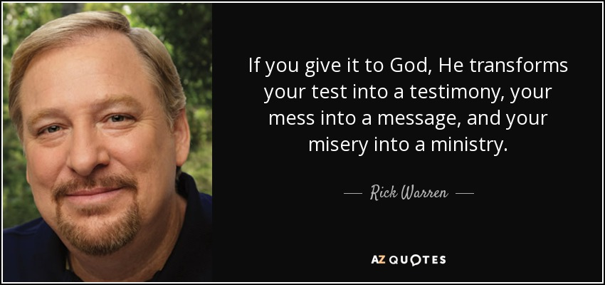
How can God use your pilgrimage?
Your pilgrimage/journey/story is not just about you; it is about God’s work in and through you
“Your story is a living testimony of God's faithfulness.”

Slide 14
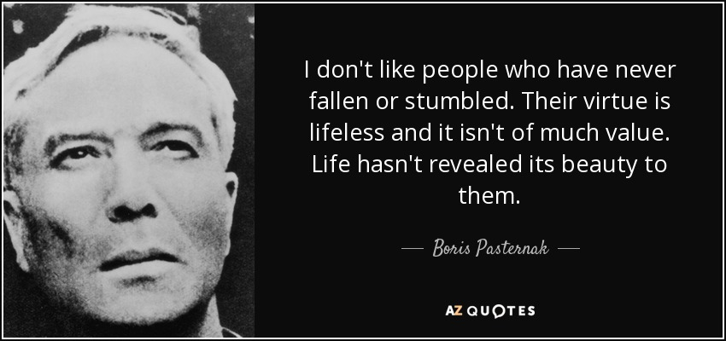
What if you have never truly struggled, failed or stumbled?
A Russian poet, novelist, composer and literary translator. 1890-1960.

Slide 15
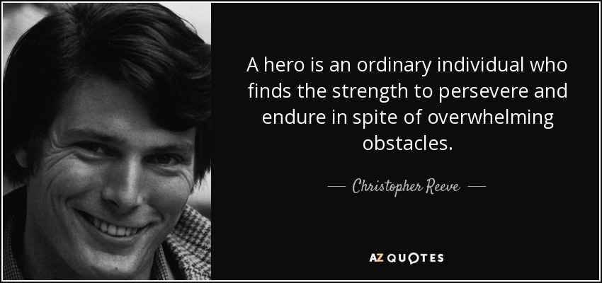

Slide 16
“Consider it pure joy…. Let perseverance finish its work so that you may be mature [perfect] and complete, not lacking anything” (James 1:2-4).

Slide 17
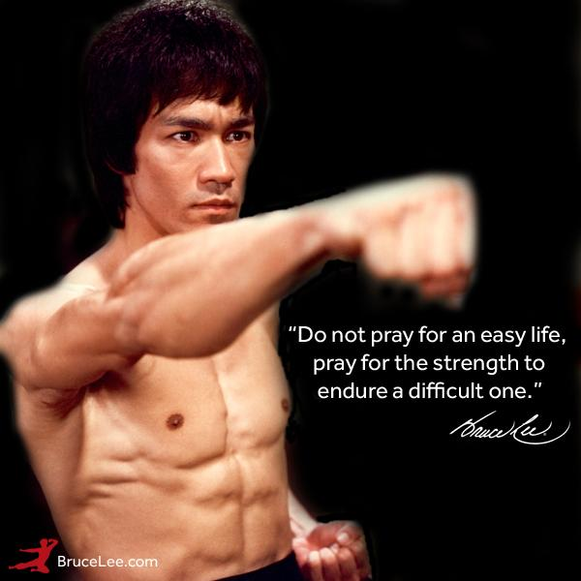

Slide 18
How do you live a life of pilgrimage?
How did Abraham live his life of pilgrimage?
“By faith Abraham, when called to go to a place he would later receive as his inheritance, obeyed and went, even though he did not know where he was going” (Heb 11:8).
“For he was looking forward to the city with foundations, whose architect and builder is God” (Heb 11:10).
“All these people were still living by faith when they died. They did not receive the things promised; they only saw them and welcomed them from a distance, admitting that they were foreigners and strangers on earth” (Heb 11:13).
“If they had been thinking of the country they had left, they would have had opportunity to return. Instead, they were longing for a better country—a heavenly one. Therefore God is not ashamed to be called their God, for he has prepared a city for them” (Heb 11:15-16).

Slide 19
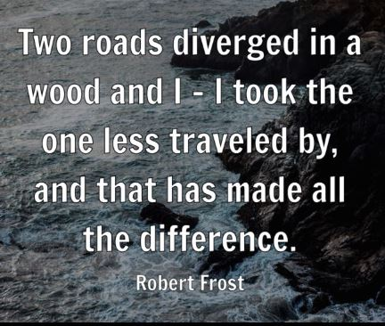
During your pilgrimage, what do you do at a crossroad?
This is what the LORD says: “Stand at the crossroads and look; ask for the ancient paths, ask where the good way is, and walk in it, and you will find rest for your souls. But you said, ‘We will not walk in it’” (Jer 6:16).
“Enter through the narrow gate. For wide is the gate and broad is the road that leads to destruction, and many enter through it. But small is the gate and narrow the road that leads to life, and only a few find it” (Mt 7:13-14).

Slide 20
What was Jesus’ pilgrimage like?
“Didn’t you know I had to be in my Father’s house?” “And Jesus grew in wisdom and stature, and in favor with God and man” (Lk 2:49, 52).
“The time has come,” he said. “The kingdom of God has come near. Repent and believe the good news!” “Come, follow me,” Jesus said, “and I will send you out to fish for people” (Mk 1:15, 17).
“…when Christ came into the world, he said: ‘Here I am—it is written about me in the scroll—I have come to do your will, my God’” (Heb 10:5, 7).
“As the time approached for him to be taken up to heaven, Jesus resolutely set out for Jerusalem” (Lk 9:51). Now Jesus was going up to Jerusalem. On the way, he took the Twelve aside and said to them, “We are going up to Jerusalem, and…” (Mt 20:17-18).
“The hour has come for the Son of Man to be glorified” (Jn 12:23).
“It was just before the Passover Festival. Jesus knew that the hour had come for him to leave this world and go to the Father” (Jn 13:1).
“…yet not my will, but yours be done” (Lk 22:42).
“Father, the hour has come. Glorify your Son, that your Son may glorify you” (Jn 17:1).
Matthew 27:46; Mark 15:34.

Slide 21
Founder of the Presbyterian Church of Scotland. 1514-1572.
1. Sorrows
2. Seeking God’s help
3. Praising God for who He is

Slide 22
Divided into 5 books (1-41, 42-72, 73-89, 90-106, 107-150).
73 attributed to David.

Slide 23
A Long Obedience in the Same Direction
What does “a long obedience in the same direction” mean?

Slide 24
A life of obedience to God that takes root over time. Immerse oneself in the Word of God, slowly and prayerfully.
Eugene Peterson wrote this spiritual formation classic in 1980. 1,000s of Christians were inspired to deeper discipleship. Society is obsessed with the immediate, the quick fix. But Peterson encourages Christians to—a long obedience in the same direction.
Following Jesus requires a life of prayer, which we learn from the Psalms. The Songs of Ascents (Psalms 120-134) was sung by travelers on their way to worship in Jerusalem. Peterson shows how the psalms teach us to grow in worship, service, joy, work, happiness, humility, community, and blessing.

Slide 26
Have Faith in God (Mark 11:12-25)
* Faith is in God, not in your faith (22).
- God is love (Jn 3:16; 1 Jn 4:8, 16).
- God’s love is everlasting (Jer 31:3; Heb 13:7).
* Faith is in God’s faithfulness (23).
* Faith is in God’s will (24; Mt 6:10).
* Faith is to forgive (25; Mt 6:12).
Authority: “May no one ever eat fruit from you again.” And his disciples heard him say it” (Mk 11:14; Gen 1:3).
“On reaching Jerusalem, Jesus entered the temple courts and began driving out those who were buying and selling there. He overturned the tables of the money changes and the benches.. Is it not written:… The chief priests and the teachers of the law heard this and began looking for a way to kill him” (15, 17, 18).
“In the morning, as they went along, they saw the fig tree withered from the roots. Peter remembered and said to Jesus, ‘Rabbi, look! The fig tree you cursed has withered’” (20-21).
Faith: ²² “Have faith in God,” Jesus answered. ²³ “Truly I tell you, if anyone says to this mountain, ‘Go, throw yourself into the sea,’ and does not doubt in their heart but believes that what they say will happen, it will be done for them. ²⁴ Therefore I tell you, whatever you ask for in prayer, believe that you have received it, and it will be yours. ²⁵ And when you stand praying, if you hold anything against anyone, forgive them, so that your Father in heaven may forgive you your sins.”

