Slide 1
God Sees and Knows Everything (Psalm 139:1-24). Sun, 3/17/2024.
The Crown of all psalms
“You have searched me, Lord, and you know [yāḏaʿ] me” (Ps 139:1). “Search me, God, and know [yāḏaʿ] my heart; test me and know [yāḏaʿ] my anxious thoughts. See if there is any offensive way in me, and lead me in the way everlasting” (Ps 139:23-24).

Slide 2
Knowledge: How often does it double?
Buckminster Fuller coined the concept of the “knowledge doubling curve” in his 1982 book Critical Path. Fuller's theory is that knowledge
doubled every century until 1900, then
doubled every 25 years by 1945 and
doubled every year by 1982.
Some now say that knowledge is doubling every day due to the arrival of the internet.

Slide 4
Too Wonderful for Me: “Such knowledge is too wonderful for me…” “…your works are wonderful” (6, 14).
God knows all [omniscient (1-6)]. The all-seeing.
God is present everywhere [omnipresent (7-12)]. The all-present.
God is all powerful [omnipotent (13-18)]. The all-creative.
God is holy (19-24). The all-holy.

Slide 5
1. God the all-knowing (1-6): omniscience
¹ You have searched me, Lord, and you know [yāḏaʿ-947x] me. ² You know [yāḏaʿ] when I sit and when I rise; you perceive my thoughts from afar.
³ You discern my going out and my lying down; you are familiar with all my ways. ⁴ Before a word is on my tongue you, Lord, know [yāḏaʿ] it completely. ⁵ You hem me in behind and before, and you lay your hand upon me. [“you” 9x in 5 vs.]
⁶ Such knowledge is too wonderful for me, too lofty [high] for me to attain [17 personal pronouns].

Slide 6
What does God's omniscience teach us about His knowledge?
Is it scary that God knows everything about you?
Do you want your children, parents, spouse or friends to know your every thought and desire just like God does?
Immeasurable.
Instructional (“you” 9x in vs. 1-5).
Individual and Intimate (17 personal pronouns in vs. 1-6).
Inspirational (vs. 5-6, 17, 23-24).
Since God’s ability transcends my reality it’s best to bow to his immensity.

Slide 7
2. God the all-present (7-12): omnipresence.
GODISNOWHERE
GODISNOWHERE
GODISNOWHERE
Here, There and Everywhere

Slide 8
2. God the all-present (7-12): omnipresence.
⁷ Where can I go from your Spirit? Where can I flee from your presence [face]?
⁸ If I go up to the heavens, you are there; if I make my bed in the depths[šᵊ'ôl], you are there.
⁹ If I rise on the wings of the dawn, if I settle on the far side of the sea,
¹⁰ even there your hand will guide me, your right hand will hold me fast.
¹¹ If I say, “Surely the darkness will hide me and the light become night around me,”
¹² even the darkness will not be dark to you; the night will shine like the day, for darkness is as light to you.

Slide 9
The Hound of Heaven by Francis Thompson
I fled Him, down the nights and down the days;
I fled Him, down the arches of the years;
I fled Him, down the labyrinthine ways
Of my own mind; and in the mist of tears
I hid from Him, and under running laughter.
Up vistaed hopes I sped;
And shot, precipitated,
Shade of His hand, outstretched caressingly?
‘Ah, fondest, blindest, weakest,
I am He Whom thou seekest!
Thou dravest love from thee, who dravest Me.’

Slide 10
3. God the all-creating (13-18): omnipotence.
¹³ For you created my inmost being; you knit me together in my mother’s womb.
¹⁴ I praise you because I am fearfully and wonderfully made; your works are wonderful, I know [yāḏaʿ] that full well.
¹⁵ My frame was not hidden from you when I was made in the secret place, when I was woven together in the depths of the earth.
¹⁶ Your eyes saw my unformed body; all the days ordained for me were written in your book before one of them came to be.
¹⁷ How precious [weighty] to me are your thoughts, God! How vast is the sum of them!
¹⁸ Were I to count them, they would outnumber the grains of sand—when I awake, I am still with you.

Slide 11
4. God the all-holy (19-24). God’s judgment
¹⁹ If only you, God, would slay the wicked! Away from me, you who are bloodthirsty! ²⁰ They speak of you with evil intent; your adversaries misuse your name.
²¹ Do I not hate those who hate you, Lord, and abhor those who are in rebellion against you? ²² I have nothing but hatred for them; I count them my enemies.
²³ Search me, God, and know [yāḏaʿ] my heart; test me and know [yāḏaʿ] my anxious thoughts.
²⁴ See if there is any offensive way in me, and lead me in the way everlasting.

Slide 12
Since God is all-present and all-powerful…
If God is always with you… (Ps 139:7-12)
You are never alone (Mt 28:20; Isa 43:2).
You can go anywhere courageously.
You can live without fear, worry or anxiety.
If God is the all-creating God...(Ps 139:13-18)
God’s works are wonderful / marvelous (13-14).
God’s workmanship is meticulous (15-16).
God’s wisdom is matchless (17-18).

Slide 13
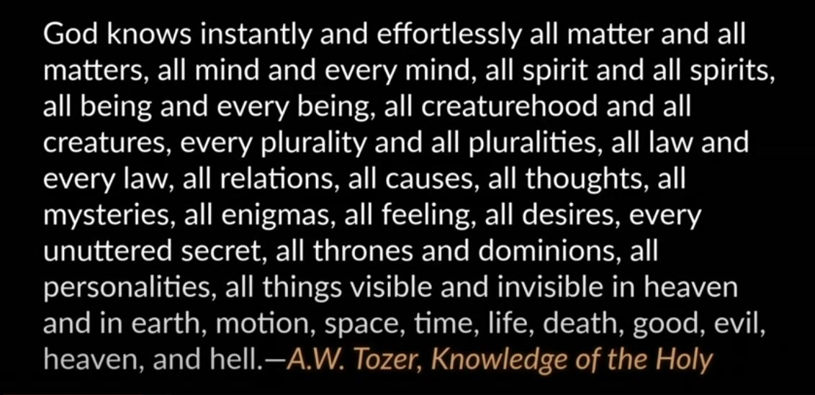
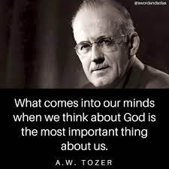
Why is it important to know what you think about God?
How would you describe God’s knowledge, his omniscience?

Slide 14
“For your ways are in full view of the Lord, and he examines all your paths” (Pro 5 5:21).
“Nothing in all creation is hidden from God’s sight. Everything is uncovered and laid bare before the eyes of him to whom we must give account” (Heb 4:13).
“...he [God] knows everything” (1 Jn 3:20).
To God there is no difference between history and prophecy.
300 predictions about Christ in the OT.

Slide 15
Psalm 139 is a combination of high spirituality, serious theological thought and strict moral application.
Since God knows everything about you...
God knows the worst about you (Ps 51:3-4).
God knows the best about you (Jn 21:15-17). “If our hearts condemn us, we know that God is greater than our hearts, and he knows everything” (1 Jn 3:20).
God knows the potential in you (Eph 2:10; Rom 8:28-30).

Slide 16
How does Psalm 139 point to Jesus?
1. Jesus is God who searches & knows you (1).
“Then all the churches will know that I am he who searches hearts and minds, and I will repay each of you according to your deeds” (Rev 2:23).
2. Jesus protects His people (5).
“Simon, Simon, Satan has asked to sift all of you as wheat. But I have prayed for you, Simon, that your faith may not fail. And when you have turned back, strengthen your brothers” (Lk 22:31).
“…how often I have longed to gather your children together, as a hen gathers her chicks under her wings…” (Mt 23:37; Lk 13:34).

