Slide 1
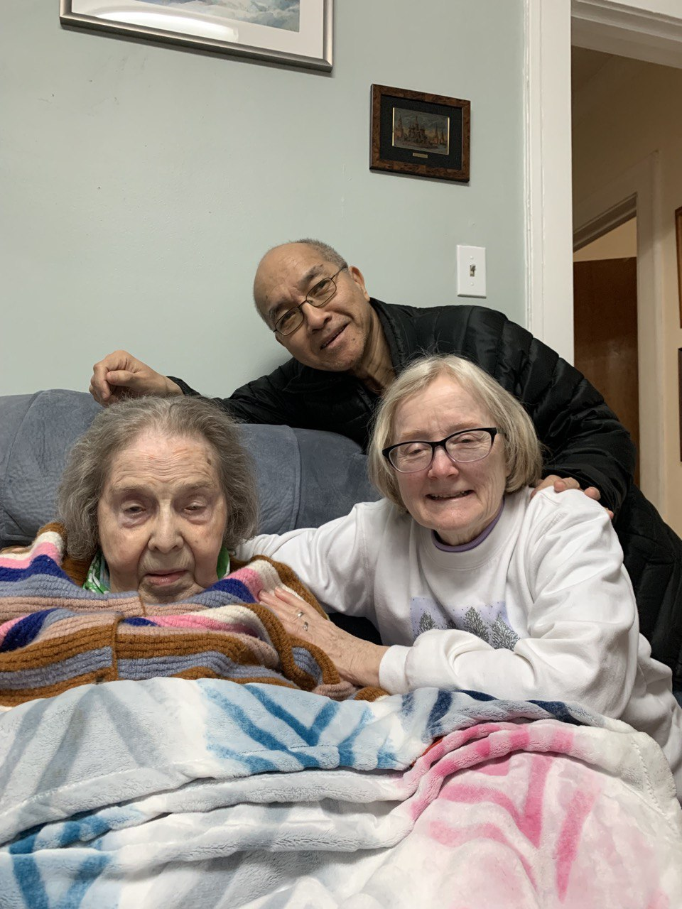

Slide 2
Death (Ps 49:1-20) & Judgment (Ps 50:1-24)
“Just as people are destined to die once, and after that to face judgment” (Heb 9:27).
Everyone, Listen (Ps 49:1-6).
Everyone Dies (Ps 49:7-14).
Everyone, Be Wise (Ps 49:15-20).
All God’s People Summoned (50:1-6).
All God’s People, Be Thankful (50:7-15).
All God’s People Warned (50:16-23).

Slide 3
Everyone, Listen (49:1-4): Life is unstable.
¹ Hear [šāma-1,159x]ʿthis, all you peoples; listen, all who live in this world,
² both low and high, rich and poor alike:
³ My mouth will speak words of wisdom; the meditation of my heart will give you understanding.
⁴ I will turn my ear to a proverb; with the harp I will expound my riddle:
⁵ Why should I fear when evil days come, when wicked deceivers surround me—
⁶ those who trust in their wealth and boast of their great riches?

Slide 4
Everyone Dies (49:5-14): Death is universal.
⁷ No one can redeem the life of another or give to God a ransom for them—⁸ the ransom for a life is costly, no payment is ever enough—
⁹ so that they should live on forever and not see decay.
¹⁰ For all can see that the wise die, that the foolish and the senseless also perish, leaving their wealth to others.¹¹ Their tombs will remain their houses forever, their dwellings for endless generations, though they had named lands after themselves.
¹² People, despite their wealth, do not endure; they are like the beasts that perish. ¹³ This is the fate of those who trust in themselves, and of their followers, who approve their sayings.
¹⁴ They are like sheep and are destined to die [šᵊ'ôl]; death will be their shepherd (but the upright will prevail over them in the morning). Their forms will decay in the grave [šᵊ'ôl], far from their princely mansions.

Slide 5
Everyone, Be Wise (15-20): Redemption is possible.
¹⁵ But God will redeem me from the realm of the dead [šᵊ'ôl, Sheol, grave, hell] he will surely take me to himself.
¹⁶ Do not be overawed when others grow rich, when the splendor of their houses increases; ¹⁷ for they will take nothing with them when they die, their splendor will not descend with them. ¹⁸ Though while they live they count themselves blessed—and people praise you when you prosper—¹⁹ they will join those who have gone before them, who will never again see the light of life.
²⁰ People who have wealth but lack understanding are like the beasts that perish.

Slide 6
Wisdom about money and life
“For the love of money is a root of all kinds of evil. Some people, eager for money, have wandered from the faith and pierced themselves with many griefs” (1 Tim 6:10).
“Do not store up for yourselves treasures on earth, where moths and vermin destroy, and where thieves break in and steal. But store up for yourselves treasures in heaven, where moths and vermin do not destroy, and where thieves do not break in and steal. For where your treasure is, there your heart will be also” (Mt 6:19-21).
“Keep your lives free from the love of money and be content with what you have, because God has said, “Never will I leave you; never will I forsake you.” (Heb 13:5).
“Whoever loves money never has enough; whoever loves wealth is never satisfied with their income” (Eccl 5:10).

Slide 7
šᵊ'ôl (Sheol, Hades, grave, hell, pit)
What do the psalms say about death and dying?
65x. Death 333-394x. 4.3 born, 2 die/sec. 6-7K/hour.
Death is appointed by God: “..all the days ordained for me were written in your book before one of them came to be” (Ps 139:16b).
Death is horrible: “My heart is in anguish within me; the terrors of death have fallen on me. Fear and trembling have beset me; horror has overwhelmed me” (Ps 55:4-5).
Death is not the end: “…because you will not abandon me to the realm of the dead [šᵊ'ôl], nor will you let your faithful one see decay. You make known to me the path of life; you will fill me with joy in your presence, with eternal pleasures at your right hand” (Ps 16:10-11; Ac 2:25-28).

Slide 8
The Brevity of Life, the Certainty of Death and the Futility of Wealth (Psalm 49)
Life is unstable.
Death is universal.
Redemption is possible.
We live precariously.
We die certainly.
We plan accordingly.

Slide 9
Judgment (Psalm 50:1-24): The Judge in the High Court Breaks Silence.
“Listen [šāma], my people, and I will speak; I will testify against you, Israel: I am God, your God” (Ps 50:7).
“…call on me in the day of trouble; I will deliver you, and you will honor me” (Ps 50:15).

Slide 10
All God’s People Summoned (Ps 50:1-6)
¹ The Mighty One, God, the Lord, speaks and summons the earth from the rising of the sun to where it sets.
² From Zion, perfect in beauty, God shines forth.
³ Our God comes and will not be silent; a fire devours before him, and around him a tempest rages.
⁴ He summons the heavens above, and the earth, that he may judge his people:
⁵ “Gather to me this consecrated people, who made a covenant with me by sacrifice.”
⁶ And the heavens proclaim his righteousness, for he is a God of justice.

Slide 11
All God’s People, Be Thankful (50:7-15)
⁷ “Listen [šāma], my people, and I will speak; I will testify against you, Israel: I am God, your God.
⁸ I bring no charges against you concerning your sacrifices or concerning your burnt offerings, which are ever before me.
⁹ I have no need of a bull from your stall or of goats from your pens,
¹⁰ for every animal of the forest is mine, and the cattle on a thousand hills. ¹¹ I know every bird in the mountains, and the insects in the fields are mine. ¹² If I were hungry I would not tell you, for the world is mine, and all that is in it.
¹³ Do I eat the flesh of bulls or drink the blood of goats?
¹⁴ “Sacrifice thank offerings to God, fulfill your vows to the Most High,
¹⁵ and call on me in the day of trouble; I will deliver you, and you will honor me.”

Slide 12
All God’s People Warned (Ps 50:16-23).
¹⁶ But to the wicked person, God says: “What right have you to recite my laws or take my covenant on your lips?
¹⁷ You hate my instruction and cast my words behind you.
¹⁸ When you see a thief, you join with him; you throw in your lot with adulterers. ¹⁹ You use your mouth for evil and harness your tongue to deceit. ²⁰ You sit and testify against your brother and slander your own mother’s son.
²¹ When you did these things and I kept silent, you thought I was exactly like you. But I now arraign you and set my accusations before you.
²² “Consider this, you who forget God, or I will tear you to pieces, with no one to rescue you:
²³ Those who sacrifice thank offerings honor me, and to the blameless I will show my salvation.”

Slide 13
How does Psalm 49, 50 point to Christ?
Jesus’ warning and parable: “Watch out! Be on your guard against..; life does not consist in... ‘You fool! This very night your life will be… Then who will get what..?’ This is how it will be with whoever stores up things for themselves but is not…” (Lk 12:15, 20-21).
Jesus is our Redeemer (Ps 49:7-8; Gal 3:13; 1 Pet 1:18-19; Rom 3:24).
Jesus was redeemed from the power of the grave (Ps 49:15; 1 Cor 15).
Jesus made a covenant with us, for us by sacrifice (Ps 50:5-6). “In the same way, after the supper he took the cup, saying, ‘This cup is the new covenant in my blood, which is poured out for you’” (Lk 22:20).
Jesus is the Judge of all the earth (2 Cor 5:10; Mt 25:31-32).
Jesus became “like the beasts that perished” (Ps 49:12, 20) for us.

Slide 15
Death (Ps 49:1-20) and Judgment (Ps 50:1-24): Two Certainties of Life. 3/10/24
“Hear this, all you peoples; listen, all who live in this world, both low and high, rich and poor alike” (Ps 49:1-2).
“The Mighty One, God, the Lord, speaks and summons the earth…” (Ps 50:1a).
“Just as people are destined to die once, and after that to face judgment” (Heb 9:27).

Slide 16
Death (Ps 49:1-20): The Brevity of Life, the Certainty of Death and the Futility of Wealth.
Everyone, Listen (Ps 49:1-6). “Hear this, all you peoples; listen, all who live in this world, both low and high, rich and poor alike” (1-2).
Everyone Dies (Ps 49:7-14). “For all can see that the wise die, that the foolish and the senseless also perish” (Ps 49:10). “People who have wealth but lack understanding are like the beasts that perish” (Ps 49:20).
Everyone, Be Wise (Ps 49:15-20). “But God will redeem me from the realm of the dead; he will surely take me to himself” (Ps 49:15).

Slide 17
Beyond Life and Beyond Death (Ps 49)
Life is unstable (1-4).
Death is universal (5-14).
Redemption is possible (15-20). [Mountain top/High water mark]
Therefore, know the following:
We live precariously.
We die certainly.
We must plan accordingly.

Slide 18
4. All God’s People Summoned (50:1-6): “The Mighty One, God, the Lord, speaks and summons the earth from the rising of the sun to where it sets” (1a).
5. All God’s People, Be Thankful (7-15): “I bring no charges against you concerning your sacrifices…” “Sacrifice thank offerings to God…” (8, 14a).
6. All God’s People, Be Warned (16-23): “Consider this, you who forget God, or I will tear you to pieces, with no one to rescue you: Those who sacrifice thank offerings honor me, and to the blameless I will show my salvation” (22-23).
Rebuking religious ritualism (7-15) and hypocritical disobedience (16-23).

