Slide 1
2 Peter 3:1-10 ESV ¹ This is now the second letter that I am writing to you, beloved. In both of them I am stirring up your sincere mind by way of reminder, ² that you should remember the predictions of the holy prophets and the commandment of the Lord and Savior through your apostles, ³ knowing this first of all, that scoffers will come in the last days with scoffing, following their own sinful desires. ⁴ They will say, “Where is the promise of his coming? For ever since the fathers fell asleep, all things are continuing as they were from the beginning of creation.”

Slide 2
⁵ For they deliberately overlook this fact, that the heavens existed long ago, and the earth was formed out of water and through water by the word of God, ⁶ and that by means of these the world that then existed was deluged with water and perished. ⁷ But by the same word the heavens and earth that now exist are stored up for fire, being kept until the day of judgment and destruction of the ungodly. ⁸ But do not overlook this one fact, beloved, that with the Lord one day is as a thousand years, and a thousand years as one day. ⁹ The Lord is not slow to fulfill his promise as some count slowness, but is patient toward you,^{[a]} not wishing that any should perish, but that all should reach repentance. ¹⁰ But the day of the Lord will come like a thief, and then the heavens will pass away with a roar, and the heavenly bodies^{[b]} will be burned up and dissolved, and the earth and the works that are done on it will be exposed.^{[c]}

Slide 3
The Day of the Lord Will Come 2 Peter 3:1-10 Key Verse:10: “¹⁰ But the day of the Lord will come like a thief, and then the heavens will pass away with a roar, and the heavenly bodies^{[b]} will be burned up and dissolved, and the earth and the works that are done on it will be exposed.^{[c]}

Slide 4
Read verses 1-2. “This is now the second letter that I am writing to you, beloved. In both of them I am stirring up your sincere mind by way of reminder, ² that you should remember the predictions of the holy prophets and the commandment of the Lord and Savior through your apostles…”

Slide 6
Read verses 3-4. “…³ knowing this first of all, that scoffers will come in the last days with scoffing, following their own sinful desires. ⁴ They will say, ‘Where is the promise of his coming? For ever since the fathers fell asleep, all things are continuing as they were from the beginning of creation.’”

Slide 7
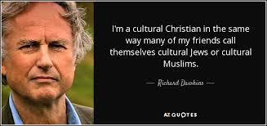

Slide 8
2 Corinthians 5:10 reads, “¹⁰ For we must all appear before the judgment seat of Christ, so that each one may receive what is due for what he has done in the body, whether good or evil.”

Slide 9
Verse 4, “Where is the promise of his coming? For ever since the fathers fell asleep, all things are continuing as they were from the beginning of creation.”

Slide 10
Read verses 5-6. “⁵ For they deliberately overlook this fact, that the heavens existed long ago, and the earth was formed out of water and through water by the word of God, ⁶ and that by means of these the world that then existed was deluged with water and perished.”

Slide 11
Genesis 1:1, “In the beginning God created the heavens and the earth,”

Slide 12
Genesis 8:22, “²² While the earth remains, seedtime and harvest, cold and heat, summer and winter, day and night, shall not cease.”

Slide 13
Read verse 7. “⁷ But by the same word the heavens and earth that now exist are stored up for fire, being kept until the day of judgment and destruction of the ungodly.”

Slide 14
Isaiah 13:10 reads, “For the stars of the heavens and their constellations will not give their light; the sun will be dark at its rising, and the moon will not shed its light.”

Slide 15
Isaiah 24:19 reads, “The earth is utterly broken, the earth is split apart, the earth is violently shaken.”

Slide 16
Micah 1:4 reads, “And the mountains will melt under him, and the valleys will split open, like wax before the fire, like waters poured down a steep place.”

Slide 17
Read verse 8. “⁸ But do not overlook this one fact, beloved, that with the Lord one day is as a thousand years, and a thousand years as one day.”

Slide 18
Psalm 90:4, “For a thousand years in your sight are but as yesterday when it is past, or as a watch in the night.”

Slide 19
Read verse 9. “⁹ The Lord is not slow to fulfill his promise as some count slowness, but is patient toward you,^{[b]} not wishing that any should perish, but that all should reach repentance.”

Slide 20
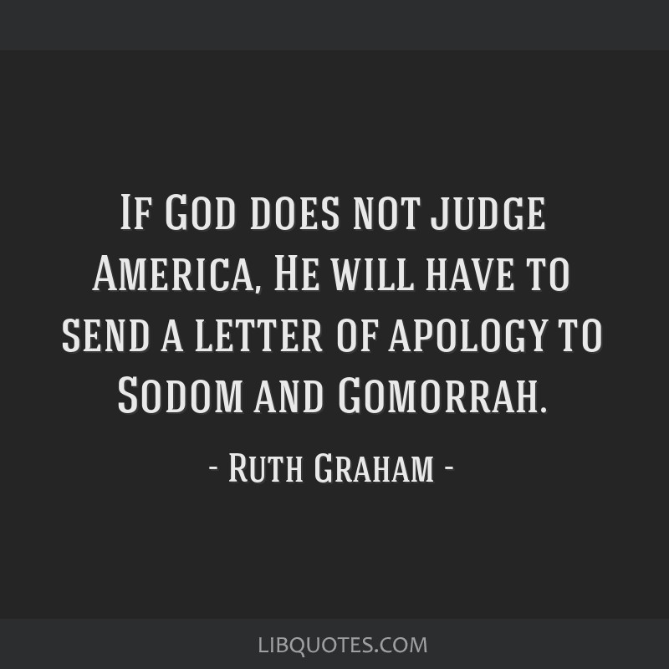

Slide 21
Ezekiel 33:11 reads, “Say to them, As I live, declares the Lord God, I have no pleasure in the death of the wicked, but that the wicked turn from his way and live; turn back, turn back from your evil ways, for why will you die, O house of Israel?”

Slide 22
Romans 8:25 reads, “²⁵ Lest you be wise in your own sight, I do not want you to be unaware of this mystery, brothers: a partial hardening has come upon Israel, until the fullness of the Gentiles has come in.”

Slide 23
Read verse 10. “¹⁰ But the day of the Lord will come like a thief, and then the heavens will pass away with a roar, and the heavenly bodies^{[d]} will be burned up and dissolved, and the earth and the works that are done on it will be exposed.^{[e]”}

Slide 24
Isaiah 13:6 reads, “Wail, for the day of the Lord is near; as destruction from the Almighty it will come!”

Slide 25
Jeremiah 46:10a reads, “That day is the day of the Lord God of hosts, a day of vengeance, to avenge himself on his foes. The sword shall devour and be sated and drink its fill of their blood.”

Slide 27
First Thessalonians 5:2 reads, “² For you yourselves are fully aware that the day of the Lord will come like a thief in the night.”

Slide 28
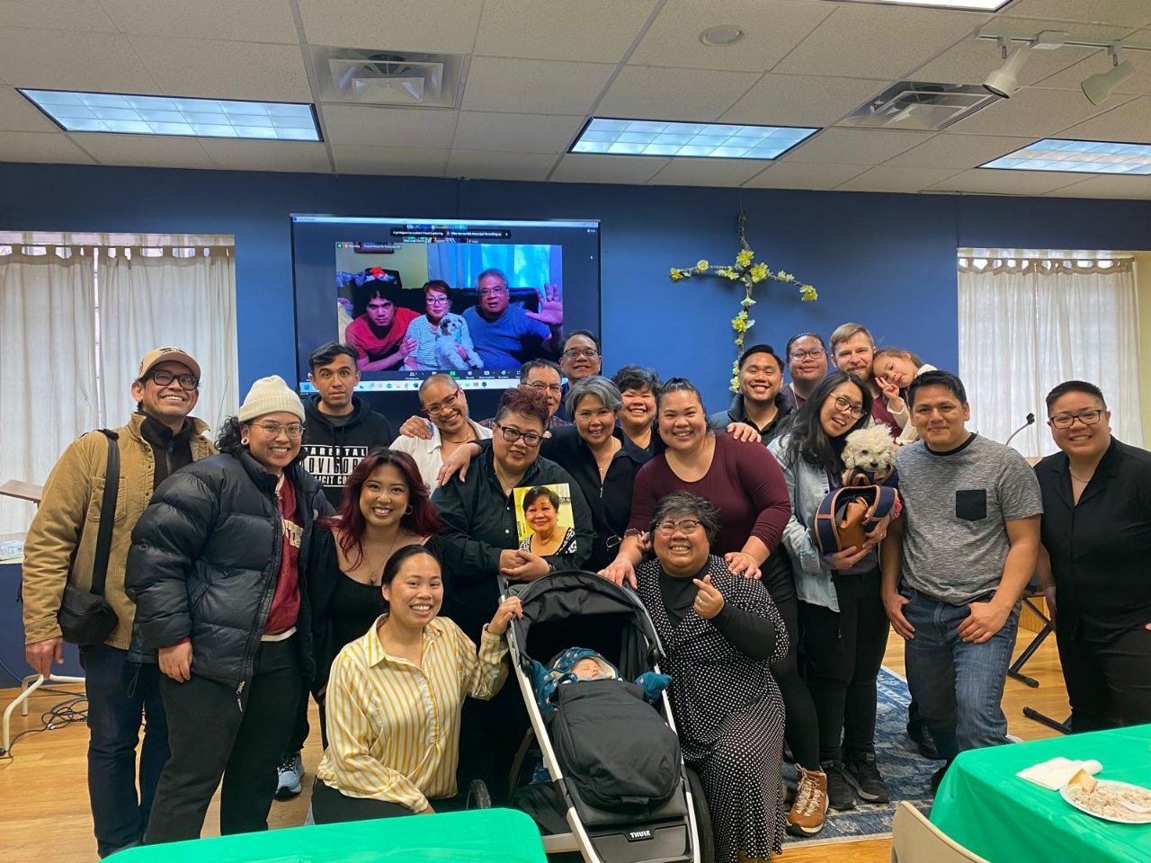

Slide 29
Two Timothy 4:8 reads, “Henceforth there is laid up for me the crown of righteousness, which the Lord, the righteous judge, will award to me on that day, and not only to me but also to all who have loved his appearing.”

