Slide 1
Luke 23:26-56 ²⁶ And as they led him away, they seized one Simon of Cyrene, who was coming in from the country, and laid on him the cross, to carry it behind Jesus. ²⁷ And there followed him a great multitude of the people and of women who were mourning and lamenting for him. ²⁸ But turning to them Jesus said, “Daughters of Jerusalem, do not weep for me, but weep for yourselves and for your children. ²⁹ For behold, the days are coming when they will say, ‘Blessed are the barren and the wombs that never bore and the breasts that never nursed!’ ³⁰ Then they will begin to say to the mountains, ‘Fall on us,’ and to the hills, ‘Cover us.’ ³¹ For if they do these things when the wood is green, what will happen when it is dry?”

Slide 2
³² Two others, who were criminals, were led away to be put to death with him. ³³ And when they came to the place that is called The Skull, there they crucified him, and the criminals, one on his right and one on his left. ³⁴ And Jesus said, “Father, forgive them, for they know not what they do.”^{[b]} And they cast lots to divide his garments. ³⁵ And the people stood by, watching, but the rulers scoffed at him, saying, “He saved others; let him save himself, if he is the Christ of God, his Chosen One!” ³⁶ The soldiers also mocked him, coming up and offering him sour wine ³⁷ and saying, “If you are the King of the Jews, save yourself!” ³⁸ There was also an inscription over him,^{[c]} “This is the King of the Jews.”

Slide 3
³⁹ One of the criminals who were hanged railed at him,^{[d]} saying, “Are you not the Christ? Save yourself and us!” ⁴⁰ But the other rebuked him, saying, “Do you not fear God, since you are under the same sentence of condemnation? ⁴¹ And we indeed justly, for we are receiving the due reward of our deeds; but this man has done nothing wrong.” ⁴² And he said, “Jesus, remember me when you come into your kingdom.” ⁴³ And he said to him, “Truly, I say to you, today you will be with me in paradise.”

Slide 4
⁴⁴ It was now about the sixth hour,^{[e]} and there was darkness over the whole land until the ninth hour,^{[f]} ⁴⁵ while the sun's light failed. And the curtain of the temple was torn in two. ⁴⁶ Then Jesus, calling out with a loud voice, said, “Father, into your hands I commit my spirit!” And having said this he breathed his last. ⁴⁷ Now when the centurion saw what had taken place, he praised God, saying, “Certainly this man was innocent!” ⁴⁸ And all the crowds that had assembled for this spectacle, when they saw what had taken place, returned home beating their breasts. ⁴⁹ And all his acquaintances and the women who had followed him from Galilee stood at a distance watching these things.

Slide 5
⁵⁰ Now there was a man named Joseph, from the Jewish town of Arimathea. He was a member of the council, a good and righteous man, ⁵¹ who had not consented to their decision and action; and he was looking for the kingdom of God. ⁵² This man went to Pilate and asked for the body of Jesus. ⁵³ Then he took it down and wrapped it in a linen shroud and laid him in a tomb cut in stone, where no one had ever yet been laid. ⁵⁴ It was the day of Preparation, and the Sabbath was beginning.^{[g]} ⁵⁵ The women who had come with him from Galilee followed and saw the tomb and how his body was laid. ⁵⁶ Then they returned and prepared spices and ointments. On the Sabbath they rested according to the commandment.

Slide 6
“Father, Forgive Them.” Luke 23:26-56 Key Verse 23:34a “Jesus said, ‘Father, forgive them, for they do not know what they are doing.’”

Slide 7
Verses 26-31. “²⁶ And as they led him away, they seized one Simon of Cyrene, who was coming in from the country, and laid on him the cross, to carry it behind Jesus. ²⁷ And there followed him a great multitude of the people and of women who were mourning and lamenting for him. ²⁸ But turning to them Jesus said, ‘Daughters of Jerusalem, do not weep for me, but weep for yourselves and for your children. ²⁹ For behold, the days are coming when they will say, ‘Blessed are the barren and the wombs that never bore and the breasts that never nursed!’ ³⁰ Then they will begin to say to the mountains, ‘Fall on us,’ and to the hills, ‘Cover us.’ ³¹ For if they do these things when the wood is green, what will happen when it is dry?”

Slide 8
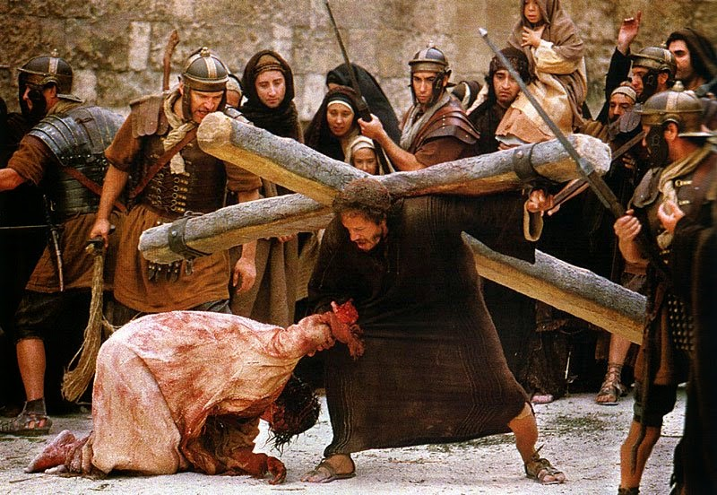

Slide 9
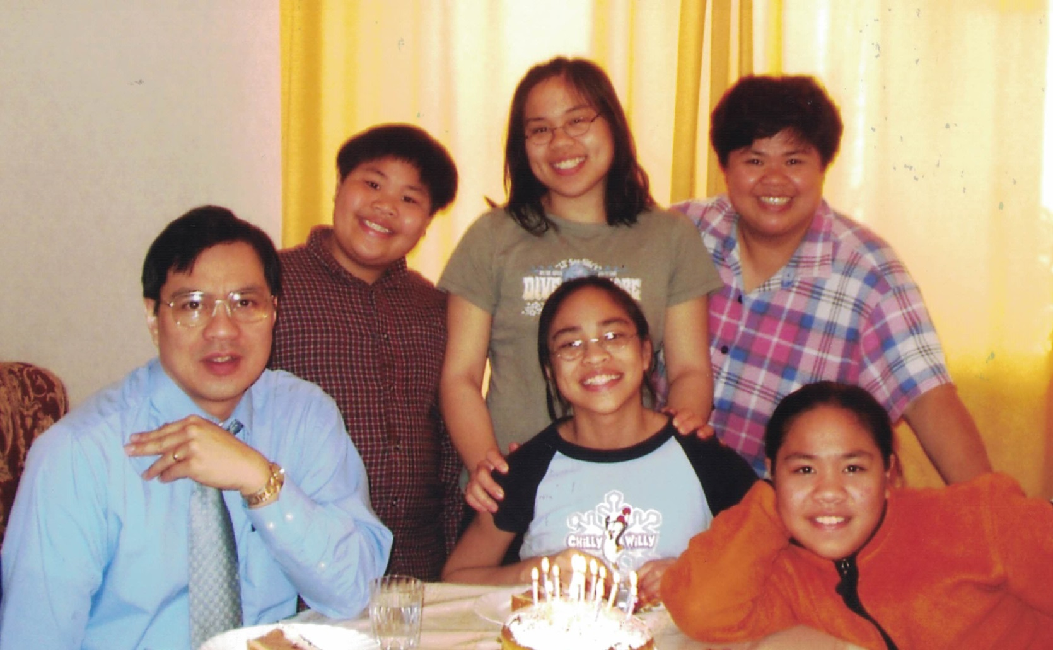

Slide 10
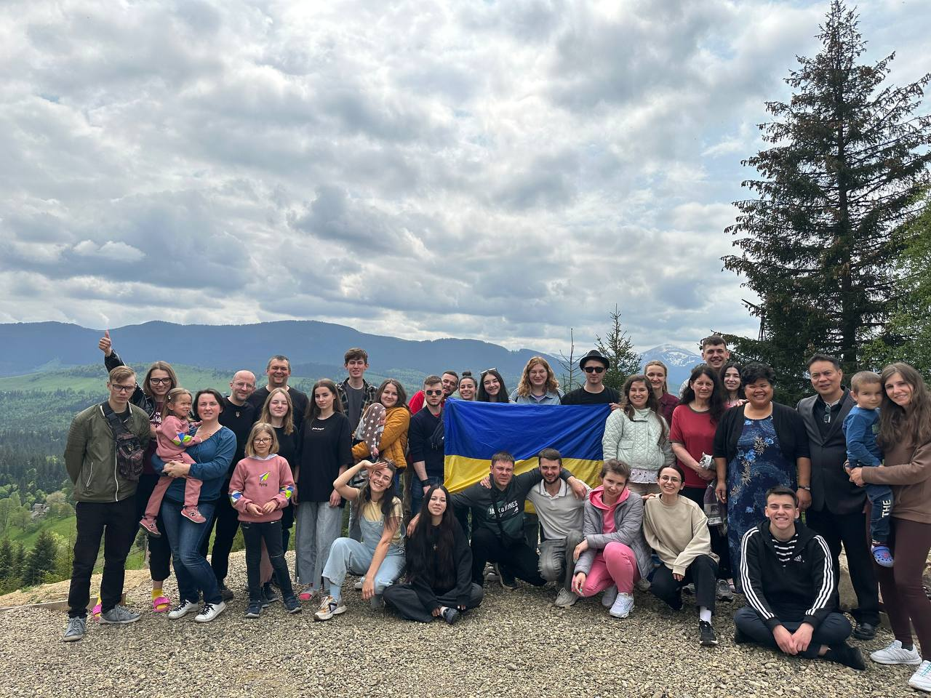

Slide 11
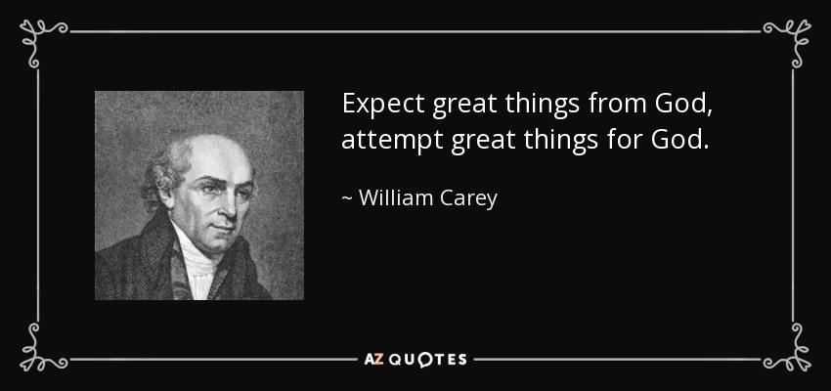

Slide 12
Revelation 6:16-17 reads, “¹⁶…calling to the mountains and rocks, ‘Fall on us and hide us from the face of him who is seated on the throne, and from the wrath of the Lamb, ¹⁷ for the great day of their wrath has come, and who can stand?’”

Slide 13
Look at verses 32-33. “³² Two others, who were criminals, were led away to be put to death with him. ³³ And when they came to the place that is called The Skull, there they crucified him, and the criminals, one on his right and one on his left.”

Slide 14
Isaiah 53:4–5 reads, “Surely he took up our pain and bore our suffering, yet we considered him punished by God, stricken by him, and afflicted. But he was pierced for our transgressions, he was crushed for our iniquities; the punishment that brought us peace was on him, and by his wounds we are healed.”

Slide 15
Isaiah 53:12, “Therefore I will give him a portion among the great, and he will divide the spoils with the strong, because he poured out his life unto death, and was numbered with the transgressors. For he bore the sin of many, and made intercession for the transgressors.”

Slide 16
Look at verse 34. “And Jesus said, ‘Father, forgive them, for they do not know what they do.’^{[a]}And they cast lots to divide his garments.”

Slide 17
Acts 9:4-6 reads, “⁴ And falling to the ground, he heard a voice saying to him, ‘Saul, Saul, why are you persecuting me?’ ⁵ And he said, ‘Who are you, Lord?’ And he said, ‘I am Jesus, whom you are persecuting. ⁶ But rise and enter the city, and you will be told what you are to do.’”

Slide 18
Luke 15:17-20 reads, “¹⁷ But when he came to himself, he said, ‘How many of my father's hired servants have more than enough bread, but I perish here with hunger! ¹⁸ I will arise and go to my father, and I will say to him, “Father, I have sinned against heaven and before you. ¹⁹ I am no longer worthy to be called your son. Treat me as one of your hired servants.”’ ²⁰ And he arose and came to his father. But while he was still a long way off, his father saw him and felt compassion, and ran and embraced him and kissed him.”

Slide 19
Romans 5:8: “⁸ …but God shows his love for us in that while we were still sinners, Christ died for us.”

Slide 20
Look at verses 35-43. “³⁵ And the people stood by, watching, but the rulers scoffed at him, saying, ‘He saved others; let him save himself, if he is the Christ of God, his Chosen One!’ ³⁶ The soldiers also mocked him, coming up and offering him sour wine ³⁷ and saying, ‘If you are the King of the Jews, save yourself!’ ³⁸ There was also an inscription over him,^{[b]} ‘This is the King of the Jews.’³⁹ One of the criminals who were hanged railed at him,^{[c]} saying, “Are you not the Christ? Save yourself and us!” ⁴⁰ But the other rebuked him, saying, “Do you not fear God, since you are under the same sentence of condemnation? ⁴¹ And we indeed justly, for we are receiving the due reward of our deeds; but this man has done nothing wrong.” ⁴² And he said, “Jesus, remember me when you come into your kingdom.” ⁴³ And he said to him, “Truly, I say to you, today you will be with me in paradise.”

Slide 21
Look at verses 44-49. “⁴⁴It was now about the sixth hour,^{[d]} and there was darkness over the whole land until the ninth hour,^{[e]} ⁴⁵ while the sun's light failed. And the curtain of the temple was torn in two. ⁴⁶ Then Jesus, calling out with a loud voice, said, ‘Father, into your hands I commit my spirit!’ And having said this he breathed his last. ⁴⁷ Now when the centurion saw what had taken place, he praised God, saying, ‘Certainly this man was innocent!’ ⁴⁸ And all the crowds that had assembled for this spectacle, when they saw what had taken place, returned home beating their breasts. ⁴⁹ And all his acquaintances and the women who had followed him from Galilee stood at a distance watching these things.”

Slide 22
Joel 2:31 reads, ^{“31} The sun shall be turned to darkness, and the moon to blood, before the great and awesome day of the Lord comes.” 2 Peter 2:17, “¹⁷ These are waterless springs and mists driven by a storm. For them the gloom of utter darkness has been reserved.”

Slide 23
Hebrews 10:19-20 reads, “¹⁹ Therefore, brothers, since we have confidence to enter the holy places by the blood of Jesus, ²⁰ by the new and living way that he opened for us through the curtain, that is, through his flesh.”

Slide 24
Acts 2:23 reads, “This man was handed over to you by God’s set purpose and foreknowledge; and you with the help of wicked men put him to death by nailing him to the cross.” Acts 23:37-38 reads, “³⁷ Now when they heard this they were cut to the heart, and said to Peter and the rest of the apostles, ‘Brothers, what shall we do?’ ³⁸ And Peter said to them, ‘Repent and be baptized every one of you in the name of Jesus Christ for the forgiveness of your sins, and you will receive the gift of the Holy Spirit.’”

Slide 25
Verses 50-56. “⁵⁰ Now there was a man named Joseph, from the Jewish town of Arimathea. He was a member of the council, a good and righteous man, ⁵¹ who had not consented to their decision and action; and he was looking for the kingdom of God. ⁵² This man went to Pilate and asked for the body of Jesus. ⁵³ Then he took it down and wrapped it in a linen shroud and laid him in a tomb cut in stone, where no one had ever yet been laid. ⁵⁴ It was the day of Preparation, and the Sabbath was beginning.^{[f]} ⁵⁵ The women who had come with him from Galilee followed and saw the tomb and how his body was laid. ⁵⁶ Then they returned and prepared spices and ointments. On the Sabbath they rested according to the commandment.”

Slide 26
Romans 6:4 reads, “We were buried therefore with him by baptism into death, in order that, just as Christ was raised from the dead by the glory of the Father, we too might walk in newness of life.”

Slide 27
Key Verse: 34a: “Father, forgive them for they do not know what they are doing.”

