Slide 1
2 Peter 3:10-18: ¹⁰ But the day of the Lord will come like a thief. The heavens will disappear with a roar; the elements will be destroyed by fire, and the earth and everything done in it will be laid bare.^{[a]} ¹¹ Since everything will be destroyed in this way, what kind of people ought you to be? You ought to live holy and godly lives

Slide 2
¹² as you look forward to the day of God and speed its coming.^{[b]} That day will bring about the destruction of the heavens by fire, and the elements will melt in the heat. ¹³ But in keeping with his promise we are looking forward to a new heaven and a new earth, where righteousness dwells.

Slide 3
¹⁴ So then, dear friends, since you are looking forward to this, make every effort to be found spotless, blameless and at peace with him. ¹⁵ Bear in mind that our Lord’s patience means salvation, just as our dear brother Paul also wrote you with the wisdom that God gave him.

Slide 4
¹⁶ He writes the same way in all his letters, speaking in them of these matters. His letters contain some things that are hard to understand, which ignorant and unstable people distort, as they do the other Scriptures, to their own destruction. ¹⁷ Therefore, dear friends, since you have been forewarned, be on your guard so that you may not be carried away by the error of the lawless and fall from your secure position.

Slide 5
¹⁸ But grow in the grace and knowledge of our Lord and Savior Jesus Christ. To him be glory both now and forever! Amen.

Slide 6
AS YOU LOOK FORWARD TO THE DAY OF GOD 2 Peter 3:10-18 Key Verses:11-12: “¹¹ Since everything will be destroyed in this way, what kind of people ought you to be? You ought to live holy and godly lives ¹² as you look forward to the day of God and speed its coming.^{[b]} That day will bring about the destruction of the heavens by fire, and the elements will melt in the heat.”

Slide 8
Look at verse 10. “¹⁰ But the day of the Lord will come like a thief. The heavens will disappear with a roar; the elements will be destroyed by fire, and the earth and everything done in it will be laid bare.^{[a]}“

Slide 9
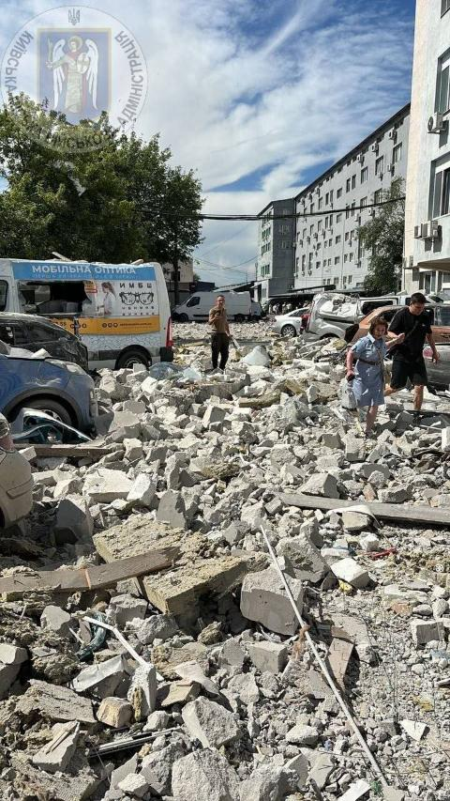
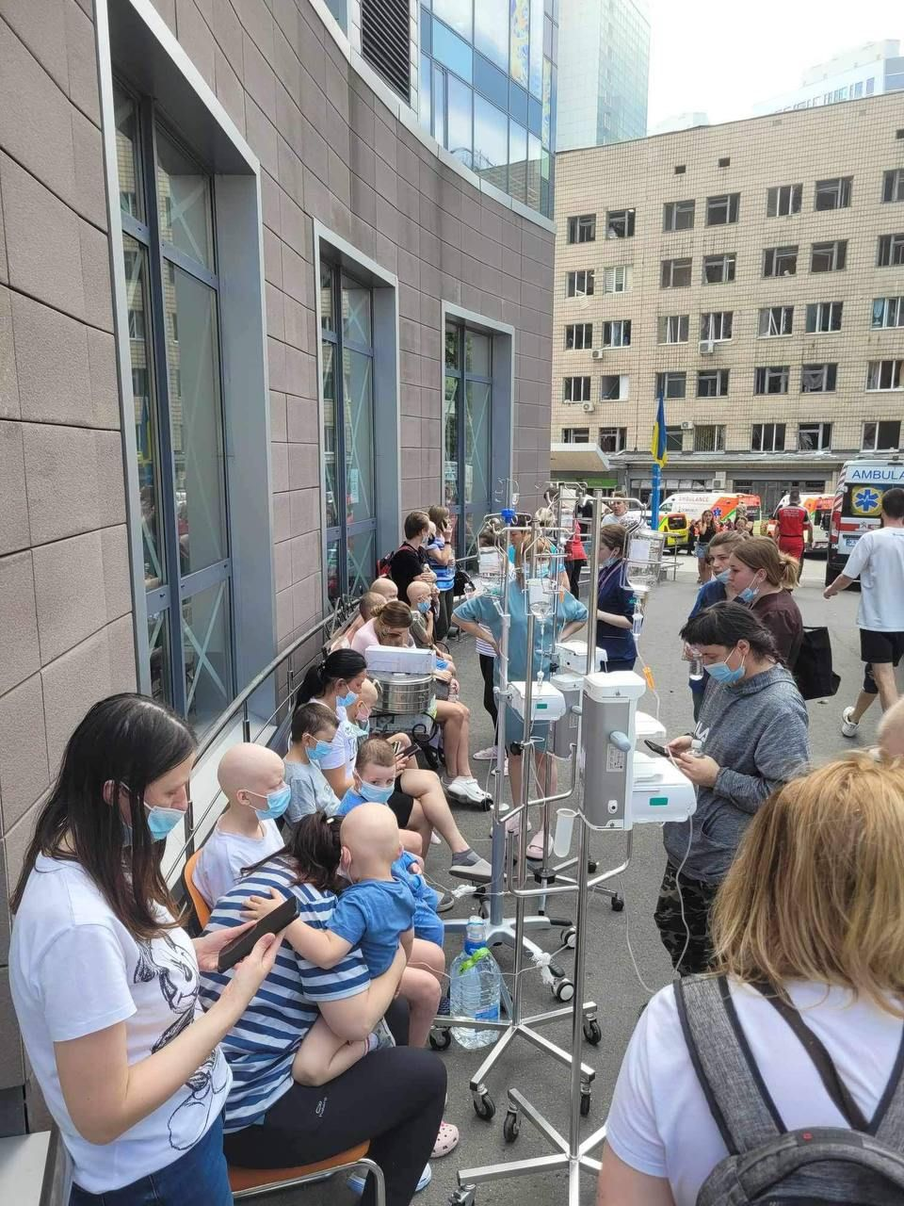

Slide 10
Isaiah 13:9-11: “See, the day of the Lord is coming—a cruel day, with wrath and fierce anger—to make the land desolate and destroy the sinners within it.¹⁰ The stars of heaven and their constellations will not show their light. The rising sun will be darkened and the moon will not give its light.¹¹ I will punish the world for its evil, the wicked for their sins. I will put an end to the arrogance of the haughty and will humble the pride of the ruthless.”

Slide 11
Look at verses 11-12. “¹¹ Since everything will be destroyed in this way, what kind of people ought you to be? You ought to live holy and godly lives ¹² as you look forward to the day of God and speed its coming.^{[b]} That day will bring about the destruction of the heavens by fire, and the elements will melt in the heat.”

Slide 12
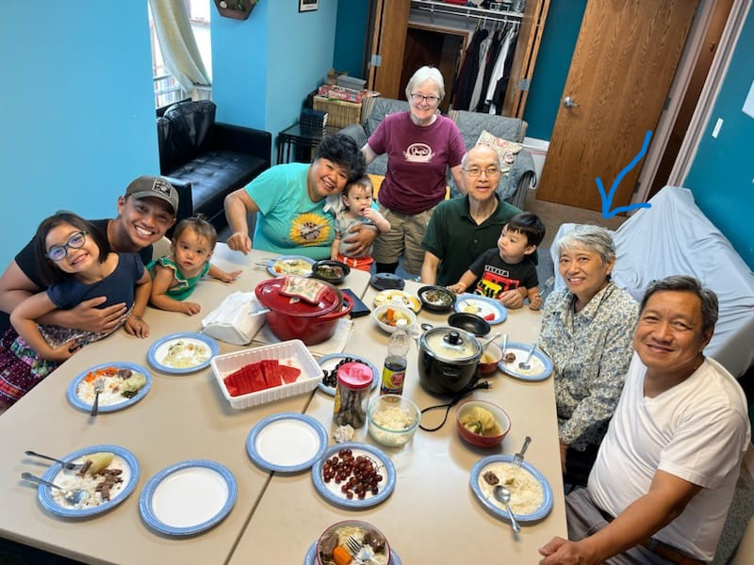

Slide 14
Look at verse 13. “¹³ But in keeping with his promise we are looking forward to a new heaven and a new earth, where righteousness dwells.”

Slide 15
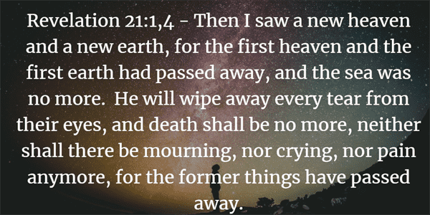

Slide 17
Look at verse 14. “¹⁴ So then, dear friends, since you are looking forward to this, make every effort to be found spotless, blameless and at peace with him.”

Slide 18
2 Corinthians 7:1 reads, “Since we have these promises, beloved, let us cleanse ourselves from every defilement of body and spirit, bringing holiness to completion in the fear of God.”

Slide 19
Hebrews 12:14 reads, “Strive for peace with everyone, and for the holiness without which no one will see the Lord.”

Slide 20
Look at verses 15-16. “¹⁵ Bear in mind that our Lord’s patience means salvation, just as our dear brother Paul also wrote you with the wisdom that God gave him. ¹⁶ He writes the same way in all his letters, speaking in them of these matters. His letters contain some things that are hard to understand, which ignorant and unstable people distort, as they do the other Scriptures, to their own destruction.”

Slide 21
Romans 2:4 reads, “Or do you show contempt for the riches of his kindness, tolerance and patience, not realizing that God’s kindness leads you toward repentance.”

Slide 22
Look at verses 17-18. “¹⁷ Therefore, dear friends, since you have been forewarned, be on your guard so that you may not be carried away by the error of the lawless and fall from your secure position. ¹⁸ But grow in the grace and knowledge of our Lord and Savior Jesus Christ. To him be glory both now and forever! Amen.”

Slide 23
Psalm 119:105, “Your word is a lamp to my feet and a light for my path.”

Slide 24
Ephesians 2:8-10 reads, “For by grace you have been saved through faith. And this is not your own doing; it is the gift of God, not a result of works, so that no one may boast. For we are his workmanship, created in Christ Jesus for good works, which God prepared beforehand, that we should walk in them.”

Slide 25
Verse 18b. “To him be glory both now and forever! Amen.”

Slide 26
1 Corinthians 10:31, “³¹ So, whether you eat or drink, or whatever you do, do all to the glory of God.”

Slide 27
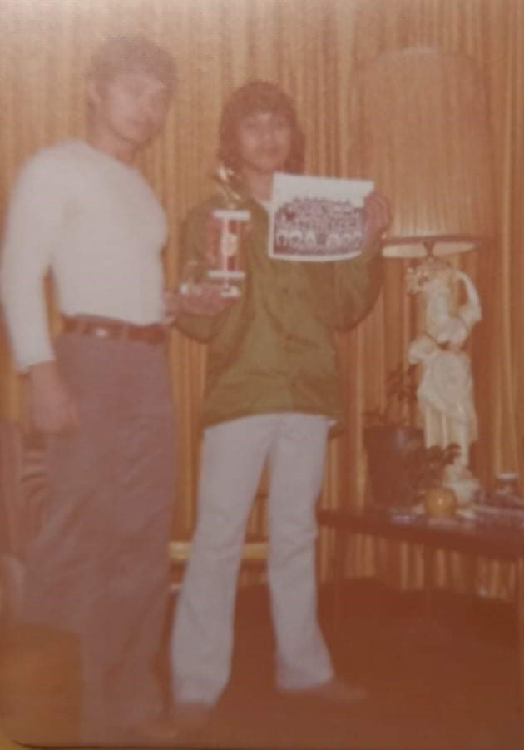
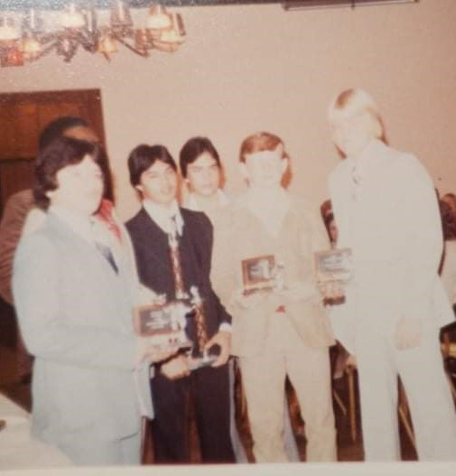

Slide 28
Key Verses:11-12: “¹¹ Since everything will be destroyed in this way, what kind of people ought you to be? You ought to live holy and godly lives ¹² as you look forward to the day of God and speed its coming.^{[b]} That day will bring about the destruction of the heavens by fire, and the elements will melt in the heat.”

