Slide 1
2 Thessalonians 2:1-12 (NASB) ¹For you yourselves know, brothers and sisters, that our ^{[a]}reception among you was not in vain, ² but after we had already suffered and been treated abusively in Philippi, as you know, we had the boldness in our God to speak to you the gospel of God ^{[b]}amid much ^{[c]}opposition.

Slide 2
³ For our exhortation does not come from error or impurity or ^{[d]}by way of deceit; ⁴ but just as we have been approved by God to be entrusted with the gospel, so we speak, not intending to please people, but to please God, who ^{[e]}examines our hearts. ⁵ For we never came ^{[f]}with flattering speech, as you know, nor with a pretext ^{[g]}for greed—God is our witness—

Slide 3
⁶ nor did we seek honor from people, either from you or from others, though ^{[h]}we could have ^{[i]}asserted our authority as apostles of Christ. ⁷ But we ^{[j]}proved to be ^{[k]}gentle ^{[l]}among you. As a nursing mother ^{[m]}tenderly cares for her own children, ⁸ in the same way we had a fond affection for you and were delighted to share with you not only the gospel of God, but also our own ^{[n]}lives, because you had become ^{[o]}very dear to us.

Slide 4
⁹ For you recall, brothers and sisters, our labor and hardship: it was by working night and day so as not to be a burden to any of you, that we proclaimed to you the gospel of God. ¹⁰ You are witnesses, and so is God, of how devoutly and rightly and blamelessly we ^{[p]}behaved toward you ^{[q]}believers;

Slide 5
¹¹ just as you know how we were exhorting and encouraging and imploring each one of you as a father would his own children, ¹² so that you would walk in a manner worthy of the God who calls you into His own kingdom and glory.

Slide 6
God’s People Entrusted with the Gospel (Not Just for Church Leaders) 1 Thessalonians 2:1-12 Key Verse: 4: ^{“4} …but just as we have been approved by God to be entrusted with the gospel, so we speak, not intending to please people, but to please God, who ^{[e]}examines our hearts.”

Slide 7
Acts 16:22-24 reads, “²² The crowd joined in an attack against them, and the chief magistrates tore their robes off them and proceeded to order them to be beaten with rods. ²³ When they had struck them with many blows, they threw them into prison, commanding the jailer to guard them securely; ²⁴and he, having received such a command, threw them into the inner prison and fastened their feet in the stocks.”

Slide 8
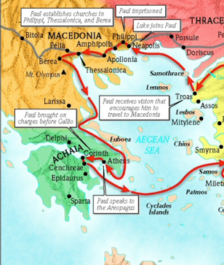

Slide 9
Acts 17:5 reads, “⁵ But the Jews, becoming jealous and taking along some wicked men from the marketplace, formed a mob and set the city in an uproar; and they attacked the house of Jason and were seeking to bring them out to the people.”

Slide 10
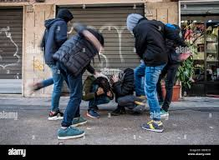

Slide 11
Look at verses 1-2. “For you yourselves know, brothers and sisters, that our ^{[a]}reception among you was not in vain, ² but after we had already suffered and been treated abusively in Philippi, as you know, we had the boldness in our God to speak to you the gospel of God ^{[b]}amid much ^{[c]}opposition.”

Slide 12
Look at verses 3-4. “³ For our exhortation does not come from error or impurity or ^{[d]}by way of deceit; ⁴ but just as we have been approved by God to be entrusted with the gospel, so we speak, not intending to please people, but to please God, who ^{[e]}examines our hearts.”

Slide 13
1 Thessalonians 1:10, “…and to wait for his Son from heaven, whom he raised from the dead—Jesus, who rescues us from the coming wrath.”

Slide 14
Acts 17:4 reads, “⁴ And some of them were persuaded and joined Paul and Silas, ^{[f]}along with a large number of the God-fearing Greeks and ^{[g]}a significant number of the leading women.”

Slide 15
Look at verse 4 again. “⁴ but just as we have been approved by God to be entrusted with the gospel, so we speak, not intending to please people, but to please God, who ^{[e]}examines our hearts.”

Slide 16
Acts 9:15, “But the Lord said to Ananias, Go! This man is my chosen instrument to carry my name before the Gentiles and their kings and before the people of Israel.”

Slide 17
2 Timothy 2:15 reads, “¹⁵ Be diligent to present yourself approved to God as a worker who does not need to be ashamed, accurately handling the word of truth.”

Slide 18
Look at verses 5-6a. “⁵ For we never came ^{[f]}with flattering speech, as you know, nor with a pretext ^{[g]}for greed—God is our witness— ⁶ nor did we seek honor from people, either from you or from others…”

Slide 19
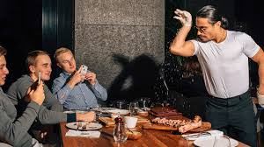

Slide 20
John 5:41-45 reads, “⁴¹ I do not receive glory from people; ⁴² but I know you, that you do not have the love of God in yourselves. ⁴³ I have come in My Father’s name, and you do not receive Me; if another comes in his own name, you will receive him. ⁴⁴ How can you believe, when you accept glory from one another and you do not seek the glory that is from the one and only God? ⁴⁵ Do not think that I will accuse you before the Father; the one who accuses you is Moses, in whom you have put your hope.”

Slide 21
Look at verses 6b-8. “…though ^{[h]}we could have ^{[i]}asserted our authority as apostles of Christ. ⁷ But we ^{[j]}proved to be ^{[k]}gentle ^{[l]}among you. As a nursing mother ^{[m]}tenderly cares for her own children, ⁸ in the same way we had a fond affection for you and were delighted to share with you not only the gospel of God, but also our own ^{[n]}lives, because you had become ^{[o]}very dear to us.”

Slide 22
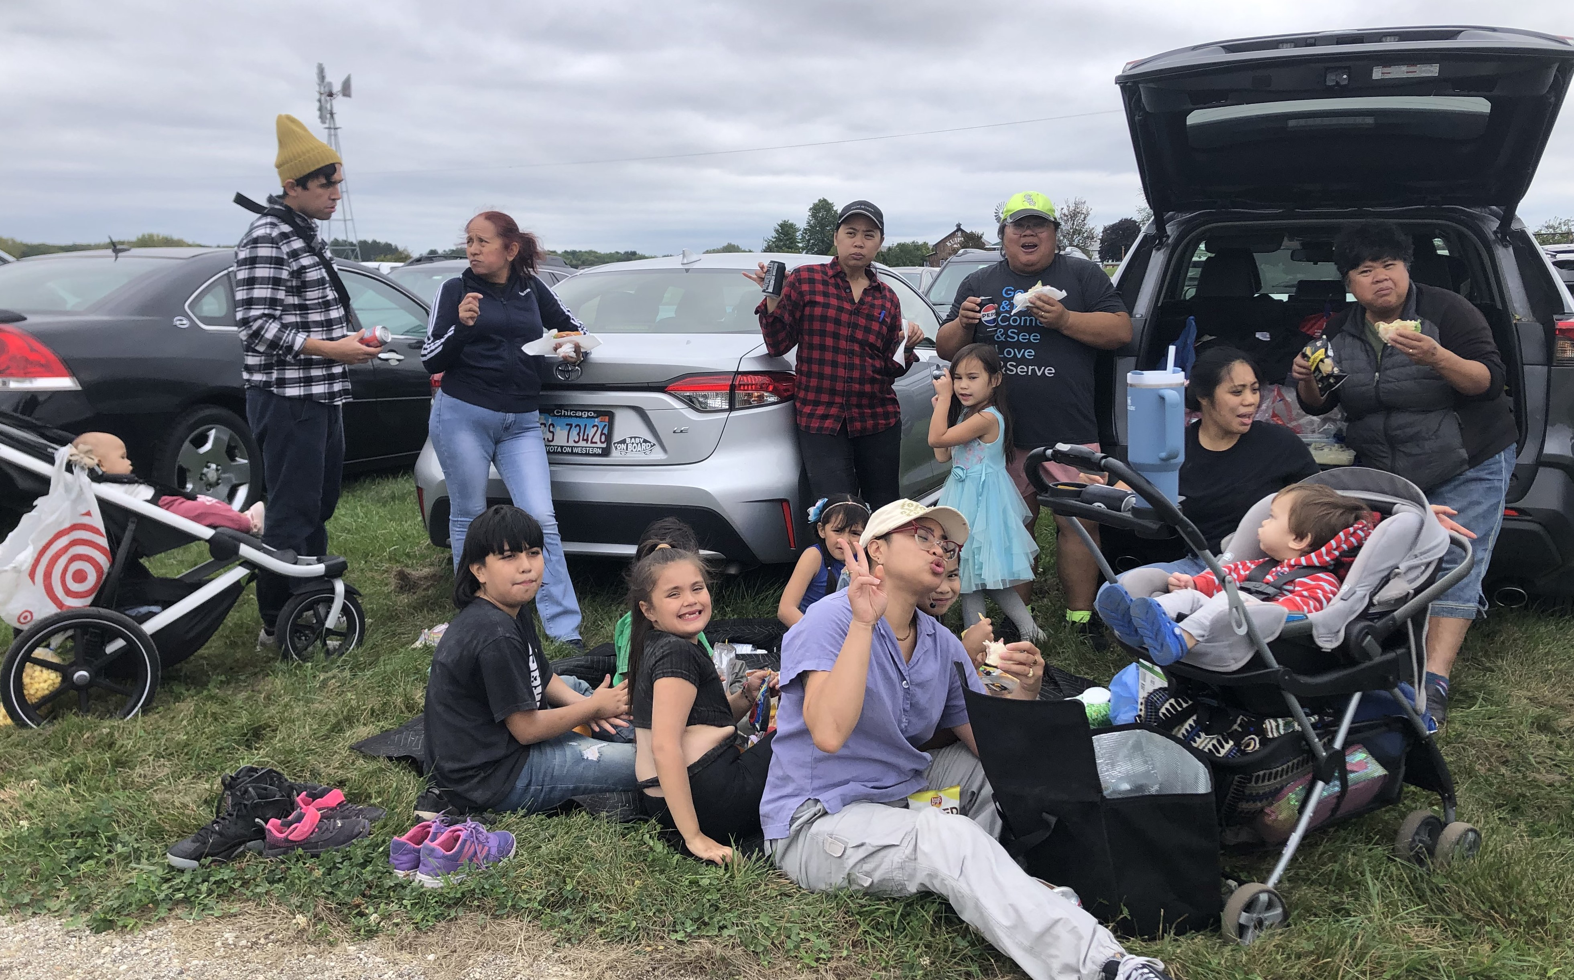

Slide 23
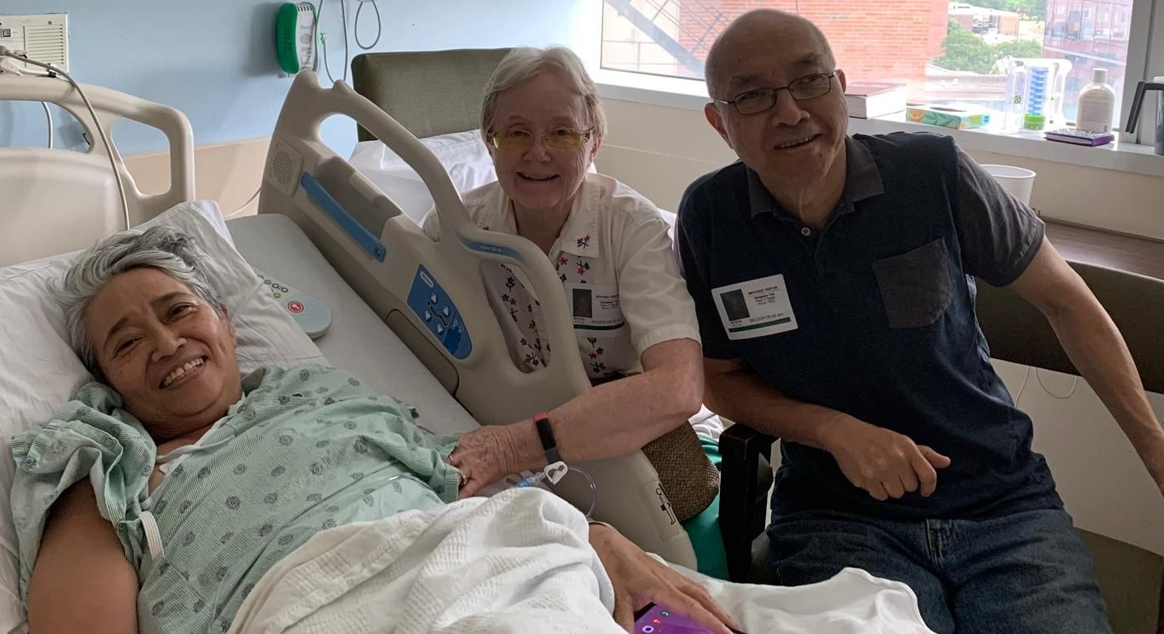

Slide 24
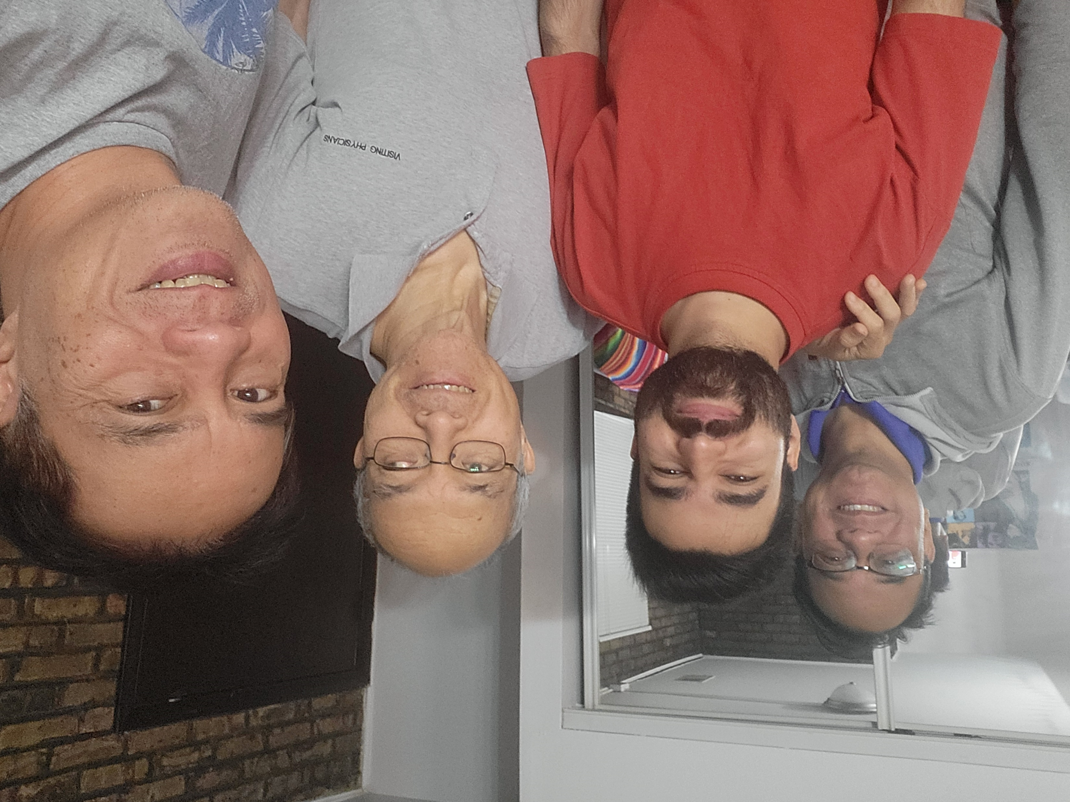

Slide 25
Look at verses 9-10. “⁹ For you recall, brothers and sisters, our labor and hardship: it was by working night and day so as not to be a burden to any of you, that we proclaimed to you the gospel of God. ¹⁰ You are witnesses, and so is God, of how devoutly and rightly and blamelessly we ^{[p]}behaved toward you ^{[q]}believers…”

Slide 26
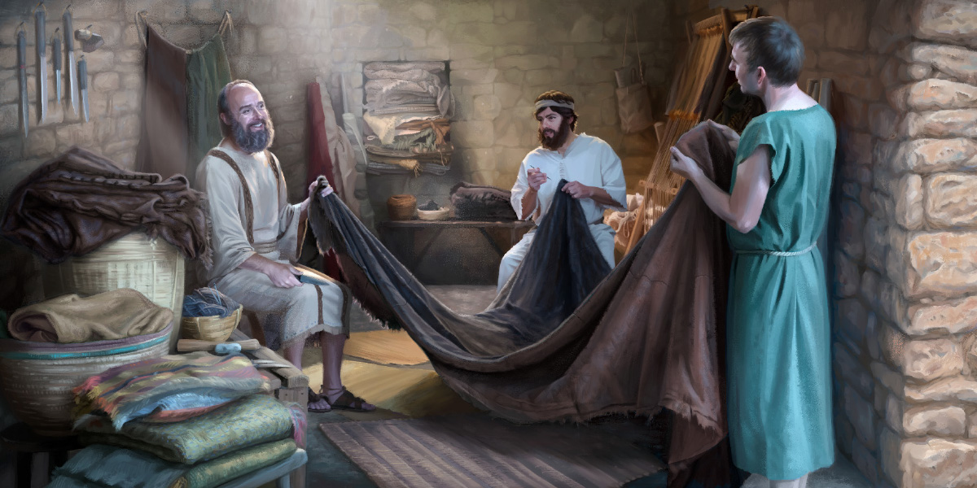

Slide 27
1 Corinthians 9:3-6 reads, “³ My defense to those who examine me is this: ^{4 [a]}Do we not have a right to eat and drink? ^{5 [b]}Do we not have a right to take along a ^{[c]}believing wife, even as the rest of the apostles and the brothers of the Lord, and ^{[d]}Cephas? ⁶ Or do only ^{[e]}Barnabas and I have no right to refrain from ^{[f]}working?”

Slide 28
Look at verses 11-12. “…¹¹ just as you know how we were exhorting and encouraging and imploring each one of you as a father would his own children, ¹² so that you would walk in a manner worthy of the God who calls you into His own kingdom and glory.”

Slide 29
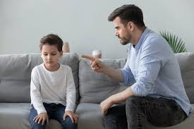

Slide 30
Hebrews 12:7-11 reads, “⁷ It is for discipline that you endure; God deals with you as with sons; for what son is there whom his father does not discipline? ⁸ But if you are without discipline, of which all have become partakers, then you are illegitimate children and not sons. ⁹ Furthermore, we had earthly fathers to discipline us, and we respected them; shall we not much more be subject to the Father of ^{[e]}spirits, and live? ¹⁰ For they disciplined us for a short time as seemed best to them, but He disciplines us for our good, so that we may share His holiness. ¹¹ For the moment, all discipline seems not to be pleasant, but painful; yet to those who have been trained by it, afterward it yields the peaceful fruit of righteousness.”

