Slide 1
1 Thessalonians 1:1-10: Paul, Silas and Timothy, To the church of the Thessalonians in God the Father and the Lord Jesus Christ: Grace and peace to you. ² We always thank God for all of you and continually mention you in our prayers. ³ We remember before our God and Father your work produced by faith, your labor prompted by love, and your endurance inspired by hope in our Lord Jesus Christ. ⁴ For we know, brothers and sisters loved by God, that he has chosen you, ⁵ because our gospel came to you not simply with words but also with power, with the Holy Spirit and deep conviction. You know how we lived among you for your sake.

Slide 2
⁶ You became imitators of us and of the Lord, for you welcomed the message in the midst of severe suffering with the joy given by the Holy Spirit. ⁷ And so you became a model to all the believers in Macedonia and Achaia. ⁸ The Lord’s message rang out from you not only in Macedonia and Achaia—your faith in God has become known everywhere. Therefore we do not need to say anything about it, ⁹ for they themselves report what kind of reception you gave us. They tell how you turned to God from idols to serve the living and true God, ¹⁰ and to wait for his Son from heaven, whom he raised from the dead—Jesus, who rescues us from the coming wrath.

Slide 3
The Encouraging Faith of the Thessalonian Believers 1 Thessalonians 1:1-10 Key Verse:3: “We remember before our God and Father your work produced by faith, your labor prompted by love, and your endurance inspired by hope in our Lord Jesus Christ.”

Slide 4
Look at verse 1a. “Paul, Silas and Timothy, To the church of the Thessalonians...”

Slide 5
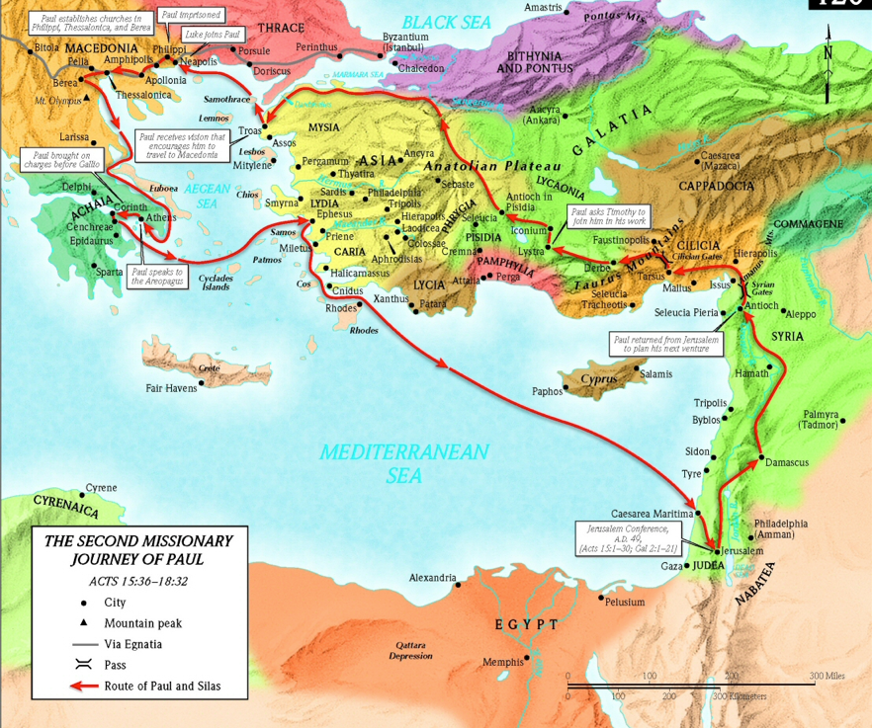

Slide 7
Acts 16:5, “⁵ So the churches were strengthened in the faith and grew daily in numbers.”

Slide 8
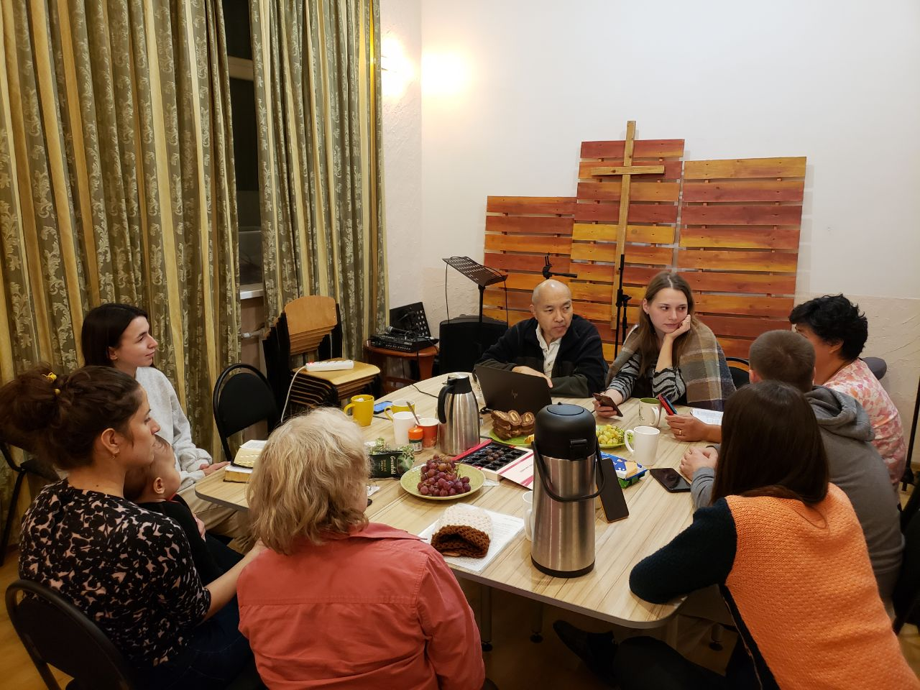
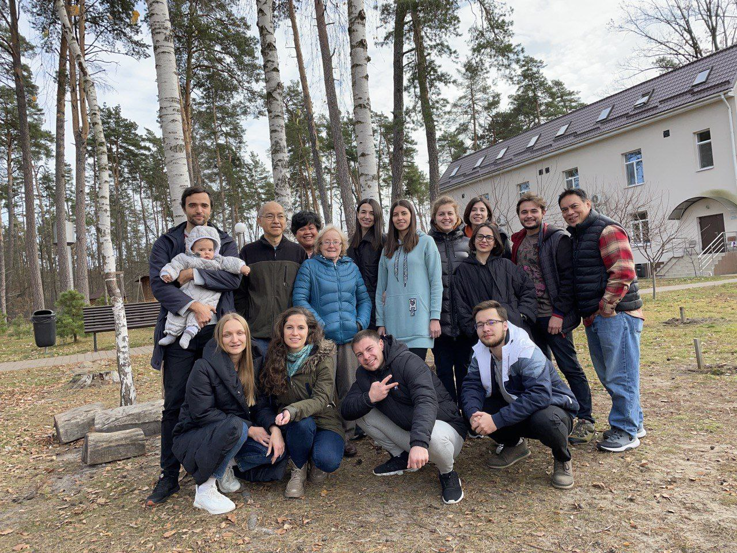

Slide 10
Acts 16:9-10 reads, “⁹ During the night Paul had a vision of a man of Macedonia standing and begging him, ‘Come over to Macedonia and help us.’ ¹⁰ After Paul had seen the vision, we got ready at once to leave for Macedonia, concluding that God had called us to preach the gospel to them.”

Slide 11
Look at verse 1. “Paul, Silas^{[a]} and Timothy, To the church of the Thessalonians in God the Father and the Lord Jesus Christ: Grace and peace to you.”

Slide 12
Look at verses 2-3. “² We always thank God for all of you and continually mention you in our prayers. ³ We remember before our God and Father your work produced by faith, your labor prompted by love, and your endurance inspired by hope in our Lord Jesus Christ.”

Slide 14
Look at verse 3 again. “³ We remember before our God and Father your work produced by faith, your labor prompted by love, and your endurance inspired by hope in our Lord Jesus Christ.”

Slide 15
James 2:17-18 reads, “In the same way, faith by itself, if is not accompanied by action, is dead. But someone will say, ‘You have faith; I have deeds.’ Show me your faith without deeds, and I will show you my faith by what I do.”

Slide 16
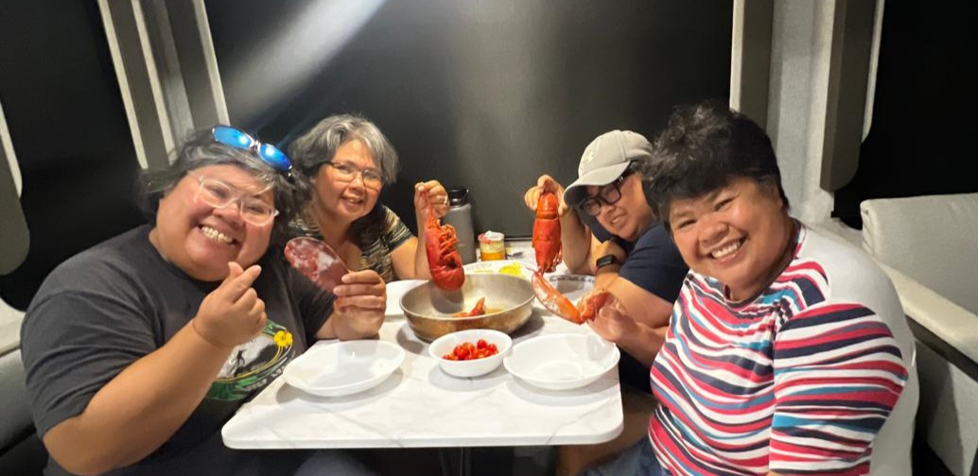

Slide 17
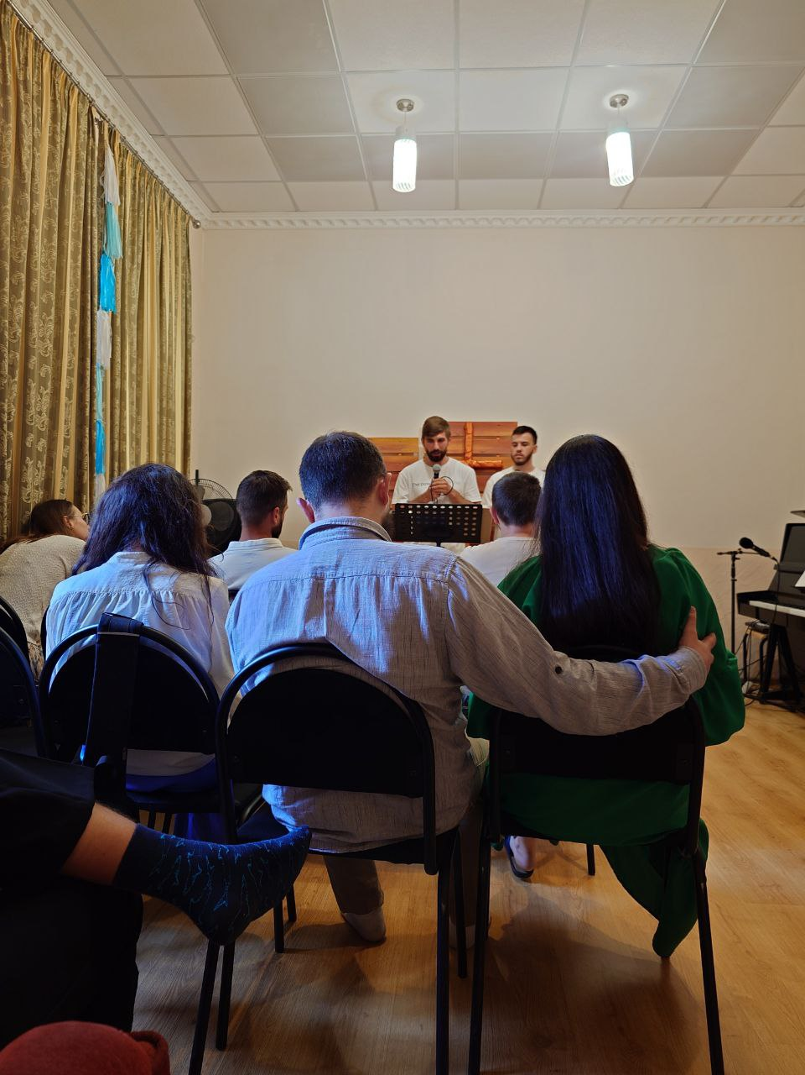
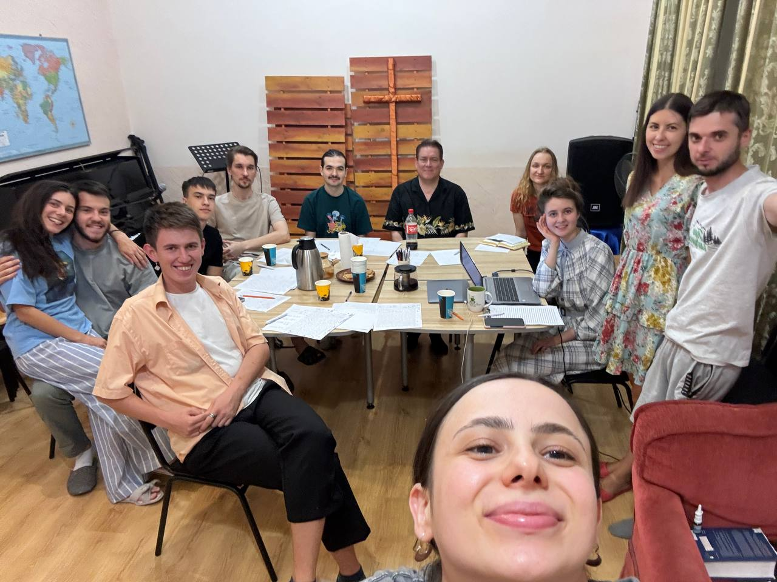

Slide 18
Look at verses 4-5. “⁴ For we know, brothers and sisters^{[b]} loved by God, that he has chosen you, ⁵ because our gospel came to you not simply with words but also with power, with the Holy Spirit and deep conviction. You know how we lived among you for your sake.”

Slide 19
John 15:16a, “You did not choose me, but I chose you and appointed you to go and bear fruit—fruit that will last.”

Slide 20
Look at verses 6-7. “⁶ You became imitators of us and of the Lord, for you welcomed the message in the midst of severe suffering with the joy given by the Holy Spirit. ⁷ And so you became a model to all the believers in Macedonia and Achaia.”

Slide 21
Second Corinthians 8:1-5, “And now brothers, we want you to know about the grace that God has given the Macedonian churches. Out of the most severe trial, their overflowing joy and their extreme poverty welled up in rich generosity. For I testify that they gave as much as they were able, and even beyond their ability. Entirely on their own, they urgently pleaded with us for the privilege of sharing in this service to the saints: And they did not do as we expected, but they gave themselves first to the Lord and then to us in keeping with God’s will.”

Slide 22
Look at verses 8-9. “⁸ The Lord’s message rang out from you not only in Macedonia and Achaia—your faith in God has become known everywhere. Therefore we do not need to say anything about it, ⁹ for they themselves report what kind of reception you gave us. They tell how you turned to God from idols to serve the living and true God…”

Slide 24
Luke 9:23, “Then he said to them all, ‘If anyone would come after me, he must deny himself and take up his cross daily and follow me.’”

Slide 25
Look at verse 10. “¹⁰…and to wait for his Son from heaven, whom he raised from the dead—Jesus, who rescues us from the coming wrath.”

Slide 26
Second Corinthians 5:10 reads, “For we must all appear before the judgment seat of Christ, that each one may receive what is due him for the things done while in the body, whether good or bad.”

