Slide 1
Love and Justice (Ps 101:1-8)
SINGS
“I will sing of your love and justice; to you, Lord, I will sing praise” (Ps 101:1). 11/3/24.
Of David. A psalm. Sat, 6/22/24
“I will sing of your love and justice; to you, Lord, I will sing praise” (Psalm 101:1).

Slide 2
A Blameless Life (Ps 101:1-8).
CONDUCT
“I will be careful to lead a blameless life—when will you come to me? I will conduct the affairs of my house with a blameless heart” (Ps 101:2). 6/22, 11/3/24.
Of David. A psalm. Sat, 6/22/24
“I will sing of your love and justice; to you, Lord, I will sing praise” (Psalm 101:1).

Slide 3
The Life of Integrity
Psalm 101:1-4
Psalm 101:5-8
Vertical/God
Inward/Internal
Private/Personal
In your own house
Who you are
Horizontal/Man
Outward/External
Public/Practice
In the world
What you do

Slide 4
Who are you? What do you do?

Slide 5
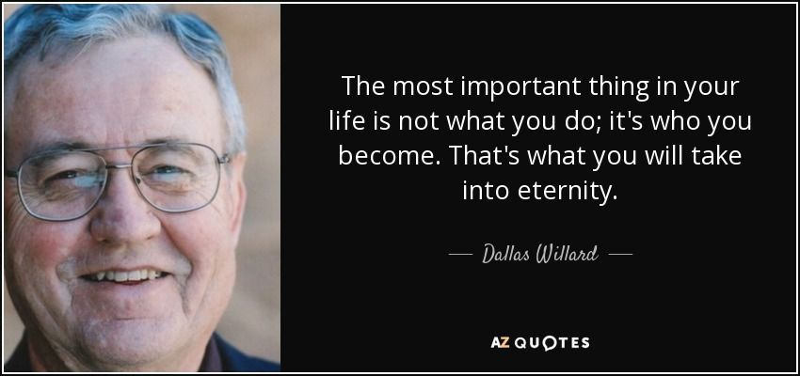
So….is what you do the most important thing in your life?

Slide 6
Ben Toh

Slide 7
1. Blameless in Private (101:1-4).
Of David. A psalm.
¹ I will sing of your love and justice; to you, Lord, I will sing praise.
² I will be careful to lead a blameless life—when will you come to me? I will conduct the affairs of my house with a blameless heart.
³ I will not look with approval on anything that is vile. I hate what faithless people do; I will have no part in it.
⁴ The perverse of heart shall be far from me; I will have nothing to do with what is evil.

Slide 8
2. Blameless in Practice (101:5-8).
⁵ Whoever slanders their neighbor in secret, I will put to silence; whoever has haughty eyes and a proud heart, I will not tolerate.
⁶ My eyes will be on the faithful in the land, that they may dwell with me; the one whose walk is blameless will minister to me.
⁷ No one who practices deceit will dwell in my house; no one who speaks falsely will stand in my presence.
⁸ Every morning I will put to silence all the wicked in the land; I will cut off every evildoer from the city of the Lord.

Slide 9
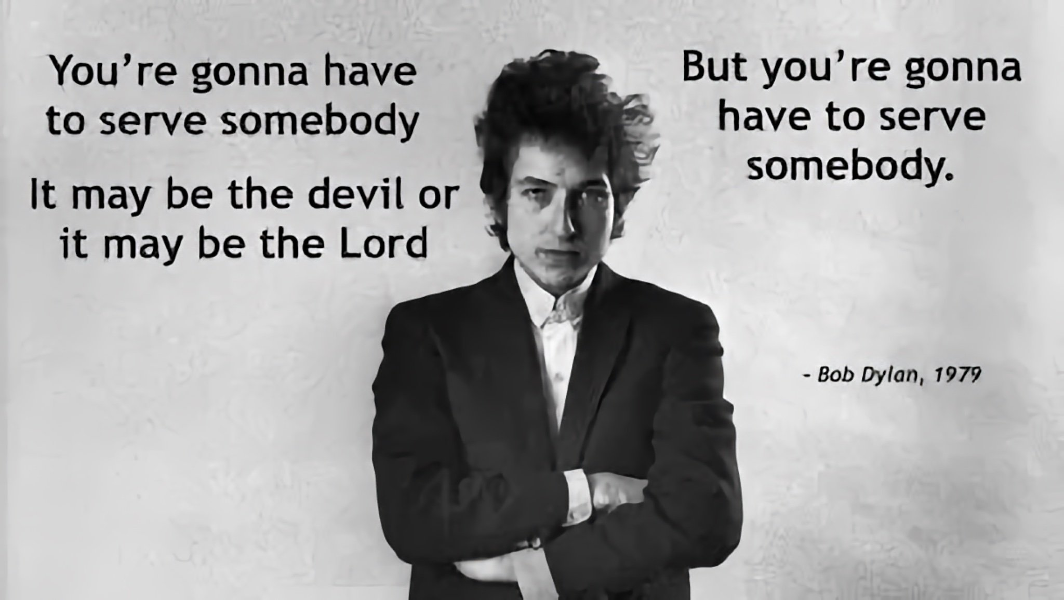
Who are you living for? Who are you serving? Can you just serve yourself or serve no one?

Slide 10
How to conduct yourself in the Cross of Christ
* “I will sing of your love and justice…” (101:1).
1. “Sing” love and justice together. Eph 5:19
* “I will be careful to lead a blameless life” (101:2).
2. “Be perfect as…” (Mt 5:48; 2 Cor 10:5).
* “I will not look…on anything that is vile” (101:3a).
3. Watch your eyes. “The eye is the lamp of the body. If your eyes are healthy, your whole body will be full of light. But if your eyes are unhealthy, your whole body will be full of darkness. If then the light within you is darkness, how great is that darkness!” (Mt 6:22-23).

Slide 11
Conducting yourself in the Cross of Christ...
* “I hate what faithless people do” (Ps 101:3b ff).
4. Shun bad company (1 Cor 15:33). Ps 1:1-2. Pr 1:10.
* “My eyes will be on the faithful in the land…” (101:6a).
5. Love God’s people. “Show proper respect to everyone, love the family of believers, fear God, honor the emperor” (1 Pet 2:17).
“Therefore, as we have opportunity, let us do good to all people, especially to those who belong to the family of believers” (Gal 6:10).
* “…the one whose walk is blameless will minister to me” (101:6b).
6. Walk blamelessly. 7. *** Irony.
Sin causes sorrow (Ps 13:2), guilt (Ps 38:1-4) and loss of joy (Ps 51:8, 12).

Slide 12
How Psalm 101 points to Christ
* “I will be careful to lead a blameless life” (Psalm 101:2).
1. Jesus is perfectly blameless without sin.
“For we do not have a high priest who is unable to empathize with our weaknesses, but we have one who has been tempted in every way, just as we are—yet he did not sin” (Heb 4:15).
* “I will cut off every evildoer from the city of the Lord” (8).
2. Jesus was cut off from God as an evildoer so that we may enter in.

Slide 13
How Psalm 101 points to Christ
* “I will sing of your love and justice…” (Ps 101:1).
3. Jesus sang God’s justice with tears and blood.
“When they had sung a hymn, they went out to the Mount of Olives” (Mt 26:30; Mk 14:26).
4. Jesus sang on his way to his execution because...
“The Lord your God is with you, the Mighty Warrior who saves. He will take great delight in you; in his love he will no longer rebuke you, but will rejoice over you with singing” (Zeph 3:17).

Slide 15
“…his eyes were like blazing fire” (Rev 1:14; 19:12).
Jesus’ eyes are on you who are faithful.
“…his eyes were like blazing fire” (Rev 1:14; 19:12).

Slide 16
Conducting yourself in the Cross of Christ...
* “I will sing of your love and justice…” (101:1).
1. Justice “sings” and loves [the unbearable].
* “I will be careful to lead a blameless life” (101:2).
2. “Be perfect as…” (Mt 5:48; 2 Cor 10:5).
* “I will not look…on anything that is vile” (101:3a).
3. Watch your eyes. “The eye is the lamp of the body. If your eyes are healthy, your whole body will be full of light. But if your eyes are unhealthy, your whole body will be full of darkness. If then the light within you is darkness, how great is that darkness!” (Mt 6:22-23).

Slide 17
How Psalm 101 points to Christ
“I will sing of your love and justice..I will cut off every evildoer” (101:1, 8).
1. Jesus loves and also judges. “the Father judges no one, but has entrusted all judgment to the Son” (Jn 5:22).
“I will be careful to lead a blameless life.” “I will have nothing to do with what is evil.” (101:2, 4).
2. Jesus is perfectly blameless without sin.
“For we do not have a high priest who is unable to empathize with our weaknesses, but we have one who has been tempted in every way, just as we are—yet he did not sin” (Heb 4:15).
“My eyes will be on the faithful in the land” (101:6).
3. Jesus’ eyes are on the faithful.
“…his eyes were like blazing fire” (Rev 1:14; 19:12).

Slide 18
The 5 books of the Psalms
Book I (1-41): Confrontation.
Book II (42-72/31): Communication.
Book III (73-89/17): Catastrophe/Devastation.
Book IV (90-106/17):
Consecration/Maturation.
Book V (107-150/44): Consummation.

Slide 19
“The Lord reigns” (Ps 93:1; 97:1; 99:1)
90: Eternity. “…from everlasting to everlasting you are God” (90:2).
91: Safety. “Whoever dwells in the shelter of the Most High will rest in the shadow of the Almighty” (91:1).
92: Praise. “It is good to praise the Lord” (92:1).
93: King. “Your throne was established…from all eternity” (93:2).
94: Judge. “Rise up, Judge of the earth: (94:2).
95: Listen. “Today, if only you would hear his voice” (95:7).
96: Worthy. “For great is the Lord and most worthy of praise” (96:3).
97: Formidable. “you are exalted far above all gods” (97:9).
98: Ruler. “He will judge the world in righteousness” (98:9).
99: Holiness. “God is holy” (99:3, 5, 9).
100: Gratitude. “Know that the Lord is God” (100:3).

