Slide 1
1 Thessalonians 2:13-20 ¹³ And we also thank God continually because, when you received the word of God, which you heard from us, you accepted it not as a human word, but as it actually is, the word of God, which is indeed at work in you who believe. ¹⁴ For you, brothers and sisters, became imitators of God’s churches in Judea, which are in Christ Jesus: You suffered from your own people the same things those churches suffered from the Jews

Slide 2
¹⁵ who killed the Lord Jesus and the prophets and also drove us out. They displease God and are hostile to everyone ¹⁶ in their effort to keep us from speaking to the Gentiles so that they may be saved. In this way they always heap up their sins to the limit. The wrath of God has come upon them at last. ¹⁷ But, brothers and sisters, when we were orphaned by being separated from you for a short time (in person, not in thought), out of our intense longing we made every effort to see you.

Slide 3
¹⁸ For we wanted to come to you—certainly I, Paul, did, again and again—but Satan blocked our way. ¹⁹ For what is our hope, our joy, or the crown in which we will glory in the presence of our Lord Jesus when he comes? Is it not you? ²⁰ Indeed, you are our glory and joy.

Slide 4
ACCEPT GOD’S WORD AS GOD’S WORD 1 Thessalonians 2:13-20 Key Verse:13: “And we also thank God continually because, when you received the word of God, which you heard from us, you accepted it not as a human word, but as it actually is, the word of God, which is indeed at work in you who believe.”

Slide 5
Look at verse 13. “¹³ And we also thank God continually because, when you received the word of God, which you heard from us, you accepted it not as a human word, but as it actually is, the word of God, which is indeed at work in you who believe.”

Slide 6
1 Thessalonians 1:2-3, “We always thank God for all of you, mentioning you in our prayers. We continually remember before our God and Father your work produced by faith, your labor prompted by love, and your endurance inspired by hope in our Lord Jesus Christ.”

Slide 7
Psalm 33:6, “By the word of the Lord were the heavens made, their starry host by the breath of his mouth.”

Slide 8
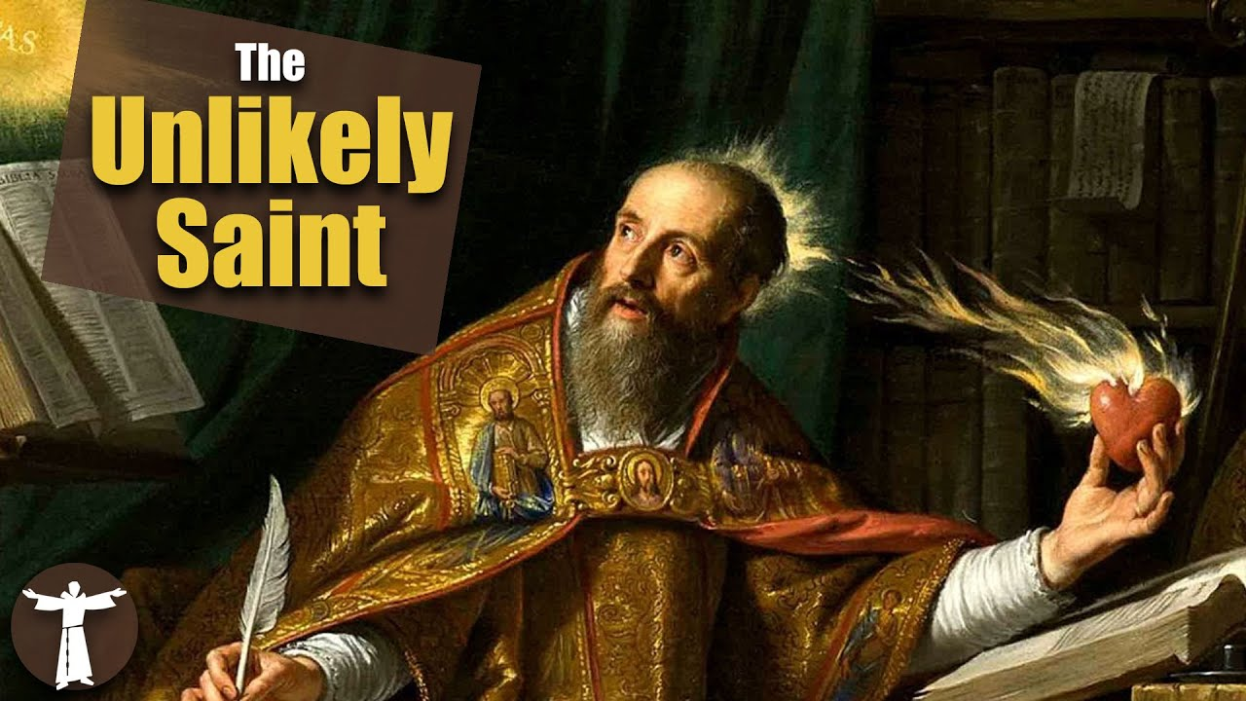

Slide 9
Romans 13:13-14, “Let us behave decently, as in the daytime, not in orgies and drunkenness not in sexual immorality and debauchery, not in dissension and jealousy. Rather, clothe yourselves with Lord Jesus Christ, and do not think about how to gratify the desires of the sinful nature.”

Slide 11
Romans 12:2, “Do not conform any longer to the pattern of this world, but be transformed by the renewing of your mind. Then you will be able to test and approve what God’s will is—his good, pleasing and perfect will.”

Slide 12
Genesis 1:31a, “God saw all that he had made, and it was very good.”

Slide 13
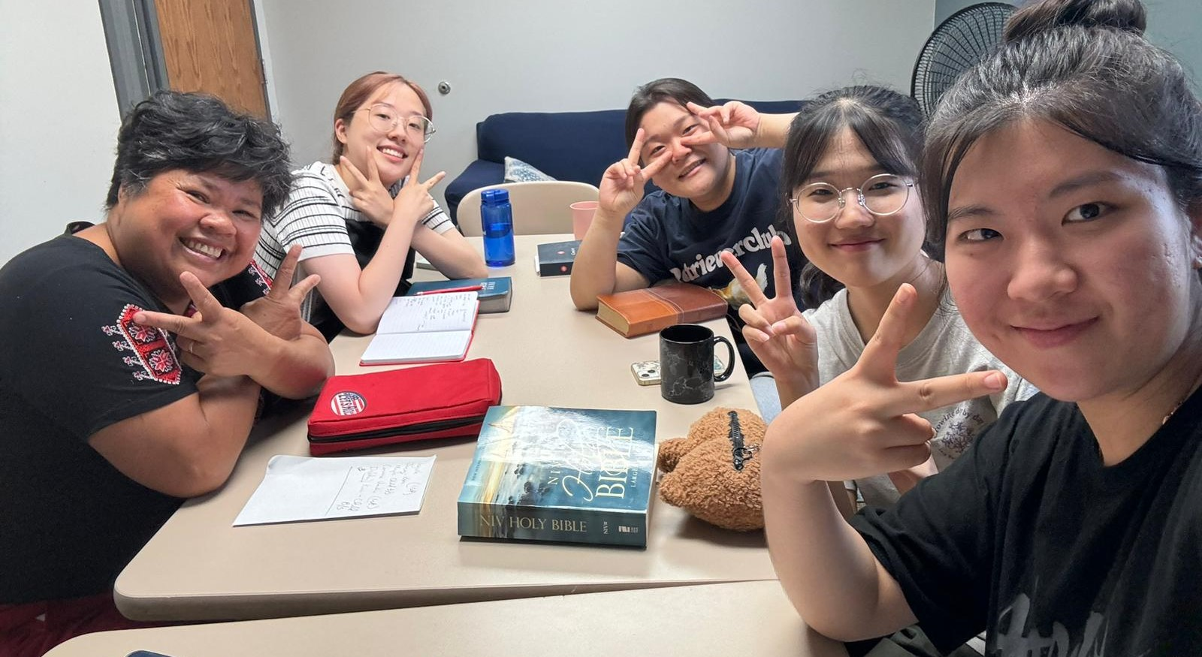

Slide 14
Genesis 35:10, “God said to him, ‘Your name is Jacob, but you will no longer be called Jacob; your name will be Israel.’ So he named him Israel.”

Slide 15
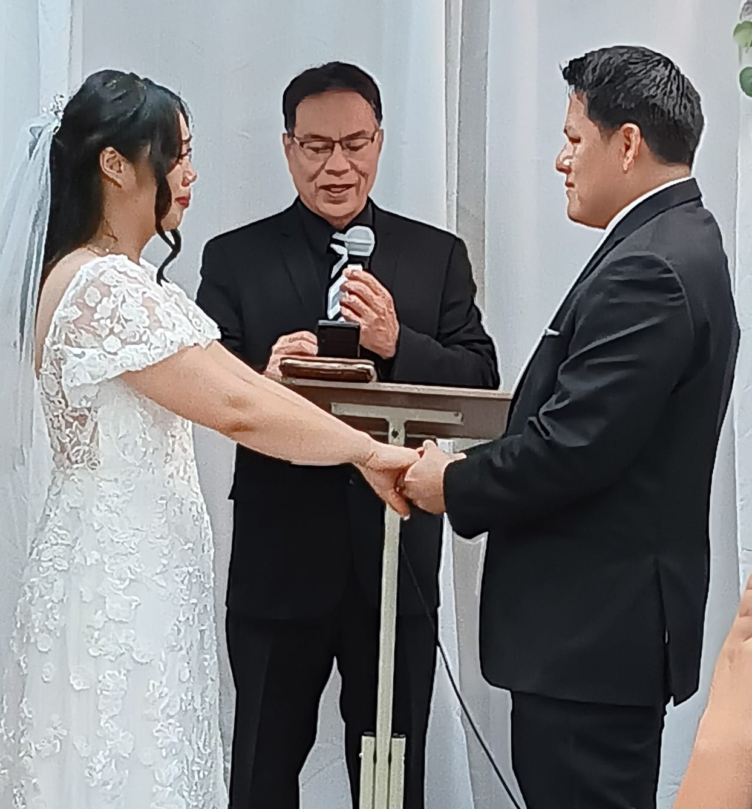
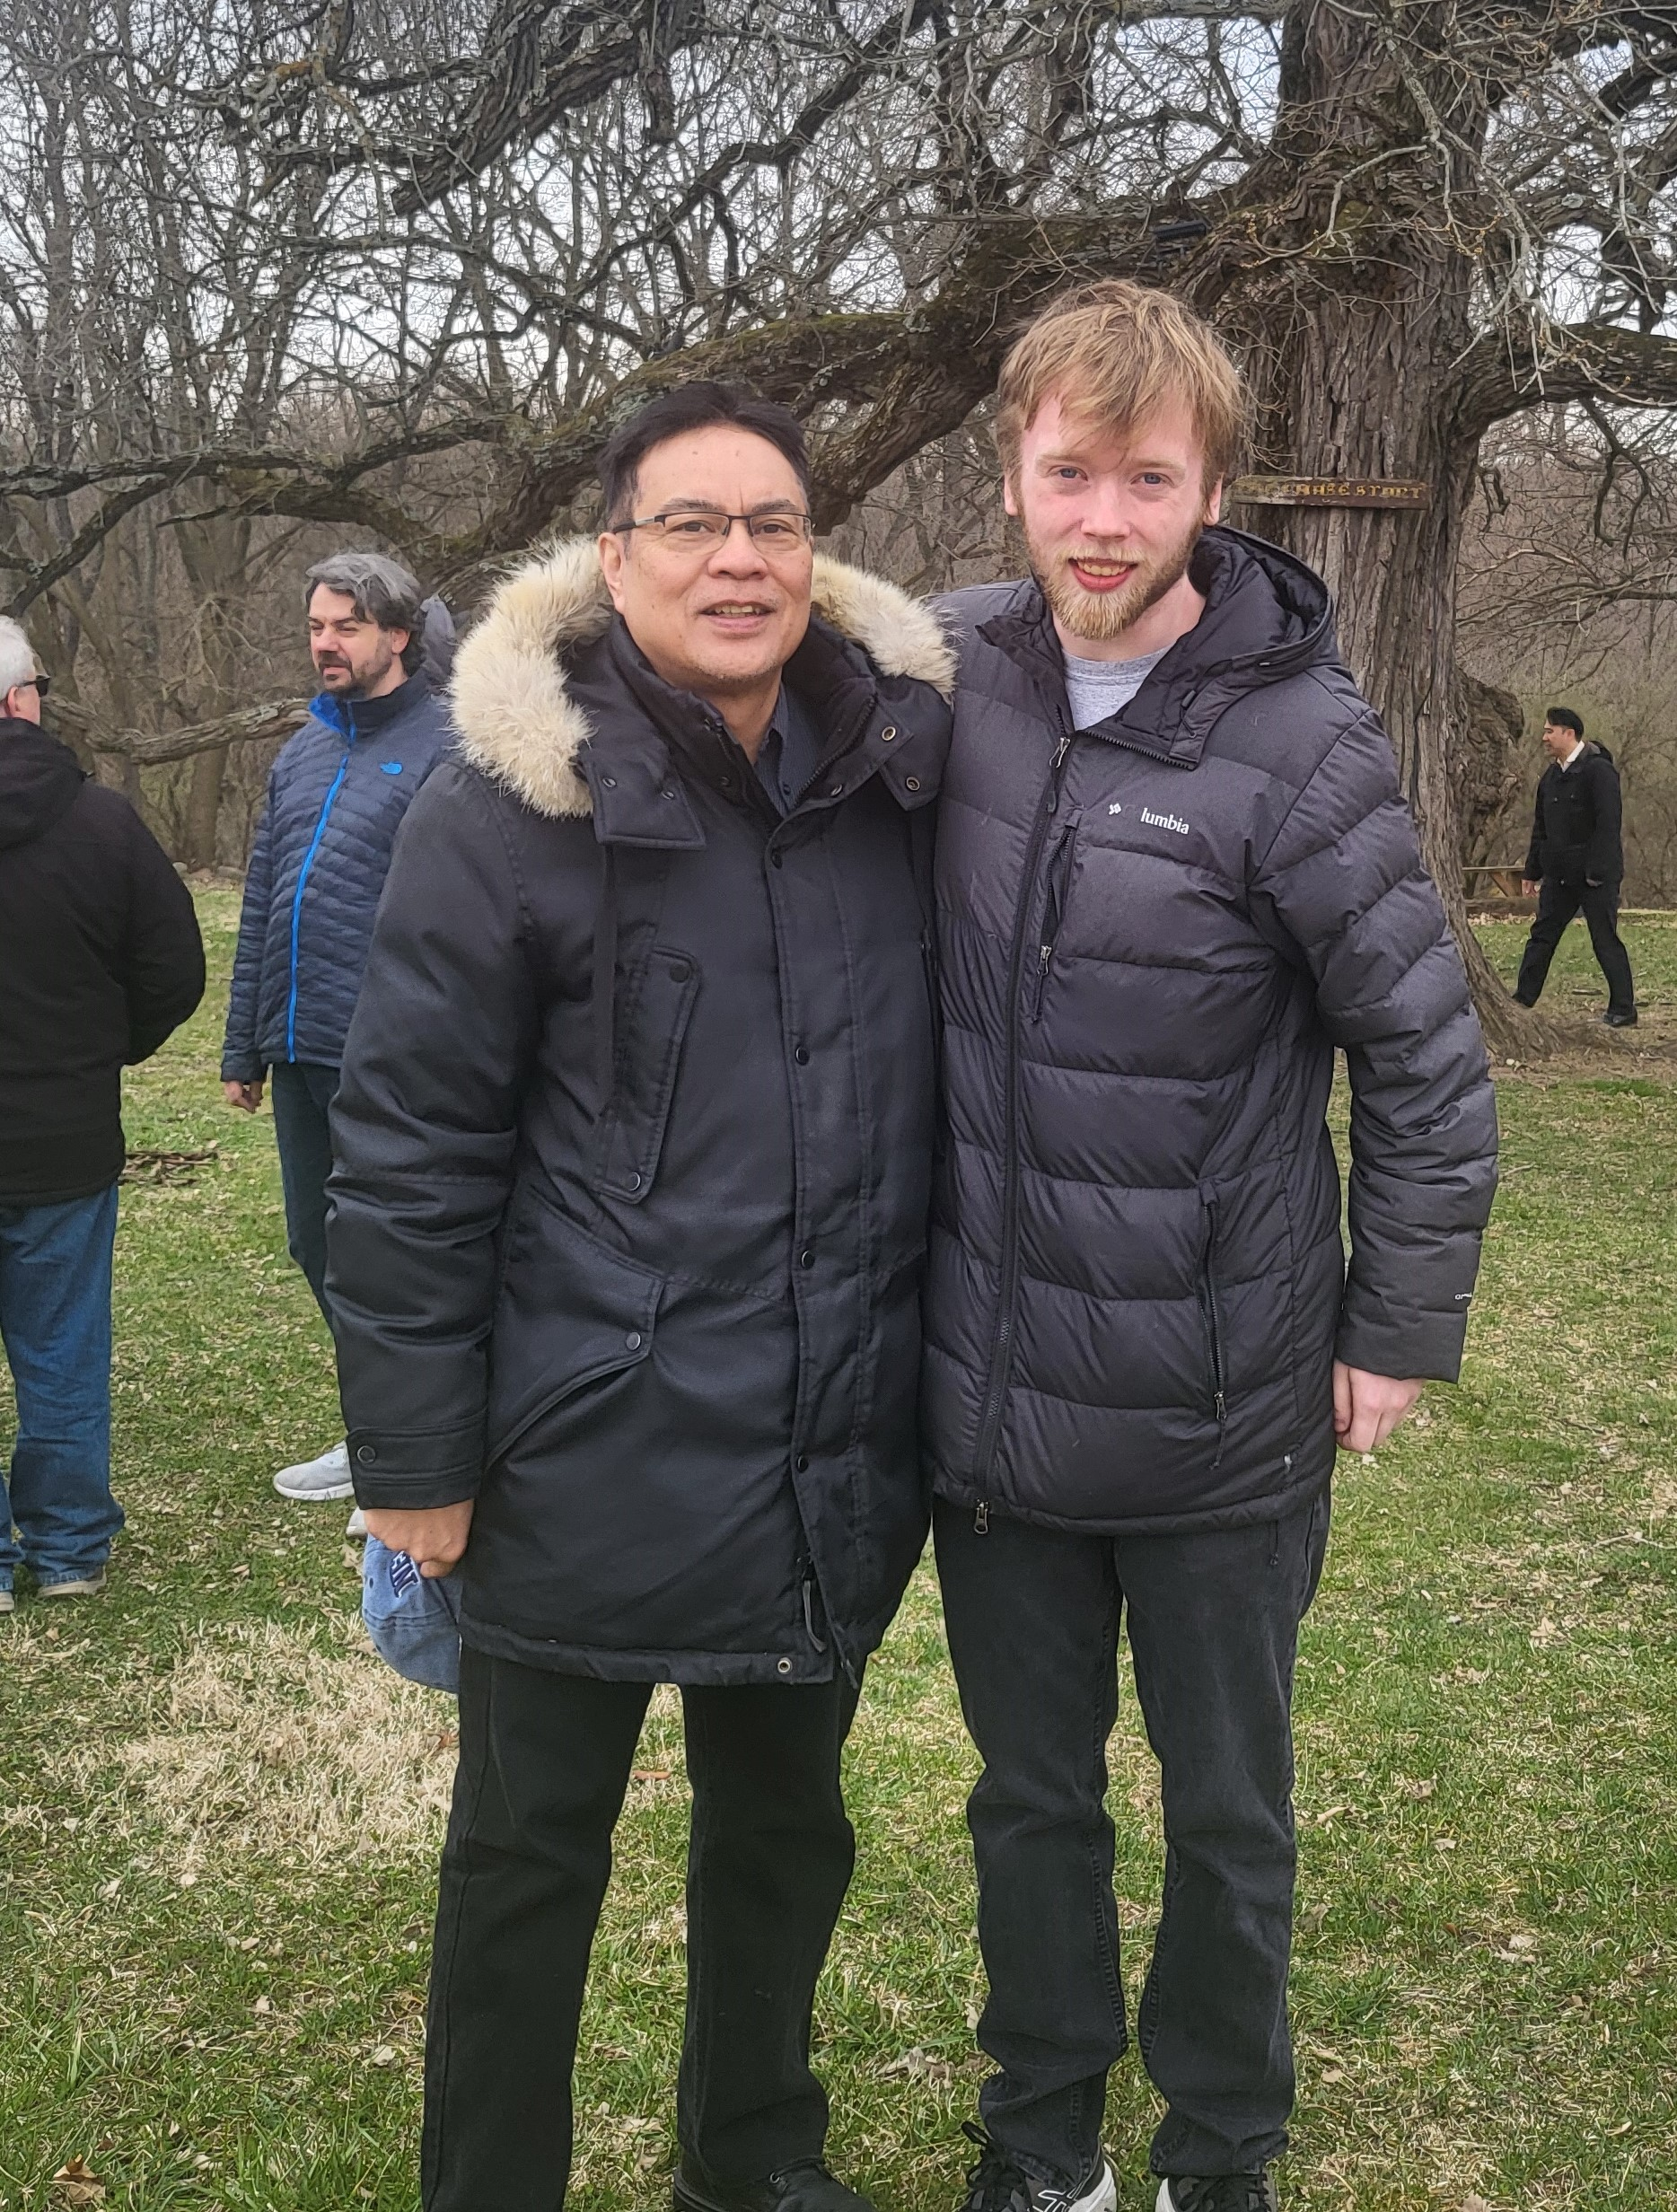
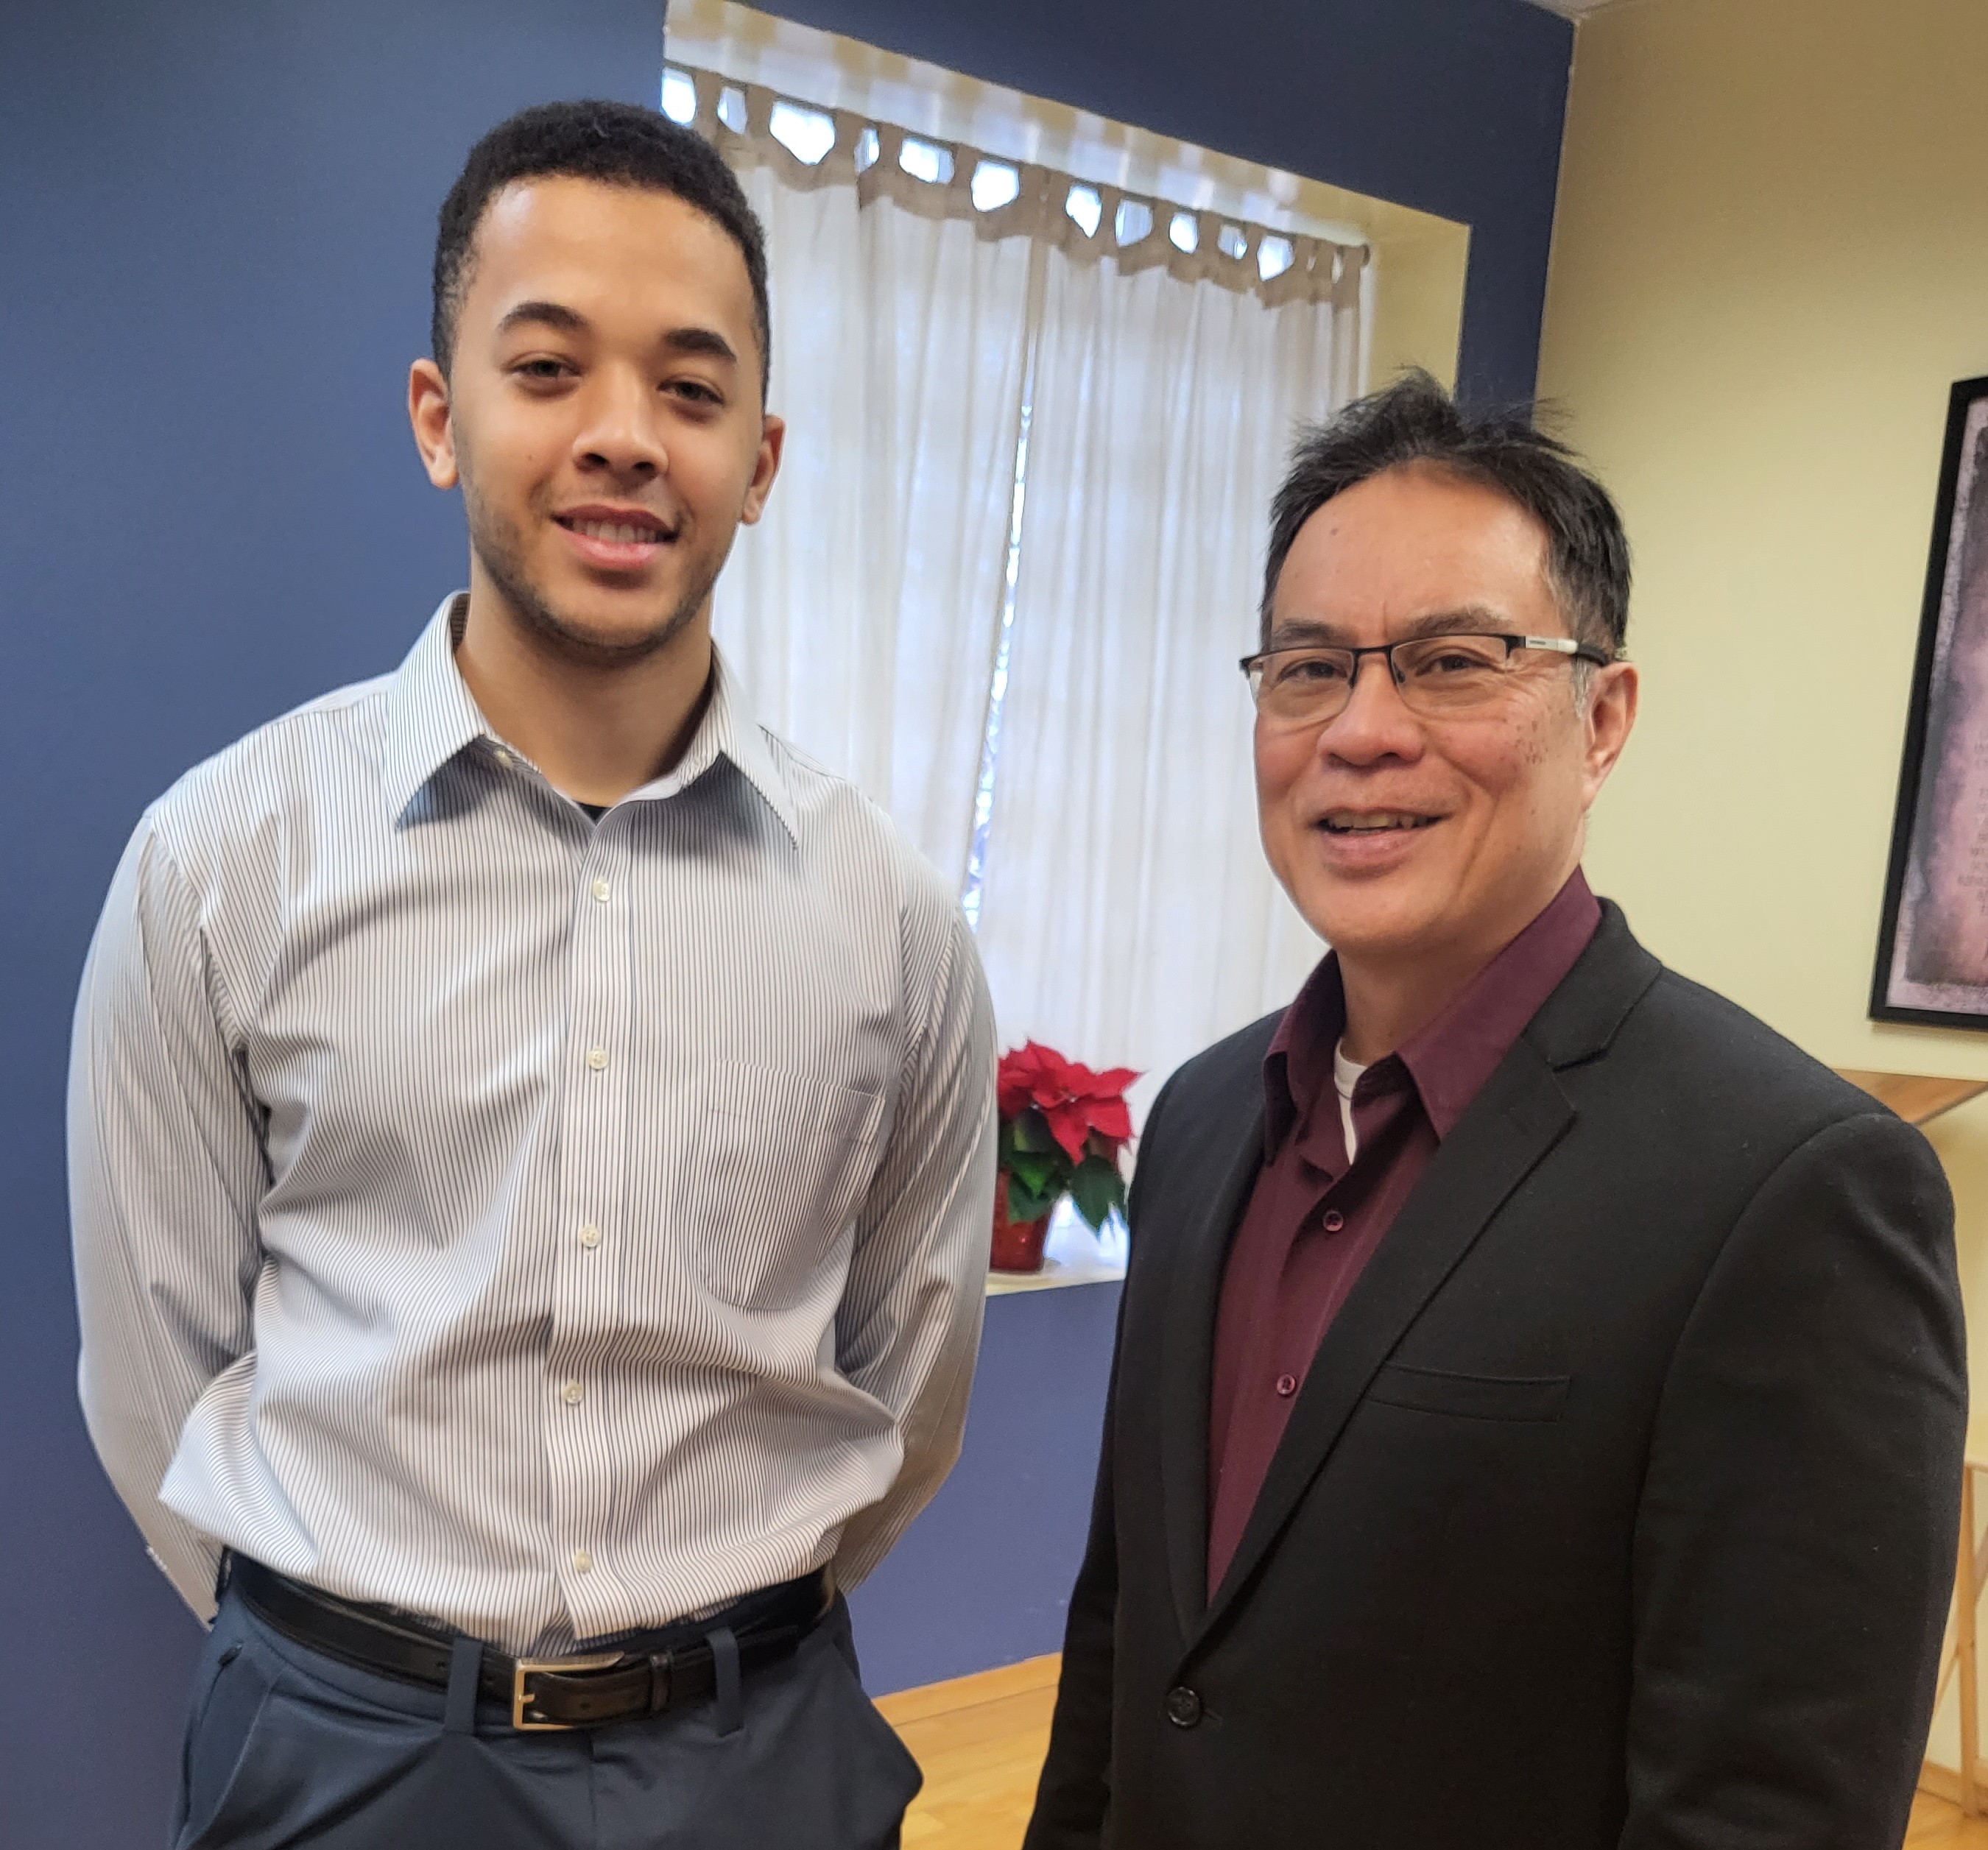

Slide 16
Look at verse 14. “¹⁴ For you, brothers and sisters, became imitators of God’s churches in Judea, which are in Christ Jesus: You suffered from your own people the same things those churches suffered from the Jews…”

Slide 17
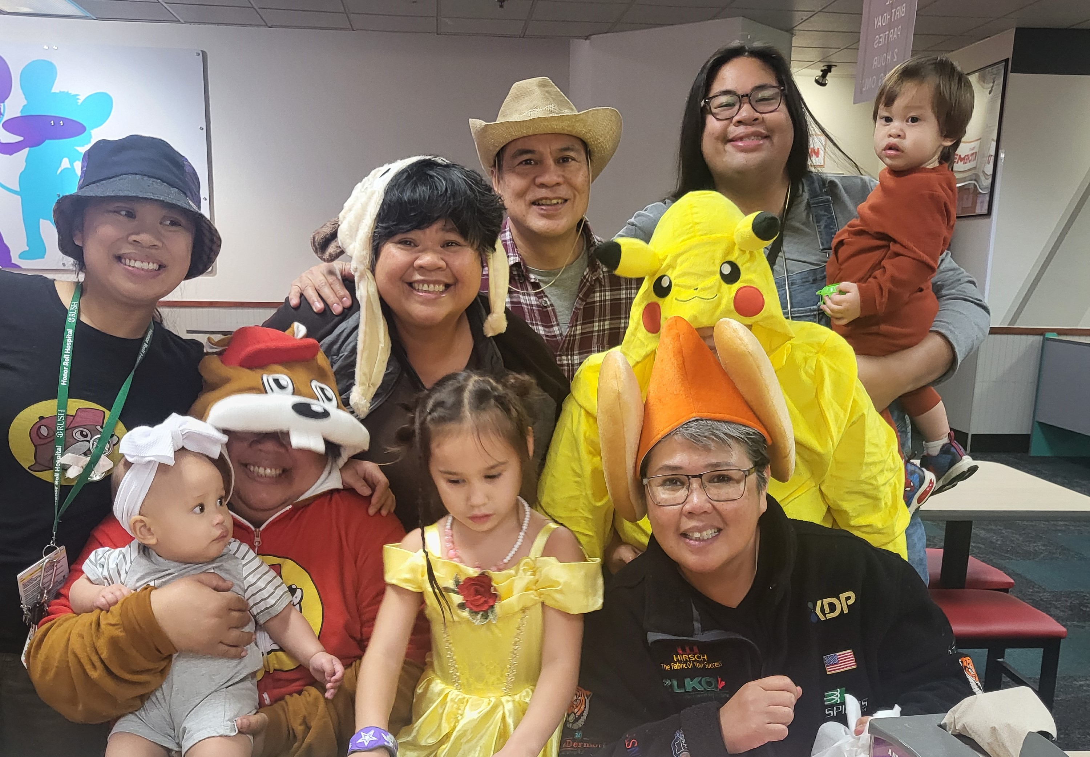

Slide 18
Verse 14b reads, “You suffered from your own people the same things those churches suffered from the Jews…”

Slide 19
Romans 5:3-5 read, “Not only so, but we also rejoice in our sufferings, because we know that suffering produces perseverance; perseverance, character, and character, hope. And hope does not disappoint us, because God has poured out his love into our hearts, by the Holy Spirit, whom he has given us.”

Slide 20
Look at verses 15-16. “¹⁵ who killed the Lord Jesus and the prophets and also drove us out. They displease God and are hostile to everyone ¹⁶ in their effort to keep us from speaking to the Gentiles so that they may be saved. In this way they always heap up their sins to the limit. The wrath of God has come upon them at last.^{[a]”}

Slide 21
Look at verse 17-18. “¹⁷ But, brothers and sisters, when we were orphaned by being separated from you for a short time (in person, not in thought), out of our intense longing we made every effort to see you. ¹⁸ For we wanted to come to you—certainly I, Paul, did, again and again—but Satan blocked our way.”

Slide 22
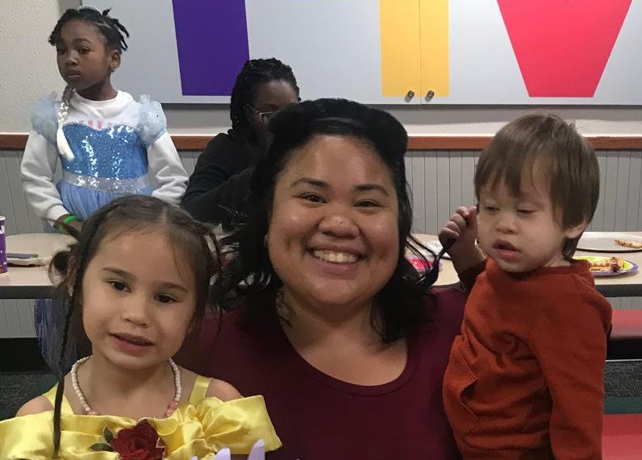

Slide 24
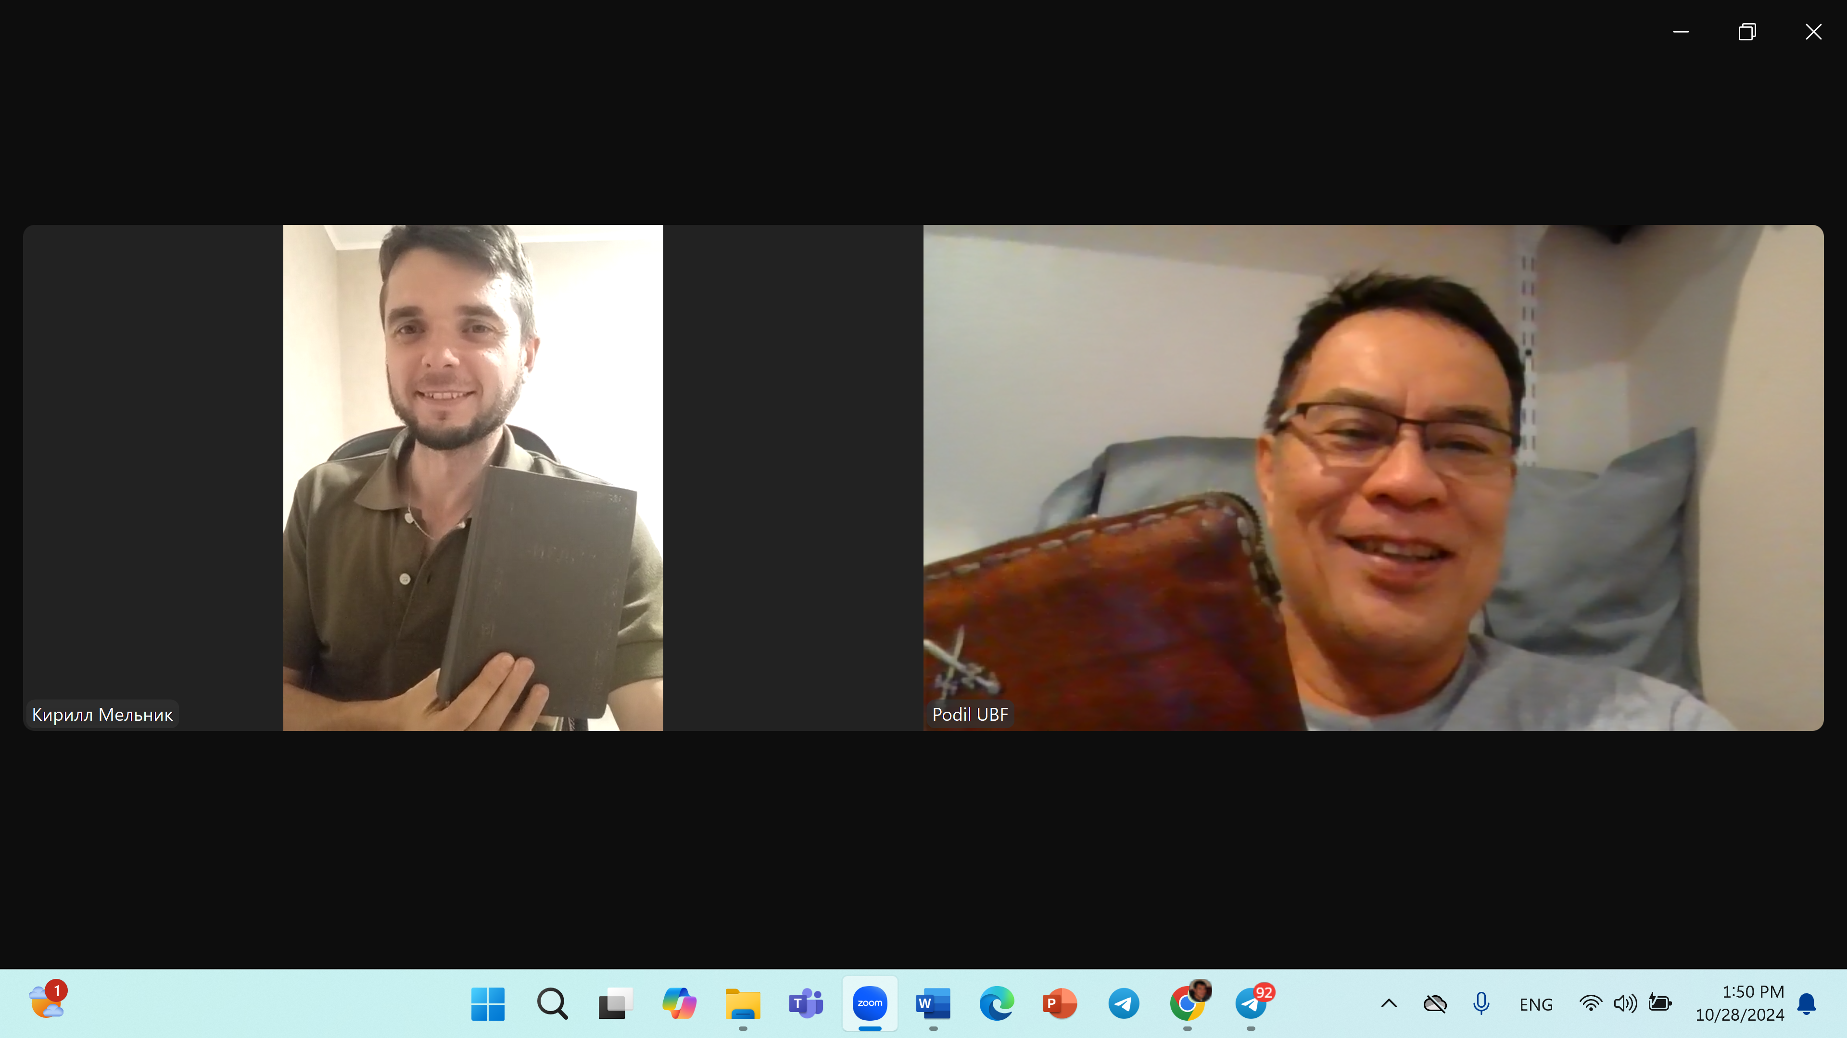

Slide 25
First Corinthians 10:13 reads, “No temptation has seized you except what is common to man. And God is faithful; he will not let you be tempted beyond what you can bear. But when you are tempted, he will also provide a way out so that you can stand under it.”

Slide 26
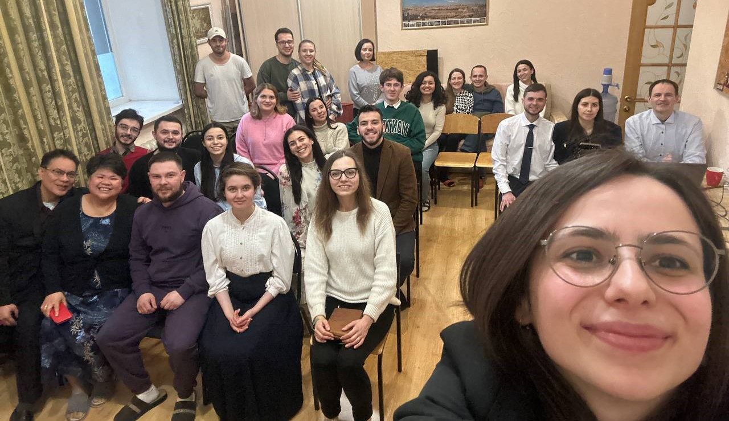
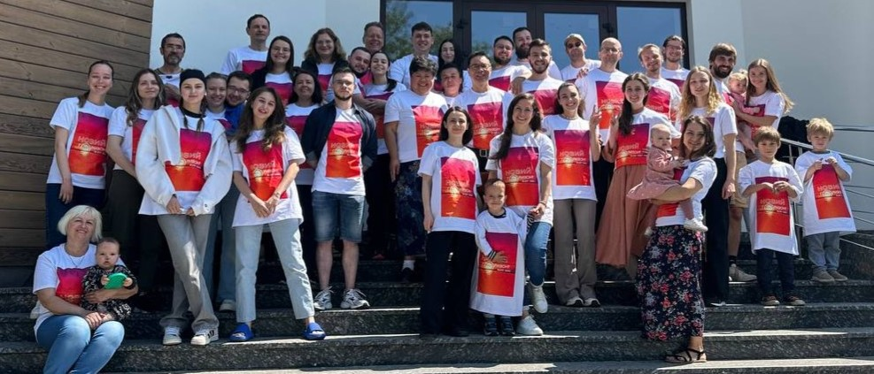

Slide 27
Look at verses 19-20. “¹⁹ For what is our hope, our joy, or the crown in which we will glory in the presence of our Lord Jesus when he comes? Is it not you? ²⁰ Indeed, you are our glory and joy.”

Slide 28
Luke 15:10, “In the same way, I tell you, there is rejoicing in the presence of the angels of God over one sinner who repents.”

Slide 29
2 Corinthians 1:14, “…as you have understood us in part, you can boast of us just as we will boast of you in the day of the Lord Jesus.”

