Slide 1
WORDS12/1/24
POISONOUS DELICACIES
“They make their tongues as sharp as a serpent’s; the poison of vipers is on their lips” (Psalm 140:3).
“Set a guard over my mouth, Lord; keep watch over the door of my lips. …do not let me eat their delicacies” (Ps 141:3, 4).

Slide 2
What happens to the words you speak?
Emily Dickinson (1830-86) is known for her bold original verse, which stands out for its epigrammatic compression, haunting personal voice, and enigmatic brilliance.

Slide 3
We turn not older with years, but newer every day.
If I can stop one heart from breaking, I shall not live in vain;
The Soul selects her own Society—
The Truth must dazzle gradually Or every man be blind —

Slide 4
POISON
Deliver me from Lying Lips (Psalm 140)
“Rescue me, Lord, from evildoers; protect me…” “Keep me safe…” “…may the mischief of their lips engulf them…” “May slanderers not be established…” (Ps 140:1, 4, 9, 11). 11/19/24.
“They make their tongues as sharp as a serpent’s; the poison of vipers is on their lips” (Ps 140:3).

Slide 5
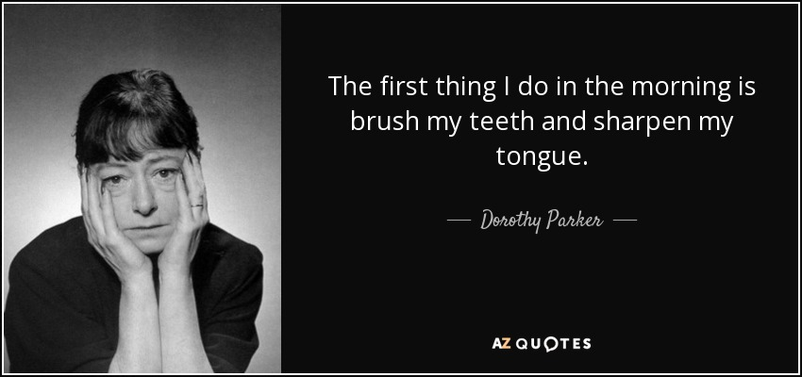
What you hopefully won’t do every morning

Slide 6
You are my God, my strong deliverer (1-13)
1. Poisonous words (1-5).
2. Divine deliverance (6-11).
3. Confident certainty (12-13).

Slide 7
1. Poisonous words (140:1-5).
For the director of music. A psalm of David.
¹ Rescue me, Lord, from evildoers; protect me from the violent,
² who devise evil plans in their hearts and stir up war every day.
³ They make their tongues as sharp as a serpent’s; the poison of vipers is on their lips.
⁴ Keep me safe, Lord, from the hands of the wicked; protect me from the violent, who devise ways to trip my feet.
⁵ The arrogant have hidden a snare for me; they have spread out the cords of their net and have set traps for me along my path.

Slide 8
2. Strong deliverer (140:6-11).
⁶ I say to the Lord, “You are my God.” Hear, Lord, my cry for mercy.
⁷ Sovereign Lord, my strong deliverer, you shield my head in the day of battle.
⁸ Do not grant the wicked their desires, Lord; do not let their plans succeed.
⁹ Those who surround me proudly rear their heads; may the mischief of their lips engulf them.
¹⁰ May burning coals fall on them; may they be thrown into the fire, into miry pits, never to rise.
¹¹ May slanderers not be established in the land; may disaster hunt down the violent.

Slide 9
3. Confident certainty (12-13).
¹² I know that the Lord secures justice for the poor and upholds the cause of the needy.
¹³ Surely the righteous will praise your name, and the upright will live in your presence.

Slide 10
“…the poison of vipers is on their lips” (Psalm 140:3b).
Know that happens when your words are like poison…

Slide 11
DELICACIES
Don’t Speak Thoughtlessly (Psalm 141)
“Set a guard over my mouth, Lord; keep watch over the door of my lips” (Ps 141:3).
“Do not let my heart be drawn to what is evil so that I take part in wicked deeds along with those who are evildoers; do not let me eat their delicacies” (Ps 141:4). 11/21/24.

Slide 12
My eyes are fixed on you (1-10)
1. Passionate prayer (1-2).
2. Practical prayer (6-11).
3. Pointed prayer (12-13). Focused faith.

Slide 13
1. Passionate prayer (141:1-2)
A psalm of David.
¹ I call to you, Lord, come quickly to me; hear me when I call to you.
² May my prayer be set before you like incense; may the lifting up of my hands be like the evening sacrifice.

Slide 14
2. Practical prayer (141:3-6).
³ Set a guard over my mouth, Lord; keep watch over the door of my lips.
⁴ Do not let my heart be drawn to what is evil so that I take part in wicked deeds along with those who are evildoers; do not let me eat their delicacies.
⁵ Let a righteous man strike me—that is a kindness; let him rebuke me—that is oil on my head. My head will not refuse it, for my prayer will still be against the deeds of evildoers.
⁶ Their rulers will be thrown down from the cliffs, and the wicked will learn that my words were well spoken.

Slide 15
3. Focused faith (141:7-10).
⁷ They will say, “As one plows and breaks up the earth, so our bones have been scattered at the mouth of the grave.”
⁸ But my eyes are fixed on you, Sovereign Lord; in you I take refuge—do not give me over to death.
⁹ Keep me safe from the traps set by evildoers, from the snares they have laid for me.
¹⁰ Let the wicked fall into their own nets, while I pass by in safety.

Slide 16
How important is your tongue?
² Anyone who is never at fault in what they say is perfect, able to keep their whole body in check.
⁵ …the tongue is a small part of the body, but it makes great boasts. Consider what a great forest is set on fire by a small spark.
⁶ The tongue also is a fire, a world of evil among the parts of the body. It corrupts the whole body, sets the whole course of one’s life on fire, and is itself set on fire by hell.
⁷ All kinds of animals, birds, reptiles and sea creatures are being tamed and have been tamed by mankind, ⁸ but no human being can tame the tongue. It is a restless evil, full of deadly poison.

Slide 17
“The tongue has the power of life and death, and those who love it will eat its fruit” (Prov 18:21).
3 guidelines about your words:
1. Some words are hurtful.
2. Other words are helpful.
3. All words are consequential.

Slide 18
1. Hurtful speech
1. Sharp poisonous words. “They make their tongues as sharp as a serpent’s; the poison of vipers is on their lips” (140:3).
* Have our words/speech declined over the decades?
* Words deleted from “It’s a Wonderful Life” (1946):
jerk, dang, God, lousy, impotent, garlic–eaters. Why?
2. Spiteful viscous words. “…may the mischief of their lips engulf them” (140:9).
3. Slanderous words. “May slanderers not be established in the land” (140:11). “The words of a gossip are like choice morsels; they go down to the inmost parts” (Prov 18:8).
* 5 questions to ask a gossiper.

Slide 19
2. Helpful speech
1. Honest prayer and praise. “May burning coals fall on them; may they be thrown into the fire, into miry pits, never to rise.” “Surely the righteous will praise your name, and the upright will live in your presence” (Ps 140:10, 13).
* An honest prayer is better than dishonest piety.
2. Know when not to speak. “Set a guard over my mouth, Lord; keep watch over the door of my lips” (141:4). THINK.
3. Rebuke without condemning. “Let a righteous man strike me—that is a kindness; let him rebuke me—that is oil on my head” (Ps 141:5).
“Better is open rebuke than hidden love. Wounds from a friend can be trusted, but an enemy multiplies kisses” (Prov 27:5-6).
* Your words can either be a BALM or a BOMB. It can either heal or hurt.

Slide 20
3. All words are consequential. Your words reflect who you are.
“A good man brings good things out of the good stored up in his heart, and an evil man brings evil things out of the evil stored up in his heart. For the mouth speaks what the heart is full of” (Lk 6:45).
“What you say flows from what is in your heart” (NLT). “For out of the abundance of the heart his mouth speaks” (NKJV).
* Garbage in, garbage out.

Slide 21
How does Psalm 140, 141 point to Christ?
* “…the poison of vipers is on their lips” (140:3).
1. Jesus faced poisonous lies and dies the most humiliating shameful excruciating execution.
2. When facing deadly lies, Jesus trusted God.
“Father, into your hands I commit my spirit” (Lk 23:46; Ps 31:5).
3. Jesus is the ultimate word that sustains the weary.
“The Sovereign LORD has given me a well-instructed tongue, to know the word that sustains the weary. He wakens me morning by morning, wakens my ear to listen like one being instructed” (Isaiah 50:4). “Come to me, all you who are…” Matthew 11:28-29.

Slide 22
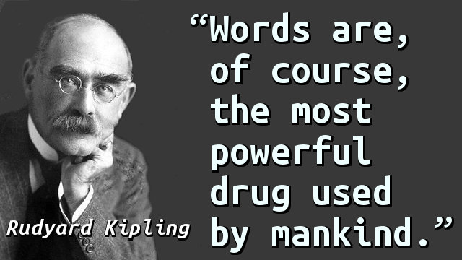

Slide 25
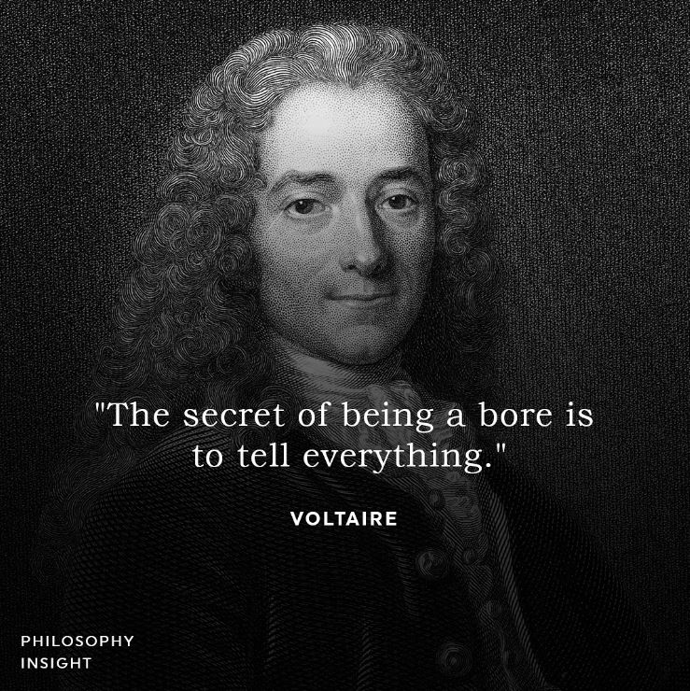

Slide 28
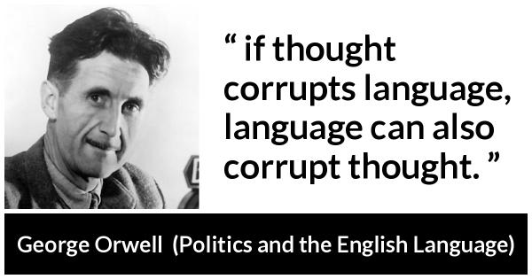
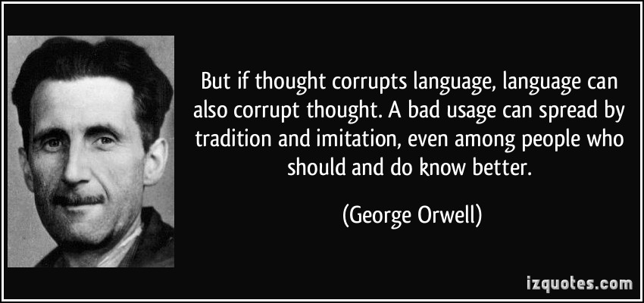

Slide 29
How does Psalm 140, 141 point to Christ?
* “I say to the Lord, “You are my God.” Hear, Lord, my cry for mercy” (Ps 140:6).
1. Jesus is the word made flesh.
“The Word became flesh…” (Jn 1:14, 1-2).
* “But my eyes are fixed on you, Sovereign Lord; in you I take refuge—do not give me over to death” (Ps 141:8).
2. Jesus is the word that sustains the weary.
“The Sovereign LORD has given me a well-instructed tongue, to know the word that sustains the weary. He wakens me morning by morning, wakens my ear to listen like one being instructed” (Isa 50:4).

