Slide 1
1 Thessalonians 3:1-13: Therefore when we could bear it no longer, we were willing to be left behind at Athens alone, ² and we sent Timothy, our brother and God's coworker^{[a]} in the gospel of Christ, to establish and exhort you in your faith, ³ that no one be moved by these afflictions. For you yourselves know that we are destined for this.

Slide 2
⁴ For when we were with you, we kept telling you beforehand that we were to suffer affliction, just as it has come to pass, and just as you know. ⁵ For this reason, when I could bear it no longer, I sent to learn about your faith, for fear that somehow the tempter had tempted you and our labor would be in vain. ⁶ But now that Timothy has come to us from you, and has brought us the good news of your faith and love and reported that you always remember us kindly and long to see us, as we long to see you— ⁷ for this reason, brothers,^{[b]} in all our distress and affliction we have been comforted about you through your faith.

Slide 3
⁸ For now we live, if you are standing fast in the Lord. ⁹ For what thanksgiving can we return to God for you, for all the joy that we feel for your sake before our God, ¹⁰ as we pray most earnestly night and day that we may see you face to face and supply what is lacking in your faith?

Slide 4
¹¹ Now may our God and Father himself, and our Lord Jesus, direct our way to you, ¹² and may the Lord make you increase and abound in love for one another and for all, as we do for you, ¹³ so that he may establish your hearts blameless in holiness before our God and Father, at the coming of our Lord Jesus with all his saints.

Slide 5
The Right View of Afflictions 1 Thessalonians 3:1-13 Key Verse:3: ³ that no one be moved by these afflictions. For you yourselves know that we are destined for this.

Slide 6
Look at verses 1-2. “Therefore when we could bear it no longer, we were willing to be left behind at Athens alone, 2 and we sent Timothy, our brother and God's coworker[a] in the gospel of Christ, to establish and exhort you in your faith.”

Slide 7
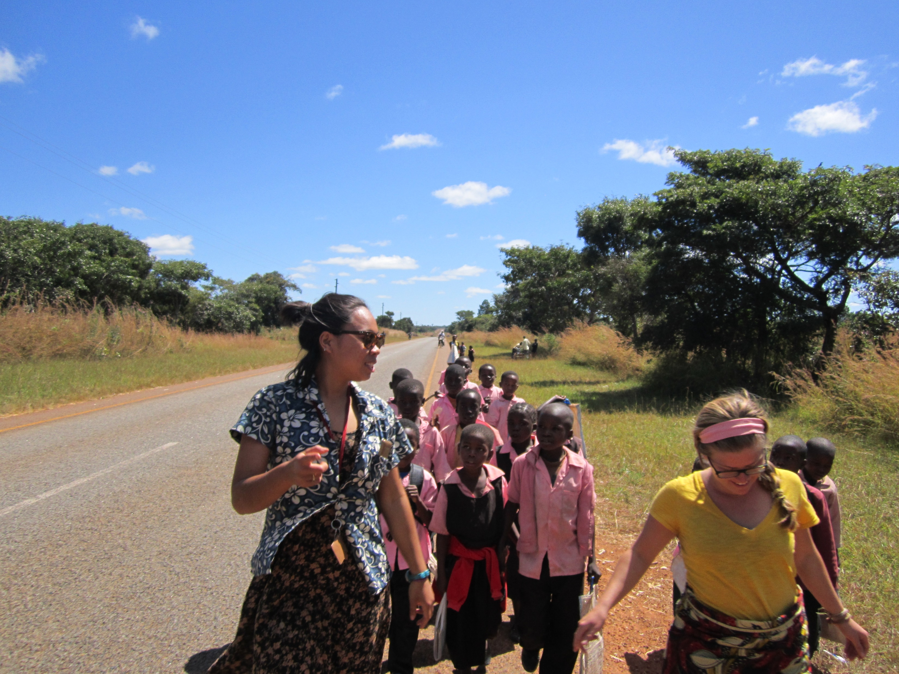
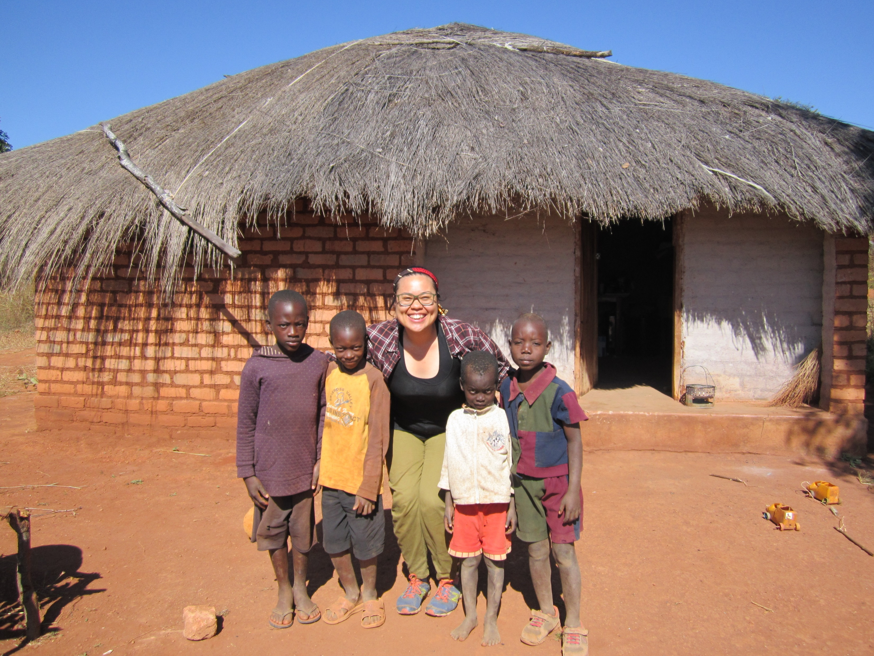
Picture of Sarah

Slide 8
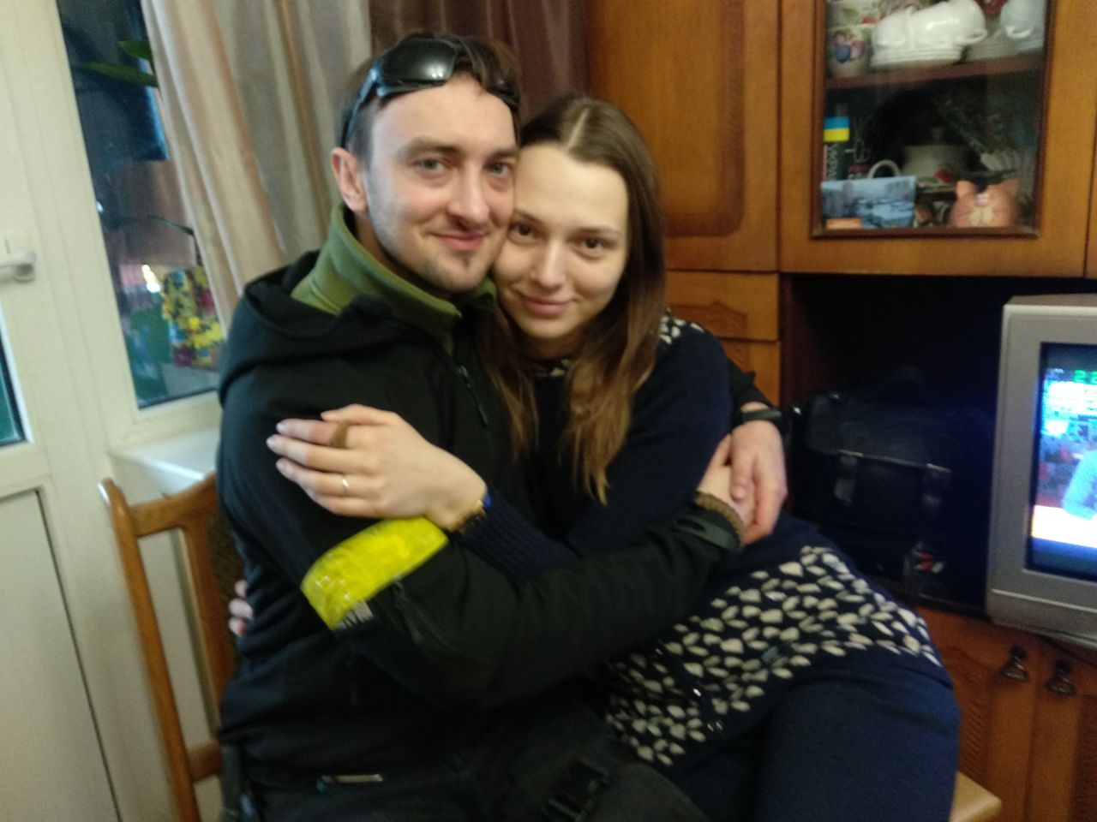

Slide 9
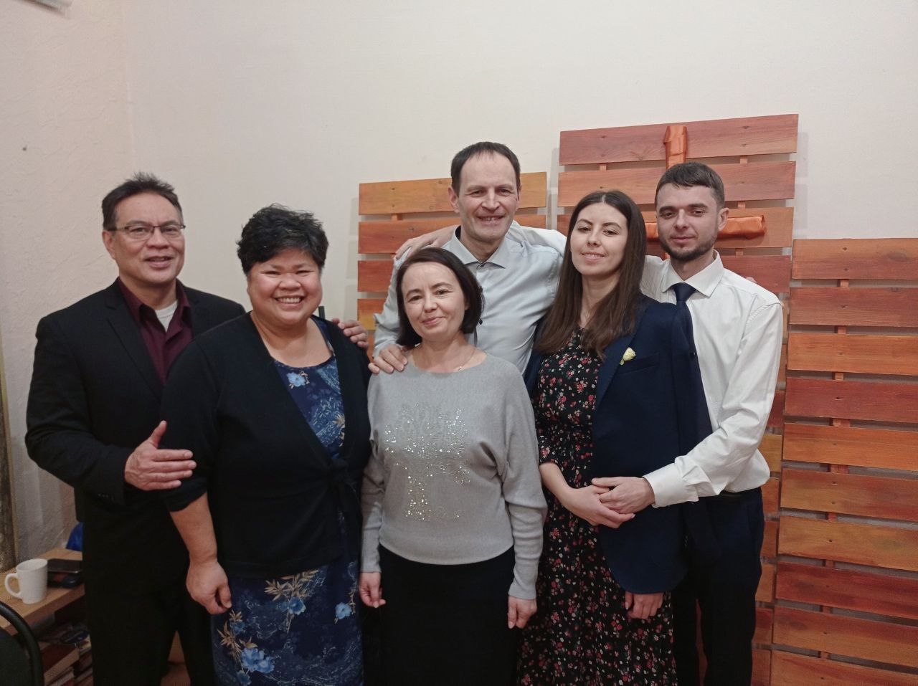
Oleg and Anya

Slide 10
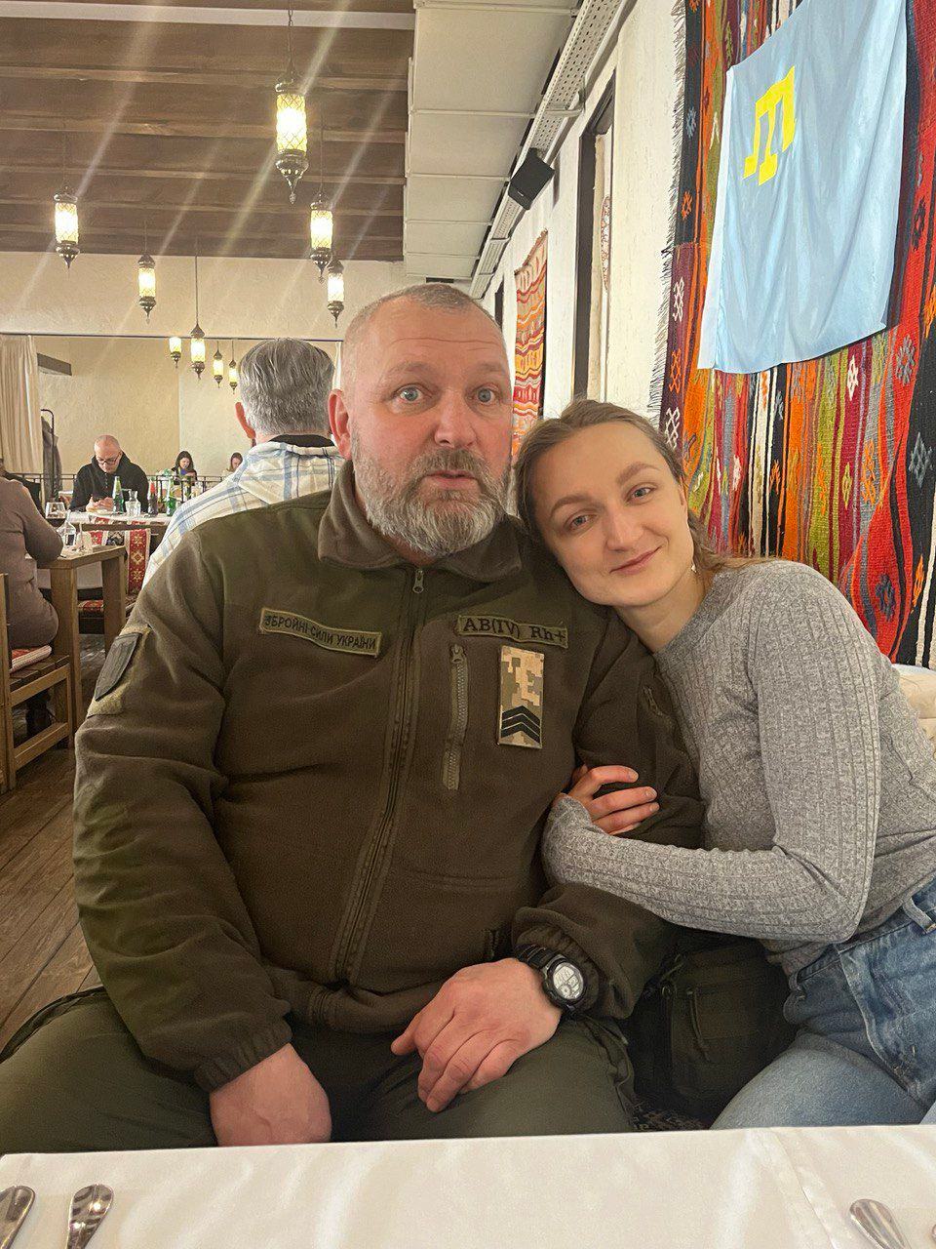

Slide 11
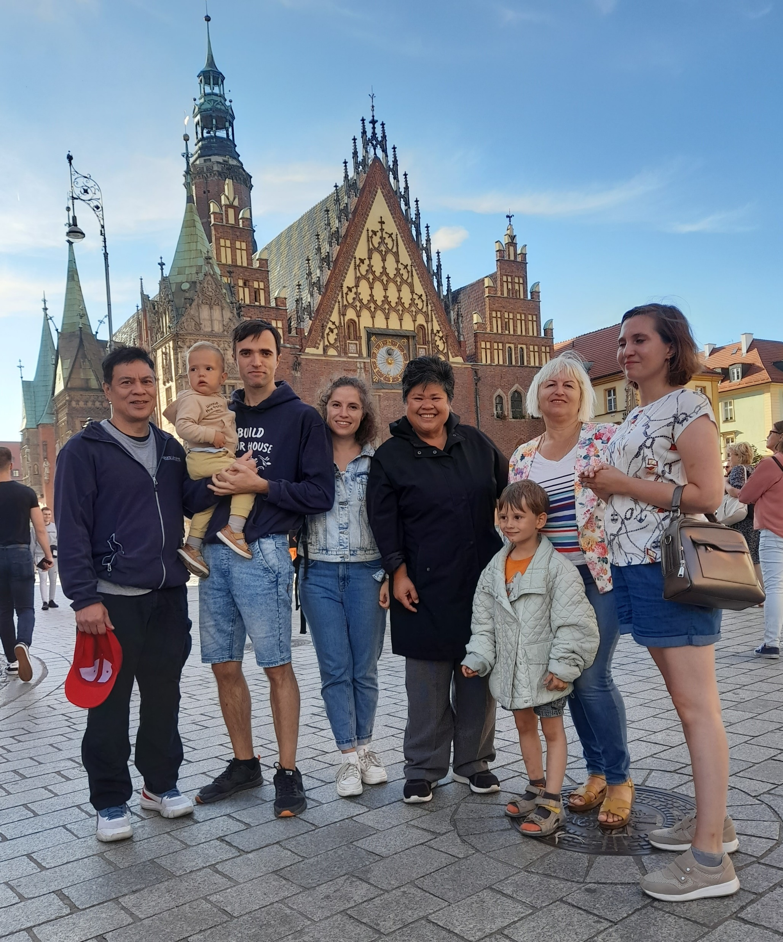
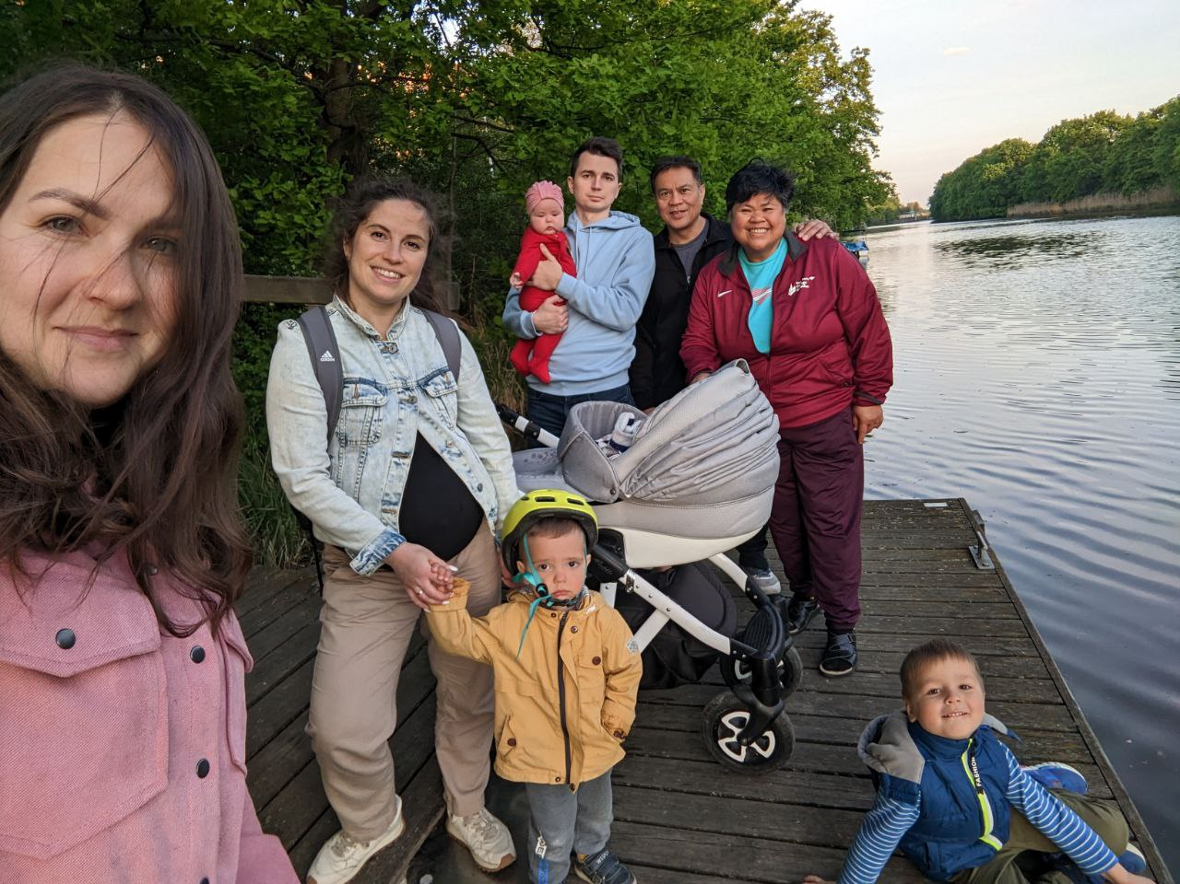

Slide 12
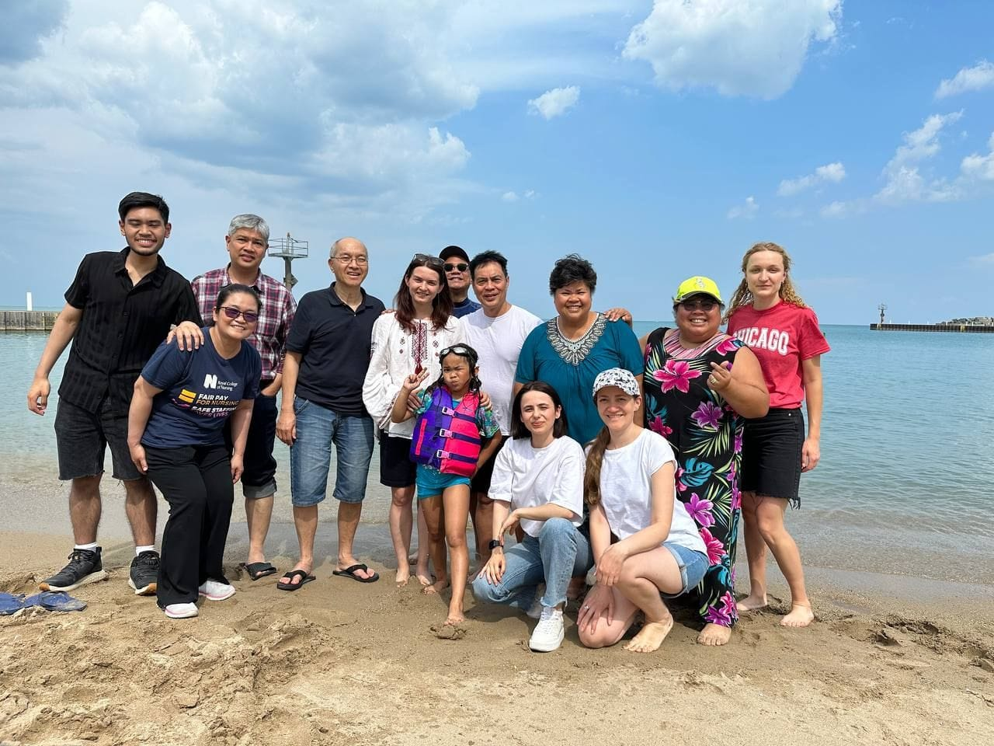

Slide 13
Look at verse 2 again. “2…and we sent Timothy, our brother and God's coworker[a] in the gospel of Christ, to establish and exhort you in your faith.”

Slide 14
Philippians 2:20 reads, “19 I hope in the Lord Jesus to send Timothy to you soon, so that I too may be cheered by news of you. 20 For I have no one like him, who will be genuinely concerned for your welfare.”

Slide 15
Look at verses 3-4. “3…that no one be moved by these afflictions. For you yourselves know that we are destined for this. 4 For when we were with you, we kept telling you beforehand that we were to suffer affliction, just as it has come to pass, and just as you know.”

Slide 16
Matthew 13:20-21, “20 As for what was sown on rocky ground, this is the one who hears the word and immediately receives it with joy, 21 yet he has no root in himself, but endures for a while, and when tribulation or persecution arises on account of the word, immediately he falls away.”

Slide 17
Job 2:10 reads, “10 But he said to her, ‘You speak as one of the foolish women would speak. Shall we receive good from God, and shall we not receive evil?’ In all this Job did not sin with his lips.”

Slide 18
Hebrews 2:10 reads, “10 For it was fitting that he, for whom and by whom all things exist, in bringing many sons to glory, should make the founder of their salvation perfect through suffering.”

Slide 19
John 16:33 reads, “33 I have said these things to you, that in me you may have peace. In the world you will have tribulation. But take heart; I have overcome the world.”

Slide 20
“Symbol of Christianity is the cross, not a soft pillow.”

Slide 21
Acts 14:21-22, “After they had preached the gospel to that city and had made many disciples, they returned to Lystra and to Iconium and to Antioch, strengthening the souls of the disciples, encouraging them to continue in the faith, and saying, ‘Through many tribulations we must enter the kingdom of God.’”

Slide 22
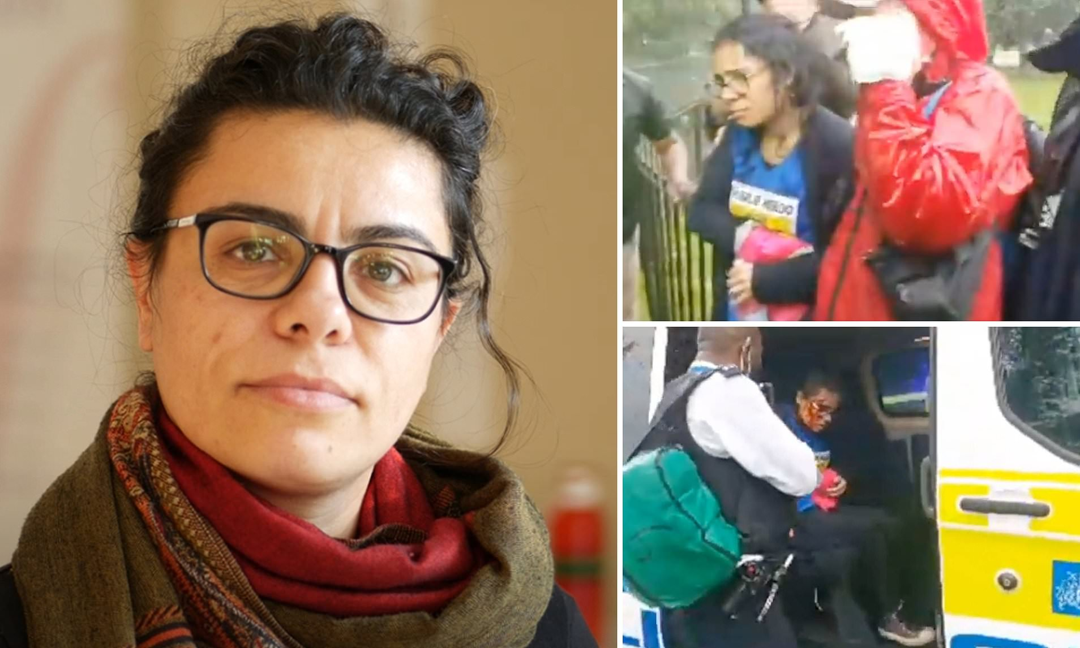

Slide 23
Look at verse 5. “5 For this reason, when I could bear it no longer, I sent to learn about your faith, for fear that somehow the tempter had tempted you and our labor would be in vain.”

Slide 24
Look at verses 6-8. “6 But now that Timothy has come to us from you, and has brought us the good news of your faith and love and reported that you always remember us kindly and long to see us, as we long to see you— 7 for this reason, brothers,[b] in all our distress and affliction we have been comforted about you through your faith. 8 For now we live, if you are standing fast in the Lord.”

Slide 25
Look at verses 9-10. “9 For what thanksgiving can we return to God for you, for all the joy that we feel for your sake before our God, 10 as we pray most earnestly night and day that we may see you face to face and supply what is lacking in your faith.”

Slide 26
Look at verses 11-13. “11 Now may our God and Father himself, and our Lord Jesus, direct our way to you, 12 and may the Lord make you increase and abound in love for one another and for all, as we do for you, 13 so that he may establish your hearts blameless in holiness before our God and Father, at the coming of our Lord Jesus with all his saints.”

Slide 27
John 13:35 reads, “35 By this all people will know that you are my disciples, if you have love for one another.”

Slide 28
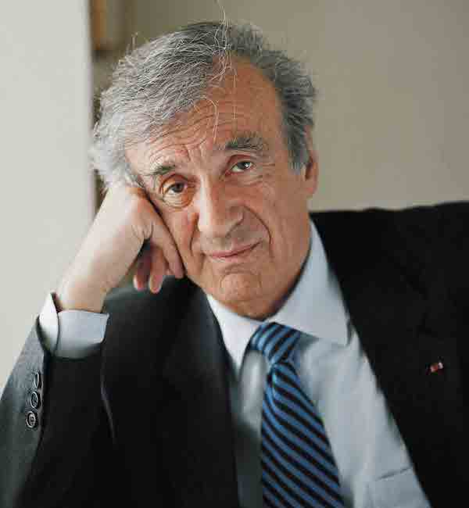
“The opposite of love is not hate; it is indifference.”

Slide 29
Look at verse 13 again. “13 so that he may establish your hearts blameless in holiness before our God and Father, at the coming of our Lord Jesus with all his saints.”

Slide 30
Acts 16:31, “And they said, ‘Believe in the Lord Jesus, and you will be saved, you and your household.’” Psalm 103:17-18, “But the steadfast love of the LORD is from everlasting to everlasting on those who fear him, and his righteousness to children's children, to those who keep his covenant and remember to do his commandments.”

