Slide 1
No One Cares (Psalm 142)
ALONE
“Look and see, there is no one at my right hand; no one is concerned for me. I have no refuge; no one cares for my life” (Psalm 142:4). 12/2, 12/15/24.

Slide 2
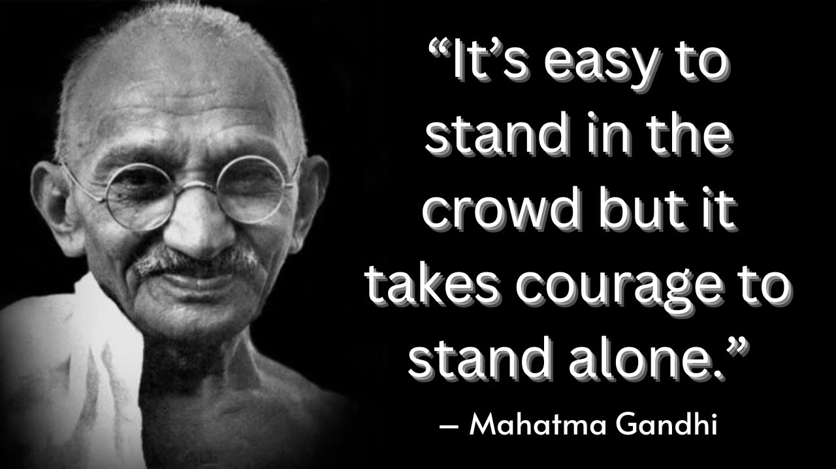
How common is it to feel all alone?

Slide 3
“…there is no one at my right hand…” (Psalm 142:4).
1. My plea (1-2)!
2. My plight (3-4).
3. My portion (5).
4. My prospect (6-7).

Slide 4
1. My Plea (142:1-2)
A maskil of David. When he was in the cave. A prayer. 1 Sam 22:1; 24:3.
¹ I cry aloud to the Lord; I lift up my voice to the Lord for mercy.
² I pour out before him my complaint; before him I tell my trouble.

Slide 5
2. My Plight (3-4)
³ When my spirit grows faint within me, it is you who watch over my way. In the path where I walk people have hidden a snare for me.
⁴ Look and see, there is no one at my right hand; no one is concerned for me. I have no refuge; no one cares for my life.

Slide 6
3. My Portion (142:5)
⁵ I cry to you, Lord; I say, “You are my refuge, my portion in the land of the living.”

Slide 7
4. My Prospect (6-7)
⁶ Listen to my cry, for I am in desperate need; rescue me from those who pursue me, for they are too strong for me.
⁷ Set me free from my prison, that I may praise your name. Then the righteous will gather about me because of your goodness to me.

Slide 8
No One is Righteous (Psalm 143:1-12)
UNRIGHTEOUS
“Do not bring your servant into judgment, for no one living is righteous before you” (Psalm 143:2). 12/2, 12/15/24. “A Pauline psalm.”

Slide 9
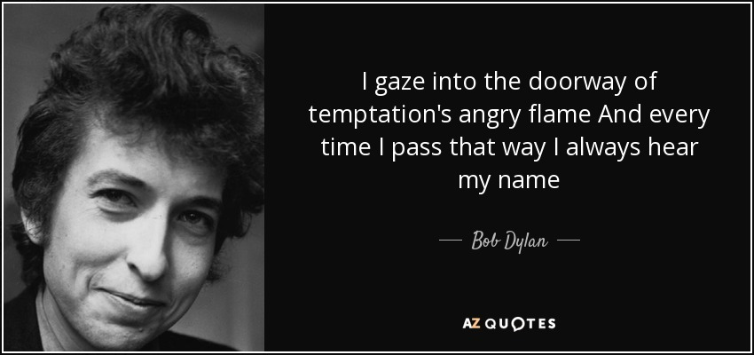
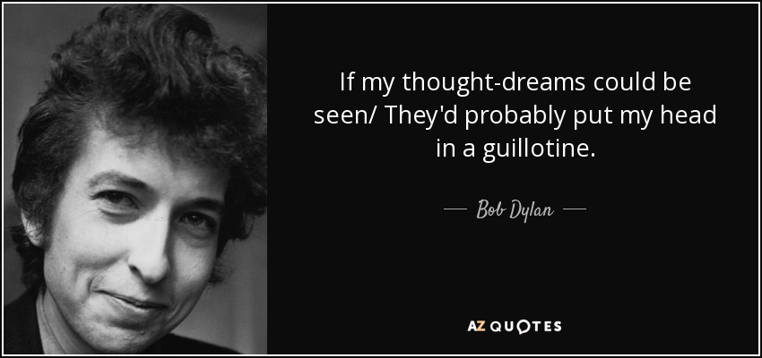
The ever present temptation that may lead to besetting sin and your own thoughts.
How do you know that you are not righteous?

Slide 10
1. Unrighteous (143:1-2)
A psalm of David.
¹ Lord, hear my prayer, listen to my cry for mercy; in your faithfulness and righteousness come to my relief.
² Do not bring your servant into judgment, for no one living is righteous before you.

Slide 11
2. Fainting (143:3-6)
³ The enemy pursues me, he crushes me to the ground; he makes me dwell in the darkness like those long dead.
⁴ So my spirit grows faint within me; my heart within me is dismayed.
⁵ I remember the days of long ago; I meditate on all your works and consider what your hands have done.
⁶ I spread out my hands to you; I thirst for you like a parched land.

Slide 12
3. Pleading (143:7-10)
⁷ Answer me quickly, Lord; my spirit fails. Do not hide your face from me or I will be like those who go down to the pit.
⁸ Let the morning bring me word of your unfailing love [hesed], for I have put my trust in you. Show me the way I should go, for to you I entrust my life. Ps 90:14.
⁹ Rescue me from my enemies, Lord, for I hide myself in you.
¹⁰ Teach me to do your will, for you are my God; may your good Spirit lead me on level ground.

Slide 13
4. Righteousness (11-12)
¹¹ For your name’s sake, Lord, preserve my life; in your righteousness, bring me out of trouble. 1 Jn 1:9. Rom 3:26. Gal 2:20.
¹² In your unfailing love [hesed], silence my enemies; destroy all my foes, for I am your servant.

Slide 14
All you ever need in life is ḥeseḏ (חֶסֶד) 250x, 127x, 26x
love (NIV)
unfailing love (NIV)
stedfast love (ESV)
lovingkindness (KJV)
faithfulness (NASB)
faithful love (HCSB)
mercy (GNT)
gracious love (ISV)
kindness (Robert Altar)
committed love (Alec Motyer)

Slide 15
What kind of love should a marriage be comprised of?
Are couples who are still in love with each other lucky?

Slide 16
ALONE, UNRIGHTEOUS and IN TROUBLE
Should you/Christians ever be in serious trouble?
* “Look and see, there is no one at my right hand; no one is concerned for me. I have no refuge; no one cares for my life” (Ps 142:4).
* Abraham, Isaac, Jacob, Joseph (Genesis).
* Moses (Exo 17:4; Num 14:10).
* All the OT prophets, John the Baptist.
* “In fact, everyone who wants to live a godly life in Christ Jesus will be persecuted” (2 Timothy 3:12).
What do you expect of your life as a Christian today?

Slide 17
ALONE, UNRIGHTEOUS and IN TROUBLE
Do you feel righteous or unrighteous?
“..no one living is righteous before you.” “If you Lord, kept a record of sins, Lord, who could stand?” (Ps 143:2; 130:3)
* “How can a mortal be righteous before God? How can one born of woman be pure? (Job 25:4)
* “Indeed, there is no one on earth who is righteous, no one who does what is right and never sins” (Ec 7:20).
* “But your iniquities have separated you from your God; your sins have hidden his face from you, so that he will not hear” (Isa 59:2). (Rom 3:23).
* “for though the righteous fall seven times” (Pr 24:16).
What/Who is your main problem in life?

Slide 18
ALONE, UNRIGHTEOUS and IN TROUBLE
Do you ever feel alone?
Is that “normal”?
* “..there is no one at my right hand” (Ps 142:4).
* “My voice is as sad and lonely as the cries of a jackal or an ostrich” (Job 30:29, GNBUK).
* “The Israelites have rejected your covenant, torn down your altars, and put your prophets to death with the sword. I am the only one left, and now they are trying to kill me too” (1 Kings 19:10).
* “At my first defense, no one came to my support, but everyone deserted me. May it not be held against them” (2 Timothy 4:16).

Slide 19
God’s promises when you’re alone, unrighteousness & in trouble
* “Be strong and courageous. Do not be afraid or terrified because of them, for the Lord your God goes with you; he will never leave you nor forsake you.” “The Lord himself goes before you and will be with you; he will never leave you nor forsake you. Do not be afraid; do not be discouraged” (Dt 31:6, 8).
* “Have I not commanded you? Be strong and courageous. Do not be afraid; do not be discouraged, for the Lord your God will be with you wherever you go” (Jos 1:9).
* “Keep your lives free from the love of money and be content with what you have, because God has said, ‘Never will I leave you; never will I forsake you” (Heb 13:6).
* “And surely I am with you always, to the very end of the age” (Mt 28:19-20).

Slide 20
Jesus on the Cross
1. Jesus was more alone than you’ll ever be.
2. Jesus was more unrighteous than you’ll ever be.
3. Jesus was more helplessly in trouble than you’ll ever be.
4. Jesus had to loose hesed for us to have it forever.

