Slide 1
Prayer: Psalm 73:21-26
²¹ When my heart was grieved and my spirit embittered, ²² I was senseless and ignorant; I was a brute beast before you.
²³ Yet I am always with you; you hold me by my right hand. ²⁴ You guide me with your counsel, and afterward you will take me into glory. ²⁵ Whom have I in heaven but you? And earth has nothing I desire besides you. ²⁶ My flesh and my heart may fail, but God is the strength of my heart and my portion forever. Amen.

Slide 2
Fortress, Stronghold, Deliverer (Ps 144)
PROTECTOR
“He is my loving God [hesed] and my fortress, my stronghold and my deliverer [rescuer, savior], my shield, in whom I take refuge, who subdues peoples under me” (Psalm 144:2). 12/6, 12/29/24.

Slide 3
A Happy People (Psalm 144:1-15)
BLESSEDNESS
“Blessed [happy] is the people of whom this is true; blessed [happy] is the people whose God is the Lord” (Psalm 144:15).
12/18, 12/29/24.

Slide 4
Psalm 1-2: How to be Happy in Life
HAPPINESS
Happiness comes from the Word and the Son
“Blessed [happy] is the one who does not walk… stand…sit…, but whose delight [desire, pleasure] is in the law [teaching] of the LORD, and who meditates…” (Ps 1:1-2). “Blessed [happy] are all who take refuge in him” (Ps 2:12b). 10/22/2023.

Slide 5
Are we a happy people in the U.S.A.?
Don’t all people just want to be happy?
What do you think you need to be happy?
Is happiness a choice you make? OR…
…is happiness dependent on your situation and circumstances?
What may a good and simple way to be happy and content?
Is God a happy God?
Does God want you to be happy?

Slide 6
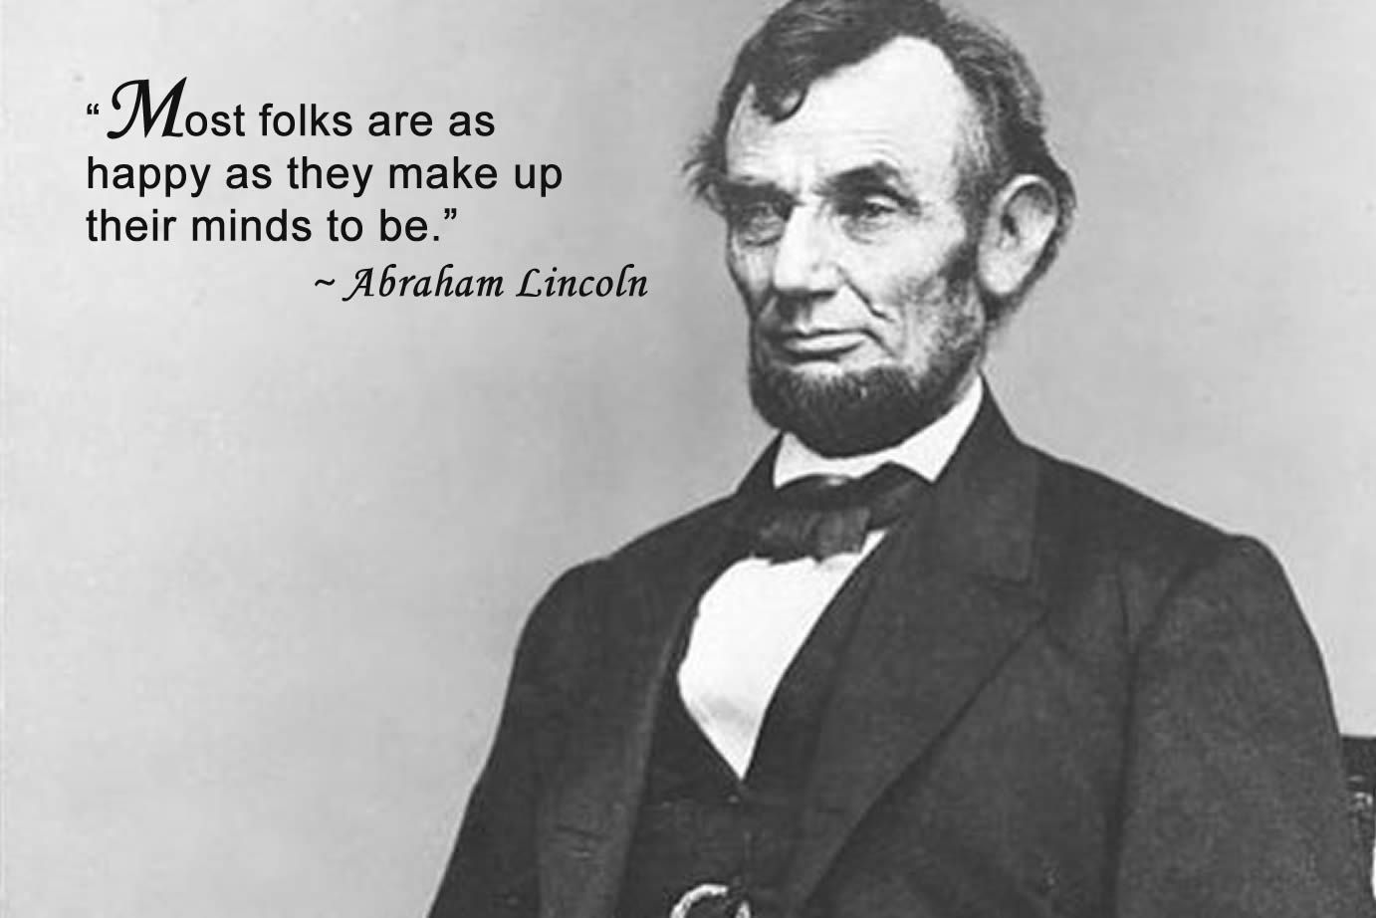

Slide 7
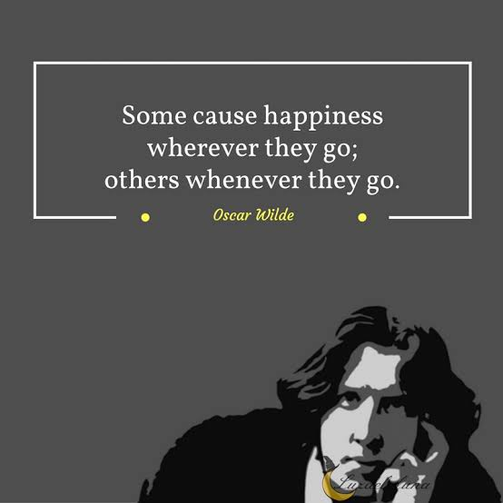
What can you do when you’re unhappy?
“Why, my soul, are you downcast [unhappy]? Why so disturbed [unhappy] within me?
Put your hope in God, for I will yet praise him, my Savior and my God” (Psalm 42:5, 11; 43:5).

Slide 8
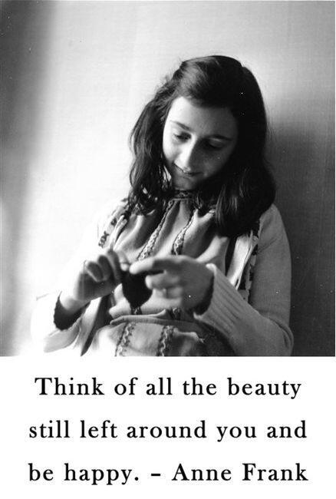
“God has not forsaken me, and He never will.” Anne Frank.

Slide 9
What you need to be happy
1. Training (Ps 144:1).
2. Protection (144:2-4).
3. Intervention (5-8).
4. Renewal (9-11).
5. Prosperity (12-15).

Slide 10
1. Training (Psalm 144:1).
Of David. ¹ Praise be to the Lord my Rock, who trains my hands for war, my fingers for battle.
“He trains my hands for battle…” (Ps 18:34).
“Before I was afflicted [trained] I went astray, but now I obey your word.” “It was good for me to be afflicted [trained] so that I might learn your decrees.” “I know, Lord, that your laws are righteous, and that in faithfulness you have afflicted [trained] me” (Ps 119:67, 71, 75).
“I love you, Lord, my strength. ² The Lord is my rock, my fortress and my deliverer; my God is my rock, in whom I take refuge, my shield and the horn of my salvation, my stronghold” (Ps 18:1-2).

Slide 11
2. Protection (Ps 144:2-4).
² He is my loving God and my fortress, my stronghold and my deliverer, my shield, in whom I take refuge, who subdues peoples under me.
³ Lord, what are human beings that you care for them, mere mortals that you think of them?
⁴ They are like a breath; their days are like a fleeting shadow.
“what is mankind that you are mindful of them, human beings that you care for them? You have made them a little lower than…” (Ps 8:4-5)

Slide 12
3. Intervention (Ps 144:5-8).
⁵ Part your heavens, Lord, and come down; touch the mountains, so that they smoke.
⁶ Send forth lightning and scatter the enemy; shoot your arrows and rout them.
⁷ Reach down your hand from on high; deliver me and rescue me from the mighty waters, from the hands of foreigners ⁸ whose mouths are full of lies, whose right hands are deceitful.
“He parted the heavens and came down…” “He shot his arrows and scattered the enemy, with great bolts of lightning he routed them” (Ps 8:9, 14).

Slide 13
4. Renewal (Ps 144:9-11).
⁹I will sing a new song to you, my God; on the ten-stringed lyre I will make music to you, ¹⁰ to the One who gives victory to kings, who delivers his servant David.
From the deadly sword ¹¹ deliver me; rescue me from the hands of foreigners whose mouths are full of lies, whose right hands are deceitful.

Slide 14
5. Prosperity (Ps 144:12-15).
¹² Then our sons in their youth will be like well-nurtured plants, and our daughters will be like pillars carved to adorn a palace. Genesis 1:28
¹³ Our barns will be filled with every kind of provision. Our sheep will increase by thousands, by tens of thousands in our fields; ¹⁴ our oxen will draw heavy loads. There will be no breaching of walls, no going into captivity, no cry of distress in our streets.
¹⁵ Blessed is the people of whom this is true; blessed is the people whose God is the Lord.
“Children are a heritage from the Lord, offspring a reward from him. Like arrows in the hands of a warrior... Blessed [happy] is the man whose quiver is full of them” (Ps 127:3-5).

Slide 15
What you need to be happy
1. Training (Ps 144:1).
2. Protection (144:2-4).
3. Intervention (5-8).
4. Renewal (9-11).
5. Prosperity (12-15).

Slide 16
1. Training: “Praise be to the Lord my Rock, who trains my hands for war, my fingers for battle” (Ps 144:1).
* Can you be a godly person without training?
“⁷ Have nothing to do with godless myths and old wives’ tales; rather, train yourself to be godly. ⁸ For physical training is of some value, but godliness has value for all things, holding promise for both the present life and the life to come” (1 Tim 4:7-8). How?
* Why might you NOT want to train yourself?
“No discipline [training] seems pleasant at the time, but painful” (Heb 12:11a).
“In your struggle against sin, you have not yet resisted to…” (Heb 12:4).
* What if you don’t train yourself?
“God disciplines [trains] us for our good, in order that we may share in his holiness” (Heb 12:10b).
* Do you need training in all areas of your life?

Slide 17
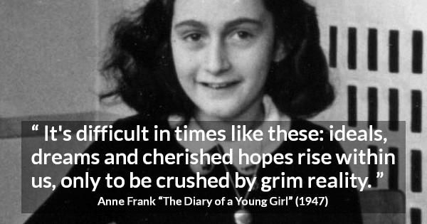
“One thing I ask from the Lord, this only do I seek: that I may dwell in the house of the Lord all the days of my life, to gaze on the beauty of the Lord and to seek him in his temple” (Psalm 27:4).

Slide 18
What can you say about happiness
1. It has little to do with your circumstances.
2. Training-hardships, adversity, suffering, i.e. life, makes you better (happier) if you don’t become bitter.
3. It depends on what you choose to focus on, think about, meditate on. So…
4. …if you’re unhappy it’s on you.
5. Embrace the truth that God is sovereign.
6. It requires you to surrender yourself to an alien will.
7. Happiness is never found by direct pursuit, but is a byproduct of pursuing something else.

Slide 19
How does Psalm 144 point to Christ
Jesus was simultaneously the saddest and happiest man who ever lived.
1. Jesus’ “training” caused excruciating suffering and sorrow [for you and I].
“Son though he was, he learned obedience from what he suffered” (Heb 5:8).
“He was despised and rejected by mankind, a man of suffering, and familiar with pain” (Isa 53:3).
2. Jesus was the happiest man.
Jn 4:32; 10:30; Mk 1:11; 9:7; Mt 3:17; 17:5; 11:25-30.

Slide 21
“…my loving God [hesed], my fortress, my stronghold, my deliverer, my shield…” (Ps 144:2).
1. Past salvation (1-4).
2. Present deliverance (5-11).
3. Future prosperity (12-15).

Slide 22
1. Past Salvation (144:1-4).
Of David. ¹ Praise be to the Lord my Rock, who trains my hands for war, my fingers for battle.
² He is my loving God and my fortress, my stronghold and my deliverer, my shield, in whom I take refuge, who subdues peoples under me.
³ Lord, what are human beings that you care for them, mere mortals that you think of them?
⁴ They are like a breath; their days are like a fleeting shadow.

Slide 23
2. Present Deliverance (144:5-11)
⁵ Part your heavens, Lord, and come down; touch the mountains, so that they smoke.
⁶ Send forth lightning and scatter the enemy; shoot your arrows and rout them.
⁷ Reach down your hand from on high; deliver me and rescue me from the mighty waters, from the hands of foreigners
⁸ whose mouths are full of lies, whose right hands are deceitful.
⁹ I will sing a new song to you, my God; on the ten-stringed lyre I will make music to you,
¹⁰ to the One who gives victory to kings, who delivers his servant David.
From the deadly sword ¹¹ deliver me; rescue me from the hands of foreigners whose mouths are full of lies, whose right hands are deceitful.

Slide 24
2. Present Deliverance (144:5-11).
⁵ Part your heavens, Lord, and come down; touch the mountains, so that they smoke.
⁶ Send forth lightning and scatter the enemy; shoot your arrows and rout them.
⁷ Reach down your hand from on high; deliver me and rescue me from the mighty waters, from the hands of foreigners
⁸ whose mouths are full of lies, whose right hands are deceitful.
⁹ I will sing a new song to you, my God; on the ten-stringed lyre I will make music to you,
¹⁰ to the One who gives victory to kings, who delivers his servant David.
From the deadly sword ¹¹ deliver me; rescue me from the hands of foreigners whose mouths are full of lies, whose right hands are deceitful.

Slide 25
3. Future Prosperity (144:12-15).
¹² Then our sons in their youth will be like well-nurtured plants, and our daughters will be like pillars carved to adorn a palace.
¹³ Our barns will be filled with every kind of provision. Our sheep will increase by thousands, by tens of thousands in our fields;
¹⁴ our oxen will draw heavy loads. There will be no breaching of walls, no going into captivity, no cry of distress in our streets.
¹⁵ Blessed is the people of whom this is true; blessed is the people whose God is the Lord.

Slide 27
Reasons for happiness are because of:
1. Life’s conflicts (1-2,5-8,11).
2. Your commitment (9-10).
3. God’s care & character (3-4, 11-15).

Slide 28
2. Protection: “He is my loving God and my fortress, my stronghold and my deliverer, my shield, in whom I take refuge” (2).

