Slide 1
1 Thessalonians 4:1-12 As for other matters, brothers and sisters, we instructed you how to live in order to please God, as in fact you are living. Now we ask you and urge you in the Lord Jesus to do this more and more. ² For you know what instructions we gave you by the authority of the Lord Jesus. ³ It is God’s will that you should be sanctified: that you should avoid sexual immorality; ⁴ that each of you should learn to control your own body^{[a]} in a way that is holy and honorable, ⁵ not in passionate lust like the pagans, who do not know God; ⁶ and that in this matter no one should wrong or take advantage of a brother or sister.^{[b]} The Lord will punish all those who commit such sins, as we told you and warned you before.

Slide 2
⁷ For God did not call us to be impure, but to live a holy life. ⁸ Therefore, anyone who rejects this instruction does not reject a human being but God, the very God who gives you his Holy Spirit. ⁹ Now about your love for one another we do not need to write to you, for you yourselves have been taught by God to love each other. ¹⁰ And in fact, you do love all of God’s family throughout Macedonia. Yet we urge you, brothers and sisters, to do so more and more, ¹¹ and to make it your ambition to lead a quiet life: You should mind your own business and work with your hands, just as we told you, ¹² so that your daily life may win the respect of outsiders and so that you will not be dependent on anybody.

Slide 3
Living to Please God in this New Year More and More 1 Thessalonians 4:1-12 Key Verse:1: “As for other matters, brothers and sisters, we instructed you how to live in order to please God, as in fact you are living. Now we ask you and urge you in the Lord Jesus to do this more and more.”

Slide 4
Look at verses 1-2. “As for other matters, brothers and sisters, we instructed you how to live in order to please God, as in fact you are living. Now we ask you and urge you in the Lord Jesus to do this more and more. 2 For you know what instructions we gave you by the authority of the Lord Jesus.”

Slide 5
1 Thessalonians 3:12-13, “May the Lord make your love increase and overflow for each other and for everyone else, just as ours does for you. 13 May he strengthen your hearts so that you will be blameless and holy in the presence of our God and Father when our Lord Jesus comes with all his holy ones.”

Slide 6
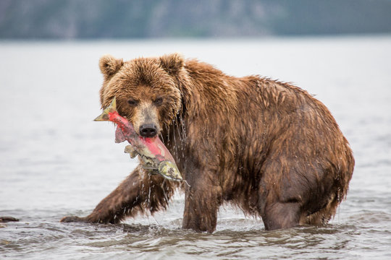

Slide 7
John 14:15 says, “If you love me, keep my commands.”

Slide 8
Look at verses 3-4. “3 It is God’s will that you should be sanctified: that you should avoid sexual immorality; 4 that each of you should learn to control your own body[a] in a way that is holy and honorable.”

Slide 9
First Corinthians 3:16-17 reads, “16 Don’t you know that you yourselves are God’s temple and that God’s Spirit dwells in your midst? 17 If anyone destroys God’s temple, God will destroy that person; for God’s temple is sacred, and you together are that temple.”

Slide 10
1 Corinthians 9:27, “No, I strike a blow to my body and make it my slave so that after I have preached to others, I myself will not be disqualified for the prize.”

Slide 11
Look at verses 5-6. “5 not in passionate lust like the pagans, who do not know God; 6 and that in this matter no one should wrong or take advantage of a brother or sister.[b] The Lord will punish all those who commit such sins, as we told you and warned you before.”

Slide 12
Look at verses 7-8. “7 For God did not call us to be impure, but to live a holy life. 8 Therefore, anyone who rejects this instruction does not reject a human being but God, the very God who gives you his Holy Spirit.”

Slide 13
Galatians 5:16-18 read, “16 So I say, walk by the Spirit, and you will not gratify the desires of the flesh. 17 For the flesh desires what is contrary to the Spirit, and the Spirit what is contrary to the flesh. They are in conflict with each other, so that you are not to do whatever[c] you want. 18 But if you are led by the Spirit, you are not under the law.”

Slide 14
Look at verses 9-10. “9 Now about your love for one another we do not need to write to you, for you yourselves have been taught by God to love each other. 10 And in fact, you do love all of God’s family throughout Macedonia. Yet we urge you, brothers and sisters, to do so more and more.”

Slide 15
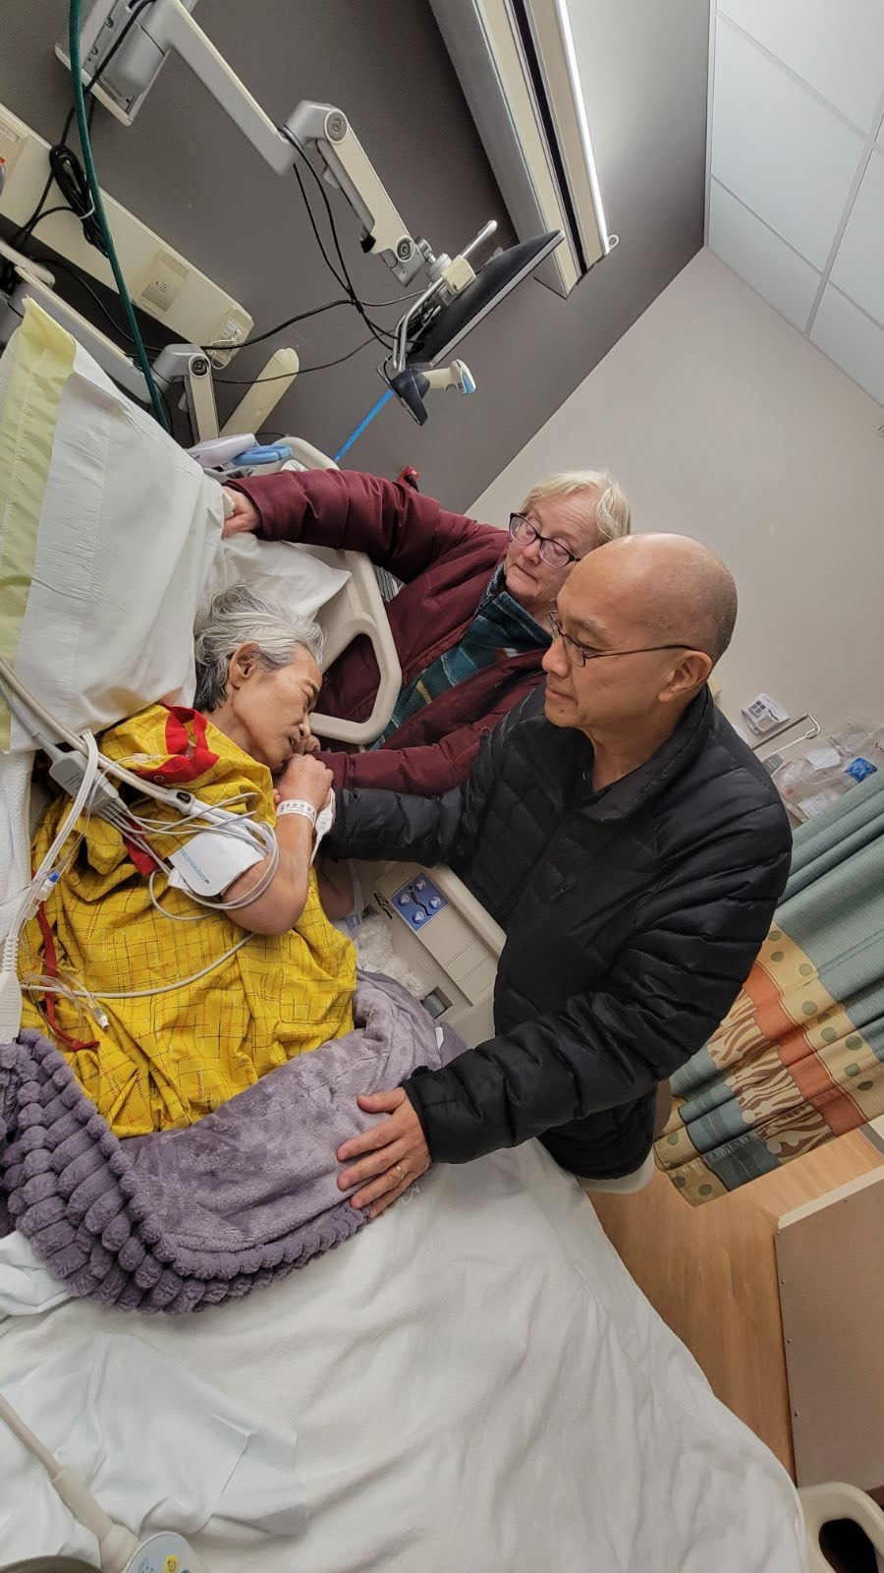
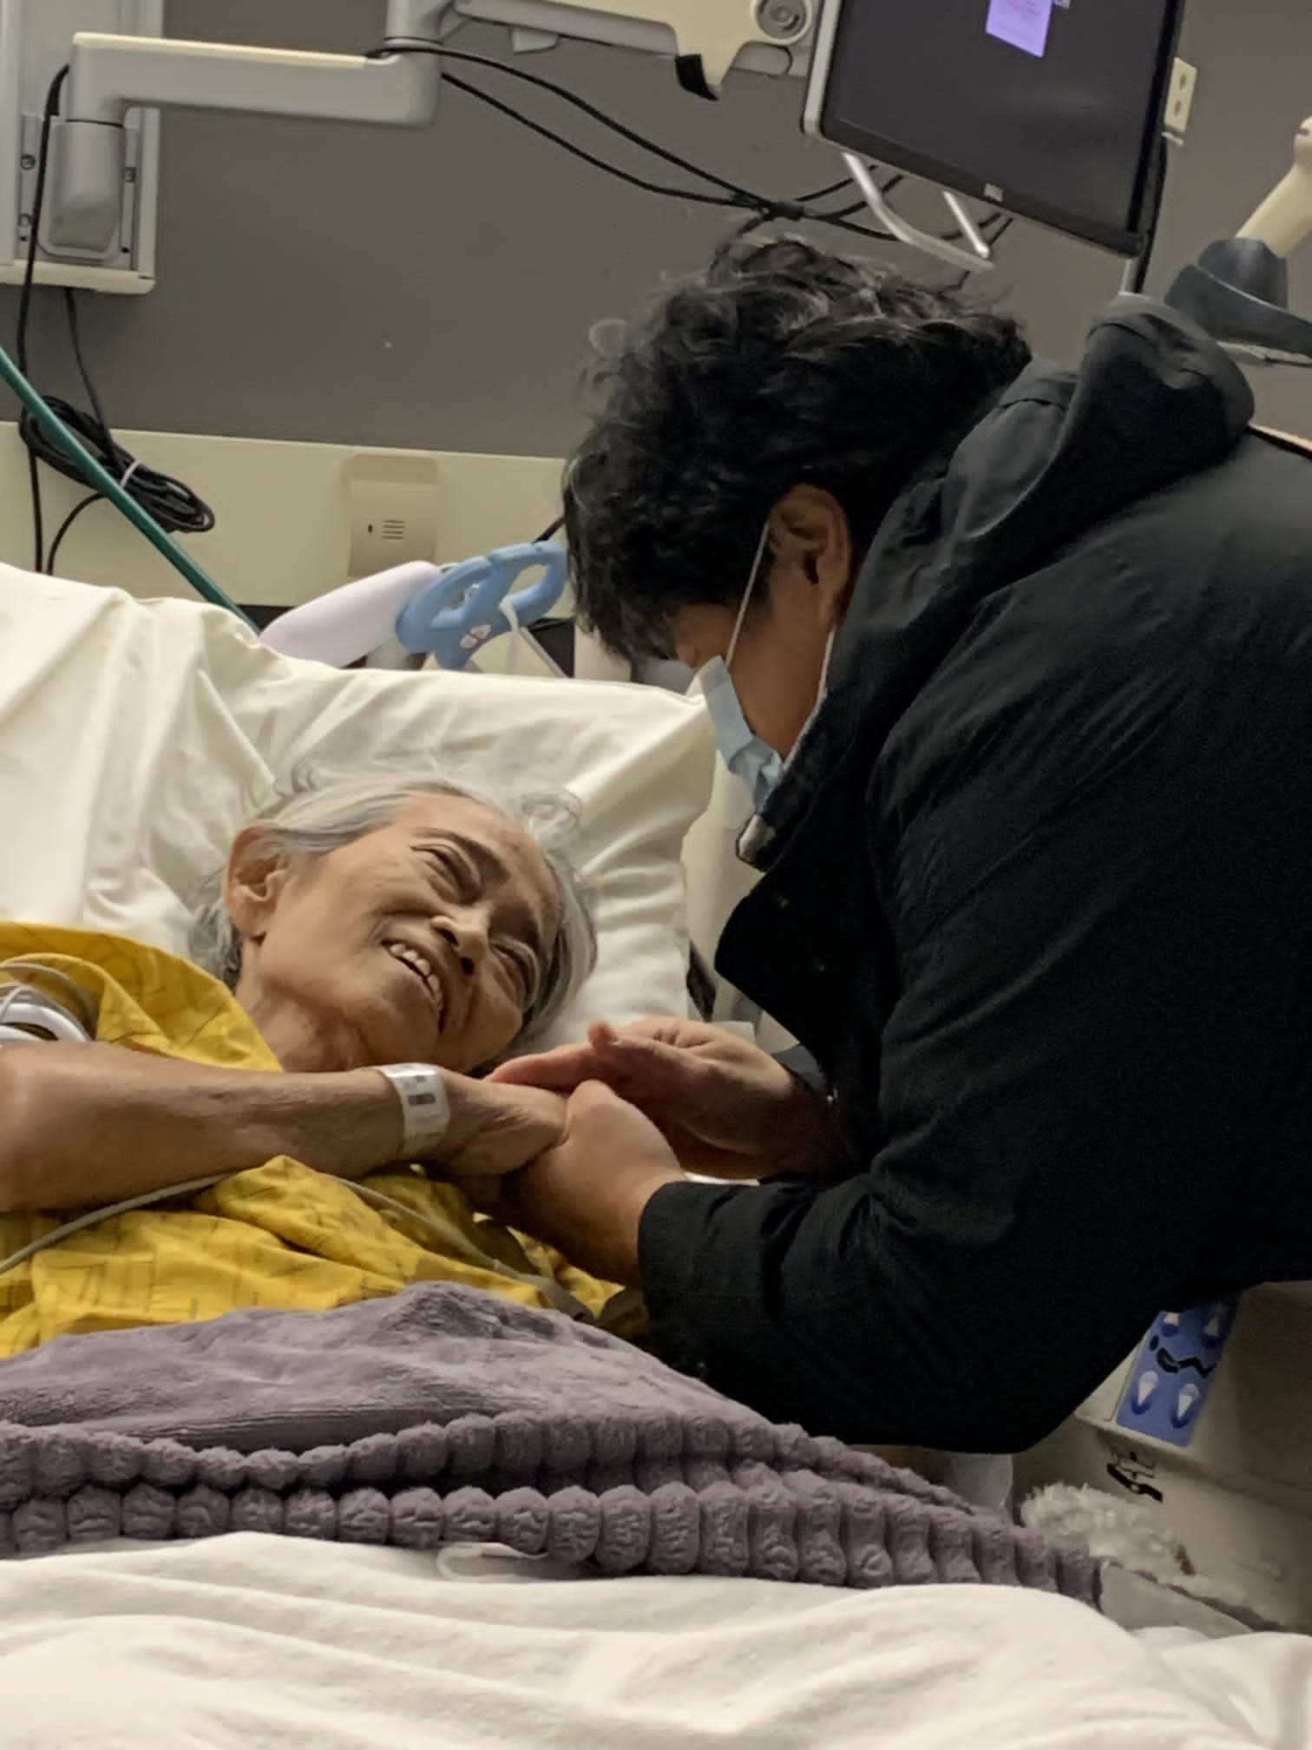
Visiting sara

Slide 16
John 13:34-35 reads, “A new command I give you: Love one another. As I have loved you, so you must love one another. 35 By this everyone will know that you are my disciples, if you love one another.”

Slide 17
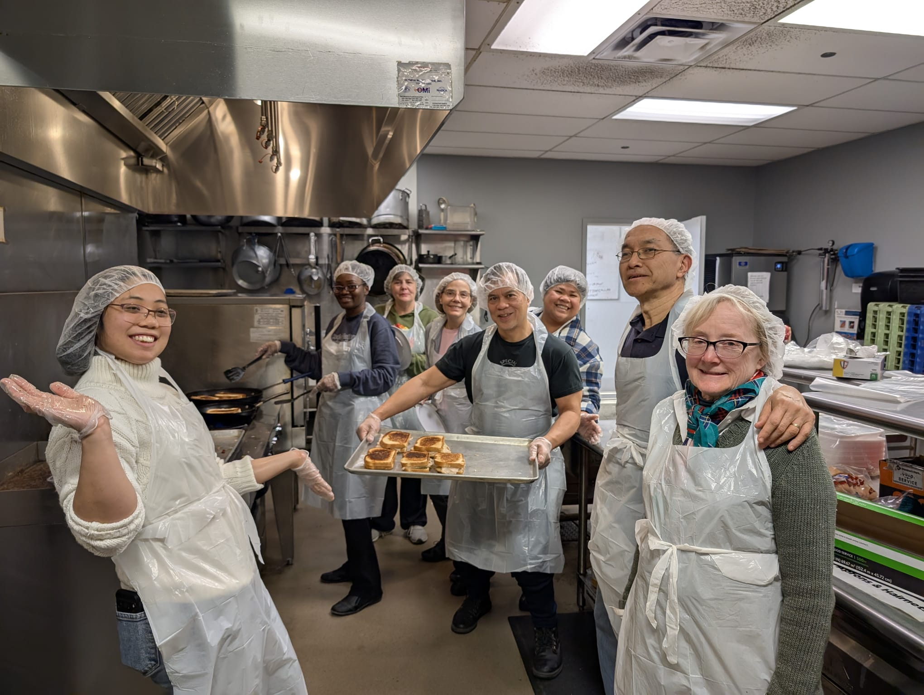
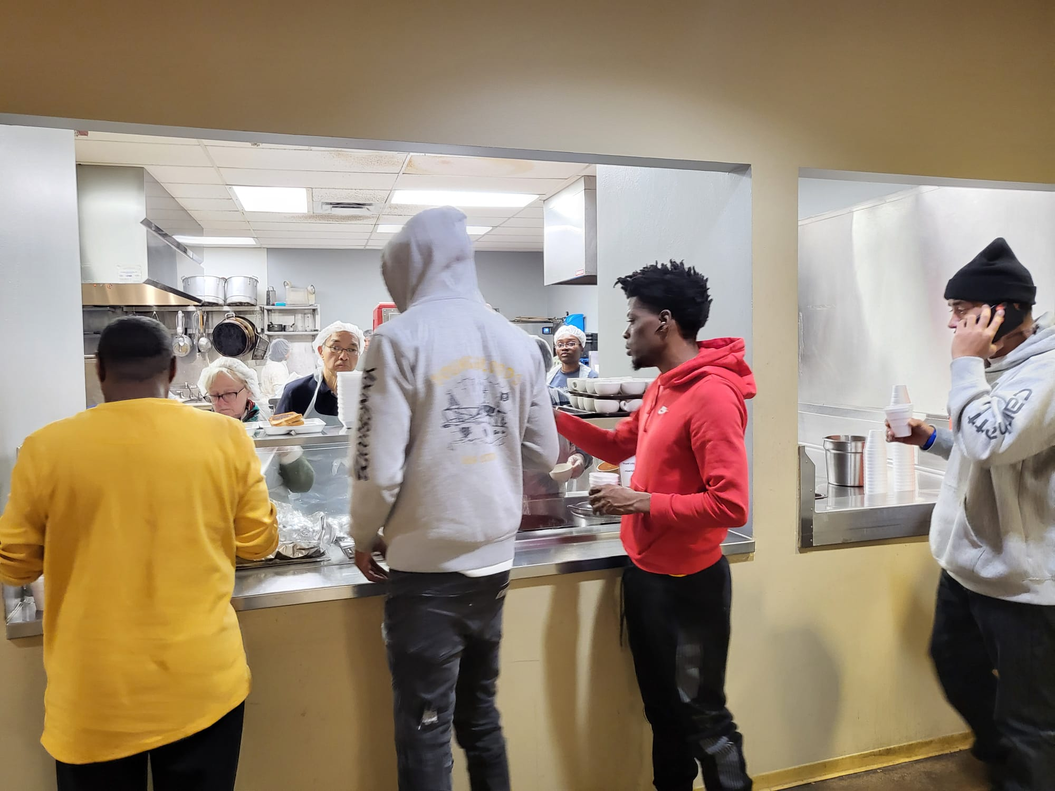

Slide 18
Look at verses 11-12. “11 …and to make it your ambition to lead a quiet life: You should mind your own business and work with your hands, just as we told you, 12 so that your daily life may win the respect of outsiders and so that you will not be dependent on anybody.”

Slide 19
