Slide 1
1 Thessalonians 4:13-18 Believers Who Have Died 13 Brothers and sisters, we do not want you to be uninformed about those who sleep in death, so that you do not grieve like the rest of mankind, who have no hope. 14 For we believe that Jesus died and rose again, and so we believe that God will bring with Jesus those who have fallen asleep in him. 15 According to the Lord’s word, we tell you that we who are still alive, who are left until the coming of the Lord, will certainly not precede those who have fallen asleep.

Slide 2
16 For the Lord himself will come down from heaven, with a loud command, with the voice of the archangel and with the trumpet call of God, and the dead in Christ will rise first. 17 After that, we who are still alive and are left will be caught up together with them in the clouds to meet the Lord in the air. And so we will be with the Lord forever. 18 Therefore encourage one another with these words.

Slide 3
The Coming of the Lord for his People (Subtitle: Rapture of Believers) 1 Thessalonians 4:13-18 Key Verse: 17: 17 After that, we who are still alive and are left will be caught up together with them in the clouds to meet the Lord in the air. And so we will be with the Lord forever.

Slide 4
Look at verse 13. “13 Brothers and sisters, we do not want you to be uninformed about those who sleep in death, so that you do not grieve like the rest of mankind, who have no hope.”

Slide 5
Second Peter 3:4 in the ESV reads, “They will say, ‘Where is the promise of his coming? For ever since the fathers fell asleep, all things are continuing as they were from the beginning of creation.’”

Slide 6
John 11:11, “After he had said this, he went on to tell them, ‘Our friend Lazarus has fallen asleep; but I am going there to wake him up.’”

Slide 7
Acts 7:60 reads, “Then he fell on his knees and cried out, ’Lord, do not hold this sin against them.’ When he had said this, he fell asleep.”

Slide 8
Look at verse 13b. “… so that you do not grieve like the rest of mankind, who have no hope.”

Slide 9
Ecclesiastes 3:11, “He has made everything beautiful in its time. He has also set eternity in the human heart; yet no one can fathom what God has done from beginning to end.”

Slide 10
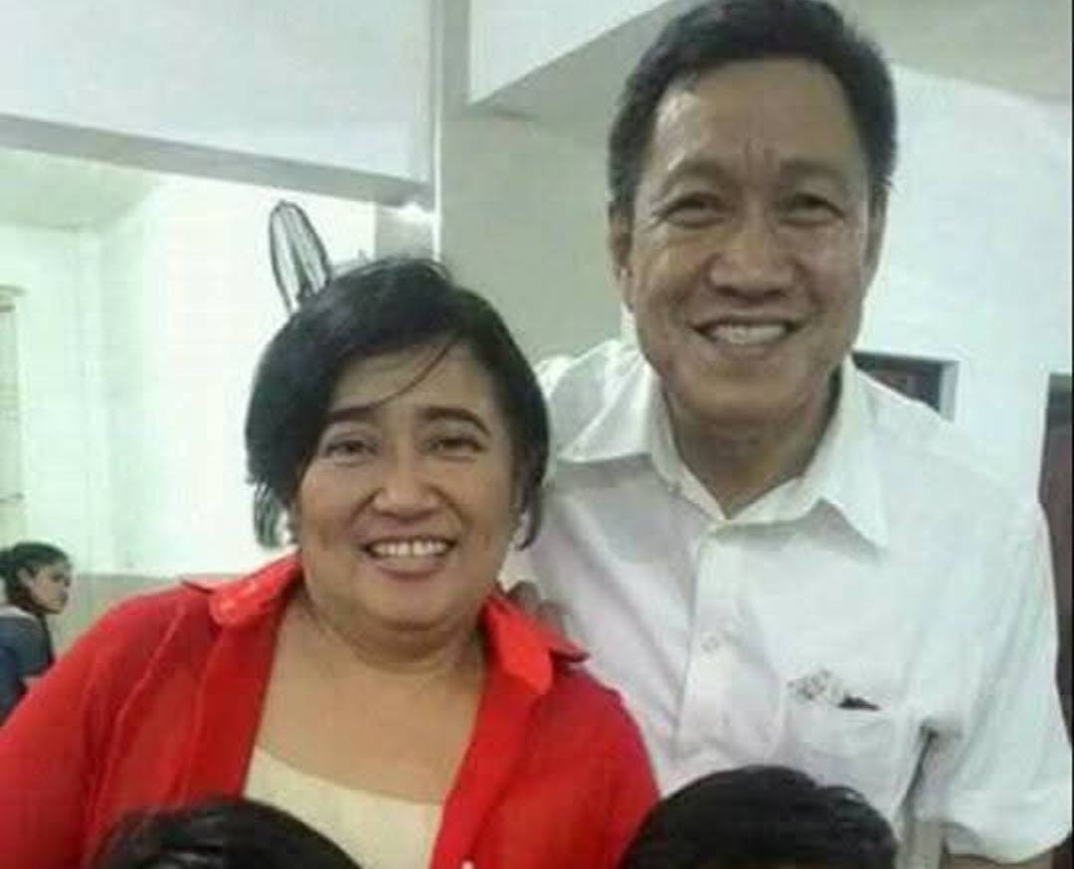

Slide 11
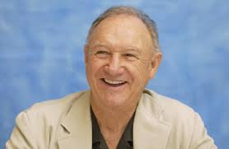

Slide 12
“14 For we believe that Jesus died and rose again, and so we believe that God will bring with Jesus those who have fallen asleep in him.”

Slide 13
John 14:9, “because I live, you will love also.”

Slide 14
1 Corinthians 15:35, “But someone may ask, ‘How are the dead raised? With what kind of body will they come?’”

Slide 15
Look at verse 15. “15 According to the Lord’s word, we tell you that we who are still alive, who are left until the coming of the Lord, will certainly not precede those who have fallen asleep.”

Slide 16
Acts 11:28 says, “One of them, named Agabus, stood up and through the Spirit predicted that a severe famine would spread over the entire Roman world. (This happened during the reign of Claudius.)”

Slide 17
Acts 21:11 says, “Coming over to us, he took Paul’s belt, tied his own hands and feet with it and said, ‘The Holy Spirit says, “In this way the Jewish leaders in Jerusalem will bind the owner of this belt and will hand him over to the Gentiles.”’”

Slide 18
John 14:1-3, “Do not let your hearts be troubled. You believe in God; believe also in me. 2 My Father’s house has many rooms; if that were not so, would I have told you that I am going there to prepare a place for you? 3 And if I go and prepare a place for you, I will come back and take you to be with me that you also may be where I am.”

Slide 19
Verse 15b, “…who are left until the coming of the Lord, will certainly not precede those who have fallen asleep.”

Slide 20
Look at verses 16-17. “16 For the Lord himself will come down from heaven, with a loud command, with the voice of the archangel and with the trumpet call of God, and the dead in Christ will rise first. 17 After that, we who are still alive and are left will be caught up together with them in the clouds to meet the Lord in the air. And so we will be with the Lord forever.”

Slide 21
John 5:25, “Very truly I tell you, a time is coming and has now come when the dead will hear the voice of the Son of God and those who hear will live.”

Slide 22
Romans 13:11, “And do this, understanding the present time: The hour has already come for you to wake up from your slumber, because our salvation is nearer now than when we first believed.”

Slide 23
Look at verse 17 again. “After that, we who are still alive and are left will be caught up together with them in the clouds to meet the Lord in the air. And so we will be with the Lord forever.”

Slide 24
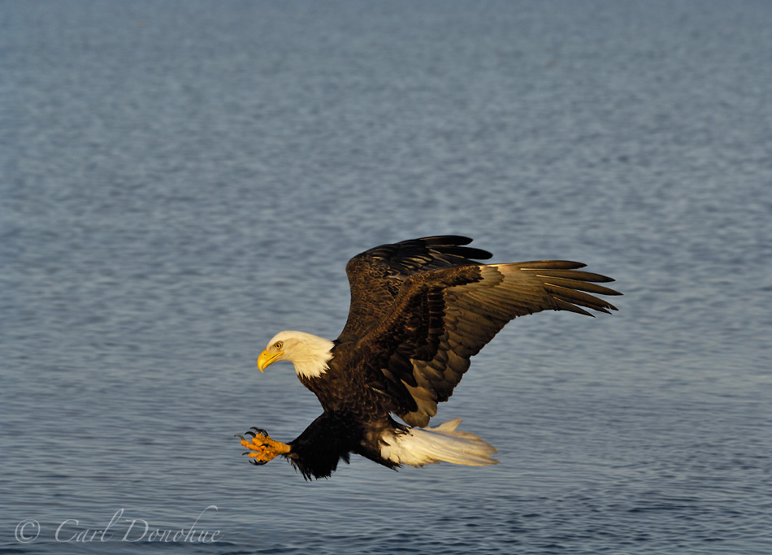

Slide 25
John 10:28-29, “28 I give them eternal life, and they shall never perish; no one will snatch them out of my hand. 29 My Father, who has given them to me, is greater than all; no one can snatch them out of my Father’s hand.”

Slide 27
1 Corinthians 15:50-52 reads, “50 I declare to you, brothers and sisters, that flesh and blood cannot inherit the kingdom of God, nor does the perishable inherit the imperishable. 51 Listen, I tell you a mystery: We will not all sleep, but we will all be changed— 52 in a flash, in the twinkling of an eye, at the last trumpet. For the trumpet will sound, the dead will be raised imperishable, and we will be changed.”

Slide 28
Look at verse 18. “18 Therefore encourage one another with these words.”

Slide 29
Matthew 24:42 and 44 reads, “42 Therefore keep watch, because you do not know on what day your Lord will come…44 So you also must be ready, because the Son of Man will come at an hour when you do not expect him.”

