Slide 1
1 Thessalonians 5:1-11: Now, brothers and sisters, about times and dates we do not need to write to you, 2 for you know very well that the day of the Lord will come like a thief in the night. 3 While people are saying, “Peace and safety,” destruction will come on them suddenly, as labor pains on a pregnant woman, and they will not escape.

Slide 2
4 But you, brothers and sisters, are not in darkness so that this day should surprise you like a thief. 5 You are all children of the light and children of the day. We do not belong to the night or to the darkness. 6 So then, let us not be like others, who are asleep, but let us be awake and sober. 7 For those who sleep, sleep at night, and those who get drunk, get drunk at night.

Slide 3
8 But since we belong to the day, let us be sober, putting on faith and love as a breastplate, and the hope of salvation as a helmet. 9 For God did not appoint us to suffer wrath but to receive salvation through our Lord Jesus Christ. 10 He died for us so that, whether we are awake or asleep, we may live together with him. 11 Therefore encourage one another and build each other up, just as in fact you are doing.

Slide 4
The Day of the Lord (Subtitle: How believers are to live while waiting for Jesus’ Return) 1 Thessalonians 5:1-11 Key Verse: 2: “…for you know very well that the day of the Lord will come like a thief in the night.”

Slide 5
Look at verses 1-3. “Now, brothers and sisters, about times and dates we do not need to write to you, 2 for you know very well that the day of the Lord will come like a thief in the night. 3 While people are saying, ‘Peace and safety,’ destruction will come on them suddenly, as labor pains on a pregnant woman, and they will not escape.”

Slide 6
Matthew 24:36 reads, “No one knows about that day or hour, not even the angels in heaven, nor the Son but only the Father.”

Slide 7
Look at verse 2 again. “…for you know very well that the day of the Lord will come like a thief in the night.”

Slide 8
Isaiah 13:6-11 reads, “Wail, for the day of the LORD is near; it will come like destruction from the Almighty. 7 Because of this, all hands will go limp, every heart will melt with fear.8 Terror will seize them, pain and anguish will grip them; they will writhe like a woman in labor. They will look aghast at each other, their faces aflame.9 See, the day of the LORD is coming—a cruel day, with wrath and fierce anger—to make the land desolate and destroy the sinners within it.10 The stars of heaven and their constellations will not show their light. The rising sun will be darkened and the moon will not give its light.”

Slide 9
2 Peter 3:10, “The day of the Lord will come like a thief, in which the heavens will pass away with a roar and the elements will be destroyed with intense heat, and the earth and all its will be burned up.”

Slide 10
Look at verse 3 again. “While people are saying, ‘Peace and safety,’ destruction will come on them suddenly, as labor pains on a pregnant woman, and they will not escape.”

Slide 11
Matthew 24:37-38 reads, “As it was in the days of Noah, so it will be at the coming of the Son of Man. 38 For in the days before the flood, people were eating and drinking, marrying and giving in marriage, up to the day Noah entered the ark.”

Slide 12
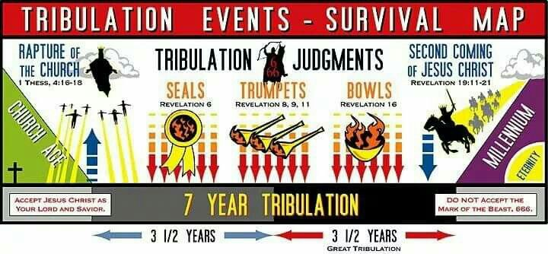

Slide 13
Look at verses 4-5. “4 But you, brothers and sisters, are not in darkness so that this day should surprise you like a thief. 5 You are all children of the light and children of the day. We do not belong to the night or to the darkness.”

Slide 14
First John 1:5 reads, “This is the message we have heard from him and declare to you: God is light; in him there is no darkness at all.”

Slide 15
John 8:12 reads, “12 When Jesus spoke again to the people, he said, ‘I am the light of the world. Whoever follows me will never walk in darkness, but will have the light of life.’”

Slide 16
John 3:19, “This is the verdict: Light has come into the world, but people loved darkness instead of light because their deeds were evil.”

Slide 17
Acts 26:18, “…to open their eyes and turn them from darkness to light, and from the power of Satan to God, so that they may receive forgiveness of sins and a place among those who are sanctified by faith in me.”

Slide 18
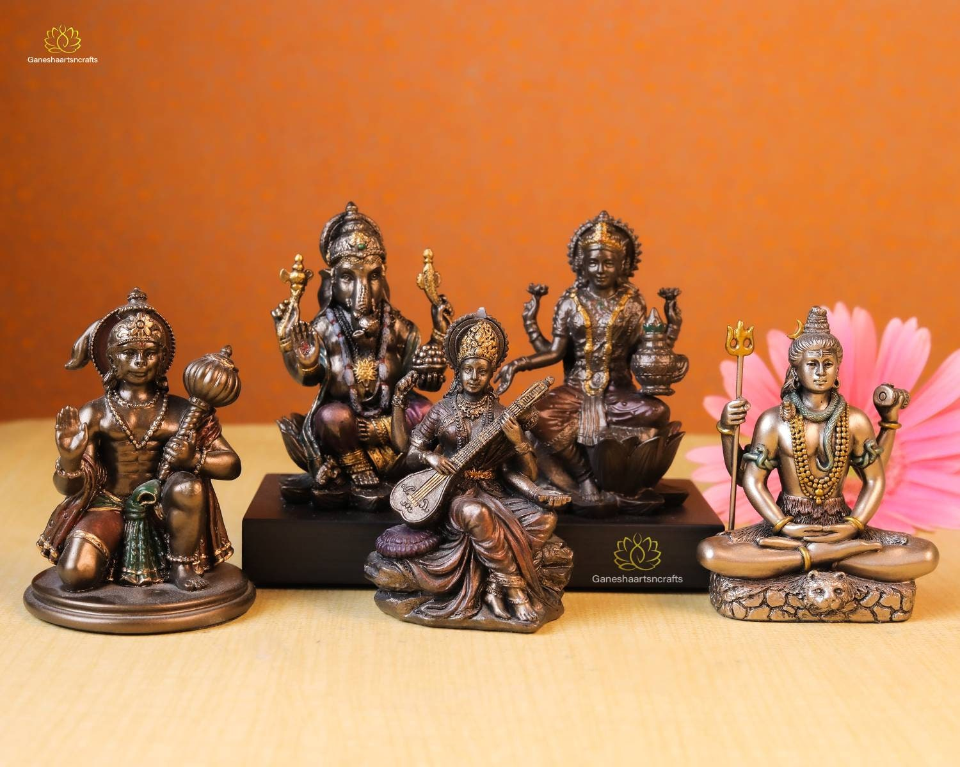

Slide 19
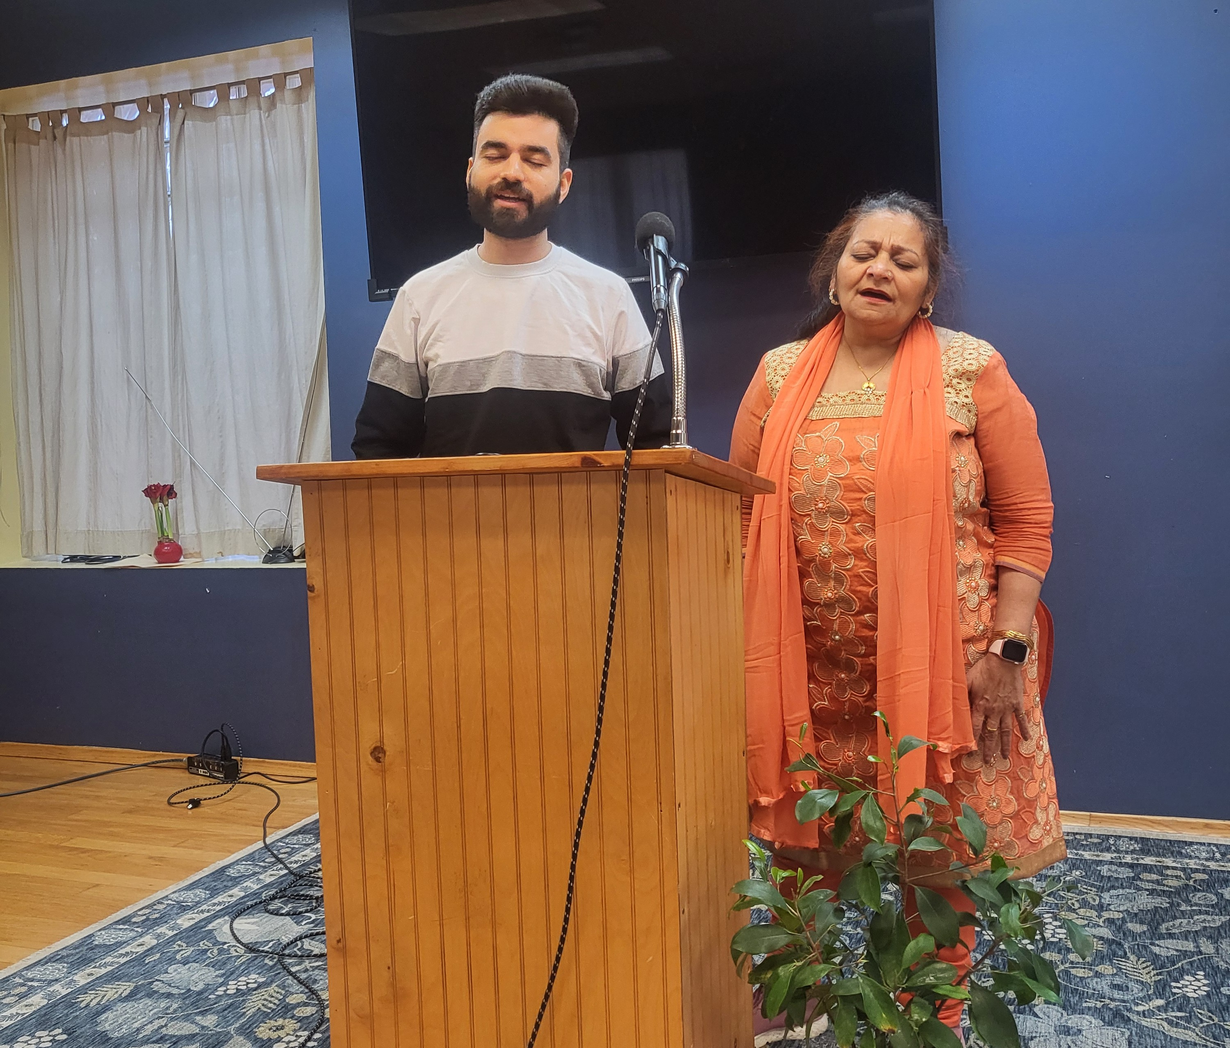

Slide 20
Look at verses 6-7. “6 So then, let us not be like others, who are asleep, but let us be awake and sober. 7 For those who sleep, sleep at night, and those who get drunk, get drunk at night.”

Slide 21
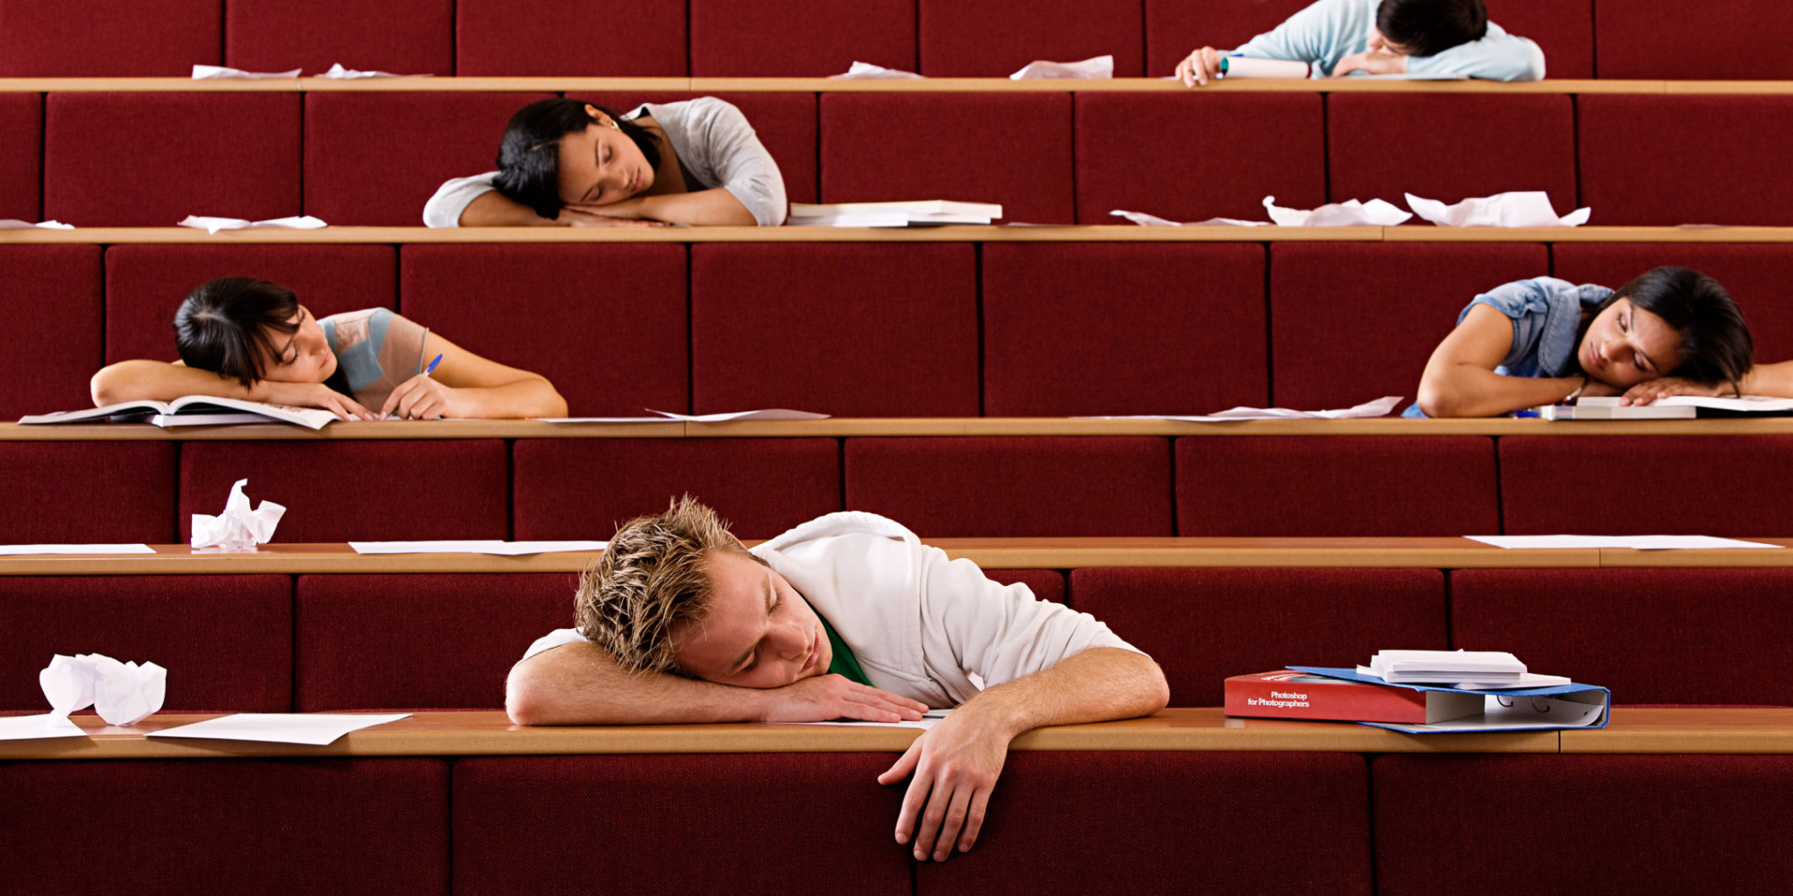

Slide 22
Look at verse 7 again. “7 For those who sleep, sleep at night, and those who get drunk, get drunk at night.”

Slide 23
Romans 13:11-14, “11 And do this, understanding the present time: The hour has already come for you to wake up from your slumber, because our salvation is nearer now than when we first believed. 12 The night is nearly over; the day is almost here. So let us put aside the deeds of darkness and put on the armor of light. 13 Let us behave decently, as in the daytime, not in carousing and drunkenness, not in sexual immorality and debauchery, not in dissension and jealousy. 14 Rather, clothe yourselves with the Lord Jesus Christ, and do not think about how to gratify the desires of the flesh.”

Slide 24
Look at verses 8-9. “8 But since we belong to the day, let us be sober, putting on faith and love as a breastplate, and the hope of salvation as a helmet. 9 For God did not appoint us to suffer wrath but to receive salvation through our Lord Jesus Christ.”

Slide 25
Look at verses 10-11. “10 He died for us so that, whether we are awake or asleep, we may live together with him. 11 Therefore encourage one another and build each other up, just as in fact you are doing.”

Slide 26
Ephesians 4:15-16, “Instead, speaking the truth in love, we will grow to become in every respect the mature body of him who is the head, that is, Christ. 16 From him the whole body, joined and held together by every supporting ligament, grows and builds itself up in love, as each part does its work.”

Slide 27
Parousia in Greek means “arrival” P. A. R. O. U. S. I. A.

