Slide 1
1 Thessalonians 5:12-28 12 Now we ask you, brothers and sisters, to acknowledge those who work hard among you, who care for you in the Lord and who admonish you. 13 Hold them in the highest regard in love because of their work. Live in peace with each other. 14 And we urge you, brothers and sisters, warn those who are idle and disruptive, encourage the disheartened, help the weak, be patient with everyone. 15 Make sure that nobody pays back wrong for wrong, but always strive to do what is good for each other and for everyone else.

Slide 2
16 Rejoice always, 17 pray continually, 18 give thanks in all circumstances; for this is God’s will for you in Christ Jesus. 19 Do not quench the Spirit. 20 Do not treat prophecies with contempt 21 but test them all; hold on to what is good, 22 reject every kind of evil.

Slide 3
23 May God himself, the God of peace, sanctify you through and through. May your whole spirit, soul and body be kept blameless at the coming of our Lord Jesus Christ. 24 The one who calls you is faithful, and he will do it. 25 Brothers and sisters, pray for us. 26 Greet all God’s people with a holy kiss. 27 I charge you before the Lord to have this letter read to all the brothers and sisters. 28 The grace of our Lord Jesus Christ be with you.

Slide 4
Be Sanctified Through and Through (Subtitle: Be Joyful, Prayerful, and Thankful) 1 Thessalonians 5:12-28 Key Verse: 23: “May God himself, the God of peace, sanctify you through and through. May your whole spirit, soul and body be kept blameless at the coming of our Lord Jesus Christ.”

Slide 5
Look at verses 12-13. “Now we ask you, brothers and sisters, to acknowledge those who work hard among you, who care for you in the Lord and who admonish you. 13 Hold them in the highest regard in love because of their work. Live in peace with each other.”

Slide 6
Acts 14:23 reads, “Paul and Barnabas appointed elders for them in each church and, with prayer and fasting, committed them to the Lord, in whom they had put their trust.”

Slide 8
John 10:11 reads, “I am the good shepherd. The good shepherd lays down his life for the sheep.”

Slide 9
Hebrews 13:17 reads, “Have confidence in your leaders and submit to their authority, because they keep watch over you as those who must give an account. Do this so that their work will be a joy, not a burden, for that would be of no benefit to you.”

Slide 10
Look at verses 14-15. “And we urge you, brothers and sisters, warn those who are idle and disruptive, encourage the disheartened, help the weak, be patient with everyone. 15 Make sure that nobody pays back wrong for wrong, but always strive to do what is good for each other and for everyone else.”

Slide 11
First Peter 2:9a reads, “But you are a chosen people, a royal priesthood, a holy nation, a people belonging to God…”

Slide 12
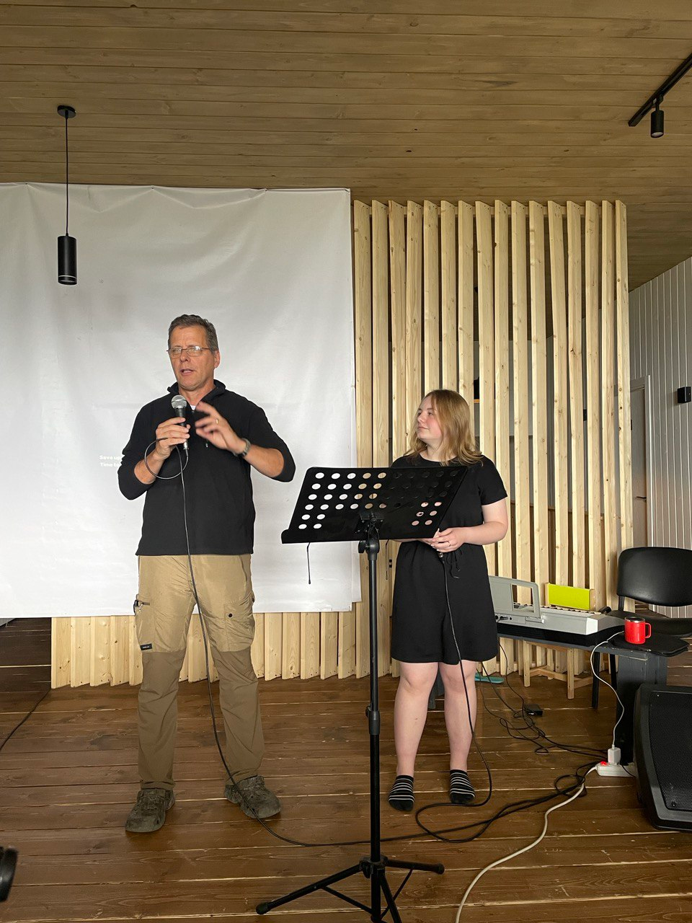

Slide 13
Look at verses 16-18. “Rejoice always, 17 pray continually, 18 give thanks in all circumstances; for this is God’s will for you in Christ Jesus.”

Slide 14
John 16:24 reads, “Until now you have not asked for anything in my name. Ask and you will receive, and your joy will be complete.”

Slide 15
Hebrews 12:11, “All discipline for the moment seems not to be joyful, but sorrowful; yet to those who have been trained by it, afterwards it yields the peaceful fruit of righteousness.”

Slide 16
What do I do with the darkness? How do I deal with its starkness? Guard my heart and my eyes; pray with tears and cries. Darkness in life will not last, but expect another when you fast. If you're not prepared, you'll be depressed. Darkness is the name of the game; it's not for the tame and lame. You need a Strong Man to deliver you; without Him, you won't have a clue.

Slide 17
Look at 19-22. “Do not quench the Spirit. 20 Do not treat prophecies with contempt 21 but test them all; hold on to what is good, 22 reject every kind of evil.”

Slide 18
Ephesians 4:29-31 reads, “Do not let any unwholesome talk come out of your mouths, but only what is helpful for building others up according to their needs, that it may benefit those who listen. 30 And do not grieve the Holy Spirit of God, with whom you were sealed for the day of redemption. 31 Get rid of all bitterness, rage and anger, brawling and slander, along with every form of malice.”

Slide 19
Look at verses 23-24. “May God himself, the God of peace, sanctify you through and through. May your whole spirit, soul and body be kept blameless at the coming of our Lord Jesus Christ. 24 The one who calls you is faithful, and he will do it.”

Slide 21
Colossians 3:2, “Set your minds on things above, not on earthly things.”

Slide 22
Verse 24, “The one who calls you is faithful, and he will do it.”

Slide 23
Hebrews 4:12 reads, “For the word of God is alive and active. Sharper than any double-edged sword, it penetrates even to dividing soul and spirit, joints and marrow; it judges the thoughts and attitudes of the heart.”

Slide 24
Look at verses 25-28. “25 Brothers and sisters, pray for us. 26 Greet all God’s people with a holy kiss. 27 I charge you before the Lord to have this letter read to all the brothers and sisters.28 The grace of our Lord Jesus Christ be with you.”

Slide 25
Admonish means to warn from harmful things: A— D— M— O— N— I— S— H—

