Slide 1
2 Thessalonians 2:1-2: 1 Paul, Silas[a] and Timothy, To the church of the Thessalonians in God our Father and the Lord Jesus Christ: 2 Grace and peace to you from God the Father and the Lord Jesus Christ. Thanksgiving and Prayer 3 We ought always to thank God for you, brothers and sisters,[b] and rightly so, because your faith is growing more and more, and the love all of you have for one another is increasing.

Slide 2
4 Therefore, among God’s churches we boast about your perseverance and faith in all the persecutions and trials you are enduring. 5 All this is evidence that God’s judgment is right, and as a result you will be counted worthy of the kingdom of God, for which you are suffering. 6 God is just: He will pay back trouble to those who trouble you 7 and give relief to you who are troubled, and to us as well. This will happen when the Lord Jesus is revealed from heaven in blazing fire with his powerful angels.

Slide 3
8 He will punish those who do not know God and do not obey the gospel of our Lord Jesus. 9 They will be punished with everlasting destruction and shut out from the presence of the Lord and from the glory of his might 10 on the day he comes to be glorified in his holy people and to be marveled at among all those who have believed. This includes you, because you believed our testimony to you.

Slide 4
11 With this in mind, we constantly pray for you, that our God may make you worthy of his calling, and that by his power he may bring to fruition your every desire for goodness and your every deed prompted by faith. 12 We pray this so that the name of our Lord Jesus may be glorified in you, and you in him, according to the grace of our God and the Lord Jesus Christ.[c]

Slide 5
Be Counted Worthy of God’s Calling (Subtitle: Jesus may be Gloried in you) 2 Thessalonians 1:1-12 Key Verse: 11: “With this in mind, we constantly pray for you, that our God may make you worthy of his calling, and that by his power he may bring to fruition your every desire for goodness and your every deed prompted by faith.”

Slide 6
Look at verses 1-2. “Paul, Silas[a] and Timothy, To the church of the Thessalonians in God our Father and the Lord Jesus Christ:2 Grace and peace to you from God the Father and the Lord Jesus Christ.”

Slide 7
Acts 16:25 reads, “About midnight Paul and Silas were praying and singing hymns to God, and the other prisoners were listening to them.”

Slide 8
Look at verses 1b-2 again. “…in God our Father and the Lord Jesus Christ:2 Grace and peace to you from God the Father and the Lord Jesus Christ.”

Slide 9
Look at verses 3-4. “We ought always to thank God for you, brothers and sisters,[b] and rightly so, because your faith is growing more and more, and the love all of you have for one another is increasing. 4 Therefore, among God’s churches we boast about your perseverance and faith in all the persecutions and trials you are enduring.”

Slide 10
John 13:34-35, “A new command I give you: Love one another. As I have loved you, so you must love one another. 35 By this everyone will know that you are my disciples, if you love one another.”

Slide 11
Romans 5:3-4 reads, “Not only so, but we also glory in our sufferings, because we know that suffering produces perseverance; 4 perseverance, character; and character, hope.”

Slide 12
Look at verses 5-7, “5 All this is evidence that God’s judgment is right, and as a result you will be counted worthy of the kingdom of God, for which you are suffering. 6 God is just: He will pay back trouble to those who trouble you 7 and give relief to you who are troubled, and to us as well. This will happen when the Lord Jesus is revealed from heaven in blazing fire with his powerful angels.”

Slide 13
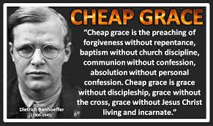

Slide 14
Look again at verses 6-7. “God is just: He will pay back trouble to those who trouble you 7 and give relief to you who are troubled, and to us as well. This will happen when the Lord Jesus is revealed from heaven in blazing fire with his powerful angels.”

Slide 15
Look at verses 8-10. “8 He will punish those who do not know God and do not obey the gospel of our Lord Jesus. 9 They will be punished with everlasting destruction and shut out from the presence of the Lord and from the glory of his might 10 on the day he comes to be glorified in his holy people and to be marveled at among all those who have believed. This includes you, because you believed our testimony to you.”

Slide 16
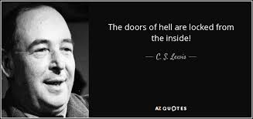

Slide 17
Romans 1:5 reads, “Through him we received grace and apostleship to call all the Gentiles to the obedience that comes from[a] faith for his name’s sake.”

Slide 18
Look at verses 11-12. “11 With this in mind, we constantly pray for you, that our God may make you worthy of his calling, and that by his power he may bring to fruition your every desire for goodness and your every deed prompted by faith. 12 We pray this so that the name of our Lord Jesus may be glorified in you, and you in him, according to the grace of our God and the Lord Jesus Christ.[c]”

Slide 19
Romans 1:32 in the ASV reads, “…who, knowing the ordinance of God, that they that practise such things are worthy of death, not only do the same, but also consent with them that practise them.”

Slide 20
John 14:13-14, “And I will do whatever you ask in my name, so that the Father may be glorified in the Son. 14 You may ask me for anything in my name, and I will do it.”

Slide 21
Look at verse 12 again. “We pray this so that the name of our Lord Jesus may be glorified in you, and you in him, according to the grace of our God and the Lord Jesus Christ.[c]”

Slide 22
John 17:4-5, “I have brought you glory on earth by finishing the work you gave me to do. 5 And now, Father, glorify me in your presence with the glory I had with you before the world began.”

Slide 23
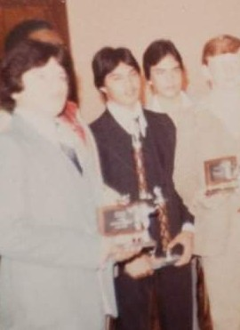

Slide 24
Worthy of God’s calling: W: O: R: T: H: Y:

