Slide 1
Acts 9:1-19a Meanwhile, Saul was still breathing out murderous threats against the Lord’s disciples. He went to the high priest ² and asked him for letters to the synagogues in Damascus, so that if he found any there who belonged to the Way, whether men or women, he might take them as prisoners to Jerusalem. ³ As he neared Damascus on his journey, suddenly a light from heaven flashed around him. ⁴ He fell to the ground and heard a voice say to him, “Saul, Saul, why do you persecute me? ⁵ “Who are you, Lord?” Saul asked. “I am Jesus, whom you are persecuting,” he replied. ⁶ “Now get up and go into the city, and you will be told what you must do.”

Slide 2
⁷ The men traveling with Saul stood there speechless; they heard the sound but did not see anyone. ⁸ Saul got up from the ground, but when he opened his eyes he could see nothing. So they led him by the hand into Damascus. ⁹ For three days he was blind, and did not eat or drink anything. ¹⁰ In Damascus there was a disciple named Ananias. The Lord called to him in a vision, “Ananias!” “Yes, Lord,” he answered. ¹¹ The Lord told him, “Go to the house of Judas on Straight Street and ask for a man from Tarsus named Saul, for he is praying. ¹² In a vision he has seen a man named Ananias come and place his hands on him to restore his sight.” ¹³ “Lord,” Ananias answered, “I have heard many reports about this man and all the harm he has done to your holy people in Jerusalem.

Slide 3
¹⁴ And he has come here with authority from the chief priests to arrest all who call on your name.” ¹⁵ But the Lord said to Ananias, “Go! This man is my chosen instrument to proclaim my name to the Gentiles and their kings and to the people of Israel. ¹⁶ I will show him how much he must suffer for my name.” ¹⁷ Then Ananias went to the house and entered it. Placing his hands on Saul, he said, “Brother Saul, the Lord—Jesus, who appeared to you on the road as you were coming here—has sent me so that you may see again and be filled with the Holy Spirit.” ¹⁸ Immediately, something like scales fell from Saul’s eyes, and he could see again. He got up and was baptized, ¹⁹ and after taking some food, he regained his strength.

Slide 4
THE POWER OF THE RISEN JESUS TO CHANGE SAUL TO PAUL (Third Sunday of Easter) Acts 9:1-19a Key Verse: 5: ⁵ “’Who are you, Lord?’ Saul asked. ‘I am Jesus, whom you are persecuting,’ he replied.”

Slide 5
Look at verses 1-2. “Meanwhile, Saul was still breathing out murderous threats against the Lord’s disciples. He went to the high priest ² and asked him for letters to the synagogues in Damascus, so that if he found any there who belonged to the Way, whether men or women, he might take them as prisoners to Jerusalem.”

Slide 6
John 14:6a, “I am the way, and the truth, and the life.”

Slide 7
Galatians 1:14 reads, “I was advancing in Judaism beyond many Jews of my own age and was extremely zealous for the traditions of my fathers.”

Slide 8
Acts 8:3 reads, “But Saul began to destroy the church. Going from house to house, he dragged off men and women and put them in prison.”

Slide 9
Philippians 3:5-6 reads, “…circumcised on the eight day, of the people of Israel, of the tribe of Benjamin, a Hebrew of Hebrews; in regard to the law, a Pharisee; as for zeal, persecuting the church; as for legalistic righteousness, faultless.”

Slide 10
Look at verses 3-4. “³ As he neared Damascus on his journey, suddenly a light from heaven flashed around him. ⁴ He fell to the ground and heard a voice say to him, “’Saul, Saul, why do you persecute me?’”

Slide 11
Revelation 1:16b, “His face was like the sun shining in all its brilliance.”

Slide 12
Look at verses 5-6. “⁵ ‘Who are you, Lord?’ Saul asked. ‘I am Jesus, whom you are persecuting,’ he replied. ⁶ ‘Now get up and go into the city, and you will be told what you must do.’”

Slide 13
Acts 26:14 reads, “We all fell to the ground, and I heard a voice saying to me in Aramaic ‘Saul, why do you persecute me? It is hard for you to kick against the goads.”

Slide 14
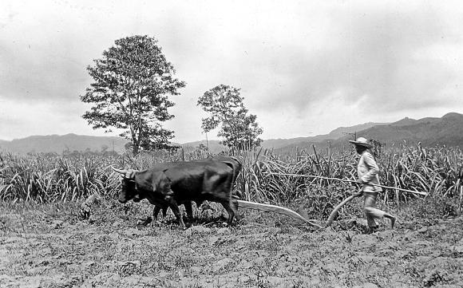

Slide 15
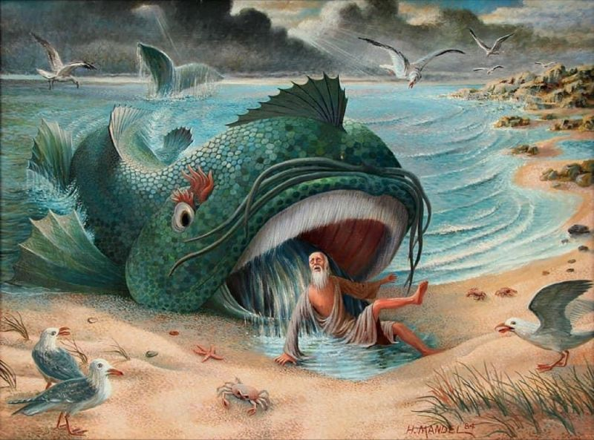

Slide 16
Look at verses 7-9. “⁷ The men traveling with Saul stood there speechless; they heard the sound but did not see anyone. ⁸ Saul got up from the ground, but when he opened his eyes he could see nothing. So they led him by the hand into Damascus. ⁹ For three days he was blind, and did not eat or drink anything.”

Slide 17
Look at verses 10-12. “¹⁰ In Damascus there was a disciple named Ananias. The Lord called to him in a vision, ‘Ananias!’ ‘Yes, Lord,’ he answered.¹¹ The Lord told him, ‘Go to the house of Judas on Straight Street and ask for a man from Tarsus named Saul, for he is praying. ¹² In a vision he has seen a man named Ananias come and place his hands on him to restore his sight.’”

Slide 18
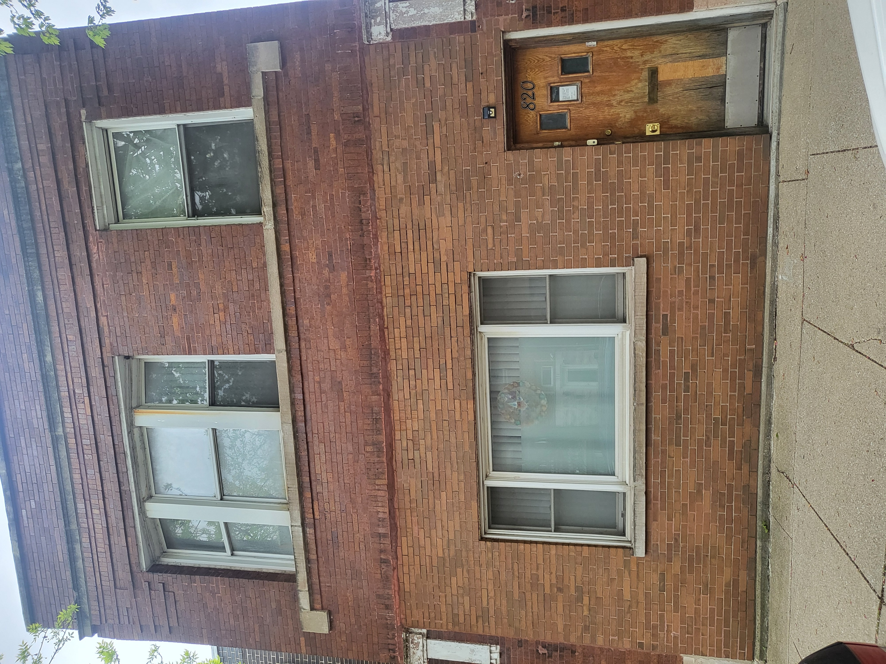

Slide 19
Look at verse 13-14. “¹³ ‘Lord,’ Ananias answered, ‘I have heard many reports about this man and all the harm he has done to your holy people in Jerusalem. ¹⁴ And he has come here with authority from the chief priests to arrest all who call on your name.’”

Slide 20
Look at verses 15-16. “¹⁵ But the Lord said to Ananias, ‘Go! This man is my chosen instrument to proclaim my name to the Gentiles and their kings and to the people of Israel. ¹⁶ I will show him how much he must suffer for my name.’”

Slide 21
1 Corinthians 9:20-22, “To the Jews I became like a Jew, to win the Jews. To those under the law I became like one under the law (though I myself am not under the law), so as to win those under the law. ²¹ To those not having the law I became like one not having the law (though I am not free from God’s law but am under Christ’s law), so as to win those not having the law. ²² To the weak I became weak, to win the weak. I have become all things to all people so that by all possible means I might save some.”

Slide 22
Look at verses 17-19a. “¹⁷ Then Ananias went to the house and entered it. Placing his hands on Saul, he said, ‘Brother Saul, the Lord—Jesus, who appeared to you on the road as you were coming here—has sent me so that you may see again and be filled with the Holy Spirit.’ ¹⁸ Immediately, something like scales fell from Saul’s eyes, and he could see again. He got up and was baptized, ¹⁹ and after taking some food, he regained his strength.”

Slide 23
John 20:29, “Then Jesus told him, ‘Because you have seen me, you have believed; blessed are those who have not seen and yet have believed.’”

Slide 24
