Slide 1
Acts 9:31-43
31 Then the church throughout Judea, Galilee and Samaria enjoyed a time of peace and was strengthened. Living in the fear of the Lord and encouraged by the Holy Spirit, it increased in numbers.
32 As Peter traveled about the country, he went to visit the Lord’s people who lived in Lydda.
33 There he found a man named Aeneas, who was paralyzed and had been bedridden for eight years.
34 “Aeneas,” Peter said to him, “Jesus Christ heals you. Get up and roll up your mat.” Immediately Aeneas got up.
35 All those who lived in Lydda and Sharon saw him and turned to the Lord.

Slide 2
³⁶ In Joppa there was a disciple named Tabitha (in Greek her name is Dorcas); she was always doing good and helping the poor.
³⁷ About that time she became sick and died, and her body was washed and placed in an upstairs room.
³⁸ Lydda was near Joppa; so when the disciples heard that Peter was in Lydda, they sent two men to him and urged him, “Please come at once!” ³⁹ Peter went with them, and when he arrived he was taken upstairs to the room. All the widows stood around him, crying and showing him the robes and other clothing that Dorcas had made while she was still with them.

Slide 3
⁴⁰ Peter sent them all out of the room; then he got down on his knees and prayed. Turning toward the dead woman, he said, “Tabitha, get up.” She opened her eyes, and seeing Peter she sat up.
⁴¹ He took her by the hand and helped her to her feet. Then he called for the believers, especially the widows, and presented her to them alive.
⁴² This became known all over Joppa, and many people believed in the Lord.
⁴³ Peter stayed in Joppa for some time with a tanner named Simon.

Slide 4
Peter Restores the Life of a Disciple Named Tabitha
(Fourth Week of Easter Season and Mother’s Day Message)
Acts 9:31–43
Key Verse: 36:
“³⁶ In Joppa there was a disciple named Tabitha (in Greek her name is Dorcas); she was always doing good and helping the poor.”

Slide 5
Look at verse 31. “Then the church throughout Judea, Galilee and Samaria enjoyed a time of peace and was strengthened. Living in the fear of the Lord and encouraged by the Holy Spirit, it increased in numbers.”

Slide 6
Proverbs 1:7 reads, “The fear of the Lord is the beginning of knowledge, but fools despise wisdom and instruction.”

Slide 7
Acts 5:11 and 14 read, “¹¹ Great fear seized the whole church and all who heard about these events…¹⁴ Nevertheless, more and more men and women believed in the Lord and were added to their number.”

Slide 8
Look at verses 32-33. “³² As Peter traveled about the country, he went to visit the Lord’s people who lived in Lydda. ³³ There he found a man named Aeneas, who was paralyzed and had been bedridden for eight years.”

Slide 9
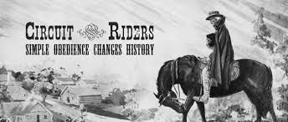

Slide 10
Look at verses 34-35. “³⁴ ‘Aeneas,’ Peter said to him, ‘Jesus Christ heals you. Get up and roll up your mat.’ Immediately Aeneas got up. ³⁵ All those who lived in Lydda and Sharon saw him and turned to the Lord.”

Slide 11
Acts 5:15-16 reads, “As a result, people brought the sick into the streets and laid them on beds and mats so that at least Peter’s shadow might fall on some of them as he passed by. ¹⁶ Crowds gathered also from the towns around Jerusalem, bringing their sick and those tormented by impure spirits, and all of them were healed.”

Slide 12
Luke 8:38-39 reads, “The man from whom the demons had gone out begged to go with him, but Jesus sent him away, saying, ³⁹ ‘Return home and tell how much God has done for you.’ So the man went away and told all over town how much Jesus had done for him.”

Slide 13
Look at verses 36-37. “³⁶ In Joppa there was a disciple named Tabitha (in Greek her name is Dorcas); she was always doing good and helping the poor. ³⁷ About that time she became sick and died, and her body was washed and placed in an upstairs room.”

Slide 14
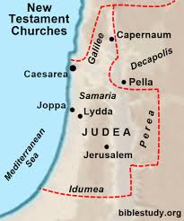

Slide 15
Ephesians 2:10, “For we are God’s handiwork, created in Christ Jesus to do good works, which God prepared in advance for us to do.”

Slide 16
Matthew 5:16, “In the same way, let your light shine before men, that they may see your good deeds and praise your Father in heaven.”

Slide 17
Look at verses 38-39. “³⁸ Lydda was near Joppa; so when the disciples heard that Peter was in Lydda, they sent two men to him and urged him, ‘Please come at once!’ ³⁹ Peter went with them, and when he arrived he was taken upstairs to the room. All the widows stood around him, crying and showing him the robes and other clothing that Dorcas had made while she was still with them.”

Slide 19
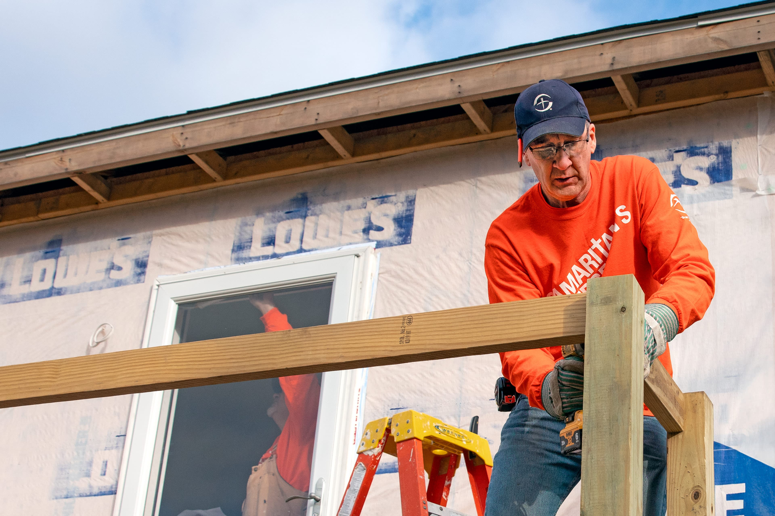

Slide 20
Look at verses 40-41. “⁴⁰ Peter sent them all out of the room; then he got down on his knees and prayed. Turning toward the dead woman, he said, ‘Tabitha, get up.’ She opened her eyes, and seeing Peter she sat up. ⁴¹ He took her by the hand and helped her to her feet. Then he called for the believers, especially the widows, and presented her to them alive.”

Slide 21
Mark 5:38-42, “When they came to the home of the synagogue leader, Jesus saw a commotion, with people crying and wailing loudly. ³⁹ He went in and said to them, ‘Why all this commotion and wailing? The child is not dead but asleep.’ ⁴⁰ But they laughed at him. After he put them all out, he took the child’s father and mother and the disciples who were with him, and went in where the child was. ⁴¹ He took her by the hand and said to her, ‘Talitha koum!’ (which means ‘Little girl, I say to you, get up!’). ⁴² Immediately the girl stood up and began to walk around (she was twelve years old). At this they were completely astonished.”

Slide 22
Look at verse 42. “⁴² This became known all over Joppa, and many people believed in the Lord.”

Slide 23
John 4:39-42, “Many of the Samaritans from that town believed in him because of the woman’s testimony, ‘He told me everything I ever did.’ ⁴⁰ So when the Samaritans came to him, they urged him to stay with them, and he stayed two days. ⁴¹ And because of his words many more became believers.⁴² They said to the woman, ’We no longer believe just because of what you said; now we have heard for ourselves, and we know that this man really is the Savior of the world.’”

Slide 24
Look at verse 43. “⁴³ Peter stayed in Joppa for some time with a tanner named Simon.”

Slide 25
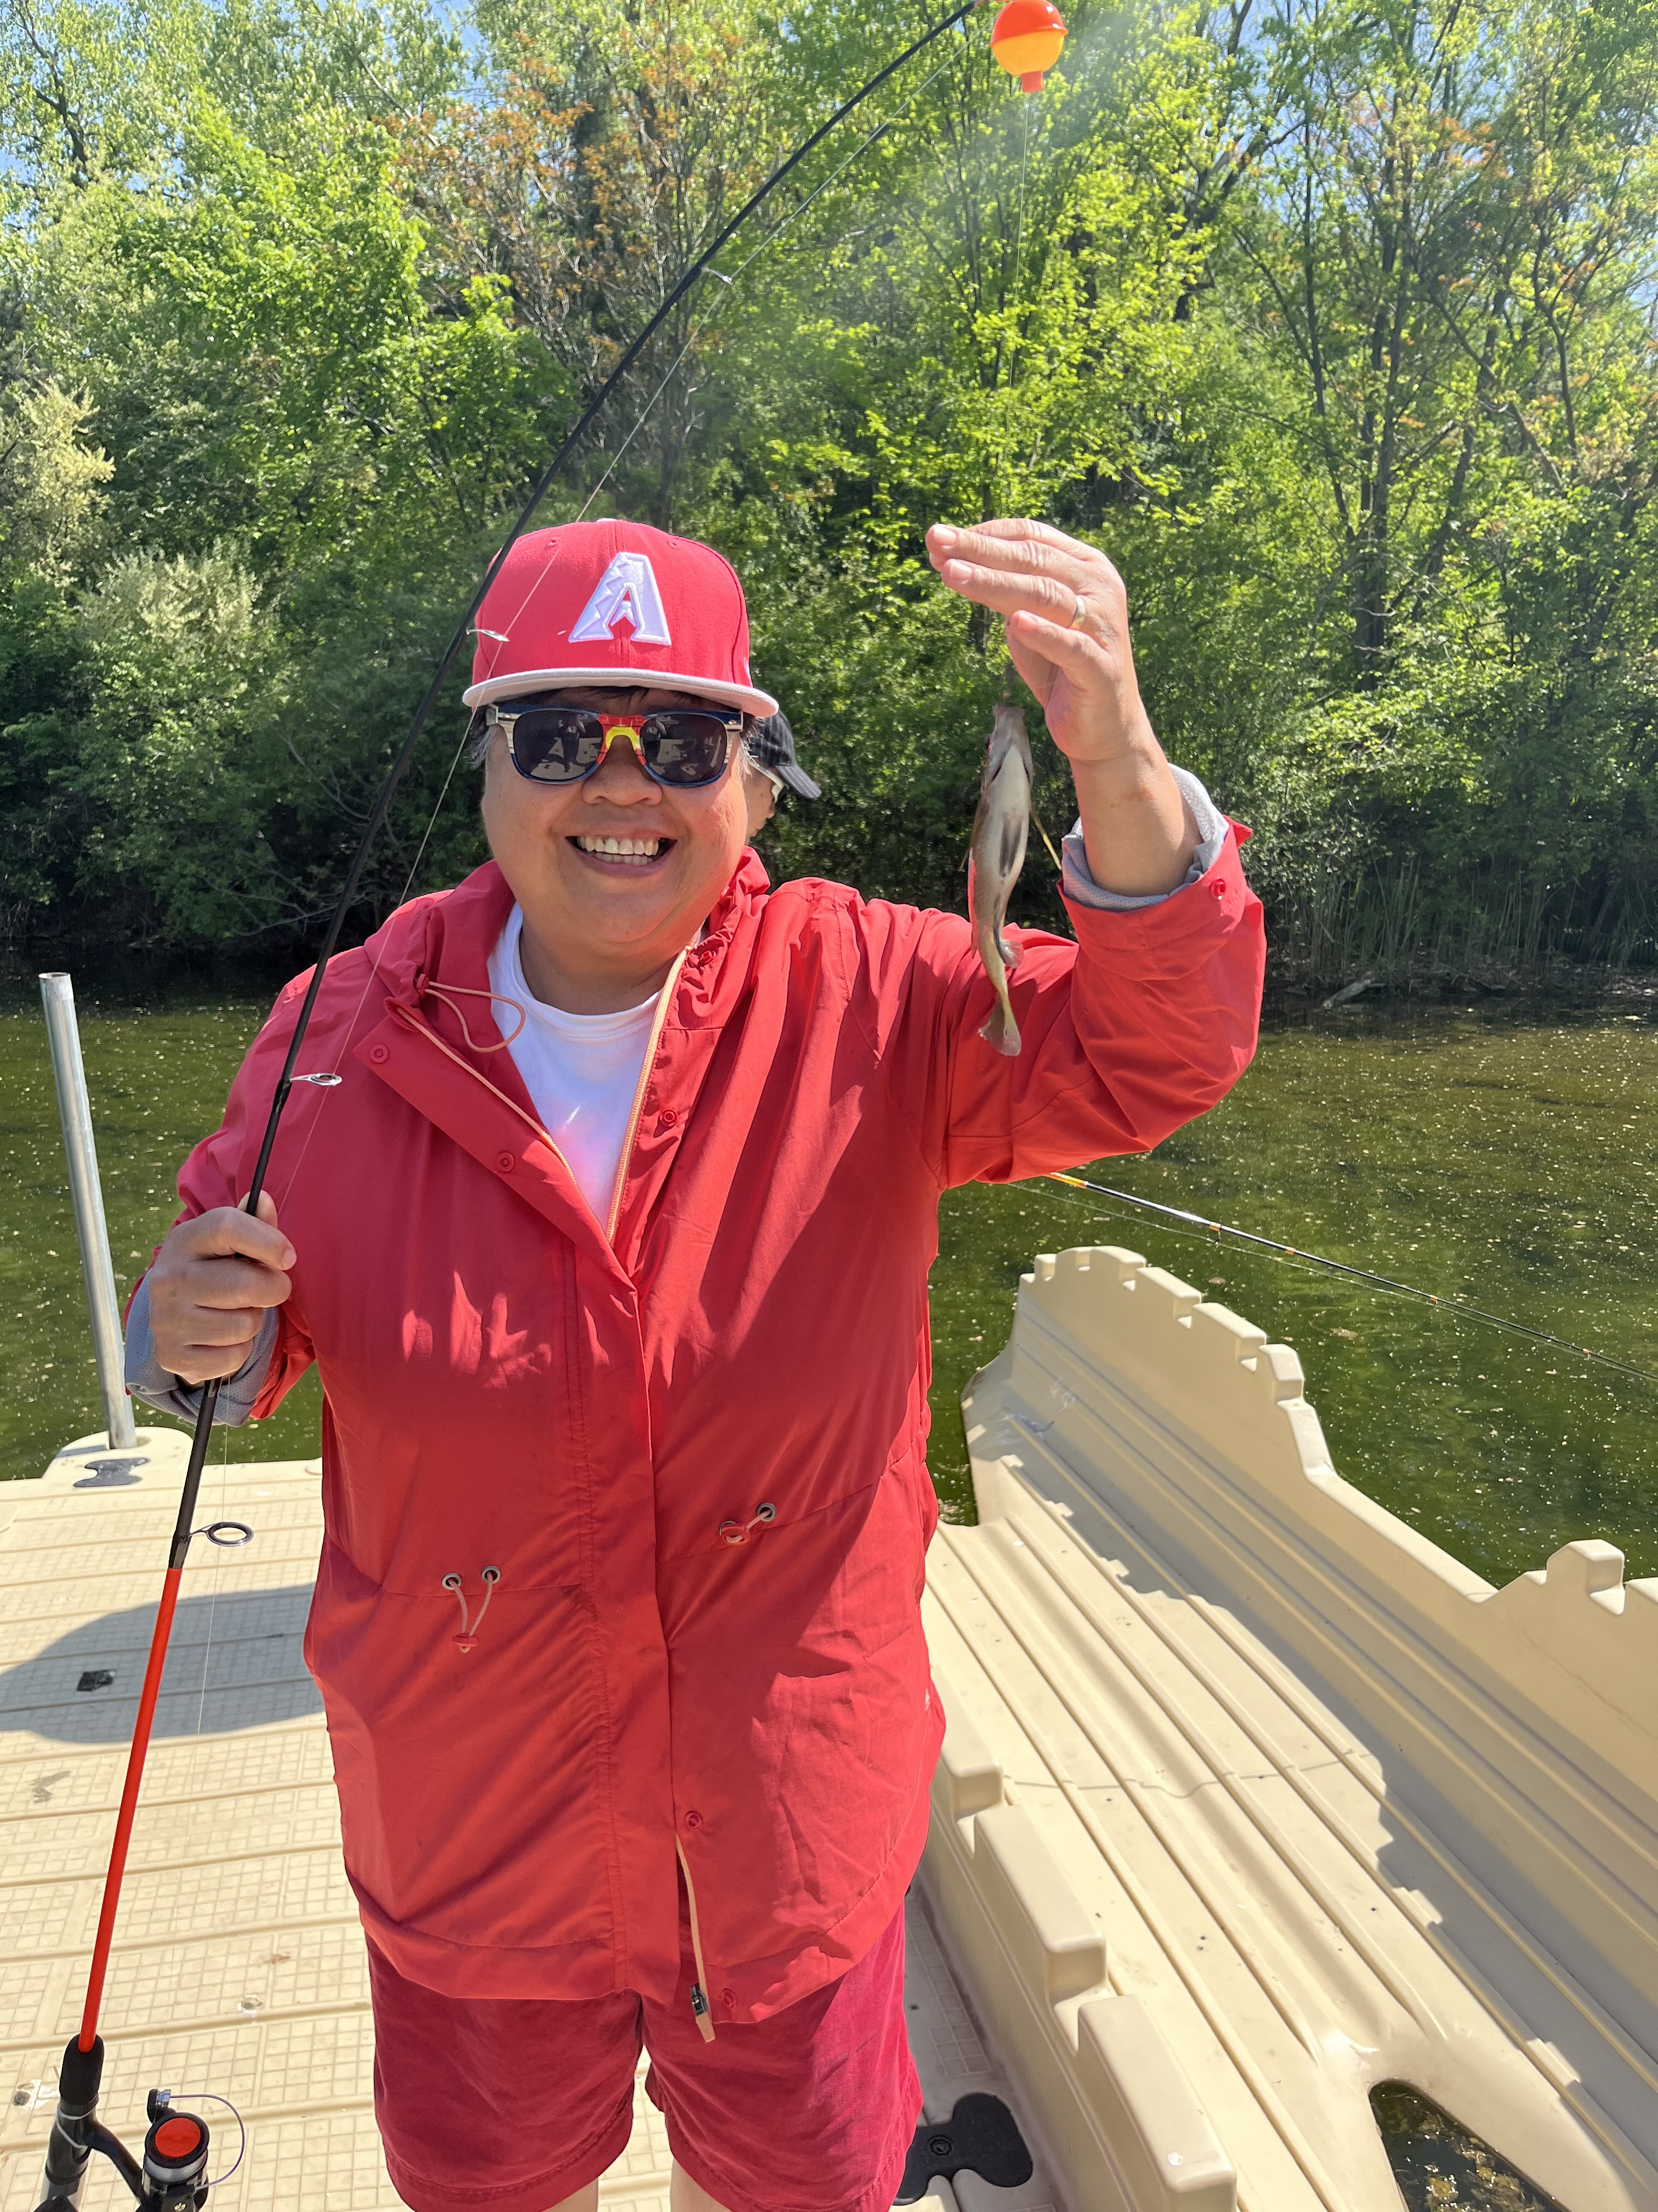

Slide 26
Mother’s Day Quiz about women of faith mentioned in the Bible:

