Slide 1
John 13:18-38:
^{“18} ‘I am not referring to all of you; I know those I have chosen. But this is to fulfill this passage of Scripture: “He who shared my bread has turned^{[a]} against me.”^{[b]}
¹⁹ ‘I am telling you now before it happens, so that when it does happen you will believe that I am who I am.
²⁰ Very truly I tell you, whoever accepts anyone I send accepts me; and whoever accepts me accepts the one who sent me.’ ²¹ After he had said this, Jesus was troubled in spirit and testified, ‘Very truly I tell you, one of you is going to betray me.’”

Slide 2
“²² His disciples stared at one another, at a loss to know which of them he meant.
²³ One of them, the disciple whom Jesus loved, was reclining next to him.
²⁴ Simon Peter motioned to this disciple and said, ‘Ask him which one he means.’
²⁵ Leaning back against Jesus, he asked him, ‘Lord, who is it?’”
“²⁶ Jesus answered, ‘It is the one to whom I will give this piece of bread when I have dipped it in the dish.’ Then, dipping the piece of bread, he gave it to Judas, the son of Simon Iscariot.
²⁷ As soon as Judas took the bread, Satan entered into him. So Jesus told him, ‘What you are about to do, do quickly.’
²⁸ But no one at the meal understood why Jesus said this to him.
²⁹ Since Judas had charge of the money, some thought Jesus was telling him to buy what was needed for the festival, or to give something to the poor.
³⁰ As soon as Judas had taken the bread, he went out. And it was night.”

Slide 3
“³¹ When he was gone, Jesus said, ‘Now the Son of Man is glorified and God is glorified in him.
³² If God is glorified in him,^{[c]} God will glorify the Son in himself, and will glorify him at once.’”
³³ “My children, I will be with you only a little longer. You will look for me, and just as I told the Jews, so I tell you now: Where I am going, you cannot come.”
“³⁴ A new command I give you: Love one another. As I have loved you, so you must love one another.
³⁵ By this everyone will know that you are my disciples, if you love one another.
“³⁶ Simon Peter asked him, ‘Lord, where are you going?’ Jesus replied, ‘Where I am going, you cannot follow now, but you will follow later.’
³⁷ Peter asked, ‘Lord, why can’t I follow you now? I will lay down my life for you.’ “³⁸ Then Jesus answered, ‘Will you really lay down your life for me? Very truly I tell you, before the rooster crows, you will disown me three times!’”

Slide 4
God is Glorified in Him
(Fifth Week of the Easter Season)
John 13:18-38
Key Verses: 31-32:
³¹ When he was gone, Jesus said, “Now the Son of Man is glorified and God is glorified in him. ³² If God is glorified in him,^{[c]} God will glorify the Son in himself, and will glorify him at once.

Slide 5
Look at verses 18-21. ^{“18} ‘I am not referring to all of you; I know those I have chosen. But this is to fulfill this passage of Scripture: “He who shared my bread has turned^{[a]} against me.”^{[b]} ¹⁹ ‘I am telling you now before it happens, so that when it does happen you will believe that I am who I am. ²⁰ Very truly I tell you, whoever accepts anyone I send accepts me; and whoever accepts me accepts the one who sent me.’ ²¹ After he had said this, Jesus was troubled in spirit and testified, ‘Very truly I tell you, one of you is going to betray me.’”

Slide 6
Look at verses 22-25. “²² His disciples stared at one another, at a loss to know which of them he meant. ²³ One of them, the disciple whom Jesus loved, was reclining next to him. ²⁴ Simon Peter motioned to this disciple and said, ‘Ask him which one he means.’ ²⁵ Leaning back against Jesus, he asked him, ‘Lord, who is it?’”

Slide 7
1 Timothy 6:10, “For the love of money is a root of all kinds of evil. Some people, eager for money, have wandered from the faith and pierced themselves with many griefs.”

Slide 8
Look at verses 26-30. “²⁶ Jesus answered, ‘It is the one to whom I will give this piece of bread when I have dipped it in the dish.’ Then, dipping the piece of bread, he gave it to Judas, the son of Simon Iscariot. ²⁷ As soon as Judas took the bread, Satan entered into him. So Jesus told him, ‘What you are about to do, do quickly.’ ²⁸ But no one at the meal understood why Jesus said this to him. ²⁹ Since Judas had charge of the money, some thought Jesus was telling him to buy what was needed for the festival, or to give something to the poor. ³⁰ As soon as Judas had taken the bread, he went out. And it was night.”

Slide 9
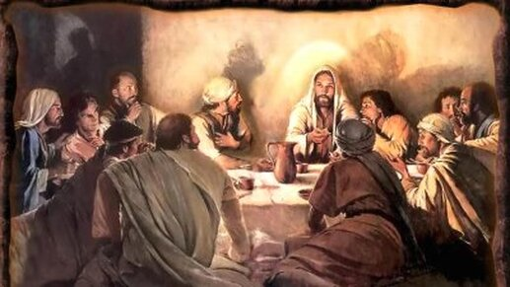

Slide 10
Hebrews 10:26-27, “If we deliberately keep on sinning after we have received the knowledge of the truth, no sacrifice for sins is left, ²⁷ but only a fearful expectation of judgment and of raging fire that will consume the enemies of God.”

Slide 11
Look at verses 31-32. “³¹ When he was gone, Jesus said, ‘Now the Son of Man is glorified and God is glorified in him. ³² If God is glorified in him,^{[c]} God will glorify the Son in himself, and will glorify him at once.’”

Slide 12


Slide 13
Look at verses 33-35. ³³ “My children, I will be with you only a little longer. You will look for me, and just as I told the Jews, so I tell you now: Where I am going, you cannot come. ³⁴ A new command I give you: Love one another. As I have loved you, so you must love one another. ³⁵ By this everyone will know that you are my disciples, if you love one another.”

Slide 14
1 John 4:7-12, “⁷ Dear friends, let us love one another, for love comes from God. Everyone who loves has been born of God and knows God. ⁸ Whoever does not love does not know God, because God is love. ⁹ This is how God showed his love among us: He sent his one and only Son into the world that we might live through him. ¹⁰ This is love: not that we loved God, but that he loved us and sent his Son as an atoning sacrifice for our sins. ¹¹ Dear friends, since God so loved us, we also ought to love one another. ¹² No one has ever seen God; but if we love one another, God lives in us and his love is made complete in us.”

Slide 15
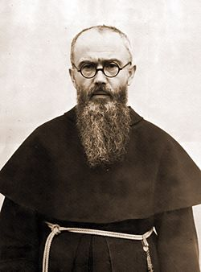

Slide 16
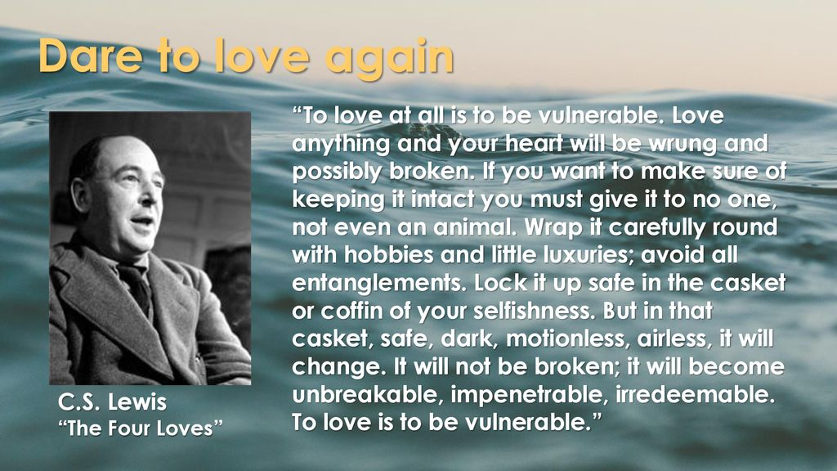

Slide 17
Look at verses 36-37. “³⁶ Simon Peter asked him, ‘Lord, where are you going?’ Jesus replied, ‘Where I am going, you cannot follow now, but you will follow later.’ ³⁷ Peter asked, ‘Lord, why can’t I follow you now? I will lay down my life for you.’ ³⁸ Then Jesus answered, ‘Will you really lay down your life for me? Very truly I tell you, before the rooster crows, you will disown me three times!’”

Slide 18
John 21:15b, “Yes, Lord, you know that I love you.”

