Slide 1
Mark 1:1-20 1 The beginning of the gospel of Jesus Christ, the Son of God.^{[a]} ² As it is written in Isaiah the prophet,^{[b]} “Behold, I send my messenger before your face, who will prepare your way,³ the voice of one crying in the wilderness: ‘Prepare^{[c]} the way of the Lord, make his paths straight,’” ⁴ John appeared, baptizing in the wilderness and proclaiming a baptism of repentance for the forgiveness of sins. ⁵ And all the country of Judea and all Jerusalem were going out to him and were being baptized by him in the river Jordan, confessing their sins.

Slide 2
⁶ Now John was clothed with camel's hair and wore a leather belt around his waist and ate locusts and wild honey. ⁷ And he preached, saying, “After me comes he who is mightier than I, the strap of whose sandals I am not worthy to stoop down and untie. ⁸ I have baptized you with water, but he will baptize you with the Holy Spirit.” ⁹ In those days Jesus came from Nazareth of Galilee and was baptized by John in the Jordan. ¹⁰ And when he came up out of the water, immediately he saw the heavens being torn open and the Spirit descending on him like a dove. ¹¹ And a voice came from heaven, “You are my beloved Son;^{[d]} with you I am well pleased.”

Slide 3
¹² The Spirit immediately drove him out into the wilderness. ¹³ And he was in the wilderness forty days, being tempted by Satan. And he was with the wild animals, and the angels were ministering to him. ¹⁴ Now after John was arrested, Jesus came into Galilee, proclaiming the gospel of God, ¹⁵ and saying, “The time is fulfilled, and the kingdom of God is at hand;^{[e]} repent and believe in the gospel.” ¹⁶ Passing alongside the Sea of Galilee, he saw Simon and Andrew the brother of Simon casting a net into the sea, for they were fishermen. ¹⁷ And Jesus said to them, “Follow me, and I will make you become fishers of men.”^{[f]}

Slide 4
¹⁸ And immediately they left their nets and followed him. ¹⁹ And going on a little farther, he saw James the son of Zebedee and John his brother, who were in their boat mending the nets. ²⁰ And immediately he called them, and they left their father Zebedee in the boat with the hired servants and followed him.

Slide 5
“WHY SHOULD I FOLLOW JESUS?” Mark 1:1-20 Key Verse: 17: “And Jesus said to them, ‘Follow me, and I will make you become fishers of men.’”

Slide 6
I. Follow Jesus because he is the divine Son of God and Messiah (1-11)

Slide 7
Look at verse 1. “The beginning of the gospel of Jesus Christ, the Son of God.”

Slide 8
Romans 1:16, “For I am not ashamed of the gospel, because it is the power of God that brings salvation to everyone who believes: first to the Jew, then to the Gentile.”

Slide 9
Look at verses 2-3. “As it is written in Isaiah the prophet, ‘Behold, I send my messenger before your face, who will prepare your way, ³ the voice of one crying in the wilderness: ‘Prepare the way of the Lord, make his paths straight,’”

Slide 10
Look at verses 4-8. “⁴ And so John the Baptist appeared in the wilderness, preaching a baptism of repentance for the forgiveness of sins. ⁵ The whole Judean countryside and all the people of Jerusalem went out to him. Confessing their sins, they were baptized by him in the Jordan River. 6 John wore clothing made of camel’s hair, with a leather belt around his waist, and he ate locusts and wild honey. 7 And this was his message: “After me comes the one more powerful than I, the straps of whose sandals I am not worthy to stoop down and untie. 8 I baptize you with[e] water, but he will baptize you with[f] the Holy Spirit.”

Slide 11
Acts 2:38, “And Peter said to them, ‘Repent and be baptized every one of you in the name of Jesus Christ for the forgiveness of your sins, and you will receive the gift of the Holy Spirit.’”

Slide 12
Look at verses 9-11. “In those days Jesus came from Nazareth of Galilee and was baptized by John in the Jordan. ¹⁰ And when he came up out of the water, immediately he saw the heavens being torn open and the Spirit descending on him like a dove. ¹¹ And a voice came from heaven, ‘You are my beloved Son; with you I am well pleased.’”

Slide 13
II. Follow Jesus who defeated Satan to save us from sin and death (12-15)

Slide 14
Look at verses 12-13. “The Spirit immediately drove him out into the wilderness. ¹³ And he was in the wilderness forty days, being tempted by Satan. And he was with the wild animals, and the angels were ministering to him.”

Slide 15
Look at verses 14-15. “Now after John was arrested, Jesus came into Galilee, proclaiming the gospel of God, ¹⁵ and saying, ‘The time is fulfilled, and the kingdom of God is at hand; repent and believe in the gospel.’”

Slide 16
Look at verse 16. “Passing alongside the Sea of Galilee, he saw Simon and Andrew the brother of Simon casting a net into the sea, for they were fishermen.”

Slide 17
John 15:16a, “You did not choose me, but I chose you and appointed you that you should go and bear fruit and that your fruit should abide.”

Slide 18
Look at verse 17, our key verse. “And Jesus said to them, ‘Follow me, and I will make you become fishers of men.’”

Slide 19
Look at verse 18. “And immediately they left their nets and followed him.”

Slide 20
Luke 5:8 reads, “But when Simon Peter saw it, he fell down at Jesus' knees, saying, ‘Depart from me, for I am a sinful man, O Lord.’”

Slide 21
Look at verses 19-20. “And going on a little farther, he saw James the son of Zebedee and John his brother, who were in their boat mending the nets. ²⁰ And immediately he called them, and they left their father Zebedee in the boat with the hired servants and followed him.”

Slide 22
1 Corinthians 1:26-29, “For consider your calling, brothers: not many of you were wise according to worldly standards, not many were powerful, not many were of noble birth. ²⁷ But God chose what is foolish in the world to shame the wise; God chose what is weak in the world to shame the strong; ²⁸ God chose what is low and despised in the world, even things that are not, to bring to nothing things that are, ²⁹ so that no human being might boast in the presence of God.”

Slide 23
Matthew 16:16-17, “Simon Peter replied, ‘You are the Christ, the Son of the living God.’ ¹⁷ And Jesus answered him, ‘Blessed are you, Simon Bar-Jonah! For flesh and blood has not revealed this to you, but my Father who is in heaven.’”

Slide 24
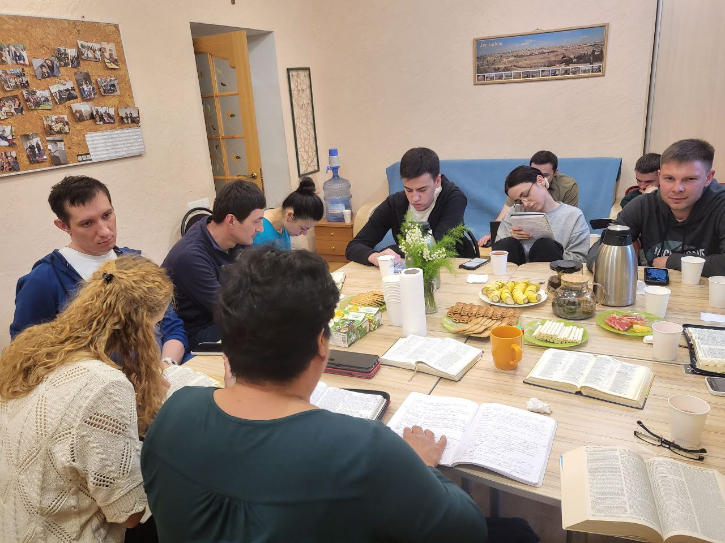

Slide 25
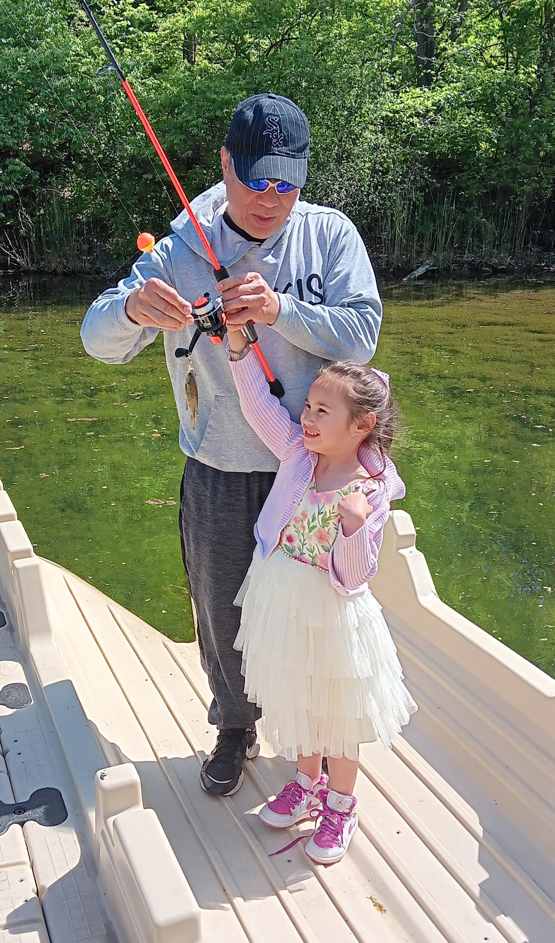

Slide 26
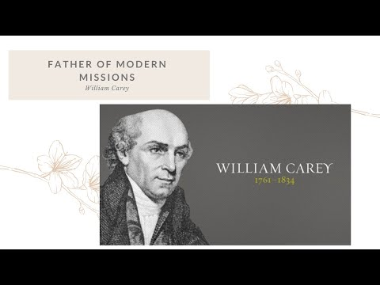

Slide 27
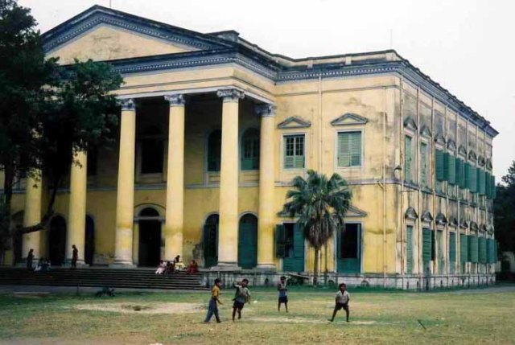

Slide 28
Galatians 6:9 reads, “Let us not become weary in doing good, for at the proper time we will reap a harvest if we do not give up.”

