Slide 1
2 Thessalonians 2:1-5:
Now concerning the coming of our Lord Jesus Christ and our being gathered together to him, we ask you, brothers,^{[a]}
² not to be quickly shaken in mind or alarmed, either by a spirit or a spoken word, or a letter seeming to be from us, to the effect that the day of the Lord has come.
³ Let no one deceive you in any way. For that day will not come, unless the rebellion comes first, and the man of lawlessness^{[b]} is revealed, the son of destruction,^{[c]}
⁴ who opposes and exalts himself against every so-called god or object of worship, so that he takes his seat in the temple of God, proclaiming himself to be God.
⁵ Do you not remember that when I was still with you I told you these things?

Slide 2
Remember the Things you were Told
2 Thessalonians 2:1-5
Key Verse:5:
Do you not remember that when I was still with you I told you these things?

Slide 3
I. The first event before the day of the Lord is the rapture (1-2)

Slide 4
Look at verse 1. “Now concerning the coming of our Lord Jesus Christ and our being gathered together to him, we ask you, brothers,^{[a]}”

Slide 5
Second Thessalonians 1:4, “Therefore we ourselves boast about you in the churches of God for your steadfastness and faith in all your persecutions and in the afflictions that you are enduring.”

Slide 6
Look at verse 2. “…not to be quickly shaken in mind or alarmed, either by a spirit or a spoken word, or a letter seeming to be from us, to the effect that the day of the Lord has come.”

Slide 7
II. The second event that has to occur before the tribulation comes is the apostasy or rebellion (3a)

Slide 8
Look at verse 3a. “Let no one deceive you in any way. For that day will not come, unless the rebellion comes first…”

Slide 9
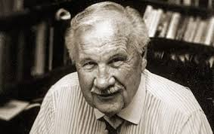
Ray Stedman
“When men lose God, the lose themselves.”

Slide 10
III. The third thing that must proceed the day of the Lord is the revelation of the man of lawlessness (3b)

Slide 11
Look at verse 3b. “…and the man of lawlessness^{[b]} is revealed, the son of destruction,^{[c]}”

Slide 12
IV. The fourth event is a rebuilt temple (4)

Slide 13
Look at verse 4. “…who opposes and exalts himself against every so-called god or object of worship, so that he takes his seat in the temple of God, proclaiming himself to be God.”

Slide 14
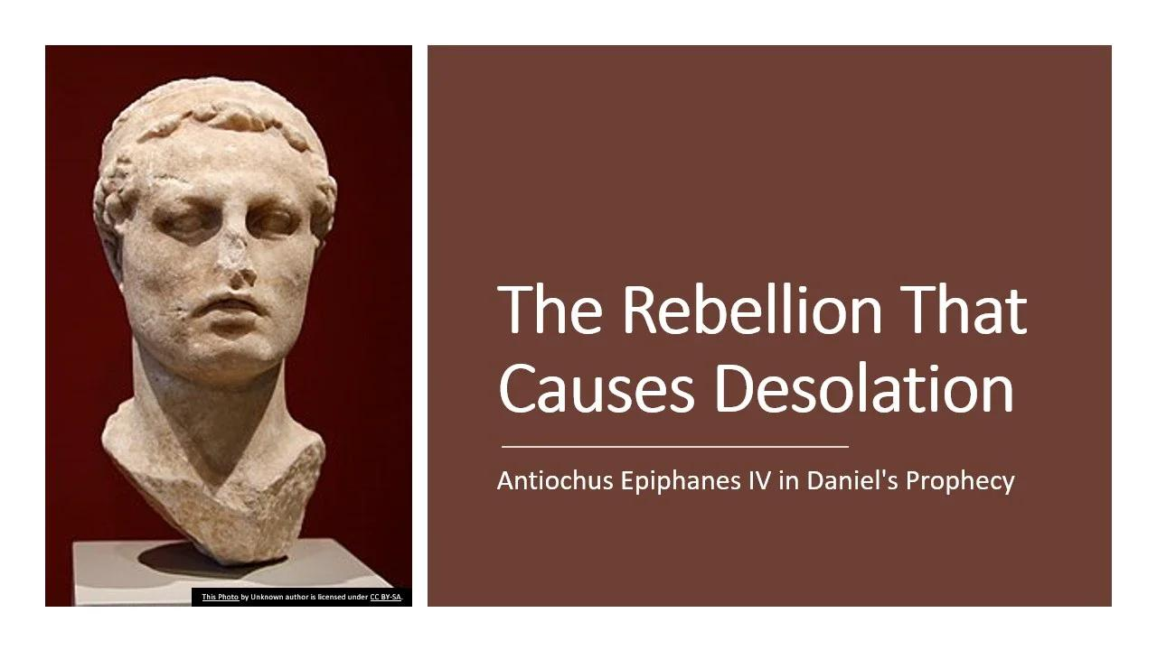

Slide 15
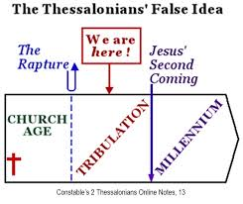
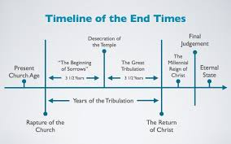

Slide 16
Look at verse 5. “ Do you not remember that when I was still with you I told you these things?”

Slide 17
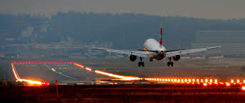

Slide 18
Matthew 24:36, “But concerning that day and hour no one knows, not even the angels of heaven, nor the Son, but the Father only.”

Slide 19
Ecclesiastes 12:1-2a reads, “Remember also your Creator in the days of your youth, before the evil days come and the years draw near of which you will say, ‘I have no pleasure in them’; ² before the sun and the light and the moon and the stars are darkened.”

