Slide 1
2 Thessalonians 2:13-17:
¹³ But we ought always to give thanks to God for you, brothers beloved by the Lord, because God chose you as the firstfruits to be saved, through sanctification by the Spirit and belief in the truth. ¹⁴ To this he called you through our gospel, so that you may obtain the glory of our Lord Jesus Christ. ¹⁵ So then, brothers, stand firm and hold to the traditions that you were taught by us, either by our spoken word or by our letter.
¹⁶ Now may our Lord Jesus Christ himself, and God our Father, who loved us and gave us eternal comfort and good hope through grace, ¹⁷ comfort your hearts and establish them in every good work and word.

Slide 2
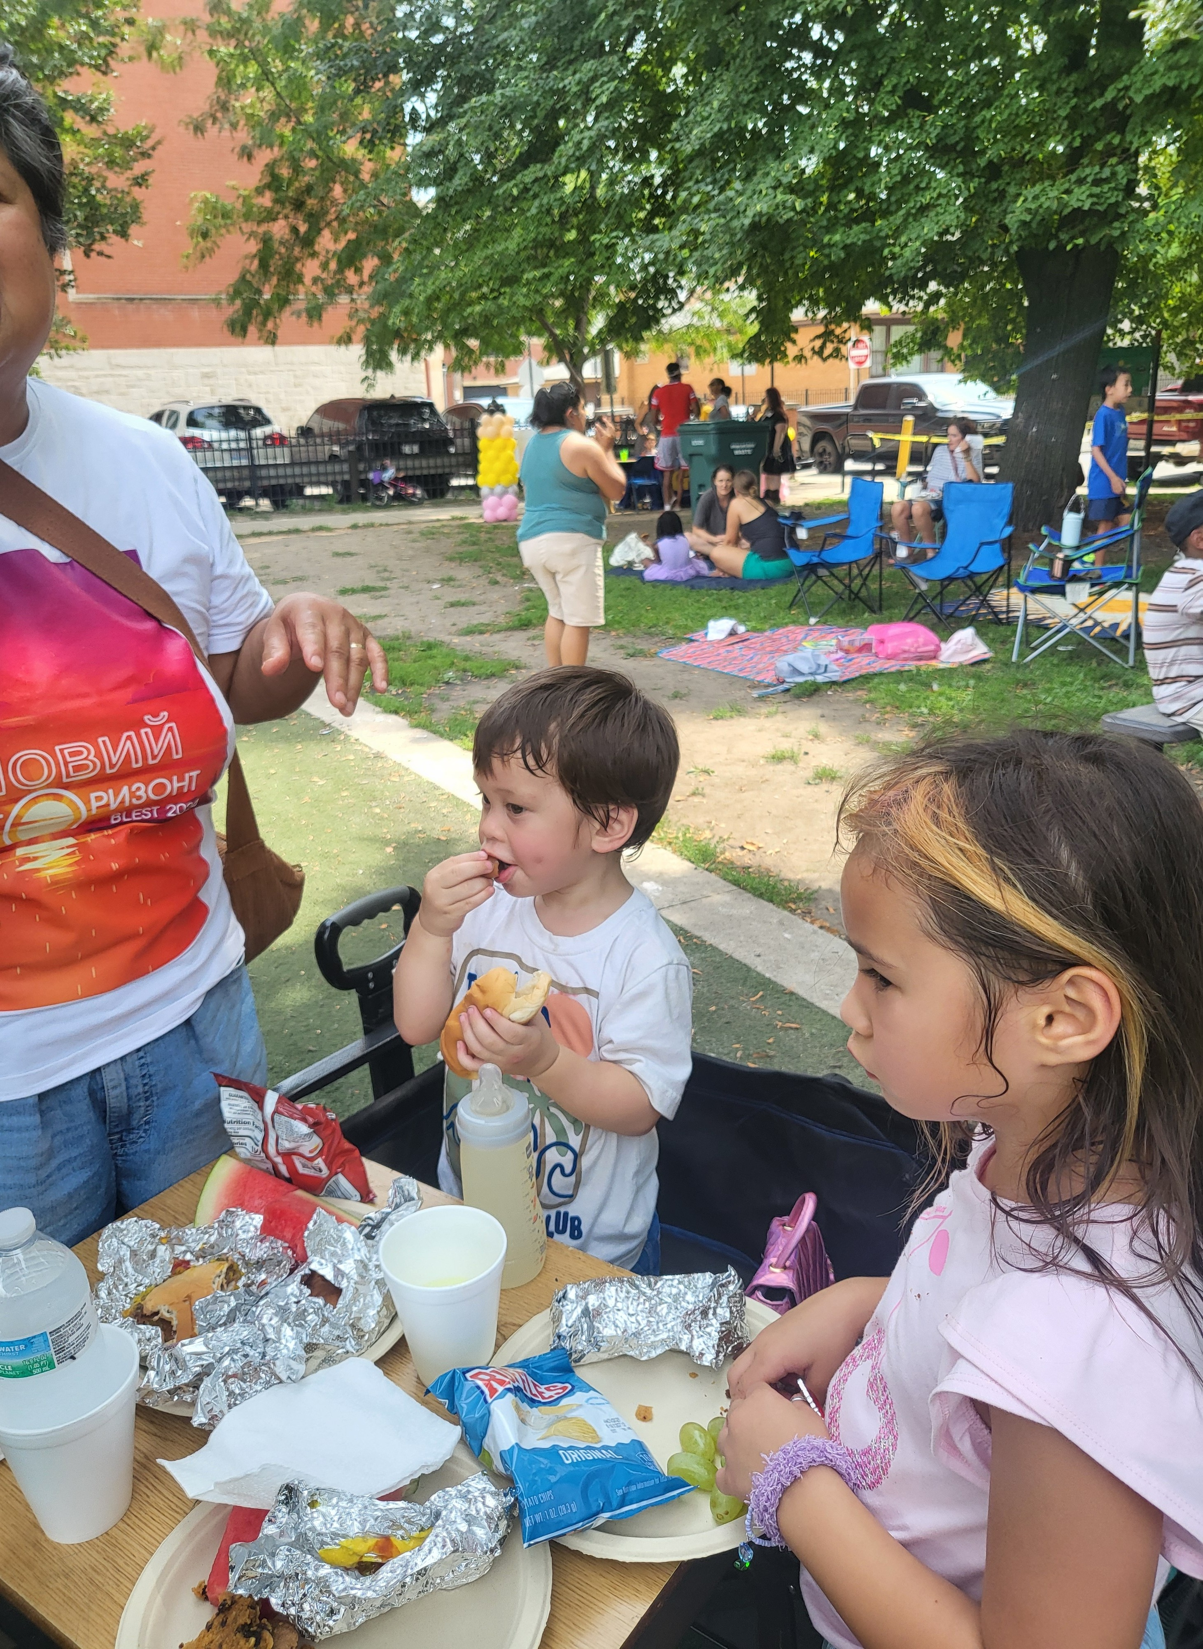

Slide 3
2 Thessalonians 2:13-17:
¹³ But we ought always to give thanks to God for you, brothers beloved by the Lord, because God chose you as the firstfruits to be saved, through sanctification by the Spirit and belief in the truth. ¹⁴ To this he called you through our gospel, so that you may obtain the glory of our Lord Jesus Christ. ¹⁵ So then, brothers, stand firm and hold to the traditions that you were taught by us, either by our spoken word or by our letter.
¹⁶ Now may our Lord Jesus Christ himself, and God our Father, who loved us and gave us eternal comfort and good hope through grace, ¹⁷ comfort your hearts and establish them in every good work and word.

Slide 4
Stand Firm and Hold On
2 Thessalonians 2:13-17
Key Verse: 15:
“So then, brothers, stand firm and hold to the traditions that you were taught by us, either by our spoken word or by our letter.”

Slide 5
Look at verse 13. “But we ought always to give thanks to God for you, brothers beloved by the Lord, because God chose you as the firstfruits to be saved, through sanctification by the Spirit and belief in the truth.”

Slide 6
First Peter 1:1-2a, “Peter, an apostle of Jesus Christ, To those who are elect exiles of the Dispersion in Pontus, Galatia, Cappadocia, Asia, and Bithynia, ² according to the foreknowledge of God the Father, in the sanctification of the Spirit, for obedience to Jesus Christ and for sprinkling with his blood.”

Slide 7
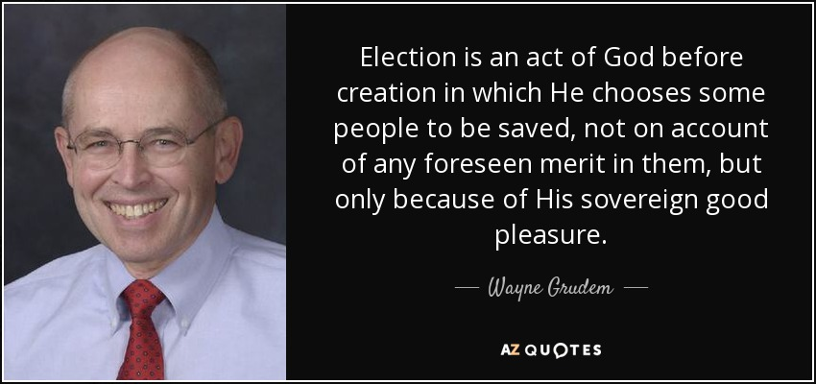

Slide 8
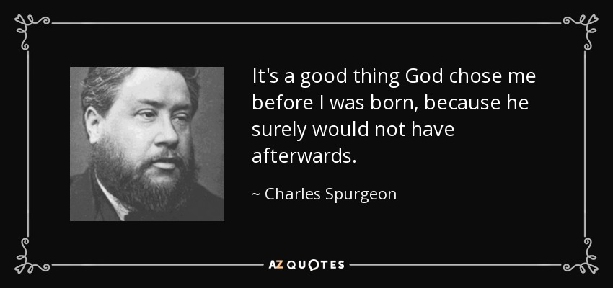

Slide 9
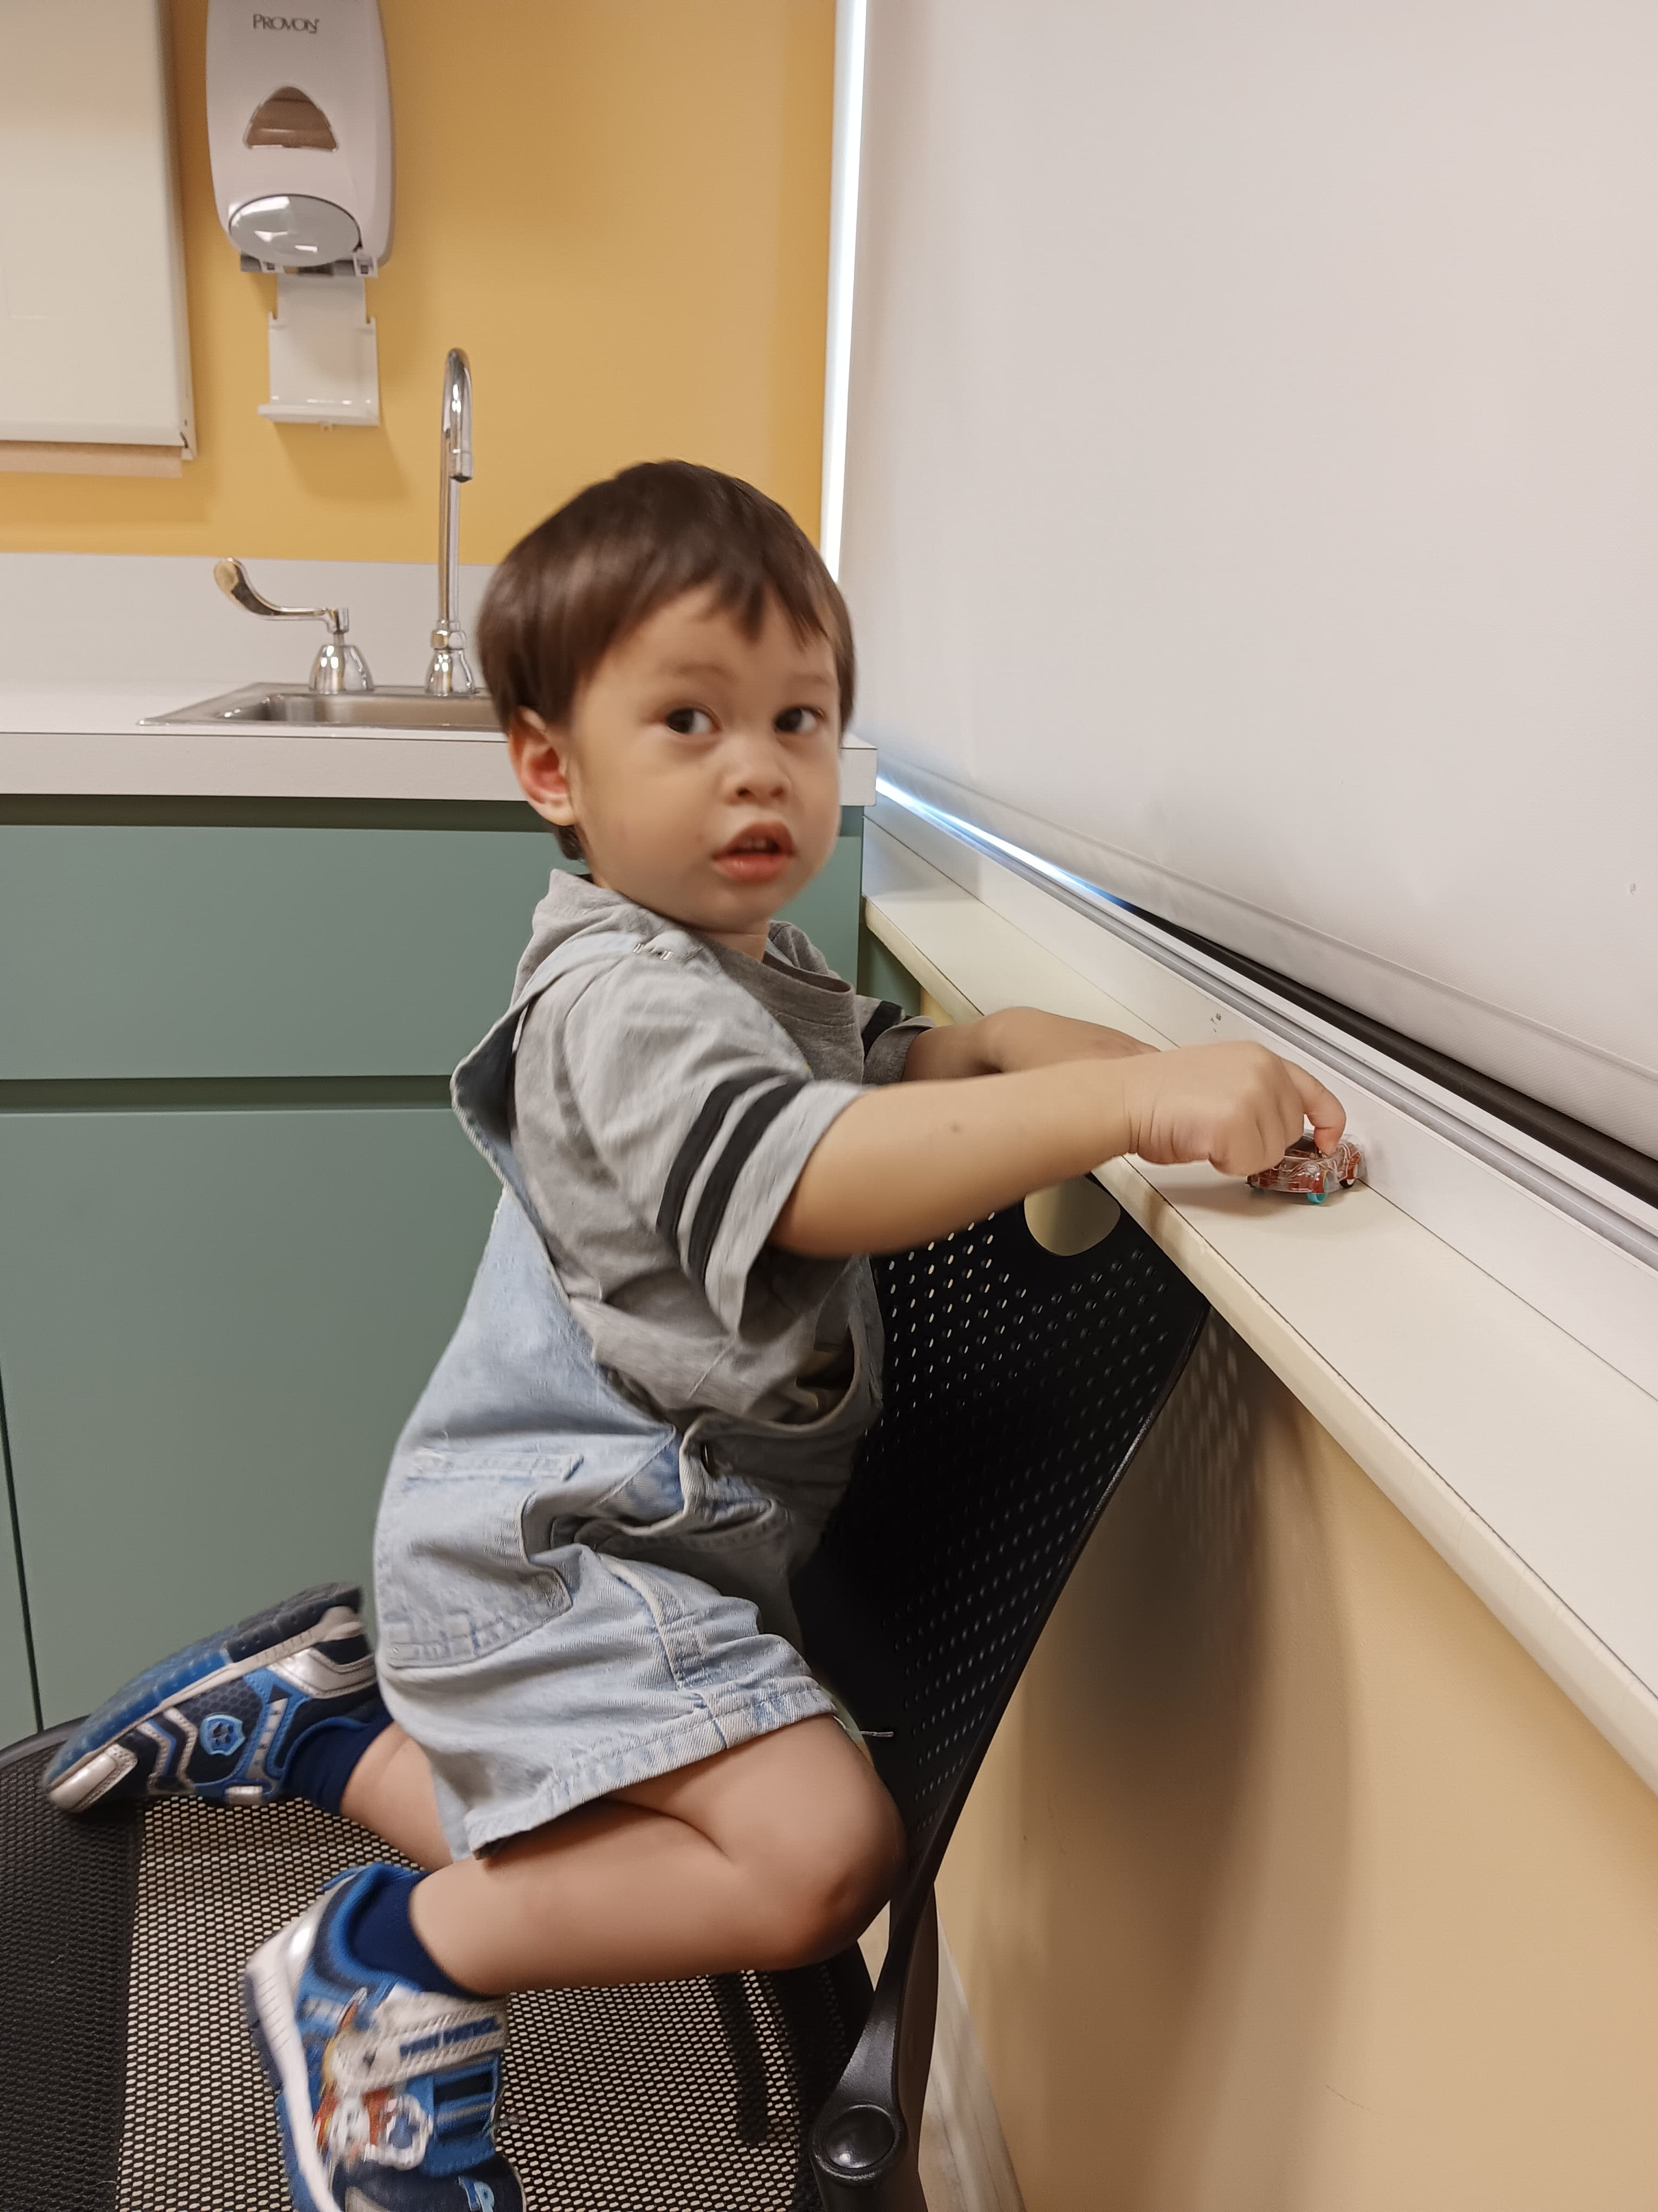

Slide 10
Isaiah 55:8-9, “For my thoughts are not your thoughts, neither are your ways my ways, declare the Lord. ⁹ For as the heavens are higher than the earth, so are my ways higher than your ways and my thoughts than your thoughts.”

Slide 11
Look at verse 14. “To this he called you through our gospel, so that you may obtain the glory of our Lord Jesus Christ.”

Slide 12
Romans 8:30, “And those whom he predestined he also called, and those whom he called he also justified, and those whom he justified he also glorified.”

Slide 13
Look at verse 15. “So then, brothers, stand firm and hold to the traditions that you were taught by us, either by our spoken word or by our letter.”

Slide 14
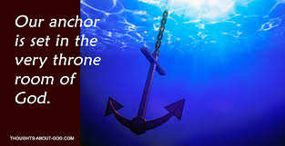

Slide 15
Hebrews 6:19, “We have this as a sure and steadfast anchor of the soul, a hope that enters into the inner place behind the curtain.”

Slide 16
Ephesians 4:14, “…so that we may no longer be children, tossed to and fro by the waves and carried about by every wind of doctrine, by human cunning, by craftiness in deceitful schemes.”

Slide 17
2 Thessalonians 3:6, “Now we command you, brothers, in the name of our Lord Jesus Christ, that you keep away from any brother who is walking in idleness and not in accord with the tradition you receive from us.”

Slide 18
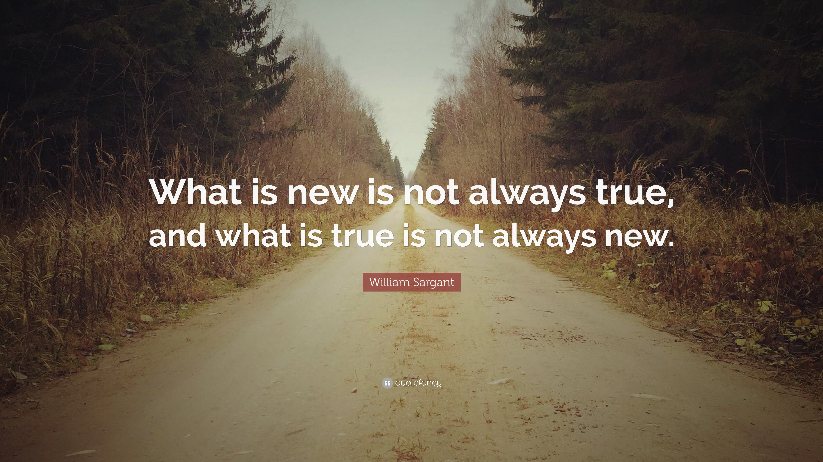

Slide 19
Look at verses 16-17. “Now may our Lord Jesus Christ himself, and God our Father, who loved us and gave us eternal comfort and good hope through grace, ¹⁷ comfort your hearts and establish them in every good work and word.”

Slide 20
Titus 2:14, “…who gave himself for us to redeem us from all lawlessness and to purify for himself a people for his own possession who are zealous for good works.”

Slide 21
Zephaniah 3:17, “The Lord your God is in your midst, a mighty one who will save; he will rejoice over you with gladness; he will quiet you by his love; he will exult over you with loud singing.”

Slide 22
Stand Firm and Hold On
2 Thessalonians 2:13-17
Key Verse: 15:
“So then, brothers, stand firm and hold to the traditions that you were taught by us, either by our spoken word or by our letter.”

