Slide 1
2 Thessalonians 3:1-5:
Finally, brothers,^{[a]} pray for us, that the word of the Lord may speed ahead and be honored,^{[b]} as happened among you, ² and that we may be delivered from wicked and evil men. For not all have faith. ³ But the Lord is faithful. He will establish you and guard you against the evil one.^{[c]} ⁴ And we have confidence in the Lord about you, that you are doing and will do the things that we command. ⁵ May the Lord direct your hearts to the love of God and to the steadfastness of Christ.

Slide 2
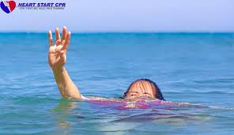

Slide 3
Pray for God’s Word to Run Swiftly
2 Thessalonians 3:1-5
Key Verse: 1:
“Finally, brothers,^{[a]} pray for us, that the word of the Lord may speed ahead and be honored,^{[b]} as happened among you.”

Slide 4
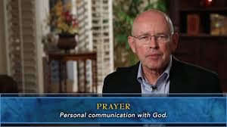

Slide 5
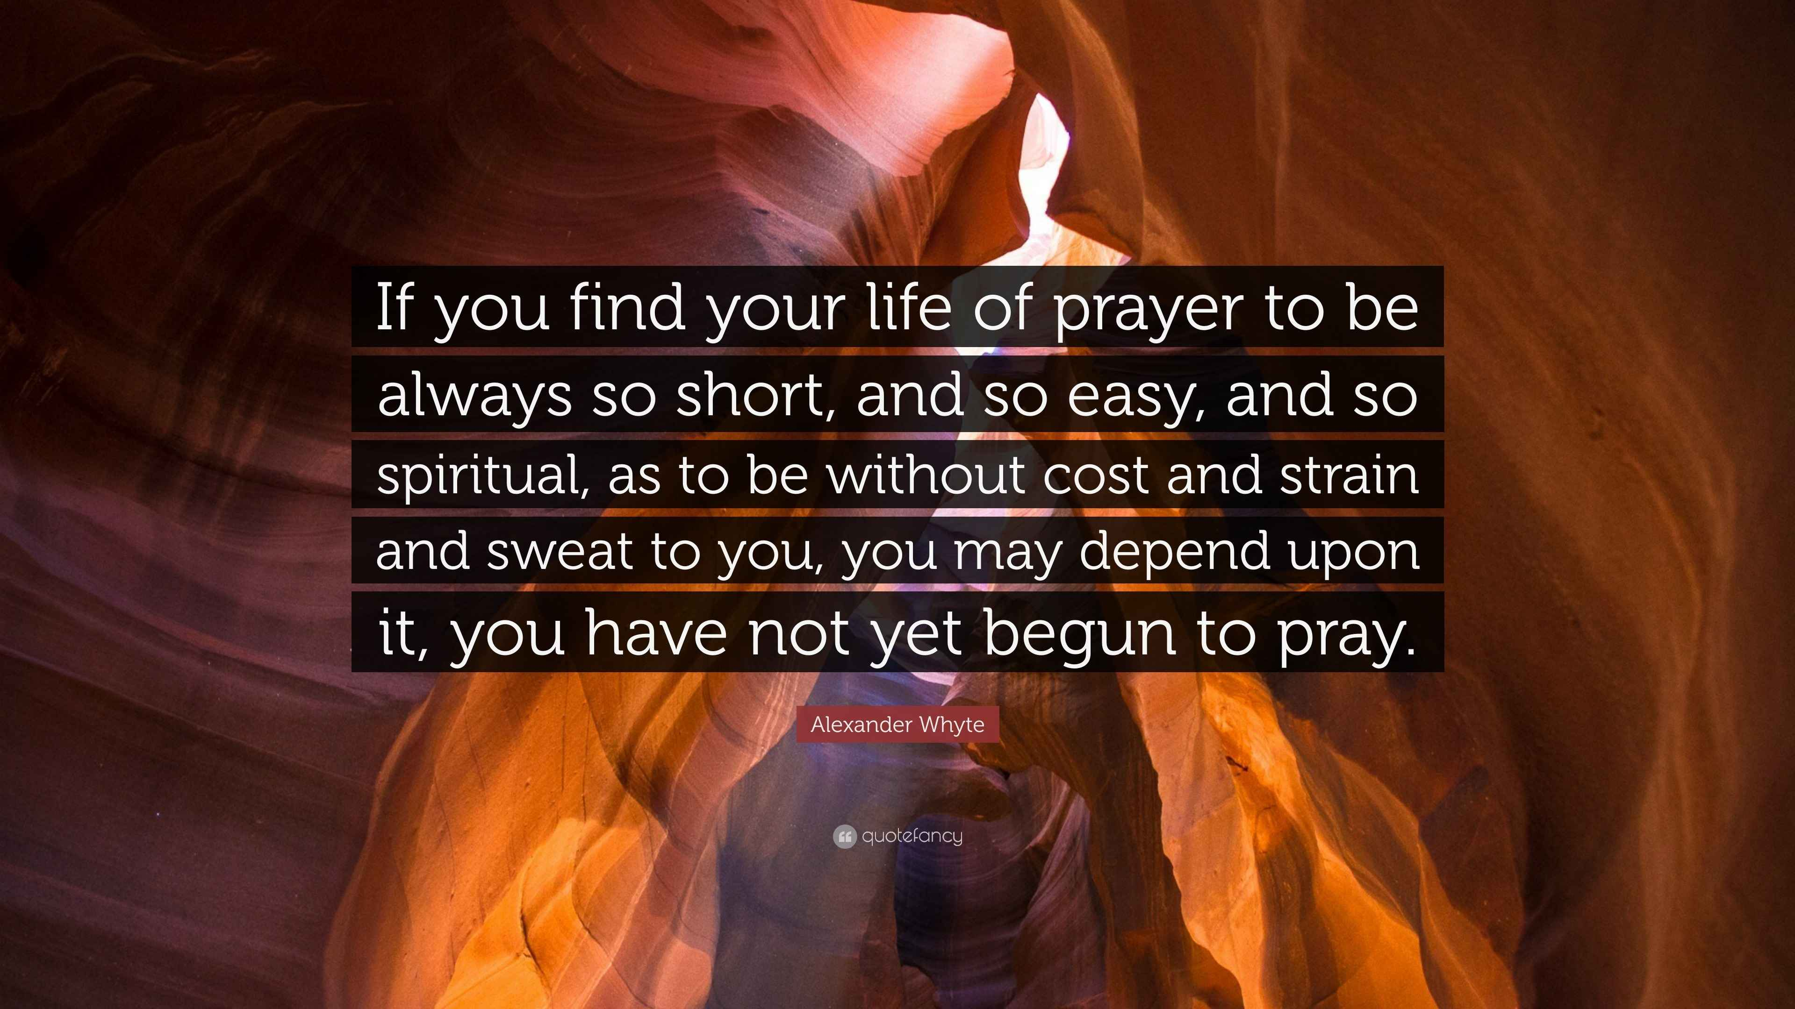

Slide 6
Look at verse 1. “Finally, brothers,^{[a]} pray for us, that the word of the Lord may speed ahead and be honored,^{[b]} as happened among you.”

Slide 7
Psalm 147:15 reads, “He sends out his command to the earth; his word runs swiftly.”

Slide 8
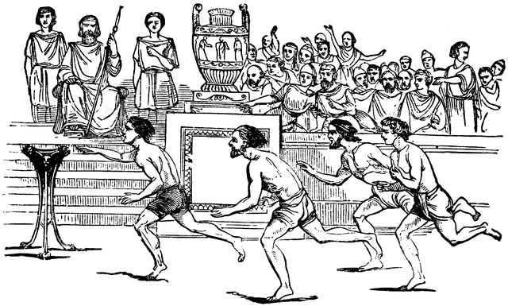

Slide 9
Colossians 4:3 reads, “At the same time, pray also for us, that God may open to us a door for the word, to declare the mystery of Christ, on account of which I am in prison.”

Slide 10
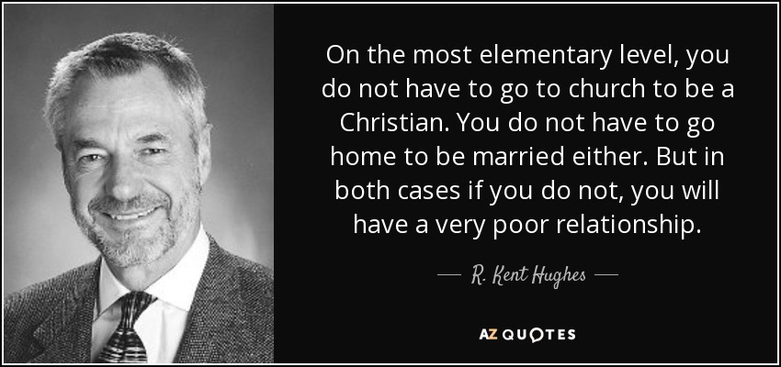
“God’s Word can no more be chained than God himself.”

Slide 11
Isaiah 55:11, “…so shall my word be that goes out from my mouth; it shall not return to me empty, but it shall accomplish that which I purpose, and shall succeed in the thing for which I sent it.”

Slide 12
John 6:68, “Simon Peter answered him, ‘Lord, to whom shall we go? You have the words of eternal life.’”

Slide 13
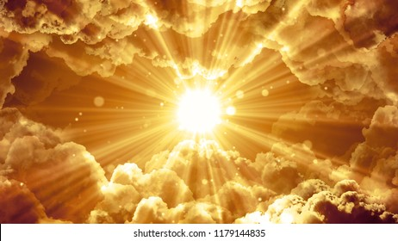

Slide 14
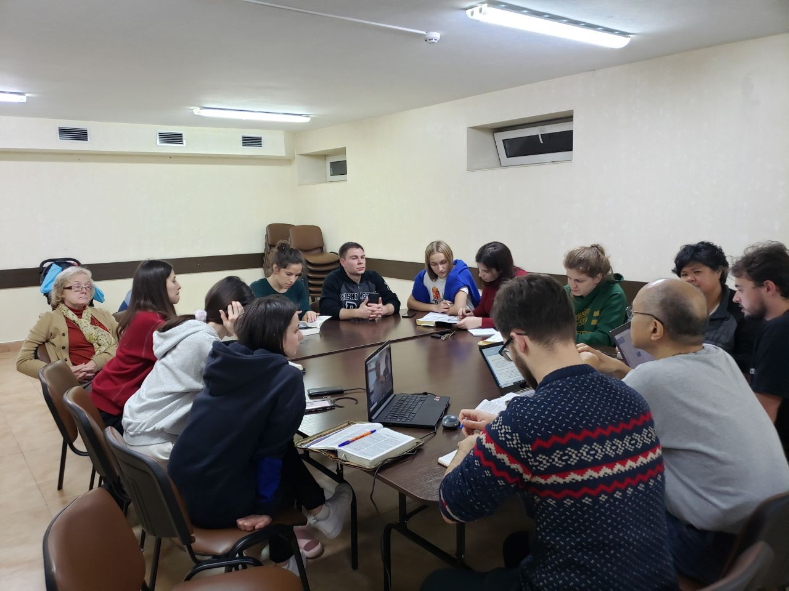
Ben and Christy visiting 2021 Podil Conference

Slide 15
Look at verse 2. “…and that we may be delivered from wicked and evil men. For not all have faith.”

Slide 16
Romans 15:31, “…that I may be delivered from the unbelievers in Judea, and that my service for Jerusalem may be acceptable to the saints.”

Slide 17
Look at verse 3. “But the Lord is faithful. He will establish you and guard you against the evil one.^{[c]”}

Slide 18
First John 1:9, “If we confess our sins, he is faithful and just to forgive us our sins and to cleanse us from all unrighteousness.”

Slide 19
Philippians 4:19, “And my God will supply every need of yours according to his riches in glory in Christ Jesus.”

Slide 20
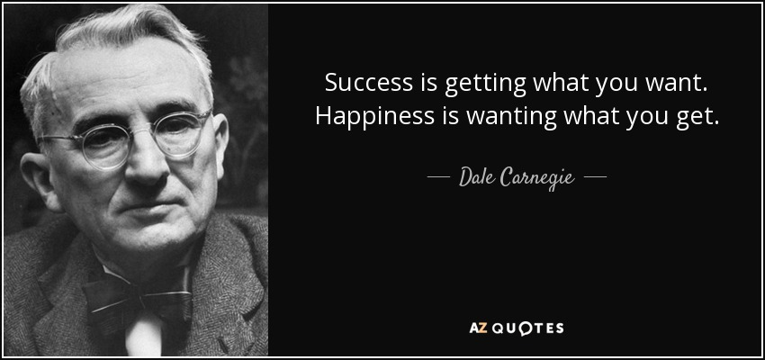

Slide 21
Romans 8:29, “For whom He foreknew, He also predestined to be conformed to the image of His Son, that He might be the firstborn among many brethren.”

Slide 22
Verse 3, “But the Lord is faithful. He will establish you and guard you against the evil one.^{[c]”}

Slide 23
Look at verse 4. “And we have confidence in the Lord about you, that you are doing and will do the things that we command.”

Slide 24
Look at verse 5. “May the Lord direct your hearts to the love of God and to the steadfastness of Christ.”

