Slide 1
2 Thessalonians 3:16-18:
¹⁶ Now may the Lord of peace himself give you peace at all times in every way. The Lord be with you all.
¹⁷ I, Paul, write this greeting with my own hand. This is the sign of genuineness in every letter of mine; it is the way I write.
¹⁸ The grace of our Lord Jesus Christ be with you all.

Slide 2


Slide 3
The Lord of Peace
2 Thessalonians 3:16-18
Key Verse: 16:
¹⁶ Now may the Lord of peace himself give you peace at all times in every way. The Lord be with you all.

Slide 4
Look at verse 16. “Now may the Lord of peace himself give you peace at all times in every way. The Lord be with you all.”

Slide 5
Ephesians 4:2-3, “with all humility and gentleness, with patience, bearing with one another in love, ³ eager to maintain the unity of the Spirit in the bond of peace.”

Slide 6
Isaiah 53:5, “But he was pierced for our transgressions; he was crushed for our iniquities; upon him was the chastisement that brought us peace, and with his wounds we are healed.”

Slide 8

“Why were some of the Saints so perfect and contemplative? Because they endeavored to mortify entirely all their earthly desires, and therefore could cling to God with their inmost hearts, and had time to attend to themselves. We are too much occupied with our own passions, and too anxious about transitory things.”

Slide 9
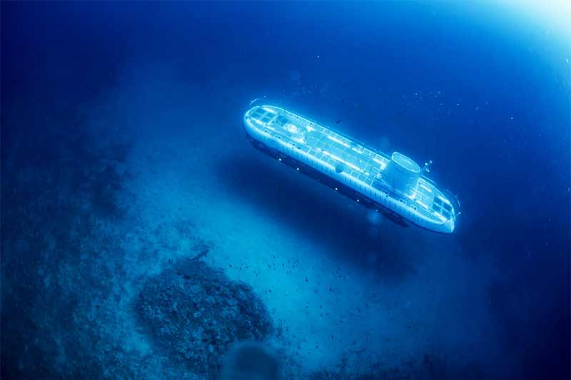

Slide 10
John 14:27, “Peace I leave with you; my peace I give to you. Not as the world gives do I give to you. Let not your hearts be troubled, neither let them be afraid.”

Slide 11
Psalm 119:165, “Great peace have those who love your law; nothing can make them stumble.”

Slide 12
Psalm 29:11, “The Lord will give strength to His people; the Lord will bless His people with peace.”

Slide 13
Look at verse 16 again. “Now may the Lord of peace himself give you peace at all times in every way. The Lord be with you all.”

Slide 14
Look at verse 16b, “…give you peace at all times in every way. The Lord be with you all.”

Slide 15
Isaiah 26:3, “You keep him in perfect peace whose mind is stayed on you, because he trusts in you.”

Slide 16
Galatians 5:22, “But the fruit of the Spirit is love, joy, peace, patience, kindness, goodness, faithfulness.”

Slide 17
Psalm 119:165, “Great peace have those who love your law; nothing can make them stumble.”

Slide 18
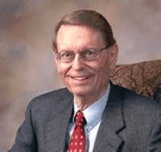
“The Bible is the greatest of all books; to study it is the noblest of all pursuits; to understand it, the highest of all goals.”

Slide 19
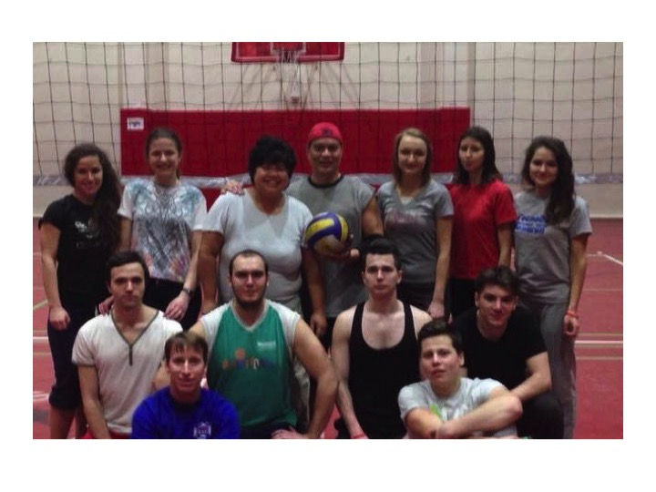

Slide 20
Philippians 4:6-7, “…do not be anxious about anything, but in everything by prayer and supplication with thanksgiving let your requests be made known to God. ⁷ And the peace of God, which surpasses all understanding, will guard your hearts and your minds in Christ Jesus.

Slide 21
Verses 17-18, “¹⁷ I, Paul, write this greeting with my own hand. This is the sign of genuineness in every letter of mine; it is the way I write. ¹⁸ The grace of our Lord Jesus Christ be with you all.”

