Slide 1
2 Thessalonians 3:6-15:
⁶ Now we command you, brothers, in the name of our Lord Jesus Christ, that you keep away from any brother who is walking in idleness and not in accord with the tradition that you received from us.
⁷ For you yourselves know how you ought to imitate us, because we were not idle when we were with you,
⁸ nor did we eat anyone's bread without paying for it, but with toil and labor we worked night and day, that we might not be a burden to any of you.
⁹ It was not because we do not have that right, but to give you in ourselves an example to imitate.

Slide 2
¹⁰ For even when we were with you, we would give you this command: If anyone is not willing to work, let him not eat.
¹¹ For we hear that some among you walk in idleness, not busy at work, but busybodies.
¹² Now such persons we command and encourage in the Lord Jesus Christ to do their work quietly and to earn their own living.^{[a]}
¹³ As for you, brothers, do not grow weary in doing good.
¹⁴ If anyone does not obey what we say in this letter, take note of that person, and have nothing to do with him, that he may be ashamed.
¹⁵ Do not regard him as an enemy, but warn him as a brother.

Slide 3
Do not Grow Weary in Working for the Lord
2 Thessalonians 3:6-15
Key Verse:13:
As for you, brothers, do not grow weary in doing good.

Slide 4
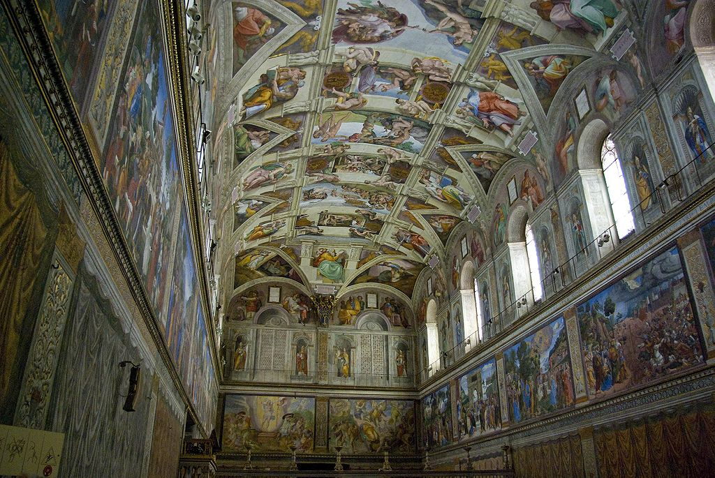

Slide 5
Genesis 1:28, “And God blessed them. And God said to them, ‘Be fruitful and multiply and fill the earth and subdue it, and have dominion over the fish of the sea and over the birds of the heavens and over every living thing that moves on the earth.’”

Slide 6
Look at verse 6. “Now we command you, brothers, in the name of our Lord Jesus Christ, that you keep away from any brother who is walking in idleness and not in accord with the tradition that you received from us.”

Slide 7
Proverbs 21:24-26, “‘Scoffer’ is the name of the arrogant, haughty man who acts with arrogant pride. ²⁵ The desire of the sluggard kills him, for his hands refuse to labor. ²⁶ All day long he craves and craves, but the righteous gives and does not hold back.”

Slide 8
Look at verses 7-9. “⁷ For you yourselves know how you ought to imitate us, because we were not idle when we were with you, ⁸ nor did we eat anyone's bread without paying for it, but with toil and labor we worked night and day, that we might not be a burden to any of you. ⁹ It was not because we do not have that right, but to give you in ourselves an example to imitate.”

Slide 9
Look at verse 8. “Nor did we eat anyone's bread without paying for it, but with toil and labor we worked night and day, that we might not be a burden to any of you.”

Slide 10
Colossians 3:23-24, “Whatever you do work at it with all of your heart as working for the Lord not for men. Since you know that you will receive an inheritance from the Lord as a reward.”

Slide 11
Look at verse 10. “For even when we were with you, we would give you this command: If anyone is not willing to work, let him not eat.”

Slide 12
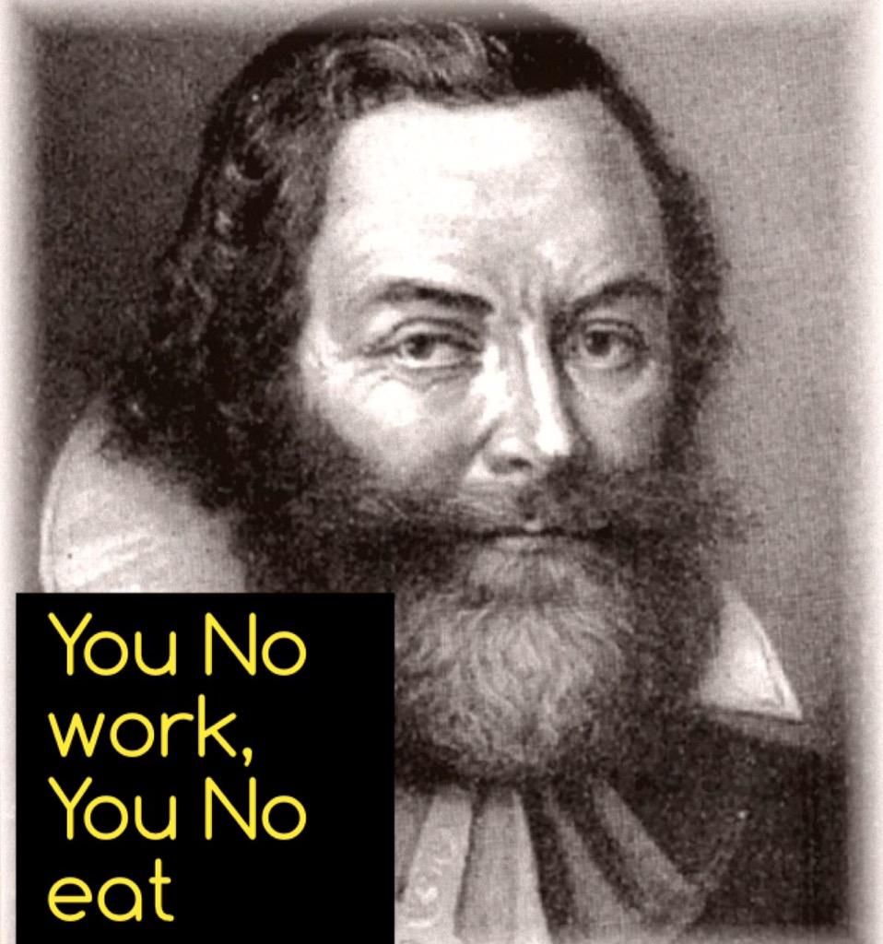

Slide 13
Look at verse 11. “For we hear that some among you are leading an undisciplined life doing no work at all but acting like busy bodies.”

Slide 14
First Peter 4:15, “But let none of you suffer as a murderer, or as a thief, or as an evil doer, or as a busybody in other men’s matters.” (KJV)
First Peter 4:15, “Do not suffer for murder, theft, or any other crime, nor because you trouble other people [as a meddler/troublemaker].” (EBV)

Slide 15
Look at verse 12. ^{“12} Now such persons we command and encourage in the Lord Jesus Christ to do their work quietly and to earn their own living.”[

Slide 16
First Thessalonians chapter 4:11, “…and to aspire to live quietly, and to mind your own affairs, and to work with your hands, as we instructed you.”

Slide 17
Look at verse 13, “But as for you do not grow weary in doing good.”

Slide 18
Luke 9:23, “And he said to all, ‘If anyone would come after me, let him deny himself and take up his cross daily and follow me.’”

Slide 19
Ecclesiastes 10:18, “Through sloth the roof sinks in, and through indolence the house leaks.”

Slide 20
Look at verses 14-15, “¹⁴ If anyone does not obey what we say in this letter, take note of that person, and have nothing to do with him, that he may be ashamed. ¹⁵ Do not regard him as an enemy, but warn him as a brother.”

Slide 21
Matthew 18:15-17: “If your brother sins against you, go and tell him his fault, between you and him alone. If he listens to you, you have gained your brother.¹⁶ But if he does not listen, take one or two others along with you, that every charge may be established by the evidence of two or three witnesses. ¹⁷ If he refuses to listen to them, tell it to the church. And if he refuses to listen even to the church, let him be to you as a Gentile and a tax collector.

Slide 22
Look at verse 15. “Do not regard him as an enemy, but warn him as a brother.”

