Slide 1
Luke 1:26-38:
²⁶ In the sixth month the angel Gabriel was sent from God to a city of Galilee named Nazareth,
²⁷ to a virgin betrothed^{[a]} to a man whose name was Joseph, of the house of David. And the virgin's name was Mary.
²⁸ And he came to her and said, “Greetings, O favored one, the Lord is with you!”^{[b]}
²⁹ But she was greatly troubled at the saying, and tried to discern what sort of greeting this might be.
³⁰ And the angel said to her, “Do not be afraid, Mary, for you have found favor with God.
³¹ And behold, you will conceive in your womb and bear a son, and you shall call his name Jesus.
³² He will be great and will be called the Son of the Most High. And the Lord God will give to him the throne of his father David,

Slide 2
³³ and he will reign over the house of Jacob forever, and of his kingdom there will be no end.”
³⁴ And Mary said to the angel, “How will this be, since I am a virgin?”^{[c]}
³⁵ And the angel answered her, “The Holy Spirit will come upon you, and the power of the Most High will overshadow you; therefore the child to be born^{[d]} will be called holy—the Son of God.
³⁶ And behold, your relative Elizabeth in her old age has also conceived a son, and this is the sixth month with her who was called barren.
³⁷ For nothing will be impossible with God.”
³⁸ And Mary said, “Behold, I am the servant^{[e]} of the Lord; let it be to me according to your word.” And the angel departed from her.

Slide 3
Isaiah 11:1, “There shall come forth a shoot from the stump of Jesse, and a branch from his roots shall bear fruit.”

Slide 4
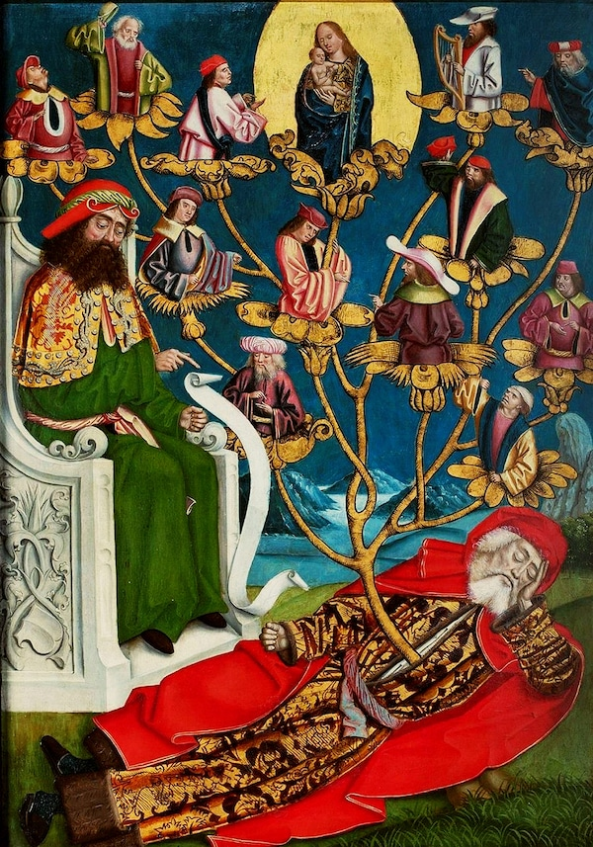

Slide 5
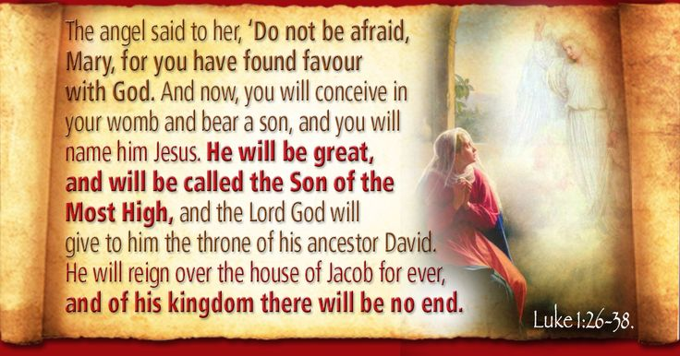

Slide 6
The Holy Son of God
Luke 1:26-38
Key Verse: 35:
³⁵ And the angel answered her, “The Holy Spirit will come upon you, and the power of the Most High will overshadow you; therefore the child to be born^{[d]} will be called holy—the Son of God.”

Slide 7
Look at verses 26-27. “²⁶ In the sixth month the angel Gabriel was sent from God to a city of Galilee named Nazareth, ²⁷ to a virgin betrothed^{[a]} to a man whose name was Joseph, of the house of David. And the virgin's name was Mary.”

Slide 8
Look at verse 28. “²⁸ And he came to her and said, ‘Greetings, O favored one, the Lord is with you!’^{[b]}”

Slide 9
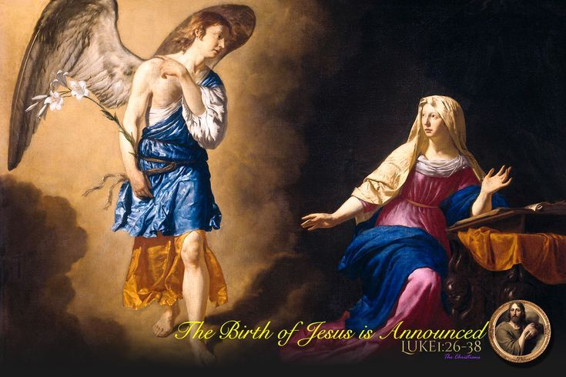

Slide 10
Psalm 84:10, “For a day in your courts is better than a thousand elsewhere. I would rather be a doorkeeper in the house of my God than dwell in the tents of wickedness.”

Slide 11
Look at verse 29. “²⁹ But she was greatly troubled at the saying, and tried to discern what sort of greeting this might be.”

Slide 12
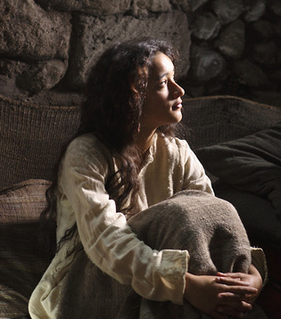

Slide 13
Look at verse 30. “³⁰And the angel said to her, ‘Do not be afraid, Mary, for you have found favor with God.’”

Slide 14
Proverbs 9:10 reads, “The fear of the Lord is the beginning of wisdom, and the knowledge of the Holy One is insight.”

Slide 15
Isaiah 11:2-3a, “And the Spirit of the Lord shall rest upon him, the Spirit of wisdom and understanding, the Spirit of counsel and might, the Spirit of knowledge and the fear of the Lord. ³ And his delight shall be in the fear of the Lord.”

Slide 16
Look at verses 31-33. “³¹And behold, you will conceive in your womb and bear a son, and you shall call his name Jesus. ³² He will be great and will be called the Son of the Most High. And the Lord God will give to him the throne of his father David, ³³ and he will reign over the house of Jacob forever, and of his kingdom there will be no end.”

Slide 17
2 Samuel 7:12-16, “When your days are fulfilled and you lie down with your fathers, I will raise up your offspring after you, who shall come from your body, and I will establish his kingdom.
13 He shall build a house for my name, and I will establish the throne of his kingdom forever. 14 I will be to him a father, and he shall be to me a son. When he commits iniquity, I will discipline him with the rod of men, with the stripes of the sons of men, 15 but my steadfast love will not depart from him, as I took it from Saul, whom I put away from before you. 16 And your house and your kingdom shall be made sure forever before me. Your throne shall be established forever.”

Slide 18
Look at verse 34. “³⁴ And Mary said to the angel, ‘How will this be, since I am a virgin?’”^{[c]}

Slide 19
Look at verses 35-37. “³⁵And the angel answered her, “The Holy Spirit will come upon you, and the power of the Most High will overshadow you; therefore the child to be born^{[d]} will be called holy—the Son of God. ³⁶ And behold, your relative Elizabeth in her old age has also conceived a son, and this is the sixth month with her who was called barren. ³⁷ For nothing will be impossible with God.”

Slide 20


Slide 21
Look at verse 38. “³⁸ And Mary said, ‘Behold, I am the servant^{[e]} of the Lord; let it be to me according to your word.’ And the angel departed from her.”

Slide 22
John 18:37a, “Then Pilate said to him, ‘So you are a king?’ Jesus answered, ‘You say that I am a king. For this purpose I was born and for this purpose I have come into the world…’”

